Slide 1
An Orientation for
Free-standing Pharmacy
Vendor Applicants
2023-2024
Notes:
Welcome! This orientation training session is designed for free-standing pharmacies that are interested in becoming authorized WIC Program vendors. Throughout this presentation I will refer to the WIC Vendor Manual, a copy of which you have in front of you and can be accessed online on the Vendor Connection webpage under the resource tab.

Slide 2
Orientation to NC WIC Program
What is WIC?
What is the role of vendors?
Free-standing pharmacy WIC vendors
How to become a WIC vendor
Guidance for completing required forms
Notes:
We will be covering a lot of material. We will talk about some general information about the WIC Program and the role of WIC vendors. We will also discuss important information specific to free-standing pharmacy vendors and how to become an authorized WIC vendor. Lastly, I will provide guidance for completing required forms to become a WIC vendor in North Carolina.

Slide 3
What is WIC?
The Special Supplemental Nutrition Program for Women, Infants and Children
Federally funded by the United States Department of Agriculture (USDA)
State-administered by the NC Department of Health and Human Services
WIC clinical services provided by contracted public health agencies
NC WIC authorized vendors are contracted with the NC Department of Health and Human Services and Local WIC Agencies
Notes:
What is the WIC Program? WIC is an acronym for the Special Supplemental Nutrition Program for Women, Infants, and Children. It is a Federal program that is funded by the United States Department of Agriculture. In North Carolina, it is administered by the NC Department of Health and Human Services, Division of Child and Family Well-Being, Community Nutrition Services Section.
WIC clinical services are provided by contracted public health agencies. Services include nutrition education, food benefits for nutritious foods and health care referrals.
NC WIC authorized vendors are contracted with the NC Department of Health and Human Services and their Local WIC Agencies.
The Local WIC Agency (that’s us) administers the WIC Program in your county.

Slide 4
What is eWIC?
eWIC is the term used for EBT (Electronic Benefit Transfer) by the North Carolina WIC Program
EBT is a method that permits access to WIC food benefits using a plastic card
Notes:
eWIC is the term used by the NC WIC Program for EBT or Electronic Benefit Transfer. EBT is a method that permits access to WIC food benefits using a plastic card.

Slide 5
WIC Works!
In NC, every WIC dollar spent on a pregnant woman saves multiple dollars in newborn health care costs
Children on WIC have better diets; particularly for vitamin C, thiamin, protein, niacin and vitamin B₆
Notes:
WIC’s goal is to prevent health problems and improve overall health during this critical time of growth and development. This includes pregnancy, infancy and early childhood.
In fact, research shows that WIC saves public health dollars. Every dollar spent on a pregnant woman saves multiple dollars in newborn health care costs. Research also shows that children on WIC have better diets, especially for key vitamins.
Photo Credit : PeoplePreg & babies vol.113: 113012.jpg
Photo Credit: AA Boy Apple_Fotolia_14820340.jpg

Slide 6
How Pharmacies Become Authorized WIC Vendors
Vendors work primarily with the Local WIC Agency
Orientation and training
Completing required forms
Technical assistance
Monitoring
Local WIC Agency submits vendor forms to the State WIC Agency
Vendor is authorized by State WIC Agency
Notes:
In order to become an authorized WIC vendor, applicants work with the Local WIC Agency (us/me). Local WIC Agency staff provides orientation (what is being done today) and training, as well as technical assistance during the process. We also assist vendor applicants in completing the forms required for submission to the State WIC Agency for approval. Lastly, we monitor applicants prior to authorization to determine if they are in compliance with WIC Program policies.
To be eligible to accept WIC benefits, free-standing pharmacies must be authorized by the State WIC Agency.

Slide 7
Types of Vendors
Vendors under Corporate Agreement
20 or more WIC-authorized pharmacies
CVS
Walgreens
Vendors not under Corporate Agreement
Notes:
There are two different types of vendors: those under corporate agreement and those that are not. Vendors under corporate agreement have 20 or more pharmacies which are WIC authorized in North Carolina. These pharmacies have a slightly different authorization process than pharmacies that are not under corporate agreement.
The other type of vendors are those that are not under corporate agreement.
It is important to remember that pharmacies can be a corporation, but not under corporate agreement with the WIC Program.

Slide 8
Free-standing Pharmacy Vendors
A Free-standing Pharmacy
Pharmacy that does not operate within a retail store
Individual or corporate agreement
Notes:
Before we review the steps to authorization, let’s discuss the definition of a free-standing pharmacy. A free-standing pharmacy is a pharmacy that does not operate within a retail store. This includes free-standing pharmacies that are part of a chain of free-standing pharmacies or under a WIC Program corporate vendor agreement. Pharmacies that are located within a retail establishment, such as a retail chain store, are not included in this category. Such pharmacies shall be authorized as part of the retail chain store and will not be authorized independently.

Slide 9
Vendor Applicant’s Responsibility
Attend training by Local WIC Agency
Meet all applicable selection criteria
Complete required forms accurately, honestly and completely
Understand and follow all Federal and State regulations and rules
Train all staff handling eWIC transactions
Notes:
As with any contracting process, each party involved has responsibilities. As a vendor applicant your responsibilities are to:
Attend annual training conducted by Local WIC Agency, held during the summer months.
Meet all applicable selection criteria.
Complete required forms accurately, honestly and completely.
Understand and follow all Federal and State regulations and rules:
Train all staff handling eWIC transactions.
Managers need to share information with pharmacy owners

Slide 10
Local WIC Agency’s Responsibilities
Provide orientation and training to pharmacy owner, manager or designee
Respond to questions about required forms and application process
Review required forms for completeness
Notes:
The responsibilities of the Local WIC Agency are to:
Provide orientation (what is being done today) and training to the pharmacy owner, manager or designee.
Respond to questions about required forms and the application process and provide technical assistance.
Review required forms for completeness.

Slide 11
Local WIC Agency’s Responsibilities continued
In a timely manner:
Perform pre-authorization monitoring
Review and complete required forms to be sent to State WIC Agency
Ensure vendor is set up to accept eWIC prior to final authorization
State Agency Staff will complete Level III Certification testing once equipment has been received by vendor or the state banking contractor has determined the vendors cash register system meets the requirements
Inform vendor of Vendor ID number (to be used on vendor forms only)
Address any questions from the vendor
Notes:
In a timely manner, we must also:
Perform a pre-authorization monitoring of your pharmacy
Review and complete required forms to be sent to the State WIC Agency
Ensure vendor is set up to accept eWIC prior to final authorization
State Agency staff will complete Level III Certification testing once equipment has been received by vendor or state banking contractor has determined the vendor’s cash register system meets the requirements
Inform vendor of Vendor ID number
Address any questions from vendors

Slide 12
Selection Criteria
Established by U.S. Department of Agriculture and NC WIC Program
20 items
Free-standing pharmacies must only comply with 18 of the items listed
Free-standing pharmacies do not have to be Supplemental Nutrition Assistance Program (SNAP) vendors, also known as the Food Stamp Program, or maintain shelf price
Notes:
The first step in authorization is to meet all applicable selection criteria. Free-standing pharmacy vendors must comply with 18 of 20 items listed on pages 7 and 8 in the Vendor Manual. Free-standing pharmacy vendors do not have to be authorized Supplemental Nutrition Assistance Program (SNAP) vendors. Free-standing pharmacies also do not need to maintain current shelf price.
Please be reminded pharmacies need to be open at least 6 days a week, for 40 hours a week between 8am and 11pm. This is a selection criteria.

Slide 13
Transactions at Pharmacies
Pharmacies can only transact exempt infant formula and WIC-eligible nutritionals
Exempt infant formula is intended for infants with unusual medical or dietary problems
WIC-eligible nutritionals are products to manage specific dietary needs of children and women
Pharmacies cannot transact eWIC benefits for contract infant formula
Notes:
Pharmacies can only transact exempt infant formula and WIC-eligible nutritionals
Exempt infant formula is intended for infants with unusual medical or dietary problems WIC-eligible nutritionals are products to manage specific dietary needs of children and women Pharmacies cannot transact contract infant formula

Slide 14
Contract Formulas
The milk-based and soy-based contract formulas cannot be provided to WIC customers by Free-standing Pharmacies
Notes:
Milk-based and soy-based contract formulas cannot be provided to WIC customers by free-standing pharmacies
The WIC Program will not reimburse a pharmacy for an eWIC transaction for any of these formulas

Slide 15
WIC Approved Foods With No NTE
NTE stands for not-to-exceed
NTEs refer to maximum prices set for approved food items
NTEs do not apply to exempt infant formula or WIC-eligible nutritionals.
Open market system (shelf price)
Exempt infant formula and WIC-eligible nutritionals are listed on the Vendor Connection webpage, under the Resources tab
Notes:
NTE stands for not-to-exceed, formerly referred to as maximum allowable prices (MAPs) for approved foods.
NTEs do not apply to Exempt infant formula or WIC-eligible nutritionals.
For these products, an open market system based on shelf prices is used to determine payments.
Exempt infant formula and WIC-eligible nutritionals are listed on the Vendor Connection webpage, under the Resources tab

Slide 16
Competitive Pricing and Price Limitations
Peer group structure
Not-to-exceed (NTEs) prices for each WIC supplemental food and contract formula
Free-standing pharmacies not subject to NTE guidelines
Notes:
Federal regulations require State WIC Programs to establish competitive pricing and price limitations during the process of vendor authorization. Competitive pricing considers the prices a vendor charges for supplemental foods as compared to the prices charged by other authorized vendors and vendor applicants. Price limitations ensure that a vendor applicant has competitive prices and maintains competitive prices as an authorized vendor.
Each vendor will be assigned to a peer group.
Peer groups will have a not-to-exceed (NTE) price for each universal product code (UPC) for each WIC supplemental food and contract formula. As I will explain, NTEs will be used for vendor selection. Also, the State WIC Agency will not pay or reimburse above the NTE for the individual approved foods.
Free-standing pharmacies not subject to NTE guidelines

Slide 17
NC Peer Group System
VENDOR PEER GROUPS
# | STORE TYPE | LOCATION | DESCRIPTION
5 | Pharmacy | Statewide | Free-standing pharmacy that sells a limited variety of foods
6 | Convenience Store | Statewide | Retailer with a limited assortment of grocery items
7 | Mass Merchandiser and Commissary | Statewide | Retailer that sells a wide variety of merchandise but also carries groceries and has store locations in most or all states Grocery store operated by US Defense Commissary on a military base
8 | Independent Grocery | Urban | Retailer that primarily sells groceries with fewer than 11 store locations
9 | Independent Grocery | Non-urban | Retailer that primarily sells groceries with fewer than 11 store locations
10 | Regional Grocery Chain | Urban | Retailer that primarily sells groceries with at least 11 store locations and operates in 2 or more states
11 | Regional Grocery Chain | Non-urban | Retailer that primarily sells groceries with at least 11 store locations and operates in 2 or more states
Notes:
North Carolina’s peer group system is displayed on the slide. The peer group system is based on store type and geography. Free-standing pharmacies are automatically placed in Peer Group 5, regardless of geography.

Slide 18
Store Types
Pharmacy – pharmacy retailer that sells limited variety of food
Mass Merchandiser – retailer that sells a wide variety of merchandise, but also carries groceries and has outlets in most or all states
Commissary – grocery store operated by US Defense Commissary within the confines of a military installation
Convenience Store – retailer with limited assortment of grocery items
Notes:
The store types present in North Carolina are:
Pharmacies – a pharmacy retailer that sells a limited variety of food items.
Mass Merchandisers – a retailer that sells a wide variety of merchandise, but also carries groceries and has outlets in most or all states.
Commissary – a grocery store operated by the US Defense Commissary within the confines of a military installation.
Convenience Store – a retailer with a limited assortment of grocery items.

Slide 19
Store Types continued
Independent Grocery – a vendor that primarily sells groceries in fewer than eleven store locations.
Regional Grocery Chain – a vendor that primarily sells groceries in eleven or more store locations whose parent company operates in more than two states.
Notes:
Two additional store types are:
An independent grocery which is defined as a vendor that primarily sells groceries in fewer than eleven store locations.
Regional grocery chain, a vendor that primarily sells groceries in eleven or more store locations whose parent company operates in more than two states.

Slide 20
Questions
Notes:
Let’s pause here for any questions

Slide 21
Purchasing and Providing Infant Formula from a State-Approved Source
Vendors must purchase and provide exempt infant formula and WIC-eligible nutritionals directly from a State-approved source
Authorized pharmacies will have their WIC Vendor Agreement terminated for failure to comply with these requirements
Notes:
A special note about all formulas, contract and exempt:
Vendors are required to purchase infant formula directly from a State-approved source. Vendors must provide WIC customers exempt infant formula and WIC-eligible nutritionals purchased only from the State-approved source. Failure to comply with these requirements shall result in termination of the WIC Vendor Agreement.

Slide 22
Purchasing and Providing Infant Formula from a State-Approved Source continued
A State-approved list of sources can be obtained from your Local WIC Agency or found on the Vendor Connection webpage
Vendors MUST keep invoices and receipts showing dates purchased and sources of exempt infant formula and WIC-eligible nutritionals
Authorized pharmacies may only accept eWIC benefits for exempt infant formula and WIC-eligible nutritionals
Notes:
A State-approved list of sources can be obtained from us here at your Local WIC Agency or found on Vendor Connection webpage.
Vendors must retain invoices, receipts, copies of purchase orders, and any other proofs of purchase for all WIC supplemental foods, including infant formula, which detail at a minimum: the name of the seller and be prepared entirely by the seller or on the seller’s business letterhead; the date of purchase and the date the authorized vendor received the WIC supplemental food at the pharmacy if different from the date of purchase; and a description of each WIC supplemental food item purchased, including brand name, unit size, type or form, and quantity. Failure to retain and provide this purchase documentation upon request can lead to disqualification from the WIC Program.
Authorized pharmacies may only accept eWIC benefits for exempt infant formula and WIC-eligible nutritionals

Slide 23
Equitable Treatment
Section 246.12(h)(3)(iii) of the Federal WIC Regulations requires WIC-authorized vendors to offer WIC Program customers the same courtesies that are offered to other (non-WIC) customers
WIC customers cannot be excluded from in-store promotions
Failure to provide the same courtesies to WIC customers is a violation of Federal WIC regulations, thereby constituting a vendor violation
Discrimination on the basis of WIC participation may result in disqualification
Notes:
WIC authorized vendors may not treat WIC customers differently from non-WIC customers by excluding them from in-store promotions. This includes disallowing the use of coupons or other vendor discounts in WIC transactions that are allowed in non-WIC transactions. This information is found in Section 246.12 (h)(3)(iii) of the Federal WIC regulations.
Similarly, WIC authorized vendors may not treat WIC customers differently by offering them incentive items, vendor discounts, coupons or other promotions that are not offered to non-WIC customers. Failure to provide the same courtesies to WIC customers is a violation of Federal WIC regulations, thereby constituting a vendor violation.
Failure to provide the same courtesies to WIC customers is a vendor violation and may result in disqualification of one year for two occurrences of discrimination on the basis of WIC participation within a 12-month period as referenced in Item (31) of Rule .0708. Each date this violation is detected is a separate occurrence;
Item (31) states that a WIC-authorized vendor should not discriminate on the basis of WIC participation, such as failing to offer WIC customers the same courtesies offered to other (non-WIC) customers or requiring separate WIC lines.

Slide 24
Definitions
Incentive item-an item or service provided by a vendor to attract customers or encourage customer loyalty
Vendor discount-an in-store promotion that reduces the price or increases the quantity of a given product; a vendor discount could also result from the use of a coupon
In-store promotion-a sales promotion in which a vendor may offer incentive items, vendor discounts or coupons in order to increase sales of certain items or to encourage customer loyalty to the vendor
Notes:
Let’s go over the definitions for incentive items, vendor discount, and in-store promotions.
An Incentive Item is an item or service provided by a vendor to attract customers or encourage customer loyalty.
A Vendor Discount is an in-store promotion that reduces the price or increases the quantity of a given product; a vendor discount could also result from the use of a coupon.
In-store promotion is a sales promotion in which a vendor may offer incentive items, vendor discounts or coupons in order to increase sales of certain items or to encourage customer loyalty to the vendor.

Slide 25
Approval for Incentive Items
To obtain approval to provide incentive items to WIC customers, a vendor must submit a written request directly to the North Carolina WIC Program State Agency.
WIC vendors cannot offer incentive items to WIC customers without approval from the State WIC Agency
Notes:
To obtain approval to provide incentive items to WIC customers, a vendor must submit a written request directly to the State WIC Agency. Written requests must be mailed to the State WIC Agency. WIC vendors cannot offer incentive items to WIC customers without approval from the State WIC Agency.

Slide 26
Approval for Incentive Items continued
Following is a list of prohibited incentive items:
Assistance applying for WIC benefits
Transportation for WIC customer to and/or from vendor premises
Delivery of WIC supplemental foods
Lottery tickets
Cash gifts
Any other service that results in a conflict of interest, any item that incurs a liability to the WIC Program or violates any Federal, State or Local law or regulation
Notes:
Following is a list of prohibited incentive items:
Assistance applying for WIC benefits
Transportation for WIC customer to and/or from vendor premises
Delivery of WIC supplemental foods
Lottery tickets
Cash gifts
Any other service that results in a conflict of interest, any item that incurs a liability to the WIC Program or violates any Federal, State or Local law or regulation.

Slide 27
In-Store Promotions and Coupons
Allowing WIC customers to use vendor discounts in WIC purchases reinforces wise food purchasing practices
Vendor staff/cashiers should be well-informed about the use of different types of in-store promotions and coupons
Understand the temporary nature of some offers in order to reduce confusion at the point of sale
Know how to properly transact eWIC using in-store promotions and coupons
Notes:
Allowing WIC customers to use vendor discounts in WIC purchases reinforces wise food purchasing practices, which is a goal of WIC nutrition education.
You should ensure that your staff/cashiers are well informed about the use of different types of in-store promotions and coupons so that both customers and the WIC Program are able to achieve the maximum benefit from such offers.

Slide 28
Types of In-Store Promotions and Coupons
Buy One, Get One Free (BOGO)
Buy One, Get One at a Reduced Price
Free ounces added to food item by manufacturer (bonus size items)
Transaction discounts
Store loyalty/Rewards cards
Manufacturers’ cents off coupons
Notes:
There are several types of in-store promotions and coupons that your pharmacy may offer, some of which are listed here:
Buy one, get one free-the WIC authorized vendor sells one WIC food item and provides a second identical food item or a different item at no additional cost. If the free item in a buy one, get one free promotion is a WIC food item, it should not be deducted from the customer’s WIC benefits.
Buy one, get one at a reduced price-the WIC vendor sells one WIC food item at full price and sells either a second identical WIC food item or a different food item at a reduced price. A buy one, get one at a reduced price promotion is a price discount.
Free ounces added to food item by manufacturer-in this promotion, a food manufacturer adds extra ounces to a product at no extra cost to the consumer. When a bonus size food item is purchased by a WIC customer, the vendor should redeem the eWIC benefits only if the new container size has been added to the Authorized Product List (APL)
Transaction discounts-in this type of promotion, the WIC vendor applies a fixed amount discount or a discount percentage to the total dollar amount of the purchase. A transaction discount is a price discount on the total purchase.
Store loyalty/rewards cards-WIC authorized vendors may provide a card that provides additional vendor discounts for frequent or regular customers. WIC customers are not required to use loyalty/reward cards, nor are WIC-authorized vendors required to scan a “dummy” card for WIC customers who do not have their own cards.
Manufacturers’ cents off coupons-allow customers to purchase certain items at a lower price. If the coupon is for a WIC approved item, the value of the coupon should be applied to the WIC transaction.

Slide 29
In-Store Promotions: BOGOs and eWIC
Per the USDA WIC EBT Operating Rules:
In a true BOGO, the free item cannot be deducted from the WIC customer’s benefit balance or reported to the State Agency
If a food item is advertised as “Buy one, get one free” with the disclosure that each item is sold for half the advertised price, both food items shall be redeemed using WIC benefits and shall reflect an item price of half the advertised price in the transaction
Quantity discount
If using this methodology for BOGOs, vendors must put this disclosure in store advertising
Notes:
Per the USDA WIC EBT Operating Rules:
In a true BOGO, the free item cannot be deducted from the WIC customer’s benefit balance or reported to the State Agency.
If a food item is advertised as “Buy one, get one free” with the disclosure that each item is sold for half the advertised price, both food items shall be redeemed using WIC benefits and shall reflect an item price of half the advertised price in the transaction.
Quantity discount is a form of BOGO
If using this methodology for BOGOs, vendors must put this disclosure in store advertising

Slide 30
Sales Tax & Cash Back
Sales Tax on Manufacturers’ Coupons
Not permitted to tax WIC items, so cannot charge WIC customers tax on manufacturer’s coupons
Cash Back
Not permitted as a result of vendor discount in any WIC transaction
Notes:
Now let’s discuss sales tax and cash back:
WIC vendors cannot tax WIC items or charge WIC customers tax on manufacturer’s coupons. Also, cash back is not permitted as a result of a vendor discount in any WIC transaction. In a transaction that only includes WIC items, all vendor discounts must be applied to the WIC transaction, thus benefiting the Program.
Photo Credit: bill and money from supermarket_Fotolia_85165590_Subscription_XL

Slide 31
What about
exchanges?
Identical items only when:
Defective
Spoiled or
Has exceeded its “best if used by” or “sell by” date on the date of purchase
Notes:
Exchanges of identical items are allowed when it is determined that they are defective or spoiled.
Exchanges are also allowed when items have exceeded their “best if used by” or “sell by” date on the date of purchase.
Photo Credit:
blond man thinking_Fotolia_82668318_Subscription_L.jpg

Slide 32
Reminders
Prevent mistakes with good training
Pharmacies cannot accept eWIC for contract formulas
You can only accept eWIC for exempt infant formula or WIC-eligible nutritionals
Notes:
Here are a few helpful ideas for easier transactions:
Prevent mistakes with good training. You are responsible for training your front-line staff and cashiers.
Pharmacies cannot accept eWIC benefits for contract formulas
You can only accept eWIC for exempt infant formula or WIC-eligible nutritionals

Slide 33
eWIC Payments Through the Banking System
Notes:
Next, we are going to review the process by which WIC vendors are paid.

Slide 34
Automated Clearing House (ACH)
Vendors will receive payment for all eWIC transactions processed in their pharmacy through an Automated Clearinghouse (ACH) system in which payments are directly deposited into their bank account.
Notes:
Vendors will receive payment for all valid eWIC transactions processed in their pharmacy through an Automated Clearinghouse (ACH) system in which payments are directly deposited into their bank account.

Slide 35
Vendor Bank Accounts
Vendor applicants submit their most current banking information to the FIS, the eWIC contractor or their third-party processor to ensure payment for eWIC transactions
Vendors can contact FIS at 1-800-894-0050 Monday- Friday from 8:00 AM to 5:00 PM CT for account changes or updates
Notes:
Vendor applicants submit their most current banking information to the eWIC contractor (FIS) or their third-party processor to ensure payment for eWIC transactions
Vendors can contact FIS at 1-800-894-0050 Monday- Friday from 8:00 to 5:00 PM CT for account changes or updates
Photo Credit:
PiggyBank_Fotolia_113540_Subscription_L

Slide 36
FIS Retailer Helpdesk
FIS Retailer Helpdesk for stand-beside device assistance:
Retailer Helpdesk: 1-844-230-0836 (available 24/7)
Email: merchant.services.support@fisglobal.com
Notes:
Should a stand-beside device vendor need assistance troubleshooting stand-beside POS equipment, you will use the contact information listed on this slide.

Slide 37
After Authorization
Should a vendor that uses stand-beside device(s) to transact eWIC decide to upgrade to an integrated system, the vendor must:
Inform the eWIC processor before making any change, so that it can be determined if the system needs to be certified and testing can be performed to establish connectivity.
Inform the State WIC Agency so that Level III certification testing can be performed prior to use of the system in the pharmacy.
Testing performed with the eWIC processor for a new system that a vendor chooses to use does not supersede the Level III certification testing that must be performed by the State WIC Agency.
These procedures also apply to vendors who alter the integrated system that they currently use or decide to use a different integrated system altogether.
Notes:
Should a vendor that uses stand-beside device(s) to transact eWIC decide to upgrade to an integrated system, the vendor must:
Inform the eWIC processor before making any change, so that it can be determined if the system needs to be certified and testing can be performed to establish connectivity.
Inform the State WIC Agency so that Level III certification testing can be performed prior to use of the system in the pharmacy.
Testing performed with the eWIC processor for a new system that a vendor chooses to use does not supersede the Level III certification testing that must be performed by the State WIC Agency.
These procedures also apply to vendors who alter the integrated system that they currently use or decide to use a different integrated system altogether.

Slide 38
After Authorization continued
The State WIC Agency, not the eWIC processor, must grant final approval before a new system or system that has been altered is used by a vendor
Vendors must inform the State WIC Agency if their integrated cash register system will be altered or revised in any manner that impacts eWIC redemption. This is a requirement detailed in the Terms of Vendor Agreement. Failure to do so may result in the termination of their WIC Vendor Agreement
Notes:
The State WIC Agency, not the eWIC processor, must grant final approval before a new system or system that has been altered is used by a vendor
Vendors must inform the State WIC Agency if their integrated cash register system will be altered or revised in any manner that impacts eWIC redemption. This is a requirement detailed in the Terms of Vendor Agreement. Failure to do so may result in the termination of their WIC Vendor Agreement.

Slide 39
After Authorization continued
Vendors with Integrated Cash Register Systems:
There is no need for WIC customers to separate their items when transacting WIC benefits. Do not make them separate their WIC items from non-WIC items. All items can be rung up together; however, the WIC customer must swipe their eWIC card first before any other tender type is applied to ensure that the proper items are deducted from the WIC customer’s benefit balance before another tender type is used for purchase
Notes:
Vendors with Integrated Cash Register Systems: There is no need for WIC customers to separate their items when transacting WIC benefits. Do not make them separate their WIC items from non-WIC items. All items can be rung up together; however, the WIC customer must swipe their eWIC card first before any other tender type is applied to ensure that the proper items are deducted from the WIC customer’s benefit balance before another tender type is used for purchase.

Slide 40
After Authorization continued
Process EBT transactions accurately, in a timely manner, and in accordance with the terms of the North Carolina WIC Vendor Agreement. Maintain compliance with the EBT Processor Vendor Agreement, the FNS EBT operating rules, standards and technical requirements, WIC Program Rules, and state and federal regulations, and statutes,
Maintain certified eWIC system that is available for WIC redemption processing during all hours the pharmacy is open;
Request eWIC Processor re-certify the vendor’s eWIC system if it is altered or revised in any manner that impacts eWIC redemption
Notes:
Process EBT transactions accurately, in a timely manner, and in accordance with the terms of the North Carolina WIC Vendor Agreement. Maintain compliance with the EBT Processor Vendor Agreement, the FNS EBT operating rules, standards and technical requirements, WIC Program Rules, and state and federal regulations, and statutes,
Maintain certified eWIC system that is available for WIC redemption processing during all hours the pharmacy is open;
Request eWIC Processor re-certify the vendor’s eWIC system if it is altered or revised in any manner that impacts eWIC redemption

Slide 41
After Authorization continued
It is important to continue to follow policies and procedures to maintain authorization
Federal regulations provide processes to support program integrity
Notes:
It is important to continue to follow policies and procedures to maintain authorization.
Federal regulations provide processes to prevent fraud and ensure compliance.

Slide 42
Questions
Notes:
Let’s pause here for any questions

Slide 43
Policy and Procedures
Notes:
We will now discuss WIC policies and procedures.

Slide 44
Termination of WIC Vendor Agreement
Change in ownership will result in termination of the WIC Vendor Agreement by the State WIC Agency
Change in pharmacy location of more than three miles from the pharmacy’s previous location will result in termination of the WIC Vendor Agreement by the State WIC Agency
Cessation of operations, withdrawal from the WIC Program or disqualification from the WIC Program will result in termination of the WIC Vendor Agreement by the State WIC Agency
Notes:
Let’s start with some reasons why your Vendor Agreement may be terminated.
Change in ownership will result in termination of the WIC Vendor Agreement by the State WIC Agency.
Change in pharmacy location of more than three miles from the pharmacy’s previous location will also result in termination of the WIC Vendor Agreement.
Additionally, cessation of operations, withdrawal from the WIC Program or disqualification from the WIC Program will result in termination of the WIC Vendor Agreement by the State WIC Agency.

Slide 45
Business Integrity Standards
May not have any owners, officers or managers who have been convicted of or had a civil judgment entered against them in the last six years for any activity indicating a lack of business integrity
Includes, but is not limited to fraud, antitrust violations, embezzlement, theft, forgery, bribery, falsification or destruction of records, receiving stolen property, making false claims, obstruction of justice
Notes:
The federal regulations require business integrity standards be a vendor selection criteria. A vendor may not have any current owners, officers or managers who have been convicted of or had a civil judgment entered against them in the last six years for any activity indicating a lack of business integrity. This includes, but is not limited to, the examples shown here:
fraud antitrust violations embezzlement theft forgery bribery falsification or destruction of records receiving stolen property

Slide 46
Conflict of Interest
A vendor shall not have any owner(s), officer(s) or manager(s) who are employed, or who have a spouse, child, or parent employed by the State WIC Agency or the Local WIC Agency serving the county in which the vendor conducts business
A vendor shall not have an employee who transacts eWIC benefits who is employed or has a spouse, child or parent who is employed by the State WIC Agency or the Local WIC Agency serving the county in which the vendor conducts business
Ask your staff if they have a spouse, child or parent who works for the WIC Program
If they do, report it to your vendor contact at your Local WIC Agency
Notes:
Another important Vendor Agreement issue related to preventing fraud is the conflict of interest policy regarding employment. This is a very important provision of the Vendor Agreement. Please make sure that you ask your staff if they have a spouse, child or parent who works for the WIC Program. If they do, inform your vendor contact (that’s me) right away.
A vendor shall not have any owner(s), officer(s) or manager(s) who are employed, or who have a spouse, child, or parent employed by the State WIC Agency or the Local WIC Agency serving the county in which the vendor conducts business
A vendor shall not have an employee who transacts eWIC benefits who is employed or has a spouse, child or parent who is employed by the State WIC Agency or the Local WIC Agency serving the county in which the vendor conducts business.

Slide 47
Violations and Sanctions
A violation is an infraction of WIC Program regulations or other requirements
A sanction is an administrative action taken as a result of a violation or pattern or violations and may include:
Disqualification and civil money penalties in lieu of disqualification
Notes:
We will now begin to talk about some important compliance aspects of the WIC Program. To make sure we are all on the same page, I will start with some definitions.
A violation is an infraction of Program regulations or other requirements.
A sanction is an administrative action taken as a result of a violation or pattern or violations and may include disqualification and civil money penalties in lieu of disqualification.

Slide 48
Violations
Any intentional or unintentional action of a vendor’s owners, officers, managers, agents or employees, with or without knowledge of management, that violates the WIC Vendor Agreement or federal or state statutes, regulations, policies or procedures governing the program
Notes:
Violations are any intentional or unintentional action of a vendor’s owners, officers, managers, agents or employees that violate the vendor agreement or federal or state statutes, regulations, policies or procedures governing the program. It is very important to emphasize that this is with or without knowledge of management.

Slide 49
Federal vs. State Violations
Federal violations for which vendors are subject to disqualification
Carry longer disqualification
Found through compliance buys and inventory audits
State violations for which vendors are subject to disqualification
Usually found during compliance buys and Local WIC Agency monitoring
Notes:
There are two categories of violations. Federal Violations for which vendors are subject to disqualification are the most serious violations, which result in disqualifications from one (1) year to permanent disqualifications. These violations are found through compliance buys and inventory audits State violations for which vendors are subject to disqualification are usually found during compliance buys and Local WIC Agency monitoring.

Slide 50
Pattern of Occurrences
The nature of the violation and the number of violations determine the sanction imposed
Sanction remains on a vendor’s record for 12 months or until a vendor is disqualified
A pattern of occurrences for the same violation can result in disqualification
The number of occurrences needed to establish a pattern depends on the violation
Notes:
The nature of the violation and the number of violations determine the sanction imposed. The sanction will remain on a vendor’s record for 12 months or until a vendor is disqualified. A pattern of occurrences for repeated incidences of the same violation can result in disqualification. The number of occurrences needed to establish a pattern depends on the violation.

Slide 51
Patterns of Violations that Lead to Disqualification
Three occurrences within a 12-month period of stocking WIC supplemental foods outside of the manufacturer’s expiration date
Notes:
Here is an example of how patterns of violations can lead to disqualification: 3 occurrences within a 12-month period of stocking WIC supplemental food items outside of the manufacturer’s expiration date, equals a pattern. Once a pattern has been established, the State WIC Agency will proceed to disqualify the vendor from the WIC Program. The Vendor Manual provides more information on patterns for specific violations.

Slide 52
Vendor Violations and Sanctions
10A NCAC 43D.0710 has been amended to include language for eWIC transactions. The rule states a vendor shall be disqualified from the WIC Program for:
One year for three occurrences within a 12-month period of failure to properly transact WIC food benefits by manually entering the EBT card number or entering the PIN into the POS instead of the WIC participant, scanning the UPC or PLU codes from UPC codebooks or reference sheets when completing a WIC participant’s EBT transaction, not entering the correct quantity and item price, or not providing the WIC participant with a receipt that shows the items purchased and the participant’s remaining food benefit balance.
Notes:
10A NCAC 43D.0710 has been amended to include language for eWIC transactions. The rule states a vendor shall be disqualified from the WIC Program for one year for three occurrences within a 12-month period of failure to properly transact WIC food benefits by manually entering the EBT card number or entering the PIN into the POS instead of the WIC participant, scanning the UPC or PLU codes from UPC codebooks or reference sheets when completing a WIC participant’s EBT transaction, not entering the correct quantity and item price, or not providing the WIC participant with a receipt that shows the items purchased and the participant’s remaining food benefit balance.

Slide 53
Vendor violations and sanctions
As a Reminder:
10A NCAC 43D.0708 (20)(j) states that the vendor must:
Scan or manually enter Universal Product Codes (UPC) only from approved supplemental foods being purchased by the WIC customer in the types, sizes, and quantities available on the WIC customer's EBT account. The vendor shall not scan codes from UPC codebooks or reference sheets;
This requirement is also listed in the current Terms of Vendor Agreement.
Notes:
As a Reminder, 10A NCAC 43D.0708 (20)(j) states that the vendor must scan or manually enter Universal Product Codes (UPC) only from approved supplemental foods being purchased by the WIC customer in the types, sizes, and quantities available on the WIC customer's EBT account. The vendor shall not scan codes from UPC codebooks or reference sheets. This requirement is also listed in the current Terms of Vendor Agreement.

Slide 54
Vendor Violations and Sanctions continued
10A NCAC 43D.0710 has also been amended with the addition of two state violations relating to the eWIC system.
Vendors may be disqualified from the WIC Program if they commit either of these state-established violations.
Notes:
10A NCAC 43D.0710 has also been amended with the addition of two state violations relating to the eWIC system. Vendors may be disqualified from the WIC Program if they commit either of these state-established violations.

Slide 55
Vendor Violations and Sanctions continued
180 days for three occurrences within a 12-month period of failure to make EBT point of sale equipment accessible to WIC customers to ensure that EBT transactions are completed in accordance with 10A NCAC 43D .0708(20).
90 days for three occurrences within a 12-month period of failure to comply with minimum lane coverage criteria required by 7 CFR 246.12(z)(2) and 10A NCAC 43D .0708(20)(c).
Notes:
The two new violations for which a vendor can be disqualified are failure to make EBT point of sale equipment accessible to WIC customers and failure to comply with minimum lane coverage criteria. The pattern of occurrences and respective disqualification periods are:
180 days for three occurrences within a 12-month period of failure to make EBT point of sale equipment accessible to WIC customers to ensure that EBT transactions are completed in accordance with 10A NCAC 43D .0708(20) and
90 days for three occurrences within a 12-month period of failure to comply with minimum lane coverage criteria required by 7 CFR 246.12(z)(2) and 10A NCAC 43D .0708(20)(c).

Slide 56
Preventing Fraud and Ensuring Compliance
State WIC Agency must investigate at least 5% of vendors annually using:
compliance (undercover) buys
inventory audits
Must also ensure that vendors are monitored by Local WIC Agency staff
Notes:
Just as there are business integrity standards, there are also systems in place for program integrity to prevent fraud and ensure compliance with program rules. Federal regulations require that the State WIC Agency investigate 5% of vendors annually using compliance (undercover) buys and inventory audits. In addition, the State WIC Agency must also ensure that vendors are monitored by their Local WIC Agency. Photo Credit: Seek. Dude with Magnifying Glass_Fotolia_65696182_Subscription_XXL.jpg

Slide 57
Compliance Buys and Audits
State WIC Agency is required to identify and investigate high-risk vendors
NC sometimes works with the U.S. Office of Inspector General for investigations
Notes:
In addition, the State WIC Agency is required by the federal government to identify and investigate high-risk vendors. NC does this through compliance buys and inventory audits; however, it sometimes works with the U.S. Office of the Inspector General for investigations. Again, you can refer to the Vendor Manual for more information.

Slide 58
Compliance Buys
Undercover purchases by a compliance investigator
May make multiple visits over one year
Vendors receive a letter from the State WIC Agency if problems are noted
Notes:
Compliance buys are undercover (anonymous) purchases by a compliance investigator. There can be multiple visits over one year. The vendor will receive a letter from the State WIC Agency if problems are identified. These problems may have sanctions associated with them.
Photo Credit: Investigator_Fotolia_67363434_Subscription_XXL.jpg

Slide 59
Vendor Overcharging
Intentionally or unintentionally charging more for exempt infant formula or WIC-eligible nutritionals to a WIC customer than a non-WIC customer or charging more than the current shelf price for exempt infant formula or WIC-eligible nutritionals provided to a WIC customer
Overcharging is a serious federal violation that can lead to vendor disqualification
This violation is uncovered during compliance buys
Notes:
One of the most frequent federal violations committed by vendors is overcharging. Overcharging is defined as intentionally or unintentionally charging more for exempt infant formula or WIC-eligible nutritionals provided to a WIC customer than a non-WIC customer or charging more than the current shelf price for exempt infant formula or WIC-eligible nutritionals provided to a WIC customer. Overcharging is a serious federal violation that can lead to vendor disqualification. It is a violation that is uncovered during compliance buys.

Slide 60
Overcharging?
Example #1
A vendor charges the WIC customer $16.25 for Nutramigen ready-to-feed. The current shelf price is $14.29. Is this vendor overcharging?
Example #2
A vendor charges a WIC customer $13.29 for WIC approved exempt infant formula. $14.29 is the current shelf price. Is this vendor overcharging?
Notes:
SPEAKER: Go over each example with the training participants Example #1: A vendor charges the WIC customer $16.25 for Nutramigen ready-to-feed. The current shelf price is $14.29. Is this vendor overcharging? The answer is yes because the vendor charged more than the current shelf price for exempt formula provided to the WIC customer. Example #2 A vendor charges a WIC customer $13.29 for WIC approved exempt infant formula. $14.29 is the current shelf price. Is this vendor overcharging? The answer is no because their current shelf price is $14.29, and the vendor did not charge the WIC customer more than the current shelf price.

Slide 61
Inventory Audits
A vendor must make available at any reasonable time and place ALL:
Program-related records: invoices, purchase orders, various tax records and records of financial and business transactions.
MUST be retained 3 years or until audit pertaining to these records is resolved, whichever is later
Notes:
Inventory audits involve reviewing a vendor’s inventory records of WIC supplemental foods over a sixty-five to ninety-day period. For inventory audits, the vendor must make available at any reasonable time and place, all: Program related records, including invoices, copies of purchase orders various tax records and records of financial and business transactions. Please note that all Program related records, such as invoices and receipts must be kept for three years or until any audits pertaining to these records is resolved. Photo Credit: Calculator_Fotolia_33099869_Subscription_L.jpg

Slide 62
Purchase Documentation Requirement
Specific requirements for purchase documentation of WIC supplemental foods
Invoices, receipts, purchase orders, and any other proofs of purchase for WIC supplemental foods must include the following
The name of the seller and be prepared entirely by the seller or on the seller’s business letterhead;
The date of purchase and the date the authorized vendor received the WIC supplemental food at the pharmacy if this date is different;
A description of each WIC supplemental food item purchased, including brand name, unit size, type or form, and quantity.
Notes:
The State rules specify requirements for purchase documentation of WIC supplemental foods. Invoices, receipts, purchase orders, and any other proofs of purchase for WIC supplemental foods must include the following: The name of the seller and be prepared entirely by the seller or on the seller’s business letterhead; The date of purchase and the date the authorized vendor received the WIC supplemental food at the pharmacy if this date is different; and A description of each WIC supplemental food item purchased, including brand name, unit size, type or form, and quantity.

Slide 63
Violations Detected During Inventory Audit
Claiming reimbursement for the sale of an amount of a specific supplemental food item which exceeds the pharmacy’s documented inventory of that supplemental food item for six or more days within the 60-day period. The six or more days do not have to be consecutive.
Inability to provide records or providing false records is also a violation
More information regarding inventory audits can be found in the Vendor Manual
Notes:
The Vendor Agreement specifically addresses violations which may have occurred as a result of an inventory audit. These violations are as follows: Claiming reimbursement for the sale of an amount of a specific supplemental food item which exceeds the pharmacy’s documented inventory of that supplemental food item for six or more days within the 60-day period. The six or more days do not have to be consecutive. Inability to provide records or providing false records is also a violation. For more information regarding inventory audits, refer to the Vendor Manual.

Slide 64
Vendor Claims
Overpayment to a vendor as determined by an inventory audit or compliance buy investigation requires repayment to the WIC Program
The State WIC Agency assesses a claim against the vendor in the amount of the overpayment
Vendors can request a conference to review the claim, but this action cannot be appealed
Notes:
Overpayment to a vendor as determined by an inventory audit or a compliance buy investigation requires repayment to the WIC Program. The State WIC Agency assesses a claim against the vendor in the amount of the overpayment. Vendors can request a conference to review the claim, but this action cannot be appealed.

Slide 65
Claims Assessed for Vendor Violations
If a vendor is assessed a claim, the vendor must reimburse the State WIC Agency in full or agree to a repayment plan within 30 days of written notification of the claim
Failure to do so will lead to termination of the WIC Vendor Agreement
A vendor applicant cannot be authorized if any of the vendor applicant’s owners, officers or managers currently have or previously had a financial interest in a WIC Vendor that was assessed a claim by the WIC Program and the claim has not been paid in full
Notes:
When the State WIC Agency determines the vendor has committed a vendor violation that affects payment to the vendor, the State WIC Agency will deny payment or assess a claim. A claim may be assessed based on violations detected through inventory audits, compliance buy investigations or any other means the State WIC Agency deems necessary to determine Program compliance.
Vendors must reimburse the State WIC Agency in full or agree to a repayment plan with the State WIC Agency within 30 days of written notification of a claim. If the vendor fails to reimburse the State WIC Agency in full or agree to a repayment plan within 30 days of written notification of a claim, the WIC Vendor Agreement will be terminated. Please refer to the Vendor Manual for more information on vendor claims.

Slide 66
Vendor Agreement: Important!
Claiming reimbursement for the sale of an amount of a specific exempt formula or medical food which exceeds the pharmacy’s documented inventory of that supplemental food item for six or more days within the 60-day period. The six or more days do not have to be consecutive
Inability to provide records or providing false records is still a violation
More information regarding inventory audits can be found in the Vendor Manual
Notes:
The Vendor Agreement specifically addresses violations which may have occurred as a result of an inventory audit. These violations are as follows:
1. Claiming reimbursement for the sale of an amount of a specific supplemental food item which exceeds the pharmacy’s documented inventory of that supplemental food item for six or more days within the 60-day period. The six or more days do not have to be consecutive.
2. Inability to provide records or providing false records is still a violation.
For more information regarding inventory audits, refer to the Vendor Manual.

Slide 67
Disqualification
Ranges from 60 days to permanent
WIC status may impact status with SNAP (formerly the Food Stamp Program)
Vendor has right to appeal
Notes:
Disqualification from the WIC Program could range from 60 days to permanent, dependent upon the violations committed. Vendors should take note that their status with the WIC Program may impact their status with SNAP (formerly the Food Stamp Program) and vice versa.
Vendors have the right to appeal a disqualification.
Photo Credit:
Monotone Legal Concept_Fotolia_6900937_Subscription_L.jpg

Slide 68
Routine Monitoring
Includes, but is not limited to:
Review of formula invoices and receipts
Treatment of WIC customers
Verify vendor is willing to provide exempt infant formula and WIC-eligible nutritionals within 24 to 48 hours
Ensure “stand beside” equipment for use in transacting eWIC is accessible (if applicable)
Visits are documented and if violation(s) found:
An occurrence is noted
The vendor must take steps to correct violation(s)
Will be monitored again within 21 days
Notes:
Local WIC Agency staff complete on-site monitoring of authorized vendors. These visits provide a chance for vendors to receive training, discuss problems and ask questions. WIC Monitoring includes, but is not limited to: Review of infant formula invoices and receipts. Treatment of WIC customers. Verify vendor is willing to provide exempt infant formula and WIC-eligible nutritionals within 24 to 48 hours. Ensure “stand beside” equipment for use in transacting eWIC is accessible (if applicable) The form used by Local WIC Agency staff during monitoring is in the Vendor Manual. Local WIC Agency staff document these visits. If violations are found, the vendor must take steps to correct them. The vendor will be monitored again within 21 days

Slide 69
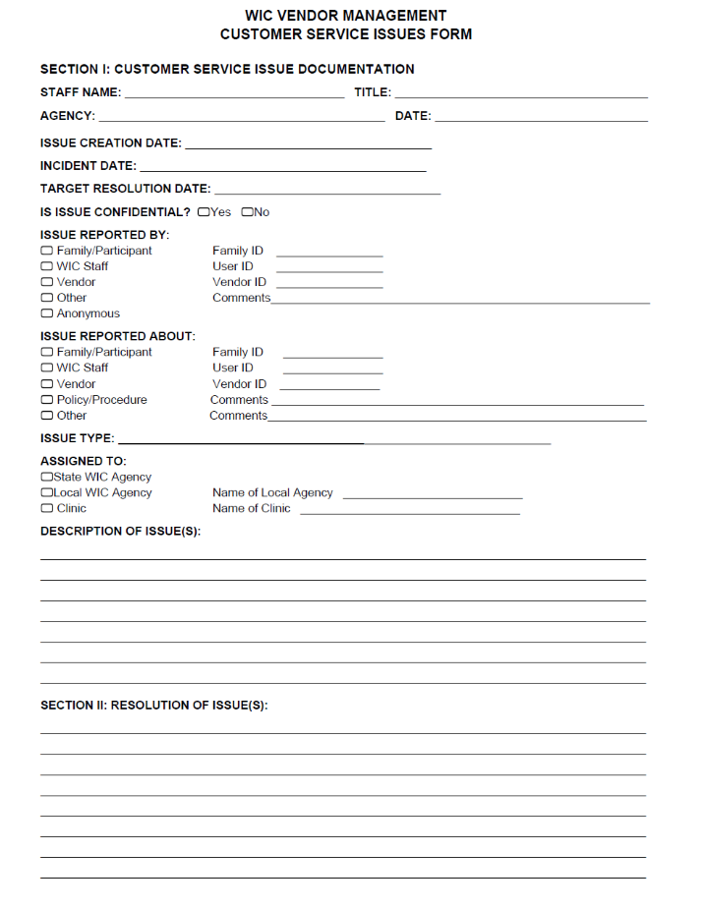
Reporting Customer Service Issues (Complaints)
Vendors should report customer service issues (complaints) to the Local WIC Agency concerning:
WIC customer inappropriate behavior
Vendors are not required to tolerate behavior from a WIC customer that they would not tolerate from other customers
Complaints about other vendors
May use form in the Vendor Manual
Notes:
We are interested in hearing any concerns and complaints you may have. In the back of the Vendor Manual is a form that you can use to report inappropriate behaviors by WIC customers. You may also become aware of issues WIC customers had with other vendors. These issues can be reported on the same form.

Slide 70
Questions
Notes:
Let’s pause here for any questions

Slide 71
Completion of Forms using DocuSign
Notes:
We’ll now review the completion of vendor forms.

Slide 72
Completing Required Forms
Free-standing pharmacies authorized through corporate vendor agreements must complete:
Application (DHHS 3282) – completed through the vendor portal
Verification of Attendance form
All other Free-standing pharmacies will complete the following in DocuSign:
WIC Vendor Agreement for Free-standing Pharmacies (DHHS 2768P) FFY 2021-2024
WIC Vendor Application (DHHS 3282)
WIC Price List for Free-standing Pharmacies (DHHS 2766P)
Cost Containment Exemption form for Pharmacies
Verification of Attendance form (provided by Local WIC Agency, not in DocuSign)
Notes:
Free-standing pharmacies authorized through corporate vendor agreements must complete: Application (DHHS 3282) completed through the vendor portal Verification of Attendance Form All other free-standing pharmacies must complete: Free-standing Pharmacy Agreement (DHHS 2768P) Application (DHHS 3282)
WIC Price List for Free-standing Pharmacies (DHHS 2766P) Cost Containment Exemption form for Pharmacies Verification of Attendance Form

Slide 73
Completing Required Forms continued
Provide an email address for the pharmacy that is closely monitored. Forms to be completed using DocuSign will be emailed
Complete Verification of Attendance form using blue or black ink
Use the exact same pharmacy name on all forms
Review all forms for accuracy. If you make an error, you may be sent forms via email again, starting the process over
Instructions for completing each form can be found in the Vendor Manual
Be complete and accurate
Notes:
All printed forms must be completed in ink, DocuSign forms, typed. Do not use pencil, correction fluid or tape or gel pens. If you make an error, mark one line through it, initial it and write in the correct information. Remember, do not fold or staple paperwork. Samples of forms and instructions for completing each can be found in your Vendor Manual.
Remember, all forms should be complete and accurate. If you have questions, please ask.

Slide 74
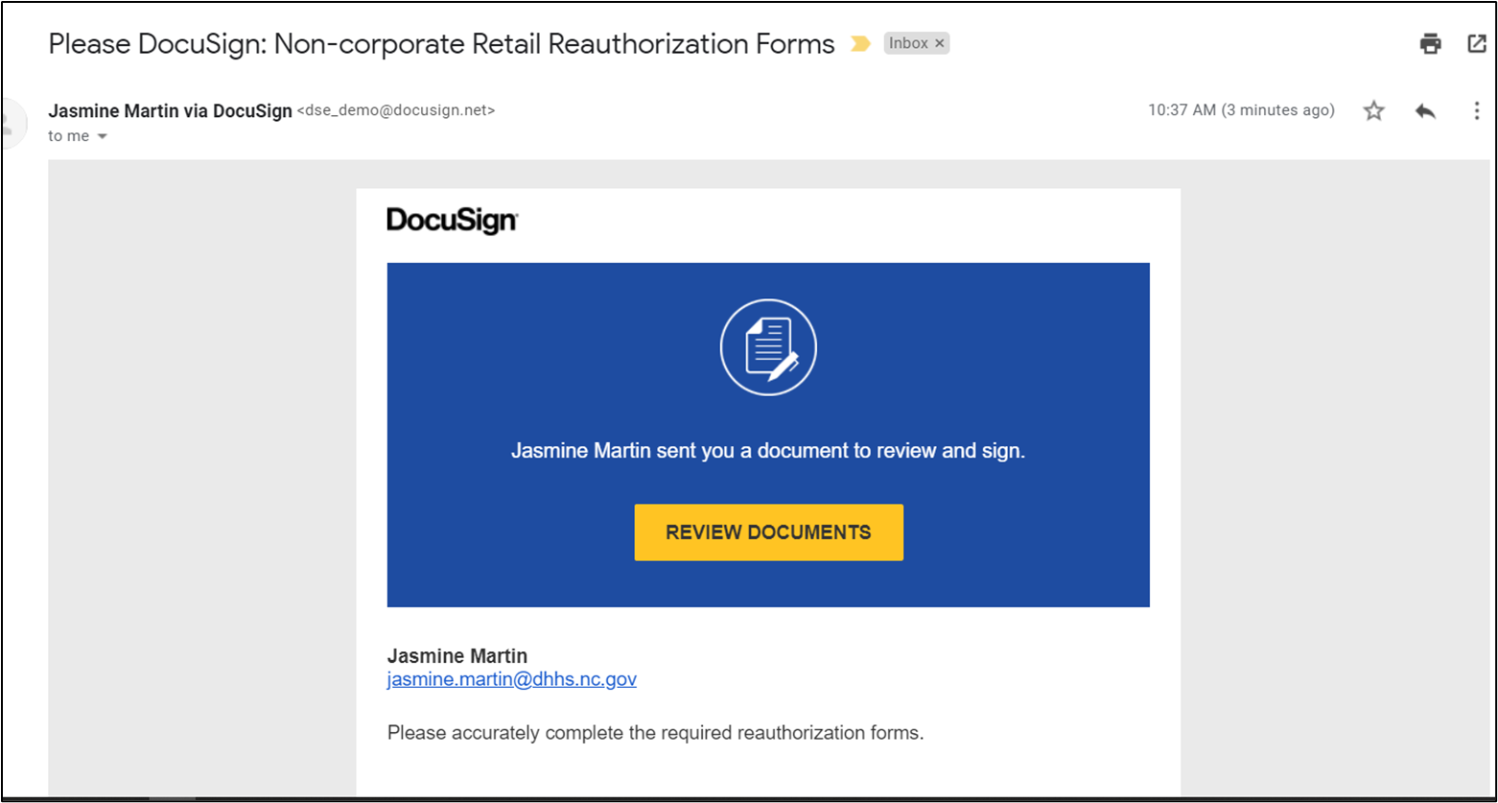
Using DocuSign
You will receive an email from the State Agency via DocuSign
This is the email you will receive
Click on the “Review Documents” button
Notes:
You will receive an email from the State Agency via DocuSign. This is a general idea of what the email will look like once received. You will click on the Review Documents button.

Slide 75
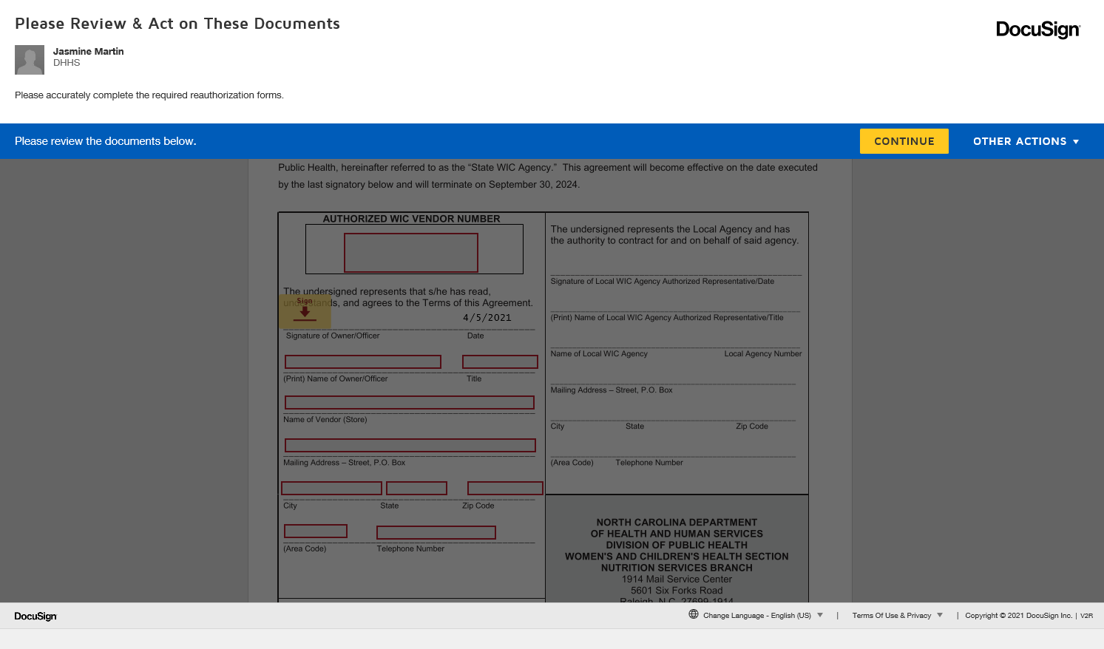
Vendor Process
Once you have clicked “Review Documents,” this screen will open
You will click the “Continue” button to review and complete the application documents (forms)
Notes:
Once you have clicked on Review Documents, this screen will open. You will click the continue button to review and complete the reauthorization documents.

Slide 76
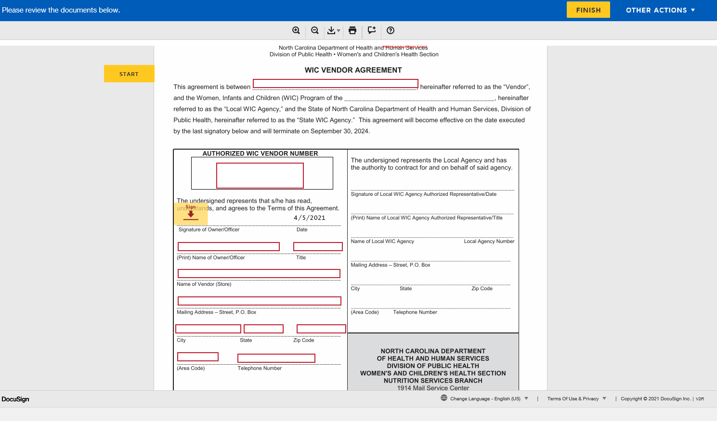
Fields to Complete
Red boxes will appear on the fields required for completion
Notes:
Red boxes will appear on the fields required for vendor completion.
NOTE: Vendors cannot enter information in fields designated for anyone other than vendors

Slide 77
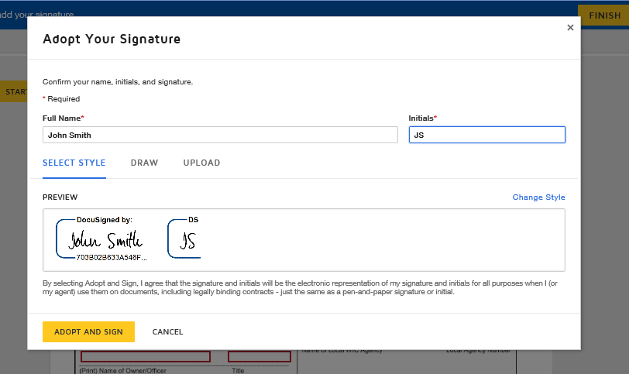
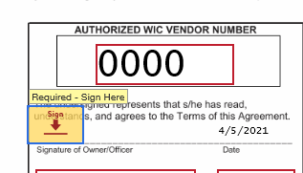
Adopting a Signature
When you click on the first Sign button, the “Adopt Your Signature” screen will appear.
Signature options
Type your name and initials and change the style to look more like your handwritten signature
Draw or “write” signature by selecting the draw tab and using the mouse
Upload a clear picture of signature for use
Notes:
When you first click on the Sign button, the adopt your signature screen will appear. You have the option to type your name and initials and change the style to look more like their handwritten signature. There is also an option to draw or “write” your signature by selecting the draw tab and using the mouse. Lastly, you have the option to upload a clear picture of your signature for use although, the first option may be best.
Once you’ve completed your signature and initials, click the adopt and sign button. Your signature will then appear in the space designated Sign.

Slide 78
SIGNATURE
Once signature and initials have been adopted, when you click any space labeled sign or initial, the adopted signature will appear.
Notes:
Once the signature and initials have been adopted, when the vendor clicks any space labeled sign or initial, the adopted signature will appear.

Slide 79
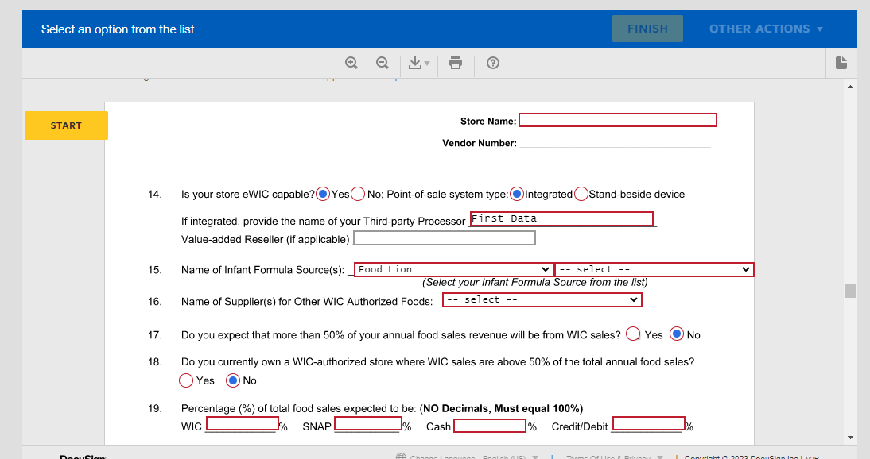
Form Fields
Certain fields triggered once specific fields selected.
Blue arrow at question 14 shows that the check box for Integrated has been selected
Sub questions and corresponding fields have now been highlighted
The value-added reseller is not highlighted in red because this is an optional field
Green arrow at question 15 shows a drop-down option.
Ensures vendors only choose State approved sources
Also available for question 16
Notes:
There are certain fields that will only trigger once specific fields have been clicked. The blue arrow at question 14 shows that the check box for Integrated has been checked. Due to this, the sub questions and corresponding fields have now been highlighted. The value-added reseller is not highlighted in red because this is an optional field, as you see, the value-added reseller only needs to be answered if applicable.
The green arrow at question 15 shows a drop-down option. This is to ensure vendors only choose state approved sources. The same is available for question 16.

Slide 80
Vendor Process Completed
Once you have gone through all documents and completed all required fields, you will be able to click the “Finish” button.
Notes:
Once you have gone through all documents and completed all required fields, you will be able to click the “Finish” button.

Slide 81
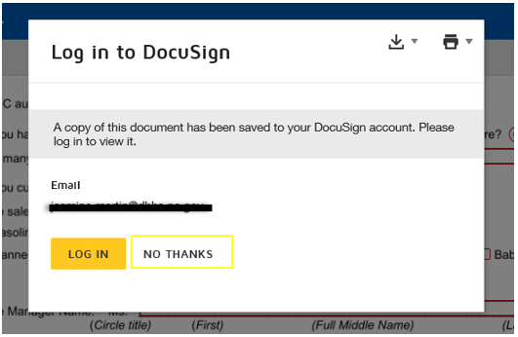
Final Screen
You may see this screen upon completion
Can select “No Thanks”
All parties will receive a copy of the fully completed forms
Notes:
Once you complete your required fields and click finish, this screen may appear. You can select “No Thanks” all parties will receive a copy once all parties involved have signed.

Slide 82
Application (DHHS 3282)
All vendor applicants must complete an application
The pharmacy owner or officer should complete and sign
Do not leave blanks
Do not type “same as above”
All required fields must be completed to move forward in DocuSign
Notes:
All vendor applicants must complete this form.
The pharmacy owner or officer should complete and sign this form.
Do not leave blanks, do not type “same as above”.
Take out your copy of this form so that you can follow along as I point out some items to assist you in completing this.
At the top of each page is a place to write in the pharmacy name. Make sure that the name is listed the same way on all pages and is consistent between forms.
Note to speaker: All questions on application should be reviewed!

Slide 83
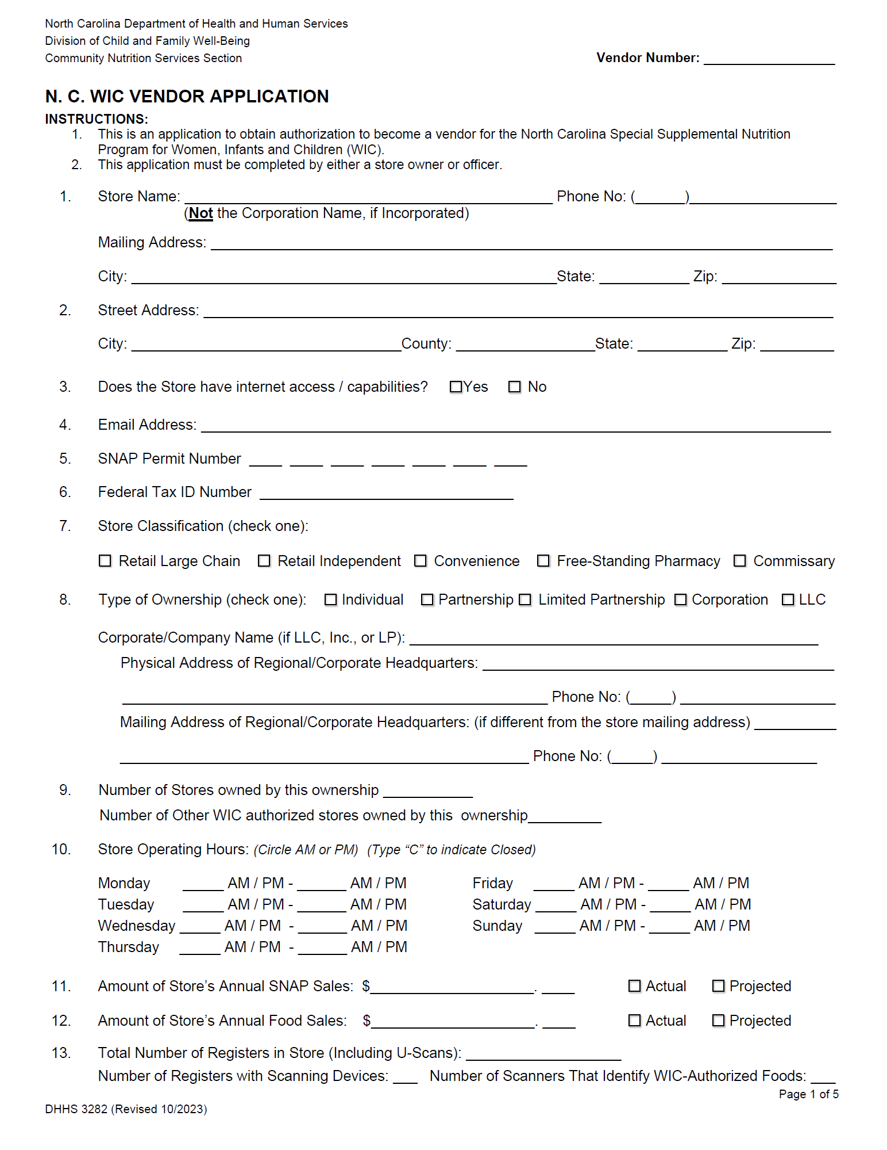
Application (DHHS 3282)
Questions #1-2
pharmacy address information
Questions #3-4
Needed for future notifications
Question #5
SNAP – (Not applicable for Free-standing pharmacies)
Question #6
Provide pharmacy’s Federal Tax ID number
Question #7 - check only one!
See instructions for definitions:
Retail Large Chain
Independent/Convenience
Free-standing Pharmacy
Commissary (Military Based Stores)
Notes:
A few notes about specific questions…. Question #’s 1-2: this is for the pharmacy mailing address, physical address Question 3 – Check whether the pharmacy has internet access. Answer yes or no Question 4 – Provide email address, if pharmacy has one. An email address will be needed in the future for vendor-related notifications. Question 5 - SNAP – (Not applicable for Free-standing pharmacies) Question 6 - Provide your pharmacy’s Federal Tax ID number Question 7 - Only one (1) block must be checked. Classification must be consistent with the Vendor Agreement. Check appropriate block that applies to pharmacy's setup. Refer to list below of pharmacy classifications with brief definitions to help decide what classification the pharmacy falls under.

Slide 84
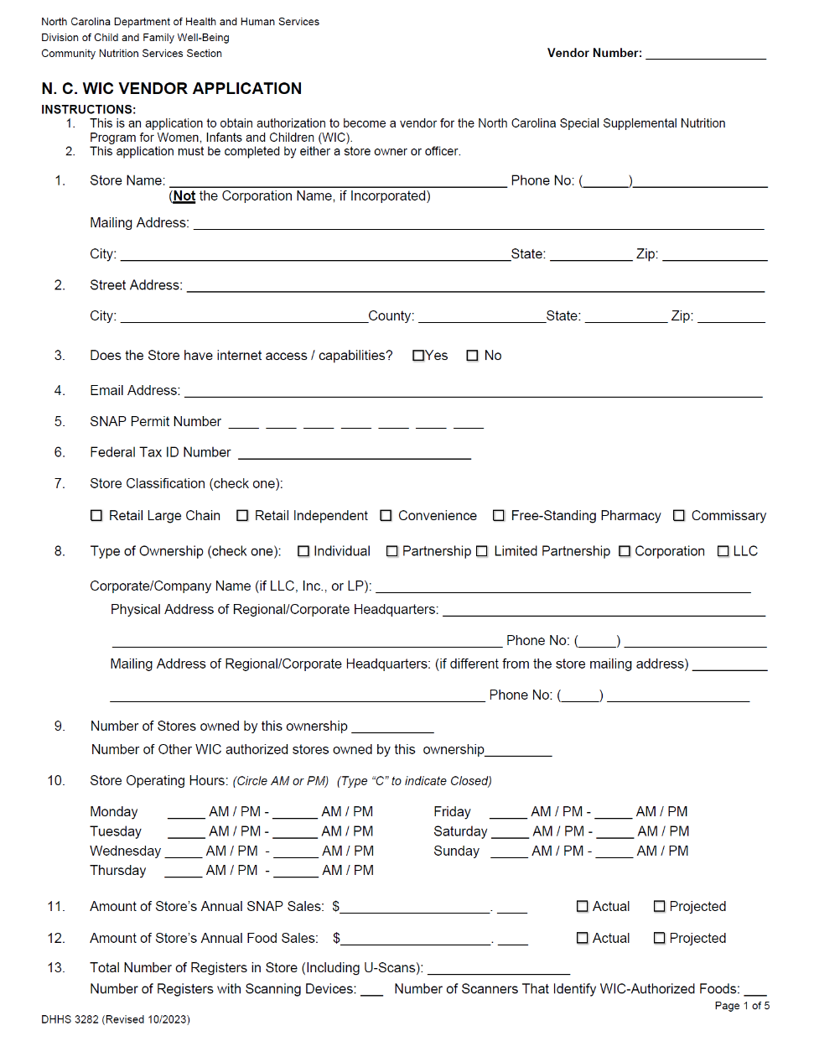
Application (DHHS 3282)
Question #8 - check only one!
Individual
Partnership
Limited Partnership
Corporation
LLC
Question #9 – NEW
Number of stores owned by this ownership (at least 1)
Number of other WIC authorized stores owned by this ownership
Question #10
Since business hours are a selection criteria, please be accurate and indicate AM/PM
Question #11-12
Annual SNAP & Food Sales – Projected for new pharmacies
Question #13- Important! May determine peer group
Total Number of registers in pharmacy - not number in use (including U-Scans)
Number of registers with scanning devices
Number of scanners that identify WIC approved foods
Notes:
Question 8 - Check only one (1) type of ownership. Use the one most appropriate. Example: If two people own a business and the pharmacy is incorporated or an LLC, the type of pharmacy is corporation or LLC even though there is a partnership formed. Provide the name, physical address and phone number of the corporation or LLC the pharmacy is registered under. Question 9 – NEW question – Provide the number of stores owned by this ownership (must be at least 1 which include the store this application if regarding)
Then provide the number of other WIC stores owned by this ownership (this number could be 0 but you must provide that answer.
Question 10 - Provide all the hours that the pharmacy is open for business. Circle AM or PM for opening and closing times. Remember that 12PM is noon and 12AM is midnight. Question 11 – Amount of pharmacy’s Annual SNAP Sales: Provide the yearly dollar amount of SNAP sales. If this is a new pharmacy, projected sales must be given based on the business conducted prior to purchase. Question 12 - Annual Food Sales: Provide the yearly dollar amount of food sales only. If this is a new pharmacy, projected sales must be given based on the business conducted prior to purchase. Question 13 – Provide the total number of cash registers in the pharmacy

Slide 85
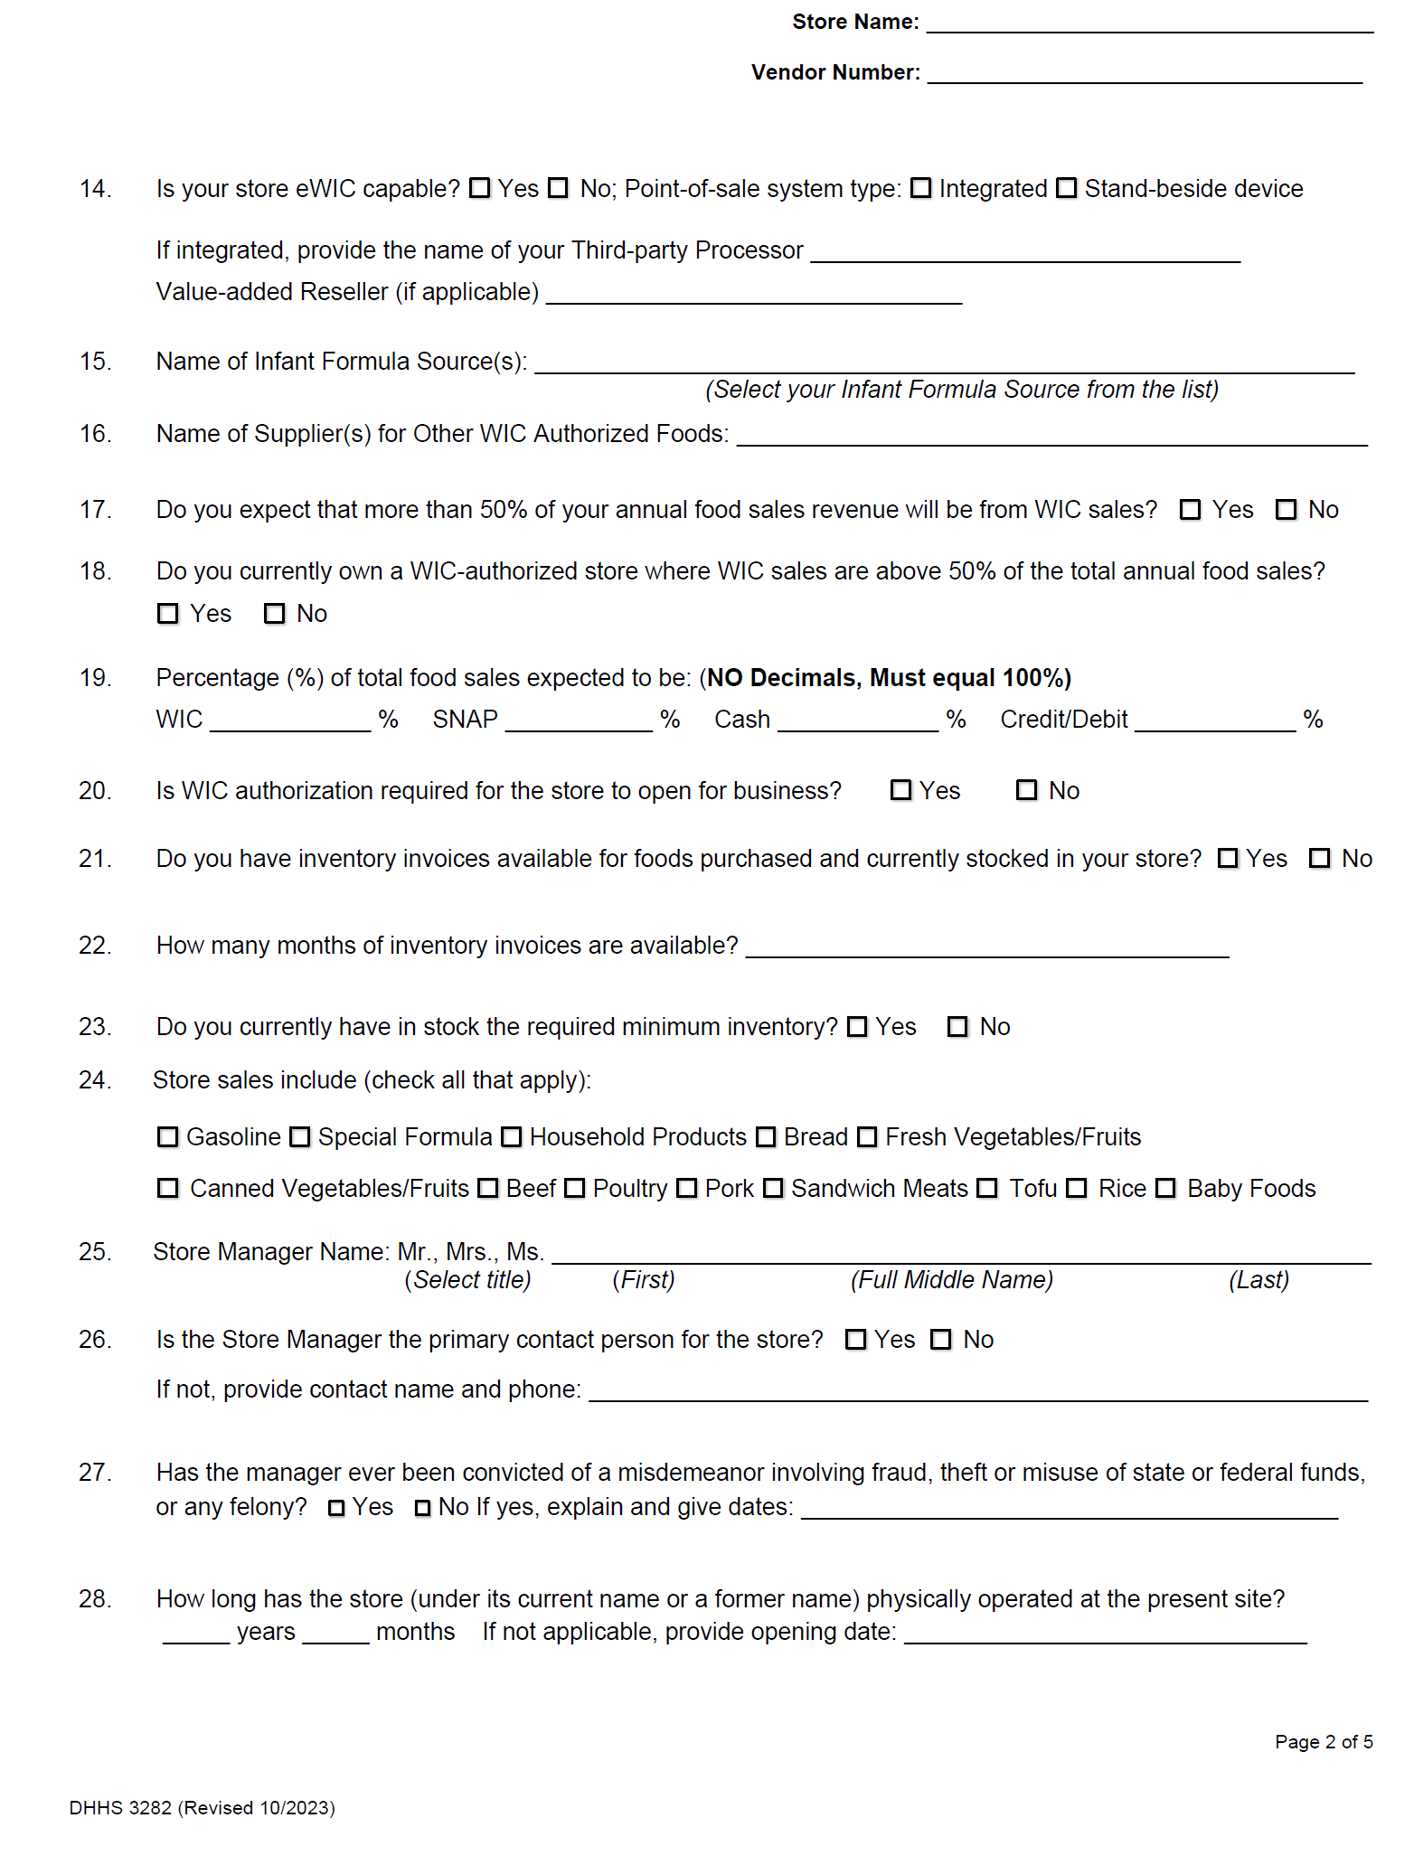
Application (DHHS 3282)
Question #14
eWIC capable
Question #15-16
Infant formula source
Food suppliers
Question #17-18
More than fifty percent of pharmacies annual revenue from WIC?
Question #19
Percentage of business expected to be WIC, SNAP, cash, and credit/debit card (no decimals)
Question #20
WIC authorization required?
Notes:
Question 14 – Check Yes or No to indicate whether pharmacy is eWIC capable or not. . Check your Point of Sale system type as either Integrated or Stand-beside. If integrated, provide the name of your Third-Party Processor and if applicable, Value-added Reseller.
Question 15 – Provide the name of source(s) for all infant formulas (Refer to list of approved sources)
Question 16 - Provide the name of supplier(s) for all WIC approved foods
Question 17 – Check whether the pharmacy expects to derive more than fifty-percent of the pharmacy’s annual revenue from the sale of food items through WIC transactions. Answer yes or no
Question 18 – Check whether you own a WIC authorized pharmacy where the WIC sales are above 50% of the total annual food sales. Answer yes or no
Question 19 - Record what percent of food sales is expected to be from WIC sales, SNAP sales, cash sales, and credit/debit. These should all total up to 100%. (no decimals)
Question 20 – Check whether WIC authorization is required in order for the pharmacy to open for business. Answer yes or no

Slide 86
Application (DHHS 3282)
Question #21-22
Inventory invoices
Question #23
Required minimum inventory-not applicable
Question #24
Check all boxes that apply
Question #25-26
Manager’s full name
Indicate if manager is primary contact for the pharmacy
Notes:
Question 21 – Check whether there are inventory invoices available for food items purchased and currently stocked in your pharmacy. Answer yes or no.
Question 22 – If the answer is yes, document how many months of inventory invoices that are available.
Question 23 – Minimum inventory is not applicable to pharmacies
Question 24 – Check all blocks that apply to what contents are sold in the pharmacy.
Question 25 - Circle title of courtesy (Mr., Mrs., Ms.) for pharmacy manager. The full name (first, middle, and last) of pharmacy manager is required. Do not use initials. Document if there is no middle name by writing “NMN”.
Question 26 – Check whether the pharmacy manager is the primary contact person for the pharmacy. If no is checked, the owner will be listed as primary contact. Answer yes or no.

Slide 87
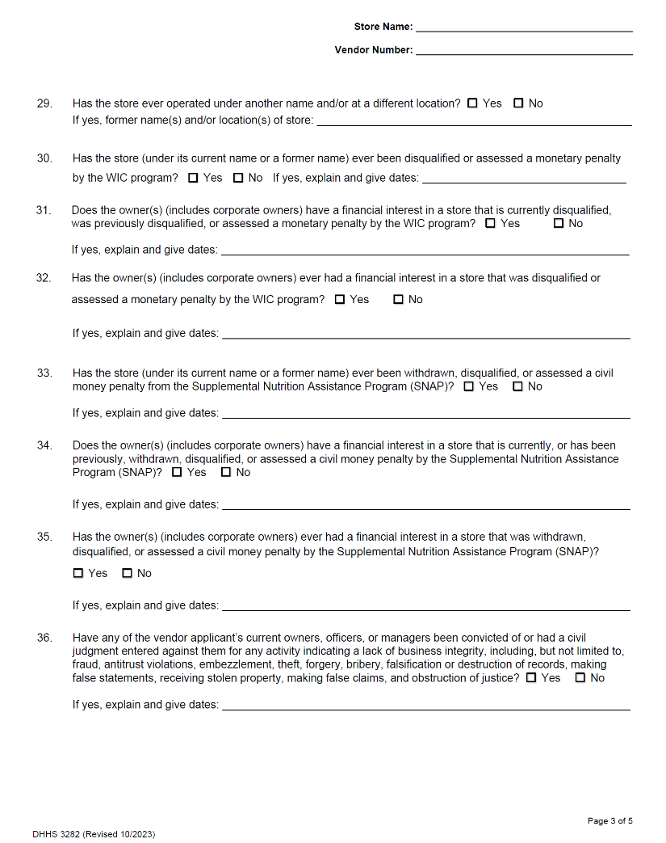
Application (DHHS 3282)
Questions #27-36
Business integrity questions
Do not leave any blanks
Provide explanations and dates for “yes” responses
Notes:
Questions 27 thru 36 pertain to business integrity. Do not leave any unanswered and always provide explanations and dates for any “Yes” responses.
Question 27 - Check only one (1) block. If "yes" is checked, a detailed explanation is required from pharmacy manager with dates of occurrence.
Question 28 - Provide how many years and months the pharmacy has been in business at the present site. If the pharmacy has been in business less than a month, provide the date the pharmacy opened for business.
PAGE 3 of 5:
Question 29 - Check only one (1) block. If "yes" is checked, provide the old name and address of the pharmacy.
Question 30 - Check only one (1) block. If "yes" is checked, a detailed explanation, including what WIC incident occurred with dates of occurrence, is required.
Question 31- Check only one (1) block. If "yes" is checked, a detailed explanation, with dates of occurrence, is required.
Question 32- Check only one (1) block. If "yes" is checked, a detailed explanation, with dates of occurrence, is required.
Provide pharmacy name in the space provided in the upper right corner of page. The pharmacy name must be consistent throughout the application.
Question 33 – 35 Check only one (1) block. If "yes" is checked, a detailed explanation, with dates of occurrence, is required.
Question 36 – Check only one (1) block. If “yes” is checked, a detailed explanation is required of all owners, officers or managers “yes” applies to. If additional space to document the explanation is necessary, attach a separate sheet of paper, with the additional documentation referring back to this question.

Slide 88
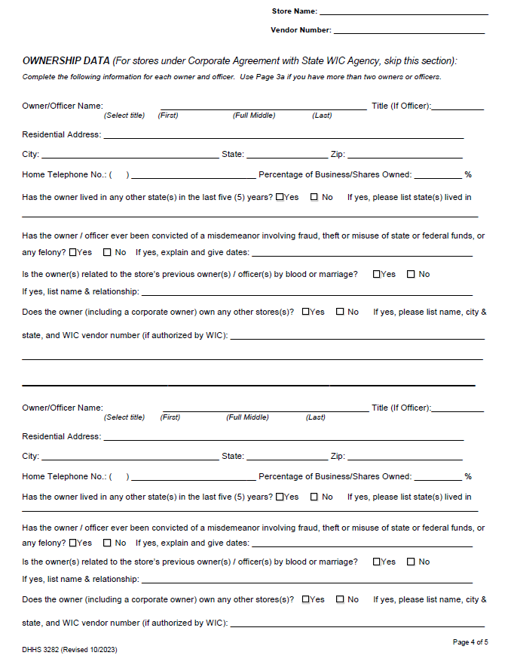
Ownership Data Section
Pharmacies under corporate agreement do not complete this section
Pharmacies not under corporate agreement should list all owners/officers
For more than two owners, request a page 4a
Incorporated or Limited Liability Companies (LLC) list officers
Notes:
On page 4 of the application, you can see there is an Ownership Data Section. Pharmacies that will be authorized under a corporate agreement do not complete this section of the form, because it is completed by your corporate office. For all others, please list all owners, regardless of the percentage owned.
Do you have more than two owners? If yes, please request a page 4a, so that you can take it with you today.
If your pharmacy is incorporated or an LLC with many owners/shareholders, please list the President on this page and complete a page 4a with the Vice President, Secretary and Treasurer.

Slide 89
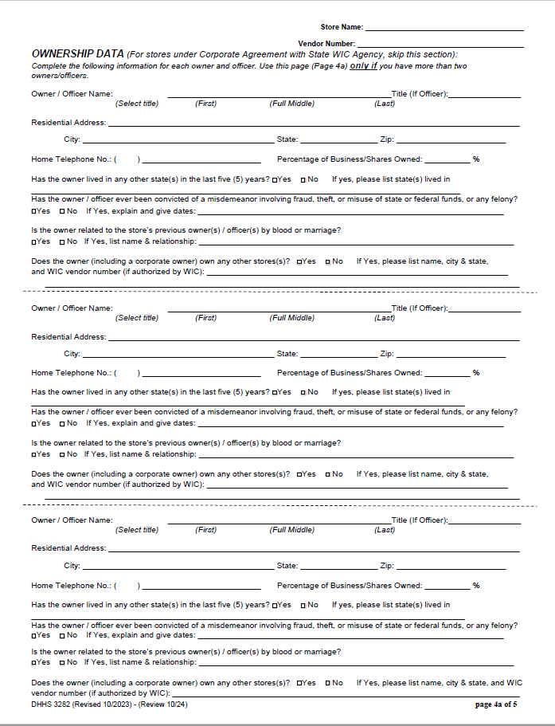
Page 4a
Additional ownership page
For vendors with more than 2 owners or officers
Notes:
This is page 4a where additional ownership information is listed. Please list all additional owners, regardless of the percentage owned.
Again if your pharmacy is incorporated or an LLC with many owners/shareholders, please list the President, Vice President, Secretary and Treasurer.

Slide 90
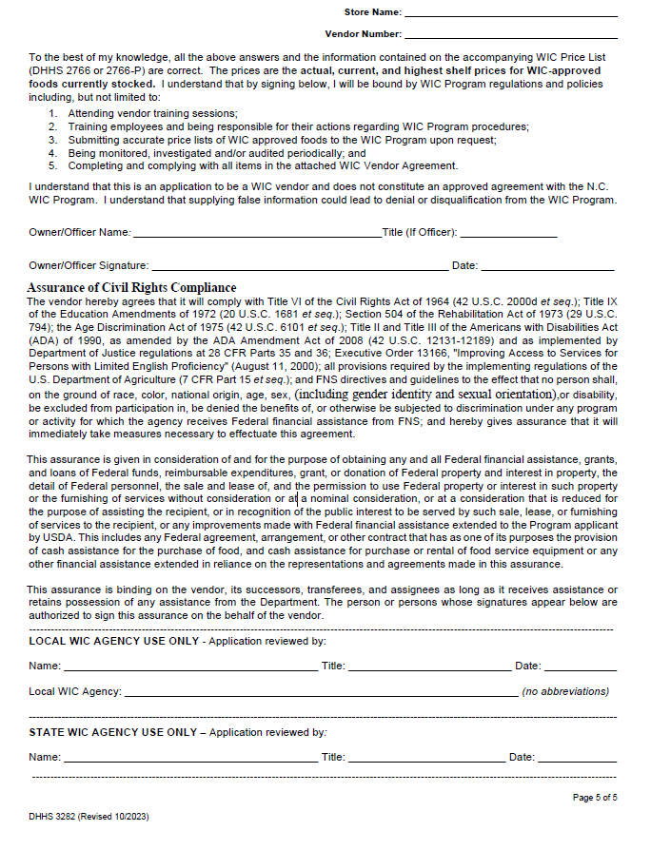
Page 5
Read application statement Pharmacy Owner/Officer signs
Check all answers before signing and clicking finish to avoid delay of processing the application
Bottom section is to be completed by the Local WIC Agency before being sent to the State WIC Agency
Notes:
Page 5 is the signature page. Please make sure to read the application statement. It must be signed by the pharmacy owner or an officer.
Page 5 also contains the detailed Assurance of Civil Rights Compliance statement.
This page is also signed by the Local Agency before being sent to the State WIC Agency.
To avoid delay of your application, it is a good idea to review all your responses before you return this to our office.

Slide 91
WIC Price List For Free-standing Pharmacies (DHHS 2766P)
Must be completed individually by each free-standing pharmacy at authorization and when requested by the State WIC Agency.
Complete price for each WIC exempt formula and eligible nutritional on the form.
Not restricted to NTE prices
For reporting purposes only
Notes:
The WIC Price List For free-standing pharmacies must be completed at authorization and when requested by the State WIC Agency by each free-standing pharmacy. It is not necessary for vendors under a corporate agreement with the State to complete a price list for each pharmacy. This is handled through the corporate office and sent directly to the State WIC Agency for processing.
You must complete a price for each WIC exempt formula and eligible nutritional. Free-standing pharmacies are not subject to Not to Exceed (NTE) prices. The purpose of the WIC Price List for Free-standing Pharmacies is to comply with federally mandated requirements.

Slide 92
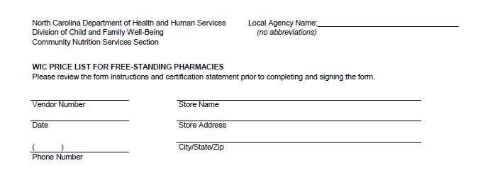
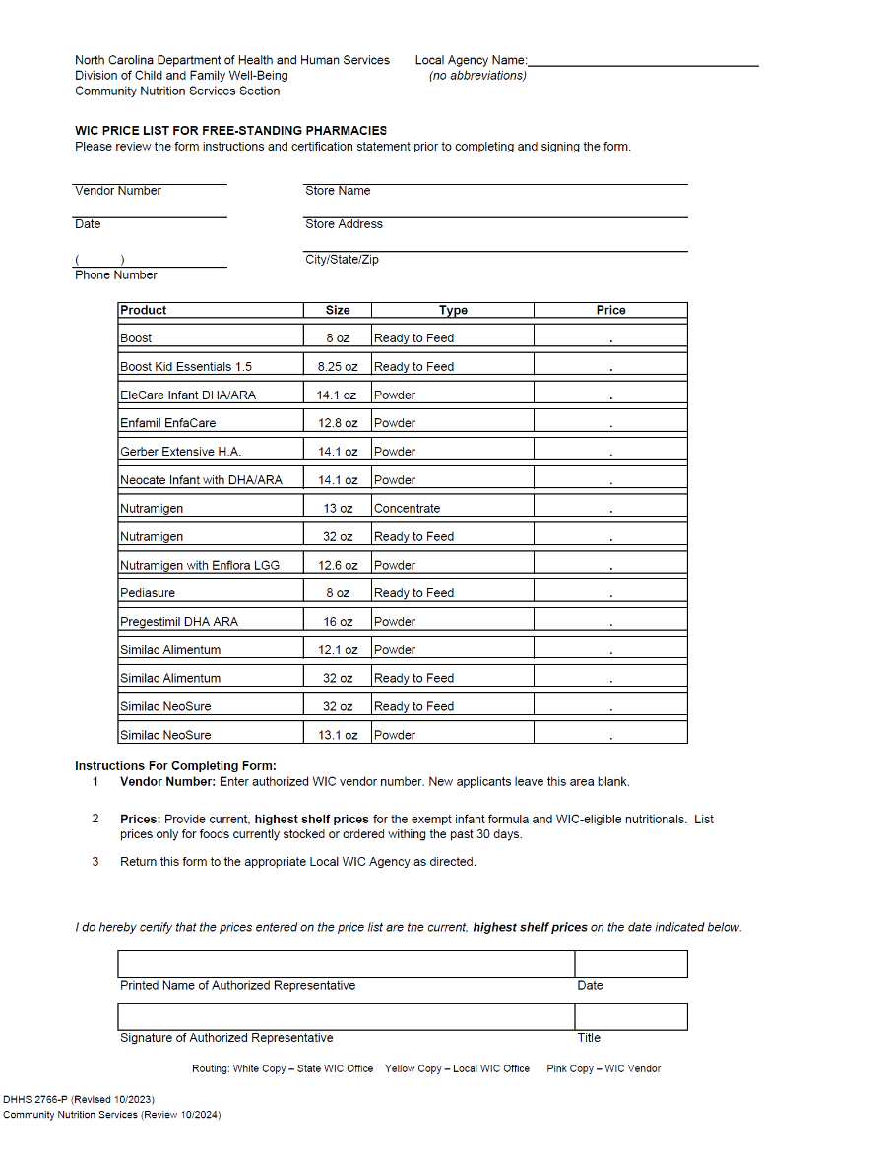
Pharmacy Name and Number
Street Address
Phone Number
Date
Notes:
As with the other forms, take care to write the pharmacy name and number. Please include the physical street address not the mailing address. Also include the phone number and the date.

Slide 93
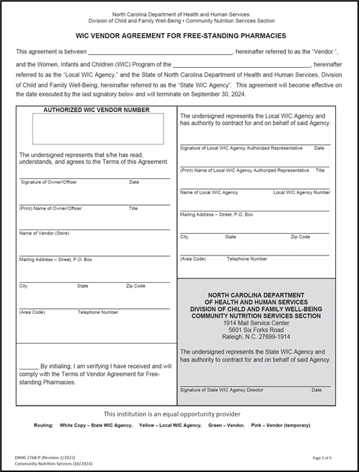
WIC Vendor Agreement For Free-standing Pharmacies
Read and understand
all terms!
Notes:
This is the WIC Vendor Agreement form that is effective through September 30, 2024. Only pharmacies not under a corporate agreement will complete this form individually. Take out your copy so that you can follow along as I review a few key points. We will also review the Terms of Vendor Agreement.
Note to Local WIC Agency: You need to go over the actual Terms of Vendor Agreement for the new contract period as well – There are differences.

Slide 94
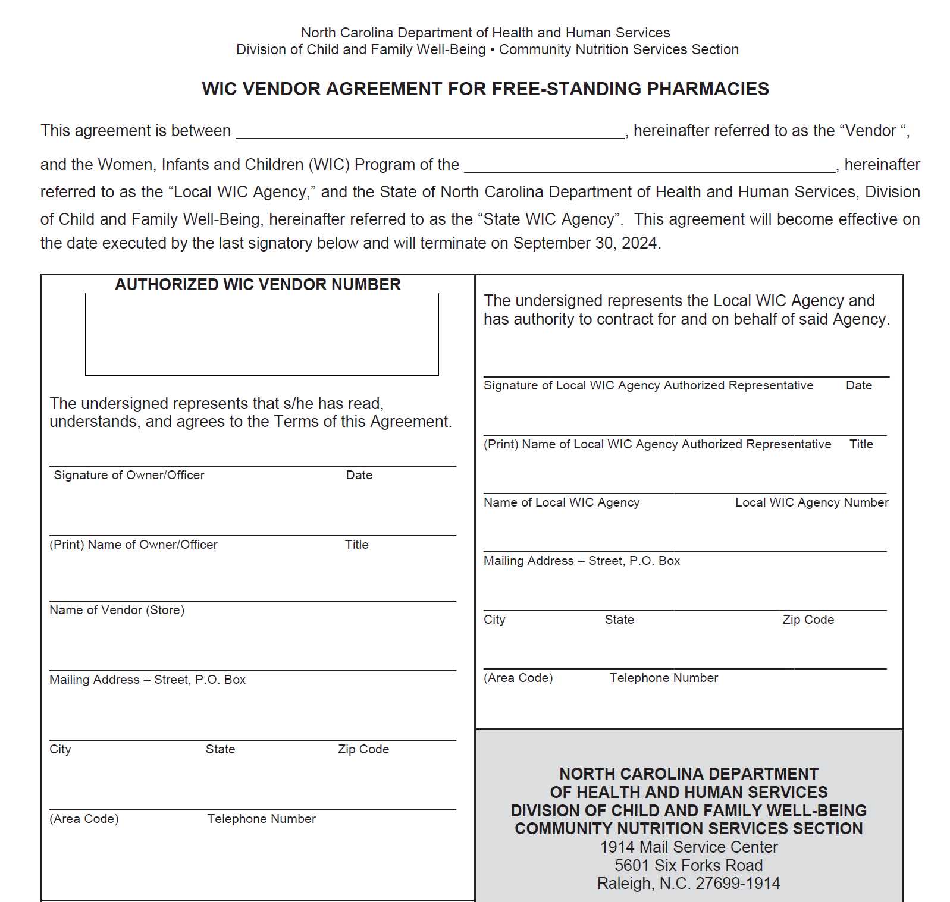
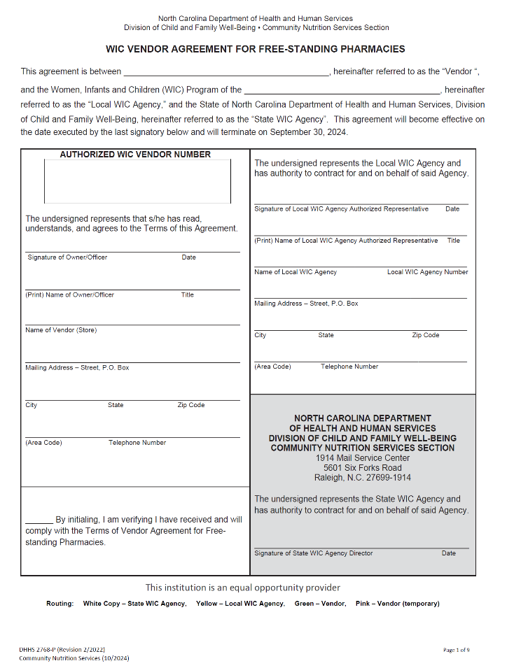
Both names must match
Notes:
This is the WIC Vendor Agreement For Free-standing Pharmacies signature page, it is a legal document with strict guidelines for its completion. It is very important that the pharmacy name matches in each place. You must use the same pharmacy name on all of your forms. Again, this is the pharmacy name, not the name of the partnership or small corporation. Leave the Authorized WIC Vendor Number area blank. This will be filled in by the State WIC Agency if the application is approved and you are assigned a vendor number.

Slide 95
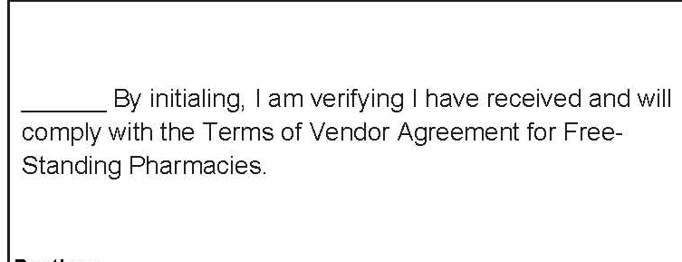
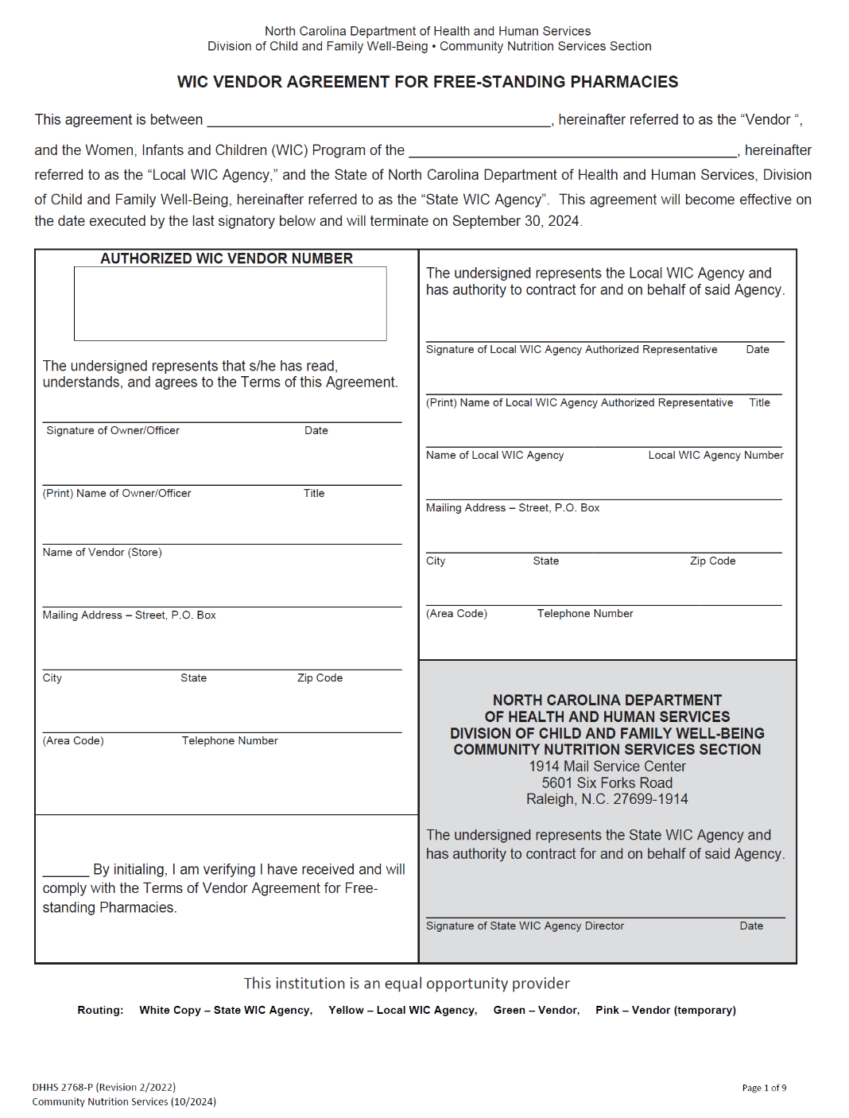
Owner must initial for the receipt of the Terms of Vendor Agreement For Free-standing Pharmacies
Terms of Vendor Agreement provided in DocuSign
Notes:
In the lower left-hand corner of the signature page of the agreement you will see a statement and a place for your initials. This statement is verification of you receiving the Terms of Vendor Agreement For Free-standing Pharmacies and that you have read, understand and will comply with the provisions in the WIC Vendor Agreement For Free-standing Pharmacies.
The owner of the pharmacy must initial this space, not the manager.

Slide 96
ID Requirement
The State WIC Agency requires that vendor applicants submit a copy of their driver’s license or state issued ID.
Notes:
The State WIC Agency requires vendor applicants to submit a copy of their driver’s license or state issued ID with your other required forms. You may provide this when returning your Verification of Attendance form to you vendor coordinator.

Slide 97
Questions
Notes:
Let’s pause here for any questions

Slide 98
Assurance of Civil Rights Compliance
The vendor hereby agrees that it will comply with Title VI of the Civil Rights Act of 1964 (42 U.S.C. 2000d et seq.); Title IX of the Education Amendments of 1972 (20 U.S.C. 1681 et seq.); Section 504 of the Rehabilitation Act of 1973 (29 U.S.C. 794); the Age Discrimination Act of 1975 (42 U.S.C. 6101 et seq.); Title II and Title III of the Americans with Disabilities Act (ADA) of 1990, as amended by the ADA Amendment Act of 2008 (42 U.S.C. 12131-12189) and as implemented by Department of Justice regulations at 28 CFR Parts 35 and 36; Executive Order 13166, "Improving Access to Services for Persons with Limited English Proficiency" (August 11, 2000); all provisions required by the implementing regulations of the U.S. Department of Agriculture (7 CFR Part 15 et seq.); and FNS directives and guidelines to the effect that no person shall, on the ground of race, color, national origin, age, sex (including gender identity and sexual orientation), or disability, be excluded from participation in, be denied the benefits of, or otherwise be subjected to discrimination under any program or activity for which the agency receives Federal financial assistance from FNS; and hereby gives assurance that it will immediately take measures necessary to effectuate this agreement.
This assurance is given in consideration of and for the purpose of obtaining any and all Federal financial assistance, grants, and loans of Federal funds, reimbursable expenditures, grant, or donation of Federal property and interest in property, the detail of Federal personnel, the sale and lease of, and the permission to use Federal property or interest in such property or the furnishing of services without consideration or at a nominal consideration, or at a consideration that is reduced for the purpose of assisting the recipient, or in recognition of the public interest to be served by such sale, lease, or furnishing of services to the recipient, or any improvements made with Federal financial assistance extended to the Program applicant by USDA. This includes any Federal agreement, arrangement, or other contract that has as one of its purposes the provision of cash assistance for the purchase of food, and cash assistance for purchase or rental of food service equipment or any other financial assistance extended in reliance on the representations and agreements made in this assurance.
This assurance is binding on the vendor, its successors, transferees, and assignees as long as it receives assistance or retains possession of any assistance from the Department. The person or persons whose signatures appear below are authorized to sign this assurance on the behalf of the vendor.
Notes:
On this slide you see the Assurance of Civil Rights Compliance Statement. Please take a moment to read it and let me know if you have any questions.

Slide 99
USDA Nondiscrimination Statement
In accordance with federal civil rights law and U.S. Department of Agriculture (USDA) civil rights regulations and policies, this institution is prohibited from discriminating on the basis of race, color, national origin, sex (including gender identity and sexual orientation), disability, age, or reprisal or retaliation for prior civil rights activity.
Program information may be made available in languages other than English. Persons with disabilities who require alternative means of communication to obtain program information (e.g., Braille, large print, audiotape, American Sign Language), should contact the responsible state or local agency that administers the program or USDA’s TARGET Center at (202) 720-2600 (voice and TTY) or contact USDA through the Federal Relay Service at (800) 877-8339.
To file a program discrimination complaint, a Complainant should complete a Form AD-3027, USDA Program Discrimination Complaint Form which can be obtained online at: https://www.usda.gov/sites/default/files/documents/USDA-OASCR%20P-Complaint-Form-0508-0002-508-11-28-17Fax2Mail.pdf, from any USDA office, by calling (866) 632-9992, or by writing a letter addressed to USDA. The letter must contain the complainant’s name, address, telephone number, and a written description of the alleged discriminatory action in sufficient detail to inform the Assistant Secretary for Civil Rights (ASCR) about the nature and date of an alleged civil rights violation. The completed AD-3027 form or letter must be submitted to USDA by:
mail: U.S. Department of Agriculture Office of the Assistant Secretary for Civil Rights 1400 Independence Avenue, SW Washington, D.C. 20250-9410;
fax: (833) 256-1665 or (202) 690-7442; or
email: program.intake@usda.gov
This institution is an equal opportunity provider.

