Slide 1
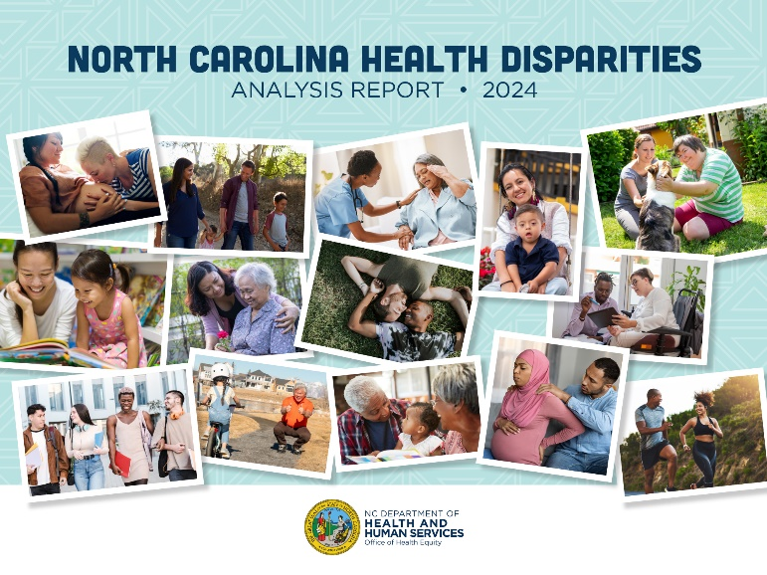
Health Disparities Analysis Report: Data Summary Presentation
Presenter Name
Aug. 15, 2024

Slide 2
Purpose i
The North Carolina Health Disparities Analysis Report aims to:
Highlight the most significant health disparities recognized by the North Carolina Department of Health and Human Services (NCDHHS) as opportunities to reduce disparities over the next three to five years.
Provide measures and a starting point to track the state’s progress in eliminating health gaps experienced by populations that have been historically marginalized.
Describe the services, programs, and resources dedicated to addressing identified disparities by NCDHHS.
Emphasize actionable strategies to reduce health disparities and seek solutions.

Slide 3
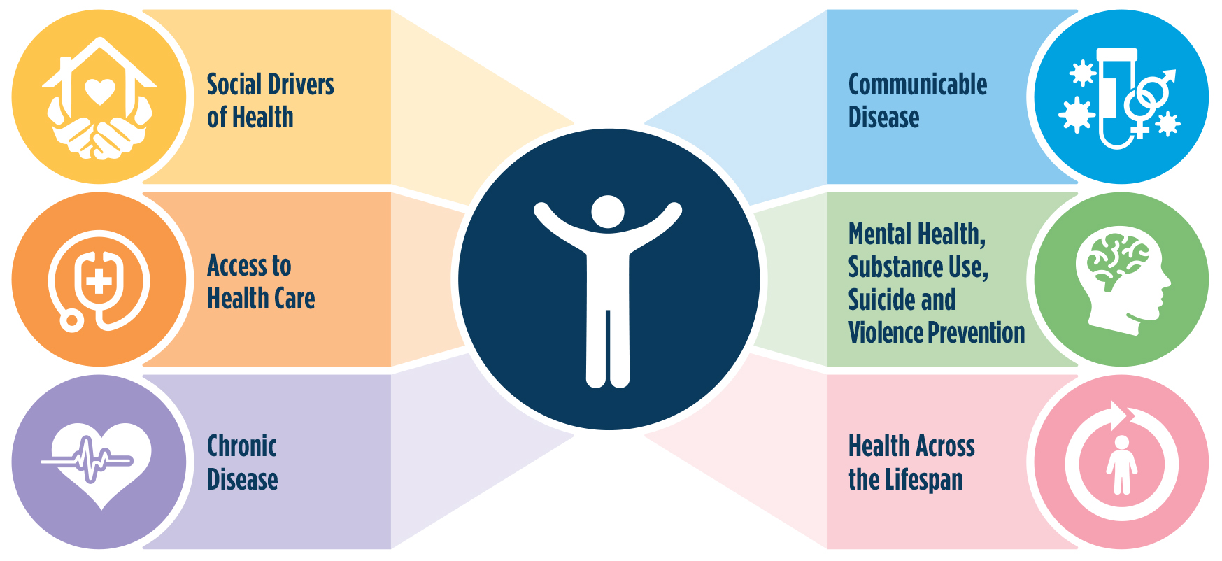
This Report Identifies Six Key Categories in Health Disparities

Slide 4
Social Drivers of Health

Slide 5
Understanding the Social Drivers of Health
Your background - including your education, job and how much money you make - affects your health.
Some communities in North Carolina have a lot of resources that help people stay healthy. Other communities do not have enough services or healthy environments to support good health for the people living there.
It makes a big difference whether families can access quality healthcare, nutritious food, and neighborhoods with safe outdoor spaces for activities. All of this impacts our overall health.

Slide 6
Social Drivers of Health
African American/Black, American Indian, and Hispanic/Latinx individuals are:
Less likely to have a bachelor's degree
Less likely to own a home
More likely to have a lower median household income
More likely to be unemployed
More likely to spend over 30% of their income on housing
More likely to experience poverty

Slide 7
Access to Health Care

Slide 8
Understanding Access to Health Care
Access:
Do you have health, dental and vision insurance?
Can you afford prescription medications?
Are there enough primary and specialized providers in your community?
Do your providers accommodate any disabilities you may have?
How far do you have to travel to see a provider?
Quality:
Is your provider familiar with your culture or identity?
Does your provider use your preferred language?
Do you feel safe, respected and valued when you are in a health care setting?

Slide 9
Access to Health Care
Hispanic/Latinx individuals are almost four times more likely to not have health insurance than White non-Hispanic populations.
American Indians are twice as likely, African Americans/Blacks are about 1.5 times more likely, and Multiracial people are 1.3 times more likely to not have health insurance.
Hispanics, African Americans/Blacks and Multiracial people are also more likely to not see a doctor because the cost is too high.

Slide 10
Access to Health Care for People with Disabilities
People with disabilities, no matter their race, are 2.5 – 4 times more likely to avoid seeing a doctor because of the cost compared to White people without disabilities.
Hispanic/Latinx individuals with a disability are nearly seven times (6.82) more likely to not have health insurance when compared to White people without disabilities.
The National Institutes of Health (NIH) recently identified people with disabilities as a group with health disparities. Health problems contribute to these disparities, but so do discrimination, unequal access and limited resources.

Slide 11
Access to Health Care for Rural Counties
About 74 counties in North Carolina have a shortage of primary care providers, with a ratio greater than 1,500 residents per primary care provider.
This means that nearly 75% of counties in North Carolina lack enough primary care access.

Slide 12
Access to Health Care
From the largest survey conducted on LGBTQ+ health in the South, which had 927 participants, only 50% of LGBTQ+ individuals in North Carolina felt their health care needs were adequately met. Also, nearly 28% worried about losing their health care coverage.*
Transgender people in North Carolina reported:
48% had to educate their medical providers about their LGBTQ+ identity
56.3% waited to seek care because of their LGBTQ+ identity
* Campaign for Southern Equality, & Western North Carolina Community Health Services. (2021, August). State Spotlight: North Carolina. https://southernequality.org/wp-content/uploads/2021/08/SouthernLGBTQHealthSurvey_NCBreakout.pdf

Slide 13
Chronic
Disease

Slide 14
Understanding Chronic Disease Disparities
Chronic (long-term) diseases like heart disease, cancer, injuries and diabetes often develop due to a mix of health behaviors, genetics and environment. These diseases are major causes of death in North Carolina.
Health behaviors, like tobacco use, alcohol use, unhealthy diet and lack of exercise, greatly influence our risk for chronic diseases and health issues. While we make individual choices, our behaviors are shaped by early life experiences, trauma, toxic stress, the way our brain develops as we grow and the environments in which we live.
Abilities and access to opportunities also play a role. Not everyone has the same chance to engage in healthy behaviors like regular exercise and nutritious eating.

Slide 15
Chronic Disease Disparities
The overall mortality rates for heart disease, stroke, diabetes and liver disease have slightly risen since the last report from 2014 to 2018. North Carolina has made great strides in reducing the disparity gaps between racial and ethnic population groups. However:
African American/Black North Carolinians are more likely to die of stroke, more likely to be diagnosed with and die from diabetes, more likely to be diagnosed with COPD (chronic obstructive pulmonary disease), and more likely to die from kidney disease than White, non-Hispanics.
African Americans/Blacks are two times more likely to be diagnosed with prostate cancer, 2.5 times more likely to be diagnosed with multiple myeloma, and more likely to die of cancer.
American Indians are more likely to die from diabetes, liver disease, kidney disease and Alzheimer’s disease than White, non-Hispanics.

Slide 16
Chronic Disease Disparities for People with Disabilities
North Carolinians with disabilities, no matter their race, have worse health outcomes in terms of chronic diseases like heart disease, high blood pressure, stroke, diabetes, cancer, COPD and depression than White Non-Hispanics without disabilities.

Slide 17
Communicable Disease

Slide 18
Understanding Communicable Disease Disparities
Communicable diseases are illnesses caused by an infectious agent, like bacteria or viruses.
To help protect against these diseases, we need more access to screenings, early detection, treatment and public support for risk reduction and protective services.
Social drivers of health also have an impact on how fast communicable diseases spread.
Communicable diseases remain a large priority for populations historically marginalized, like people of color, LGBTQ+ populations, young people and people who use substances. It is also a significant concern for people who are more vulnerable, like people with chronic illnesses, people with disabilities, older adults or people who have a weakened immune system (immunocompromised).
Reducing stigma (shame) around sexual health for communities that have been historically marginalized can reduce communicable disease too.

Slide 19
Communicable Disease
African Americans/Blacks, American Indians, Multiracial and Hispanic/Latinx populations all have significant health disparities for HIV and AIDS, syphilis, chlamydia and gonorrhea.
These disparities are most severe for African Americans/Blacks, who are six to 10 times more likely to contract these sexually transmitted diseases (STDs) compared to White, non-Hispanics
African Americans/Blacks are also nearly nine times more likely to die from HIV disease than Whites.
HIV diagnosis rates are much higher for young, gay and bisexual men of color than among other North Carolinians. Black and Hispanic gay, bisexual and other men who have sex with men also have lower viral suppression than others in 2021 in North Carolina.*
*North Carolina Public Health. (2021c). Health Equity and HIV in North Carolina, 2021: Gay, Bisexual, and Other Men Who Have Sex with Men. https://epi.dph.ncdhhs.gov/cd/stds/figures/2021-HealthEquityMen.pdf

Slide 20
Mental Health, Substance Use, Suicide and Violence Prevention

Slide 21
Understanding Mental and Behavioral Health Disparities
Mental health includes our emotions, thoughts and social connections.
Some factors that can increase risk include bad childhood experiences, like abuse or neglect, long-term illnesses, money problems and drug use.
Mental illness can also make it more likely to get other chronic diseases

Slide 22
Mental Health
In the United States, women, young adults and people of color, especially American Indians and those of mixed race, are more likely to report serious mental illness.*
In North Carolina, data indicates an increase in high school students reporting**:
Feelings of loneliness
Feelings of sadness and hopelessness
Suicidal behaviors
Feeling unsafe at school
Experiencing physical dating violence
* U.S. Department of Health and Human Services. (2023, March). Mental illness. National Institute of Mental Health. www.nimh.nih.gov/health/statistics/mental-illness
**Meeting of the North Carolina Child Fatality Task Force. ncleg.gov. (2022, December). https://www.ncleg.gov/About/Webservices

Slide 23
Substance Use Disparities (Drugs and Alcohol)
Justice-Involved Populations: People are 40 times more likely to die from an overdose in the two weeks after leaving jail or prison than the general population.*
People Experiencing Housing Insecurity: People in North Carolina that do not have a home were 13.8 times more likely to die from overdose than the general population.**
Populations Historically Marginalized: Over the past decade, overdose rates have increased among groups that have been treated unfairly in the past, including American Indian, Black/African American, Hispanic and Asian populations.
People in rural communities die from alcohol-related causes more often than people in urban areas.
Substance use disorder is a disease that requires prevention, treatment and management, like other illnesses.
* Ranapurwala SI, Shanahan ME, Alexandridis AA, Proescholdbell SK, Naumann RB, Edwards D Jr, Marshall SW. Opioid Overdose Mortality Among Former North Carolina Inmates: 2000-2015. Am J Public Health. 2018 Sep;108(9):1207-1213. doi: 10.2105/ AJPH.2018.304514. Epub 2018 Jul 19. PMID: 30024795; PMCID: PMC6085027
** Fliss, Michael Dolan, Esther O. Chung, Andrea Carey, and Brian K. Alexander. 2022. “People Experiencing Homelessness in NC Have Increased Mortality, Including High Overdose, Violence, Injury, and Chronic Disease Death Rates.” North Carolina Medical Journal 83 (5): 390–91. https://doi.org/10.18043/ncm.83.5.390.

Slide 24
Tobacco
Active Military and Veterans: 47% of the people at Fort Liberty (formerly Fort Bragg) use tobacco. 31% started using tobacco after arriving at Fort Liberty and 75% of all active-duty soldiers living in the barracks use tobacco. In North Carolina, 20.1% of veterans use tobacco.*
People with Disabilities: 25.6% of people with disabilities in North Carolina use tobacco.**
LGBTQ+ Individuals: LGBTQ+ individuals often use tobacco at higher rates than non-LGBTQ+ individuals.*
People with Mental Health or Substance Use Disorders: Estimates from the North Carolina Treatment Outcomes and Program Performance System (NC TOPPS) show that 47% of adults with mental health conditions use tobacco and 57.4% of adults with substance use disorder use tobacco.**
*Data provided by the Chronic Disease and Injury Section
**Data provided by the Chronic Disease and Injury Section, sourced from North Carolina BRFSS 2021

Slide 25
Violence Prevention
People with mental illness are three times more likely to be a victim than a perpetrator of violence. High levels of exposure to violence also reinforce cycles of trauma and fear that can worsen mental health. More than half of U.S. adults worry about a loved one being a victim of violence.
American Indians and African Americans/Blacks are more likely to be involved in assaults, firearm deaths and injuries, and homicides
The most common way both suicides and homicides happen is by firearms, at 57.3% and 75.8% respectively.

Slide 26
Health Across the Lifespan

Slide 27
Understanding Disparities Experienced by Mothers and Babies
Improving the health of mothers and babies is important for public health in the United States and remains a top priority in North Carolina.
Maternal health is not just about being healthy during pregnancy. It is about a person's health throughout their whole life.

Slide 28
Mothers and Babies
African Americans/Blacks in North Carolina are more than 1.5 times as likely as Whites to die from causes related to pregnancy.
The infant death rate is highest for African American/Black infants, followed by American Indian and Multiracial infants
In 2021, North Carolina had the 10th highest infant mortality rate in the nation

Slide 29
Understanding Disparities Experienced by Children
What happens to a person in their first five years of life is very important for their health throughout their entire lifetime.
For example, young children who go through difficult experiences, such as family problems, poverty, neglect, abuse or environmental dangers, are more likely to develop mental and physical health problems as they grow up.
* Early childhood development and education. Early Childhood Development and Education - Healthy People 2030. (n.d.). https://health.gov/healthypeople/priority-areas/social-determinants-health/literature-summaries/early-childhood-development-and-education

Slide 30
Children
African American/Black and American Indian children are twice as likely to die as White children in North Carolina.
In North Carolina, families spend an average of $9,000 to $9,850 per year on full-time childcare.*
Over 22,600 students in kindergarten through grade 12 are homeless in North Carolina.**
Ninety-nine percent (99%) of youth in NC youth development centers have a mental health diagnosis and 48% have both a mental health and substance use diagnosis.***
*Appendices-Demanding Change: Repairing our Child Care System. Child Care Aware of America. (2022). https://info.childcareaware.org/hubfs/Demanding%20Change%20Appendices.pdf
**National Center for Homeless Education. National Center for Homeless Education (NCHE). (n.d.). https://profiles.nche.seiservices.com/StateProfile.aspx?StateID=33
***NC DPS. (2022). Annual report JJ 2022 - NC DPS. https://www.ncdps.gov/jjdp-annual-report-2022/download?attachment

Slide 31
Understanding Disparities Experienced by Aging Adults
North Carolina has a large aging population.
In over half of North Carolina counties, at least one in five people is 65 or older. By 2031, there will be more older adults (65 and older) than children.
As we age, we are more likely to experience diseases and disabilities due to our body's natural processes, and the effects of our environment and health behaviors over time.
Older adults are also more vulnerable to health issues because they may have less social interaction, be less involved in work and have lower incomes.
* Office of State Budget and Management. (2022, December). NC’s population to reach 14.0 million by 2050. NC’s Population to Reach 14.0 Million by 2050 | NC OSBM. https://www.osbm.nc.gov/blog/2022/12/30/ncs-population-reach-140-million-2050#:~:text=Our%20latest%20population%20projections%20show,(a%2032.7%25%20increase)

Slide 32
Aging Adults
About 10% of older adults have an income below the poverty level and 20% have an income between 100% and 199% of the poverty level.
Most older adults (83%) have one or more chronic diseases
34% have a disability
7% reported poor health
Older adults are much more likely to visit the Emergency Room and be admitted to the hospital for accidental falls.

Slide 33
CALL TO ACTION
We Can All Help Reduce Health Disparities

Slide 34
Everyone can contribute to reducing health disparities - we all have a role to play. Here are some recommendations to make a difference:
Focus on understanding and respecting different cultures when promoting resources and opportunities.
Improve the capacity of organizations to provide inclusive language access.
Address all aspects of a person's health, including health care access, health care quality and social factors.
Create a coordinated system of programs and services by forming more local partnerships, using tools like NCCARE360 and changing policies and systems.
Join key NCDHHS meetings, events and webinars to get involved (learn more on our Community and Partner Engagement webpage)

Slide 35
Reducing health disparities requires teamwork from individuals, communities, businesses, health care providers, policymakers, government agencies and more. NCDHHS is committed to improving the health of all North Carolinians and we invite you to join us in this effort.

