Slide 1
North Carolina Division of Emergency Management Individual Assistance Program Brenda Morris, Program Manager
Notes:
Name
Job Title and responsibilities
Key goal of today’s presentation – to provide you general information of NCEM IA program and the services we help manage in the aftermath of a major disaster.
Next Slide

Slide 2
NC Individual Assistance Program
The Individual Assistance program provides financial and direct services to eligible individuals and families who have been impacted by natural or man-made disasters.
Notes:
Our Mission is to ensure all individuals affected by disaster have full opportunity and access to the many programs and services made available to in the aftermath of disaster. This is a joint effort realized through our professional partnerships with our Federal, State, local partners as well as our partnerships with our voluntary and faith based organizations.
Working with our partners, we look at their full spectrum of support, to includes preparedness planning, response operations and recovery operations..
The key programs we work together to make real are –
Next slide

Slide 3
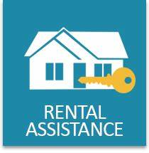
Programs Information
Housing Assistance
Direct Financial help
Home repairs and replacements, rental, and lodging assistance.
Other Needs Assistance (ONA)
Provides financial assistance
Personal property loss, deaths, child care
Transportation, dental

Slide 4
Legal Services
Free legal services
Income Tax Assistance-
Relief presidentially declared disasters
SBA(small business administration)
Low interest loans
Disaster Unemployment
Temporary unemployment benefits

Slide 5
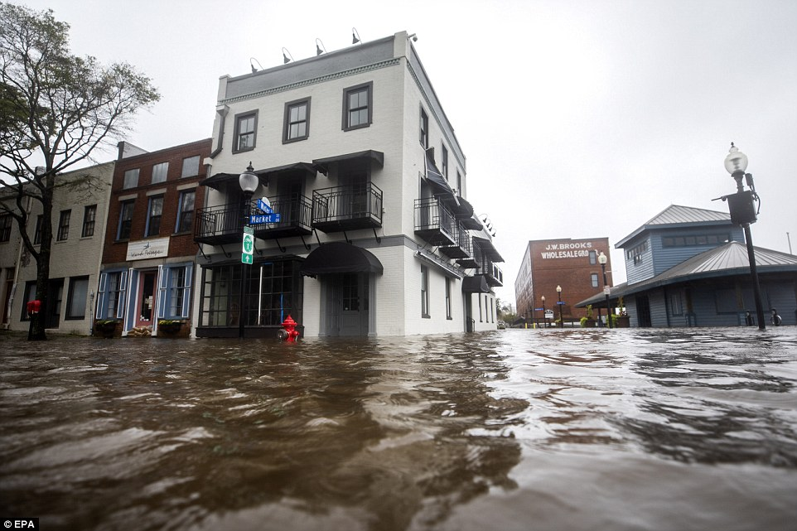
Disaster Case Management (DCM)
Resource assistance for unmet needs
Crisis Counseling
Counseling
Outreach
Education

Slide 6
Disaster Recovery Centers
Support to survivors
Registration, and grant information
Resource referral for unmet needs

Slide 7
Voluntary Agency Liaison
Facilitate the coordination and delivery of assistance
Collect and disseminate information
Notes:
When a disaster occurs the voluntary organizations are usually the first on the scene to provide food, clothing, shelter, medical and occupational supplies.

Slide 8
Community Resources
Faith-Based, Non-profits, others
211
Long-Term Recovery Groups or Community Organizations Active in Disaster
North Carolina Voluntary Organizations Active in Disaster (NCVOAD) https://www.ncvoad.org/

Slide 9
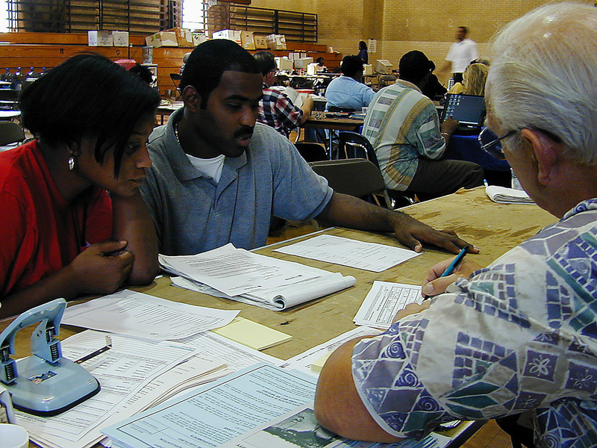
SUMMARY
We are here to assist!
Helpline (919) 825-2378
Email: IArecovery@ncdps.gov
Notes:
Partnering with local, state, non-governmental and Federal agencies, Individual Assistance is here to help disaster survivors recover.

Slide 10
For Additional Information, Questions
or Comments
Brenda Morris, Program Manager 919-825-2340 brenda.morris@ncdps.gov
Yevon Adams, Housing Specialist 919-825-2340 yevon.adams2@ncdps.gov | Phil Triplett, Voluntary Agency Liaison 919-825-2335 phil.triplett@ncdps.gov | Luz Sanabria-Reyes, Bilingual Voluntary Agency Liaison 919-825-2340 luz.sanabria-reyes@ncdps.gov
Notes:
As always our mission is to ensure that individuals and families have access to the full range of State and Federal programs made available in the aftermath of a disaster.
Questions
Contact information

