Slide 1
NC Department of Health and Human Services
NC Opioid and Prescription Drug Abuse Advisory Committee (OPDAAC)
October 5, 2023

Slide 2
Welcome to OPDAAC!
Kellie Crosbie, Division of Mental Health, Developmental Disabilities, and Substance Use Services

Slide 3
Housekeeping
Poll Categories
  Behavioral health
  Treatment and recovery
  Public health
  Academia
  Harm reduction
Mental health
In recovery
Law enforcement and corrections
Other - if you selected other, please share where you are coming from in the chat box.
Take breaks as needed
For questions during the meeting:
  Virtual attendees: Please put your questions in the Q&A box, which will be monitored for the duration of the meeting. Note: you need to send to all panelists and attendees to ensure your question is addressed in a timely manner.
  In-person attendees: Fill out an index card given at registration with your questions and put in box at the back table.
  All attendees: If you would like to ask a question to a specific presenter, please be sure to include their name in your question (either in the Q&A box or on an index card).

Slide 4
Overview: Overdose Prevention and Linkages to Care from OEMS Lens
Tripp Winslow

Slide 5
Panel: EMS Bridge Programs for Buprenorphine Access
Wendy Smith
Sonya Creek
Shellie Kilgo

Slide 6




SURRY COUNTY BRIDGE TO CARE PROGRAM
October 2023

Slide 7
Overview
ABOUT US
OUR TEAM
SCOSAR
MIH
SCHNC
OUR VISION
At Surry County, our mission it to bridge people in additional to long-term recovery through a nonjudgmental, effective, caring, and low-barrier approach.

Slide 8

Background
According to NCDHHS, over 11 North Carolinians experienced a fatal overdose each day in 2022. The rate of death in Surry County is slightly higher than the NC rate. The number of drug overdose ED visits was higher in 2022 than in previous years. How are we addressing these startling statistics in Surry County?

Slide 9
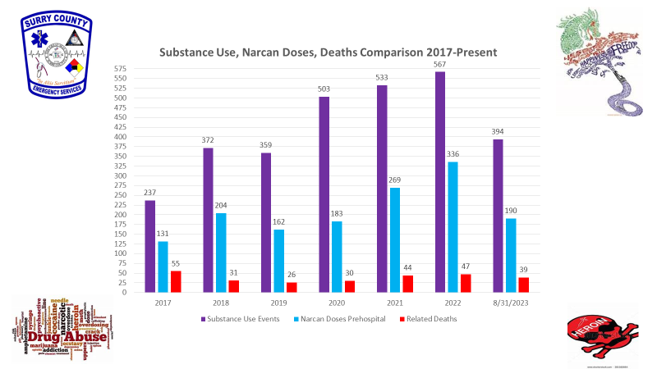
County Stats

Slide 10
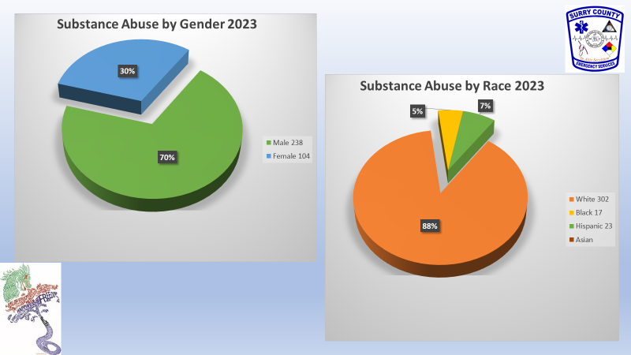
County Stats
County Stats

Slide 11
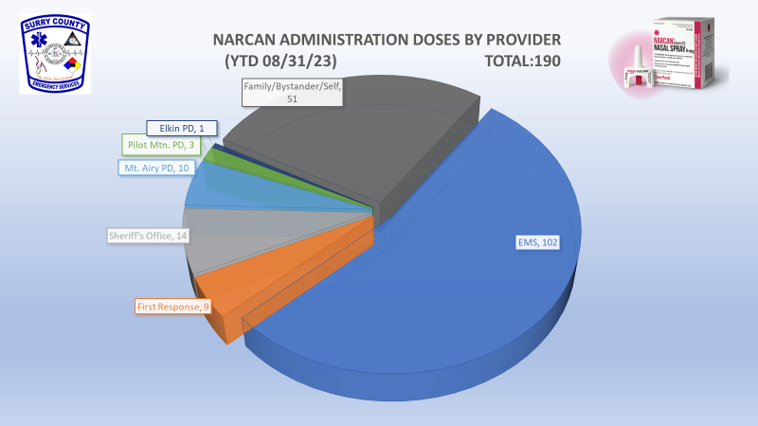
County Stats
County Stats

Slide 12


MIH
MIH/MAT Program
Medication Assisted Treatment (MAT) is available to clients with opioid use disorder (OUD) as a way to bridge the gap between their decision for a cleaner healthier life and long-term resources to help them in their recovery form addictions.
How it Works
MIH Paramedics take referrals from anyone, anywhere, at any time. We contact the client for a follow up. Once the client is evaluated and they meet the criteria for the MAT Program, and they agree to the terms of our program the client is inducted into our program and Suboxone is administered as needed to obtain a therapeutic dosage. We will then meet the client at a location of their choosing for up to the next 6 days to administer Suboxone. During these visits MIH Paramedics will speak with the client to keep them engaged in their recovery process. SCOSAR works during this time to facilitate appointments with a provider for MIH to handoff to as well as Peer Support Services.
Contact Surry County MIH
Bubba Killgo 336-374-8363
Andrew Casstevens 336-401-5931
Surry County Communications 336-374-3000

Slide 13
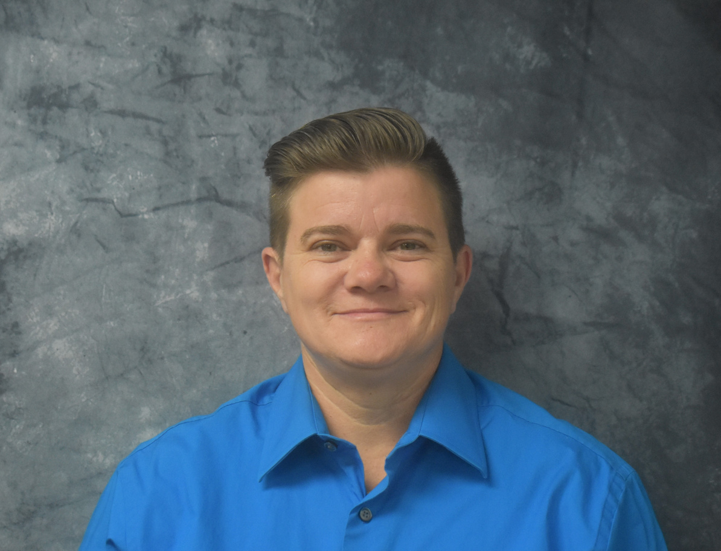
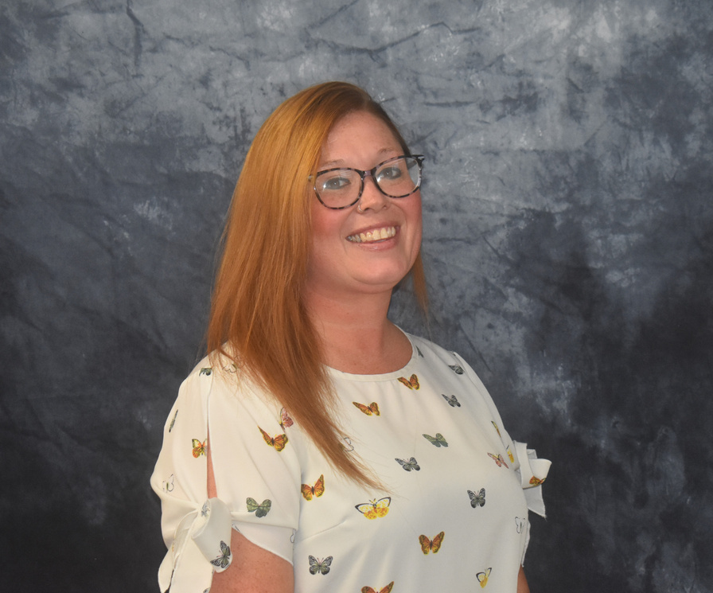
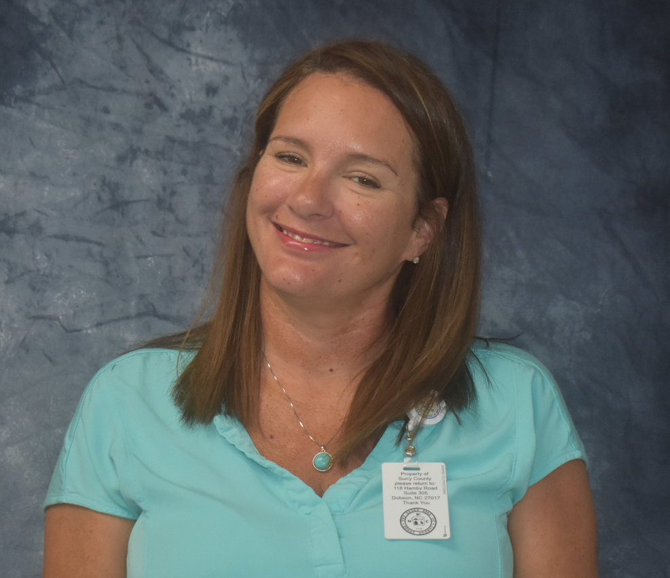
Intervention Team
Referrals
1,261
January 2020 to August 2023
SONYA CHEEK, CPSS
AMANDA STAGER, CPSS
NUMBER OF CLIENTS INDUCTED INTO EMS BRIDGE: FEB - AUG 2023
51
NUMBER OF CLIENTS CONNECTED TO FURTHER TREATMENT
28
HEATHER TAYLOR, CPSS

Slide 14

Total Surry County Intervention Team Referrals by Source July 2022 to August 2023
Probation (30)
5.1%
Shepherds House (15)
2.6%
SCOSAR Transportation Program (35)
6%
EMS (194)
33.2%
Daymark (7)
1.2%
Surry County Detention Center (52)
8.9%
Family (37)
6.3%
SCSO (3)
0.5%
Self Referral (46)
7.9%
NRH (126)
4.4%
HCH (101)
17.3%

Slide 15
Ages
25
20
15
Drug of Choice
Pain Pills/meth (2)
3.9%
Fentanyl (9)
17.6%
10
Meth/Heroin (6)
11.8%
5
0
Meth/fentanyl (3)
5.9%
Heroin (6)
11.8%
18 - 24
25 - 34
35 - 44
45 - 54
55 - 64
65+
Heroin/fentanyl (7)
13.7%
Poly (5)
9.8%
Heroin/suboxone (2)
3.9%
Meth (4)
7.8%
Pain Pills (4)
7.8%

Slide 16
FY 2023 Overdoses (OD) Comparative to Intervention Team Referrals
Overdose
Intervention Referrals
400
300
200
100
0
Ararat
Dobson
Lowgap
Pinnacle
Siloam
Westfield
Elkin
Mount Airy
Pilot Mountain
State Road

Slide 17
Total Surry County Intervention Team Clients and Successful Referrals to SUD Treatment Providers
By Month, January 2021 to August 2023
Total Clients
Successful SUD Treatment Provider Referrals
75
50
25
0
Mar-21
May-21
Jul-21
Nov-21
Jul-22
Jul-23
Jan-21
Feb-21
Apr-21
Jun-21
Aug-21
Sep-21
Oct-21
Dec-21
Jan-22
Feb-22
Mar-22
Apr-22
Jun-22
Aug-22
Sep-22
Oct-22
Nov-22
Dec-22
Jan-23
Feb-23
Mar-23
Apr-23
Jun-23
Aug-23
May-22
May-23
*January 2021 to June 2022 contract with Daymark. County Department started July 2022.

Slide 18

SCHNC
  1 primary provider + 1 PRN provider
  Training: APNA & SAMHSA
  Mentor program through MAHEC
  Accept referrals from SCOSAR or EMS
Contact Information
Wendy Smith, DNP, MSN, APRN, FNP-BC
336-401-8400
smithw@co.surry.nc.us n

Slide 19

  25 patients enrolled since 2/2023
  89 total visits
    13 linked to primary care/mental health provider
    7 currently in program
    7 lost to follow-up

Slide 20
  Peer contacts clinic to facilitate first appointment
HOW IT WORKS
  Pt. seen in clinic and evaluated. UDS completed and Rx written if appropriate
  Rx sent to contract pharmacy who agrees to bill 3rd party for Rx
  F/U appointment scheduled as appropriate but no longer than 1 week
  Pt required to remain in contact with PSS to continue in program.

Slide 21


FUNDING
GRANTS
OPIOID SETTLEMENT

Slide 22
LOCAL PHARMACY
COMMUNITY PARTNERS
LOCAL HOSPITALS
SUBSTANCE ABUSE TREATMENT CENTERS

Slide 23

HOW IT'S GOING
MONTHLY DEBRIEFING MEETINGS
VAST INCREASE IN RESOURCES
STAFF CHANGES: ADDED 4 PT MIH AND 1 FT PSS

Slide 24

LESSONS LEARNED
  Resources
  Open communication between all parties involved
  Follow-up
  Transportation
  Education: client/community
  Timeline to transition

Slide 25




THANK YOU
WWW.SURRYCOUNTYCARES.COM
CHEEKSO@CO.SURRY.NC.US
336-401-8270
DOBSON, NC

Slide 26
Panel: The Collaboration of FQHCs (Community Health Centers) & Syringe Services Programs (SSPs) in Providing Low-barrier MOUD Care
Michelle Mathis
Tim Nolan
Kati Hamm-Pressly
Mark Siler

Slide 27
Panel: Community-Based Harm Reduction for Buprenorphine Access
Mike Thull
Caiden Haarvig
Teresa Hinkle

Slide 28
Q & A

Slide 29
Resource Sharing
Jessica Foster
Kayla Rice
Blake Fagan

Slide 30
Emergency Department OUD Treatment
Buprenorphine Pilot Project & Toolkit Overview
NC OPDAAC Meeting
October 5, 2023

Slide 31

Project Objectives
Support identified hospitals in developing systems and workforce capacity to deliver Emergency Department (ED) based Medication Assisted Treatment (MAT), and to improve community linkages to care through a pilot program co-designed with a small group of hospitals receiving targeted training, education, and coaching support.
Test and refine new tools and strategies to disseminate to other communities.

Slide 32
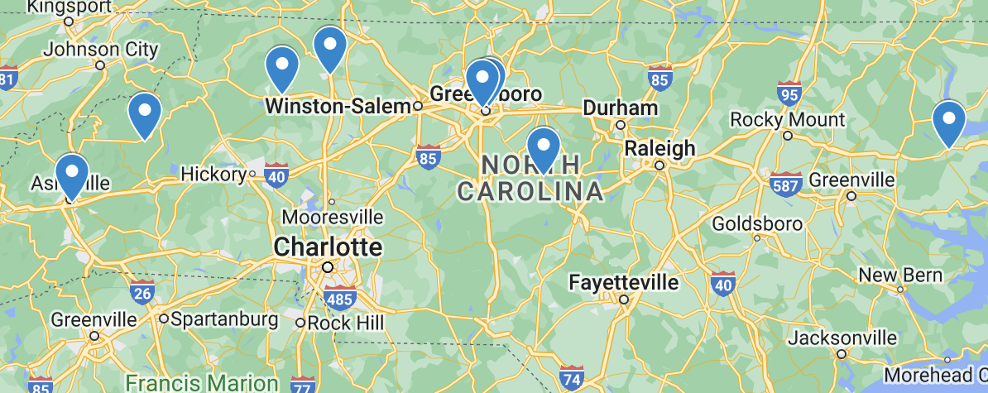

Pilot Participants
Atrium Health Wake Forest Baptist Wilkes Medical Center – Wilkesboro
Blue Ridge Regional Hospital/ Mission Health – Spruce Pine
Cone Health Hospital, Wesley Long ED & Guilford County Behavioral Health Urgent Care – Greensboro
Cone Health, Women and Children's Center OB Triage – Greensboro
Hugh Chatham Memorial Hospital – Elkin
Mission Hospital – Asheville
UNC Chatham Hospital – Siler City
Washington Regional Medical Center – Plymouth
Technical Assistance Partners
Dr. Genevieve Verrastro, Kayla Rice, Teresa Lunsford – Mountain Area Health Education Center (MAHEC)
Dr. Christopher Griggs – Atrium Health

Slide 33
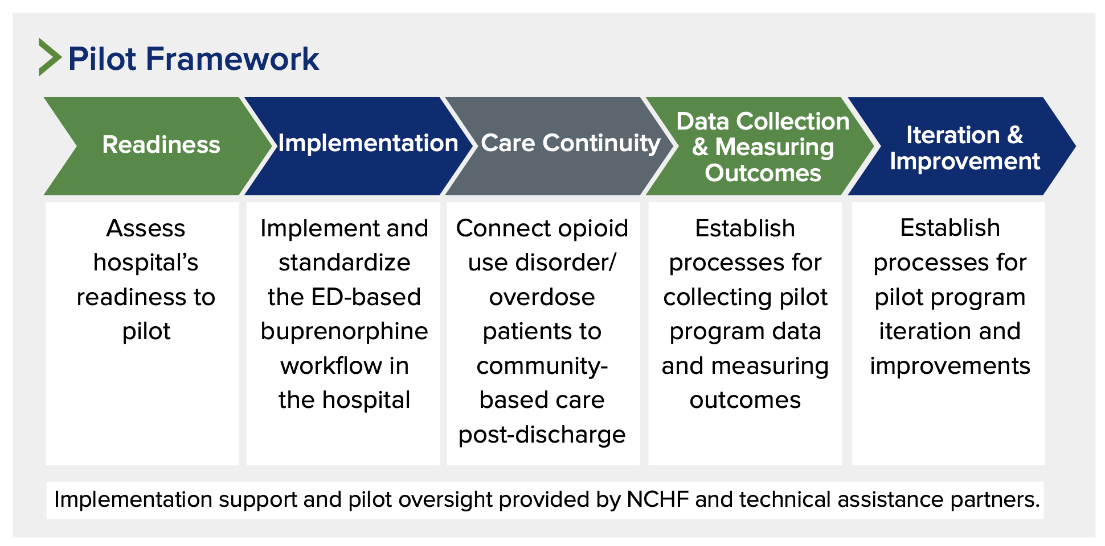

Slide 34
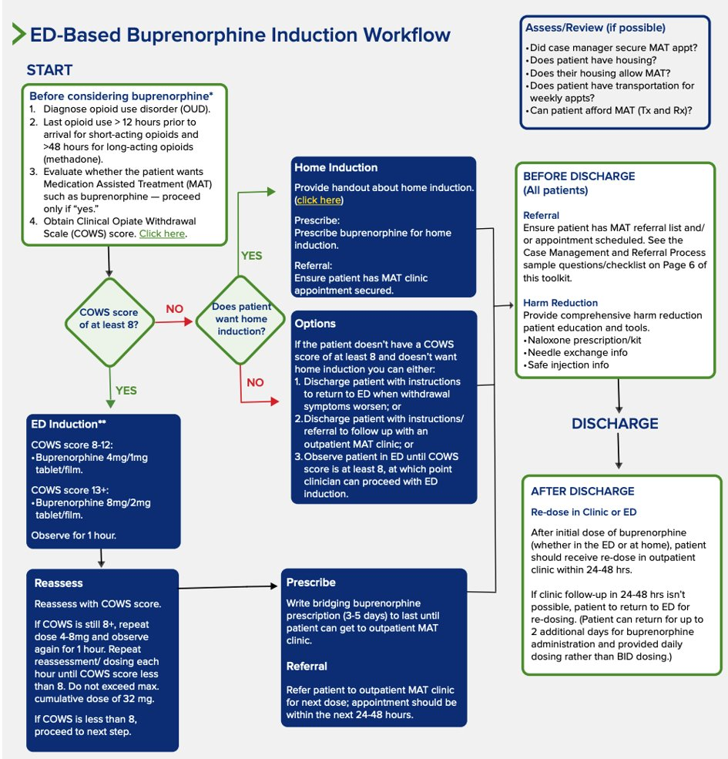
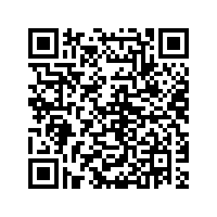
Pilot Toolkit & Workflow
Full implementation toolkit:
www.ncha.org/emergency-department-buprenorphine-pilot-program-a-toolkit-for-north-carolina-hospitals/

Slide 35
Aggregate Outcomes: January – July 2023
Screening: The monthly number of ED patients screened using the Clinical Opiate Withdrawal Scale (COWS) assessment increased from 13 in January to 16 in July. Sites reported a total of 103 patients were assessed during that time.
ED induction of buprenorphine: Total buprenorphine administration in the ED rose from 29 patients in January (all sites reported data) to 40 patients in July (missing data from 1 site).
ED prescribing of buprenorphine: Total prescribing rose from 8 patients in January (missing data from 1 site) to 26 patients in July (missing data from 2 sites).

Slide 36
Success Stories
Hugh Chatham Memorial Hospital
Atrium Health Wake Forest Baptist Wilkes Medical Center
Cone Health Women's and Children's Center

Slide 37
THANK YOU
Jessica Foster, MPH
Senior Program Manager | CaroNova
North Carolina Healthcare Foundation
North Carolina Healthcare Association
Office: 919-677-4135
jfoster@ncha.org

Slide 38

Buncombe Bridge to Care (BB2C):
Post-Overdose Buprenorphine Field Initiation Program
Buncombe County, NC

Slide 39
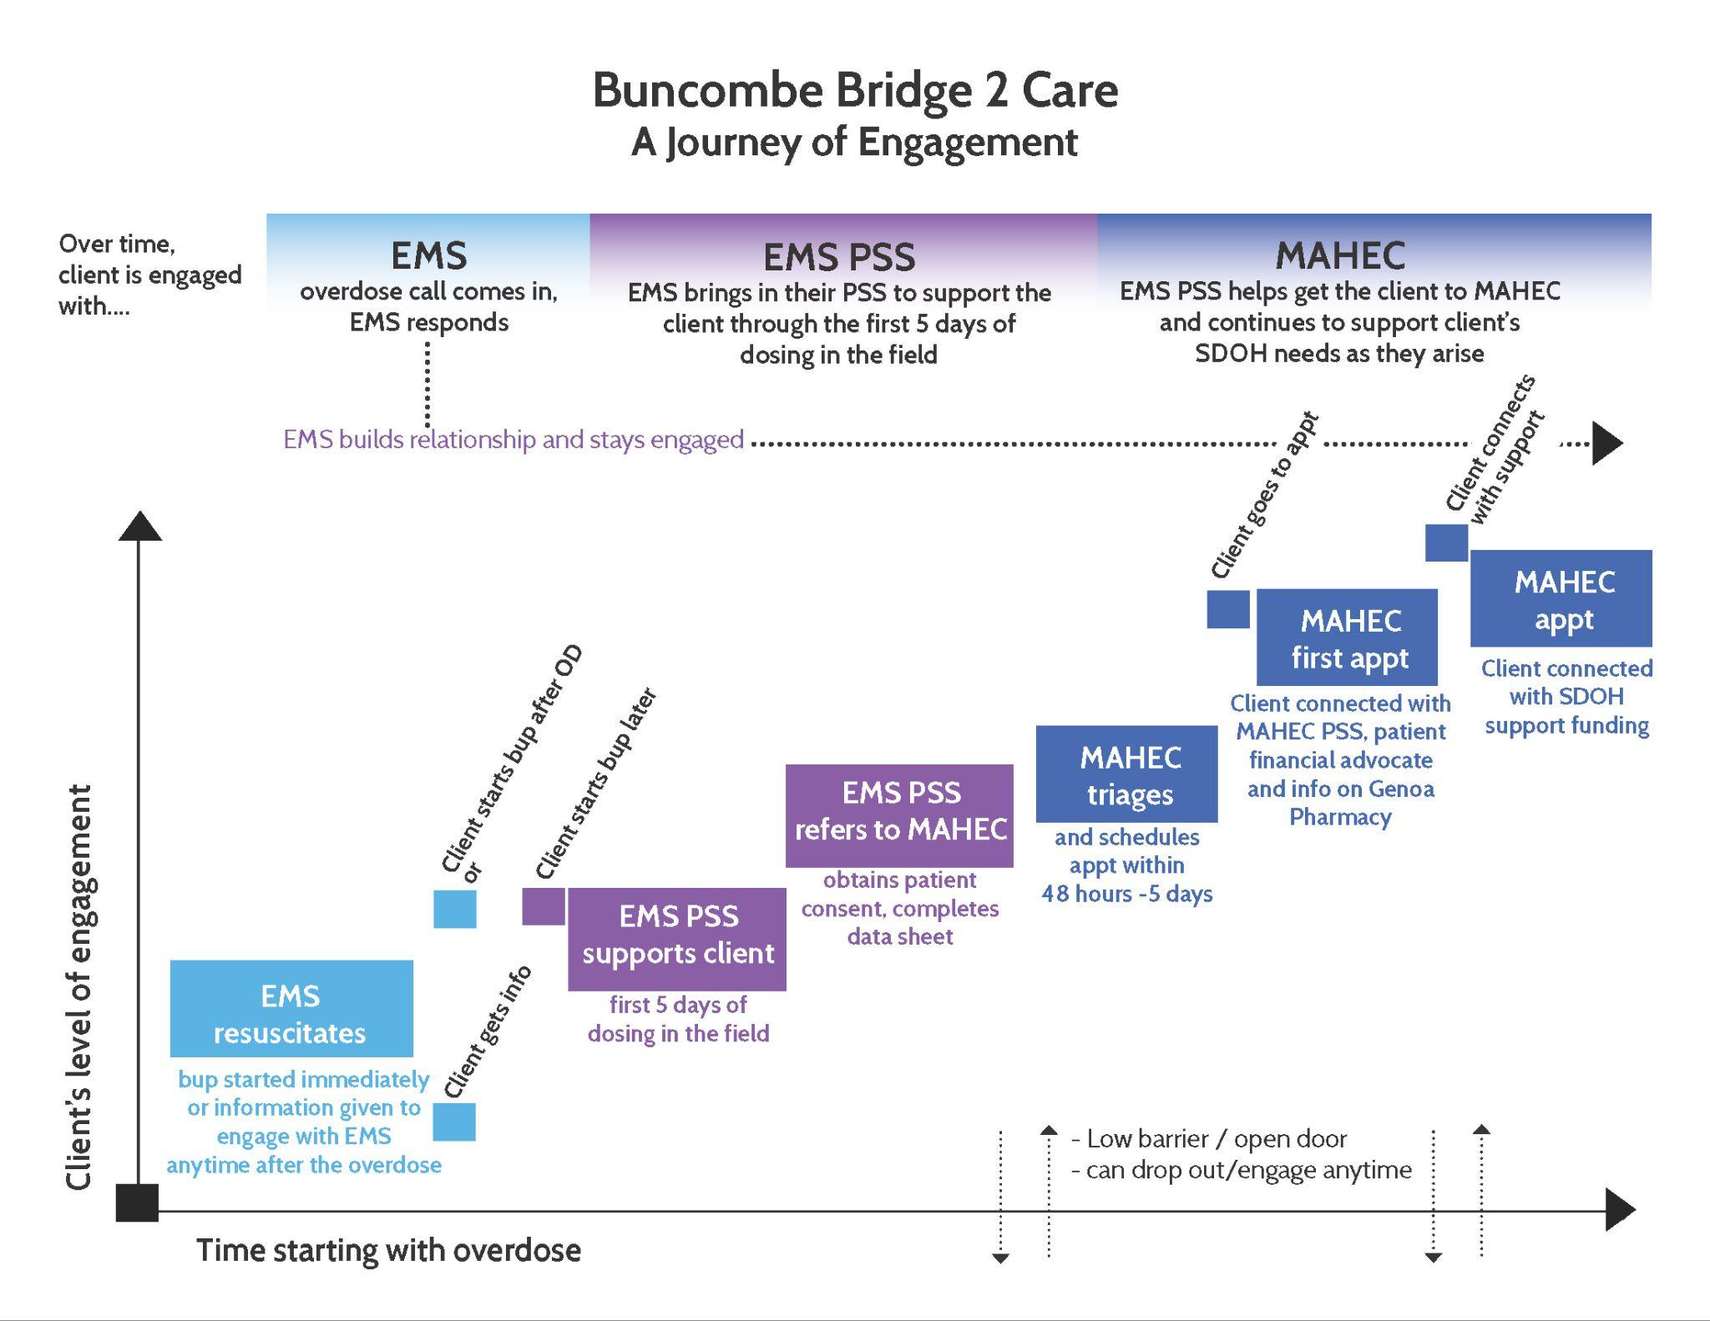
Notes:
Report from a Community Paramedic shift 10 days before we launched our Bridge to Care MAT Program: “ROI was obtained after an overdose and participant was recently discharged from jail with some suboxone, has a history of methadone experience, and was really engaged in conversation about meeting tomorrow to be connected with MAT resources and meet peer support. However, he used again at the Waffle House on Tunnel and went into cardiac arrest as a result of the second OD. I was first on scene, worked the arrest, 13 helped and transported, we got ROSC at the hospital and he is on a ventilator, but will likely never wake up. Talking with him about what we were going to be able to do in a few weeks with inducting people onto buprenorphine he even said, "That would be amazing if you had it now I would like to start now." A sad outcome since he did not make it.”
PORT connected with folks in the community
There was a missing component of linking people to care
Connecting with MAHEC for Office Based Opioid Treatment (OBOT)

Slide 40
Community Paramedic Team
From April 2022 – June 2023:
MAHEC
Scheduled 119 Patients for first visit
87% landed in Clinic
Resources
Toolkit
GI Addiction Medicine Essentails Fall Conference Presentation on October 14
Manuscript with first year results on engagement pending
Referred 125 Community Members to MAHEC through pilot
(Shuchin Shukla, MD, MPH, Claire Hubbard, RN, BCEMS, and Lauire Sykes, CPSS, CHW, CADC-P MAHEC)
Shukla, S, Belden, C, Coules, C, Friesen, T, Kopak, A

Slide 41
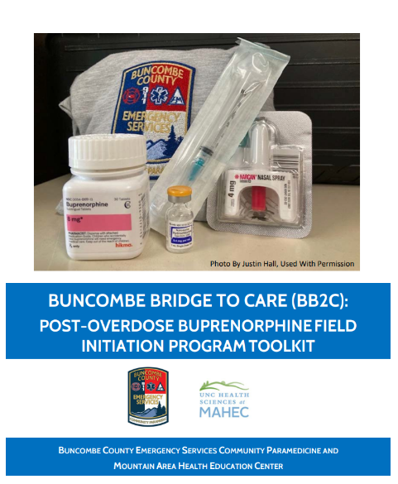
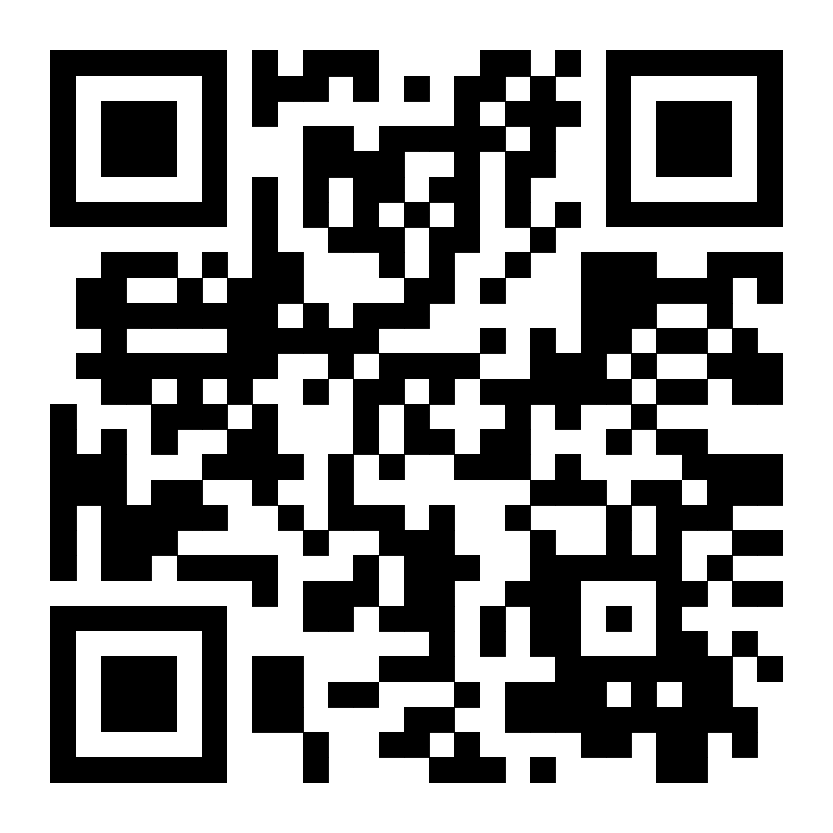
Authors: Shukla, Shuchin, MD, MPH; Rice, Kayla, BA; Friesen, Tess, MPH; Coules, Courtney, MPH; Hall, Justin, NCCPSS, EMT-B, CADC-R; Hubbard, Claire, RN

Slide 42
For questions, please contact:
Tess Friesen, Project Manager, MAHEC
Tess.friesen@mahec.net

Slide 43
Wrap up and THANK YOU!
Kellie Crosbie, Division of Mental Health, Developmental Disabilities, and Substance Use Services
  The meeting recording, agenda and PowerPoint slides will be added to our NC DHHS Overdose/OPDAAC page within 7 days
  https://www.ncdhhs.gov/about/department-initiatives/overdose-epidemic/nc-opioid-and-prescription-drug-abuse-advisory-committee
    Next OPDAAC Meetings:
    December 7, 2023 (hybrid)

