Slide 1
Session 2: Medicaid Application Procedures & the Report Card
DHHS Operational Support Team
August 2017
1

Slide 2
Medicaid Applications and Reports
ABD 2304
Family 3215

Slide 3
Medicaid Application Dates
How Received & Application Date
In Person = date person appears in local agency, application is signed.
Mail or Fax = date the complete application is received in the local agency.
Telephone = date of the telephone interview.
ePASS = date application is submitted in ePASS. When submitted after 5pm or on a weekend/holiday the application date is the next work day.
FFM = date application submitted to FFM.
LIS = date of application submitted to SSA.

Slide 4
Processing Applications
Disposition date is the date the notice is sent.
All MAD applications must be processed within 90 days
All “Other” applications (Family MA, MQB, MAA, MAB) must be processed within 45 days
Applications reopened due to appeal reversal must be processed within 5 work days of receipt of last piece of information
When processing on the 45th or 90th day – the caseworker must override the Central Print notice or the disposition date will change to the next workday. You must follow the procedures in FAST Help “Manually Override a Notice Sent for Central Print”

Slide 5
Processing Applications
When the 45th/90th day falls on a weekend/holiday, the due date is adjusted to the next workday. If the application is processed and the notice is sent on the adjusted due date, the application is timely. If the application is not dispositioned and/or the notice is not sent on this adjusted date, all calendar days until the notice is sent count in the processing time.
Exception to 45/90 day time: Applications pending for DDS decision or deductible may pend for up to six months. If any other info is missing, deny on the 45/90th day as long as requirements are met for requesting the information.

Slide 6
Excluding Processing Time
Under certain circumstances, days may be excluded from the application processing time when one of the following is needed:
  Medical bills to meet a deductible (hold up to six months)
  DDS decision (hold up to six months)
  Medical records needed to determine emergency dates
  Receipt of the FL-2/MR-2
  Receipt of CAP Plan of Care
  Client requests additional time
  NCHC Fee

Slide 7
Excluding Processing Time
Reminders
Only exclude time if you have everything else needed
Can exclude time for more than one reason ONLY for:
      DDS
      Deductible

Slide 8
Excluding Processing Time (Cont.)
Use the 5098 in NC FAST
IMPORTANT* The 5098/5099 is a combined form in NC FAST. This form is dynamic to populate and automatically triggers the exclusion for deductible and NCHC only. For all other exclusions you must manually exclude the time.
Medical Bills: The DMA-5098 cannot be the first request for medical bills, even if no other information is needed. Exclusion of time begins with the date the DMA-5098 is sent/given.
Other Reasons: The DMA-5098 does not serve as a request for info for any reason other than medical bills. You must send the DMA-5097 or other appropriate form for the initial, second or follow-up request. The DMA-5098 may be sent when no other information is needed.

Slide 9
Excluding Processing Time (Cont.)
  If a change in situation occurs that affects eligibility after the exclusion of days begins, request the new or additional information following procedures in MA-2303 and MA 3210, Verification Requirements For Applications. The exclusion of time can continue.
  When you are entering an application that is a ‘spinoff’ from a FFM application in P2/6 and P7, you will manually enter the FFM exclusion.

Slide 10

Remember:
The begin date of your exclusion of time and the date on the DMA-5098 must match.
The end date is always the date the information is received in the local agency. For DDS cases this is the release date on the DDS screen.
For non-qualified alien emergency dates, the exclusion of days ends on the date the medical records are received. Days cannot be excluded while waiting for DMA to determine emergency dates.
The begin and end date count in your processing time. Only the time in between is excluded.

Slide 11

O&M Reports for Report Card

Slide 12
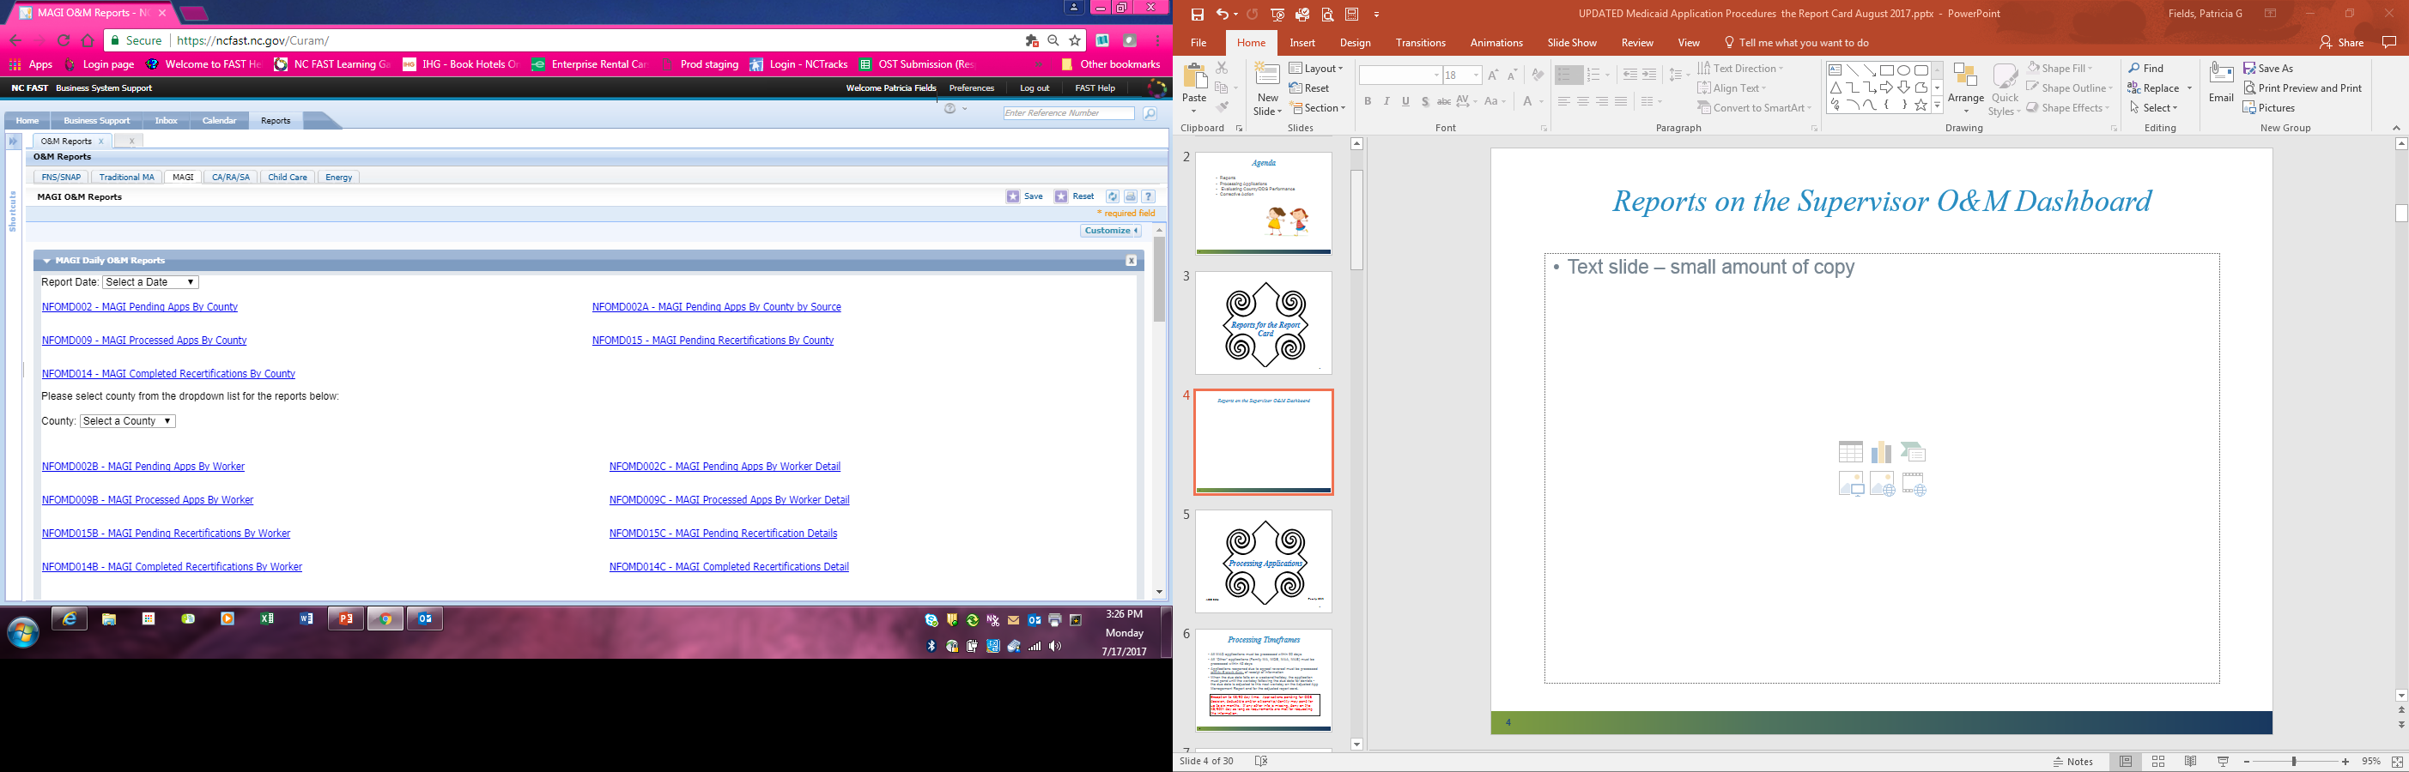
O&M Reports
MAGI Tab

Slide 13
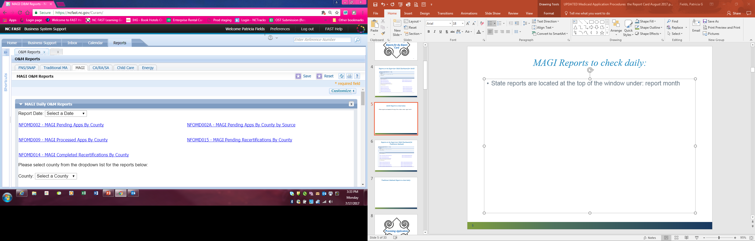
MAGI Reports to check daily:
State reports are located in the top section of the window :
Report Date (select a date)

Slide 14
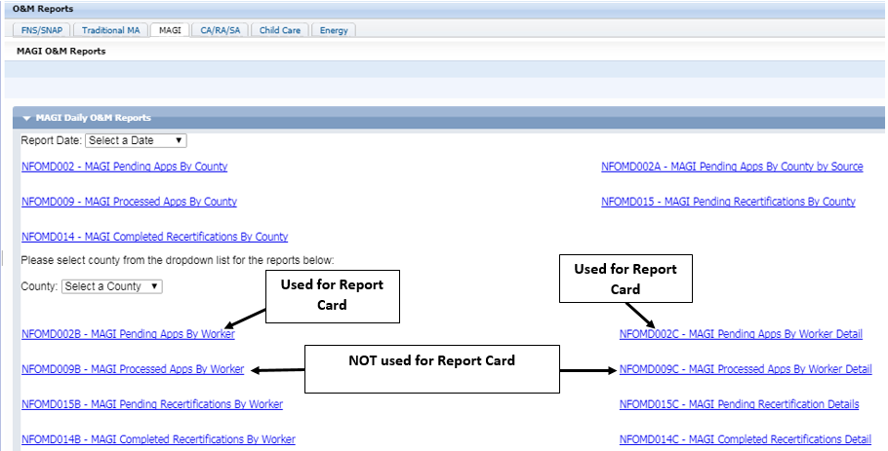
MAGI Reports to check daily:
County Specific reports are located in the bottom section of the window: County: (select a County)

Slide 15
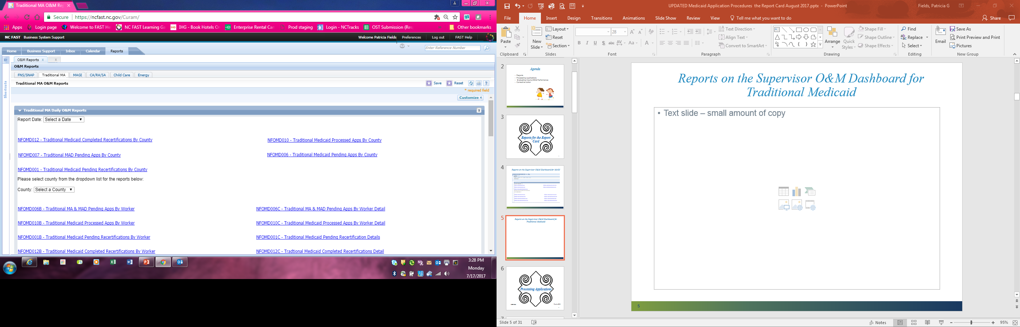
O&M Reports
Traditional MA Tab

Slide 16
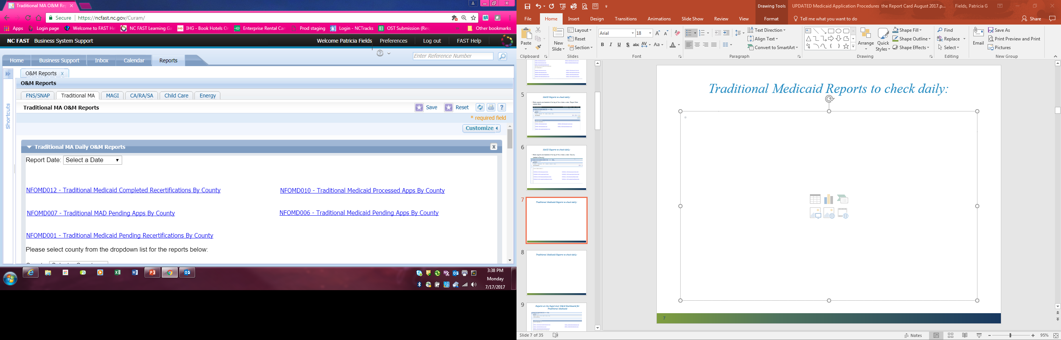
Traditional Medicaid Reports to check daily:
State reports are located in the top section of the window: Report Date (select a date)

Slide 17
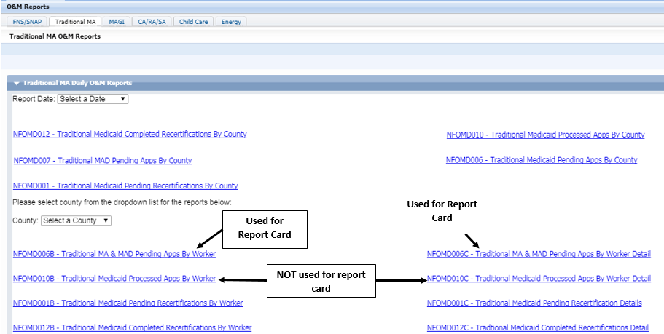
Traditional Medicaid Reports to check daily:
County Specific reports are located in the bottom section of the window: County: (select a County)

Slide 18
Example: MAGI Pending Apps By Worker Detail

Slide 19
Example: Traditional Medicaid Pending Apps By Worker Detail

Slide 20
The O&M Reports
The O&M Reports can be exported to Excel then sorted and saved as needed.
You can quickly:
Sort by worker
Identify past due applications
View days pended
View Application date and due date
View administrative applications
View excluded time and reasons

Slide 21
Why Should I Check these Reports If I’m Not Failing the Report Card?
Look for worker trends (i.e. holding application until due date)
Encourage timely dispositions
Monitor timely keying of applications
Check for proper application of exclusion of time

Slide 22
Report Card Reminders
Original due date = 45th or 90th day from Application date.
Days Pended = This reflects the days counting toward the processing time.
There is an automatic timer that adjusts the days pended when there are stop processing days due to FFM or LIS and when other exclusions are keyed.
When days are excluded – the ‘Original Due Date’ does not change….only the days pending fluctuate… it is important to pay attention to the “Days Pended” on the Pending Apps reports

Slide 23

Pending App Report
MAD indicator on the pending app report is populated with “Y” when the individual meets one of the below criteria in addition to being under age 65 at time of application date:
Benefit evidence in (Social Security Disability, Social Security Disability/Child, Social Security Disabled Widow(er)
Disability Evidence present
DDS Assessment entered
DDS Determination is entered

Slide 24
Report Card & Report Card Reports
ABD 2305
Family 3217

Slide 25
Report Card – Quick Facts
Location: Report Card Location: (NC FAST) Go to the ‘Reports’ tab > shortcuts > ‘MA/SA’ tab > County Case Profile > ‘Report Card’
County Level determines PPT needed to pass report card
DDS must render decision with an APT of 70 days. Information should be sent to DDS no later than 20 days
Two categories: MAD and Other

Slide 26

Report Card - Quick Facts
Level I counties must meet 85% PPT in each category
Level II and III counties must meet 90% PPT in each category
All counties must meet APT of 45/90 days in each category
County must meet both APT and PPT in each category to pass report card
  If 1 part failed – the county fails for the month

Slide 27
Calculations APT/PPT
Time standards are: MAGI Applications (45 days), Traditional Applications (45 & 90 days)
Average Processing Time (APT) is a measurement of the average number of days taken to disposition all applicants included on the report card.
  Add all the processing days and divide by the number of included applicants processed during the month.
Percent Processed Timely (PPT) is the percentage of applicants included on the report card dispositioned timely.
  The total number of apps processed timely divided by the total number of included applications processed = PPT

Slide 28
Calculation of Days
All applications counted in the Report Card are listed on the ‘Included Adjusted Report ‘
Days begin counting the calendar day after the date of application.
When the 45th/90th day falls on a weekend/holiday, the due date is adjusted to the next workday. If the application is processed and notice sent on the adjusted due date, the application is timely. If the application is not dispositioned and/or the notice is not sent on this adjusted date, all calendar days until the notice is sent count in the processing time. This situation requires a manual notice – the caseworker must override the Central Print notice or the disposition date will change to the next workday. You must follow the procedures in FAST Help “Manually Override a Notice Sent for Central Print”

Slide 29

Example: Report Card Calculation - LIS Application
LIS Application dated 01/03/2017 denied 04/20/2017
Application date (1/3/17) not included in calculation, time in between application date and stop date (1/20/17) is excluded - 16 days. Stop date (1/20/17) is counted as well as the date of disposition (4/20/17) this = 91 days
*The begin date and end date count in your processing time. Only the time in between is excluded.

Slide 30

Example: 45th Day Falls on Weekend
Example:
In this example, if the application is not processed until Tuesday, or if the notice is not sent until Tuesday; the 48 days will count in processing time.
*You must follow the procedures in FAST Help “Manually Override a Notice Sent for Central Print”

Slide 31
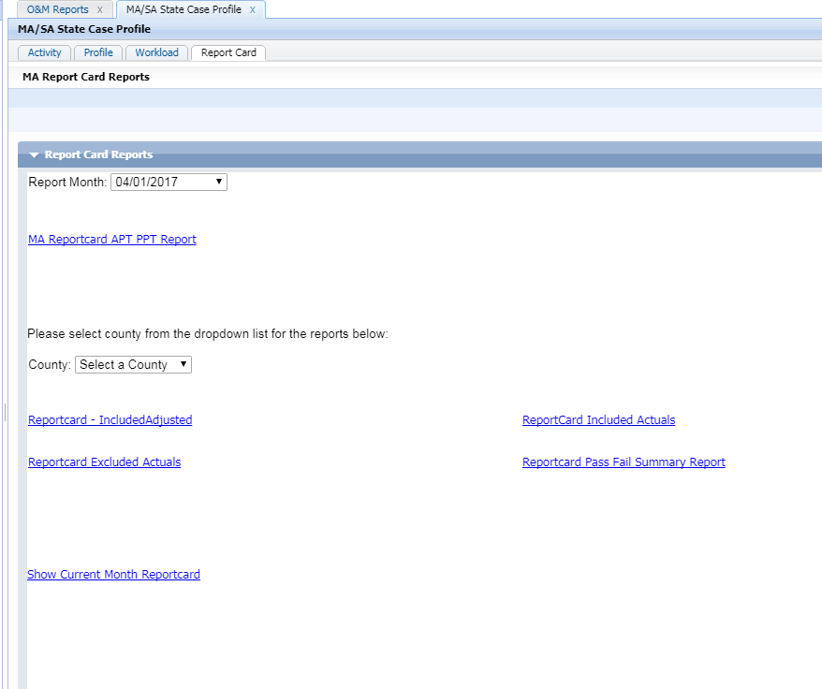
Report Card Reports

Slide 32
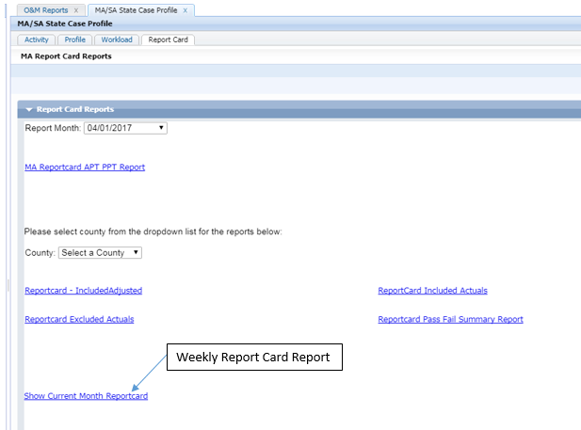
Report Card Reports
Weekly Report

Slide 33
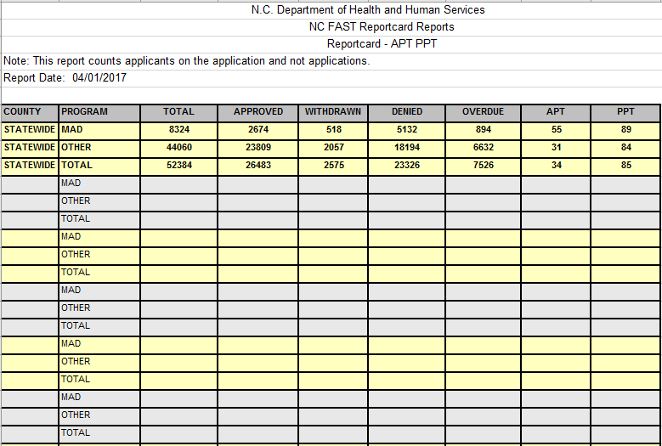
Report Card – APT PPT
State

Slide 34
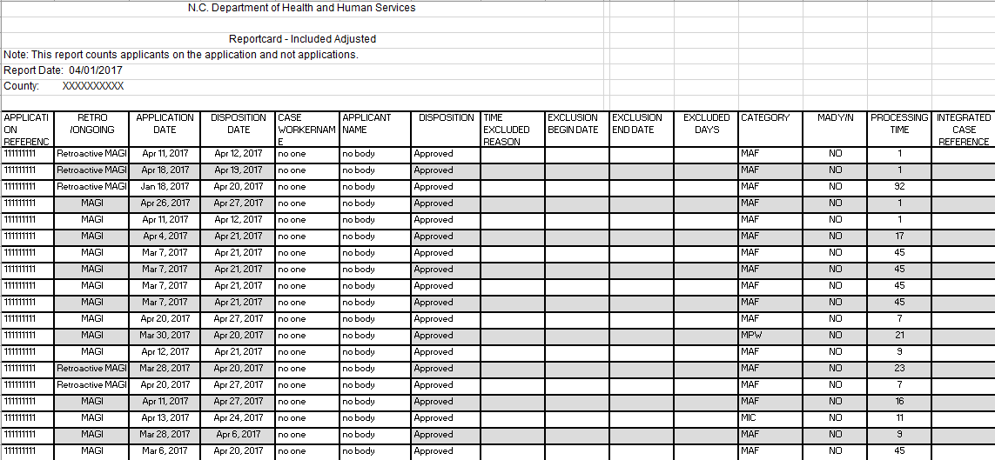
Reportcard – Included Adjusted

Slide 35
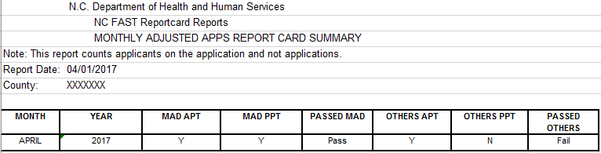
Reportcard Pass Fail Summary Report

Slide 36
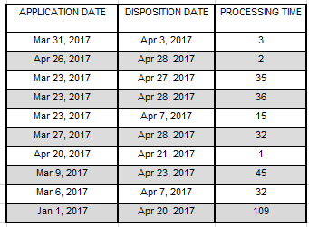
Example of Calculating your APT
Total days: 310 divide by 10 = 31 average processing time (days)
Average Processing Time (Days) – APT is a measurement of the average number of days taken to disposition all applications included on the report card.

Slide 37
Example of calculating PPT
9 divided by 10= .9 or 90%
Percent Processed Timely (PPT)-PPT is the percentage of applications dispositioned timely.

Slide 38
Compliance
ABD 2306
Family 3225

Slide 39
Local Agencies Must Take Corrective Action
When:
  fail to meet compliance thresholds for the report card
  cited for improper/incorrect actions by the monitors.
The local agency must:
  analyze the reasons for the non-compliance
  develop and implement any necessary corrective action
  maintain documentation of these efforts for review by the OST or other state staff.
The director should ensure that all Income Maintenance personnel, including receptionists, are trained and familiar with application processing requirements.

Slide 40
Report Card Failures
Non-compliance occurs when a local agency fails to meet the thresholds for Average Processing Time (APT) or Percent of Cases Processed Timely (PPT) for one month.
Report card performance may impact the local agency in two different ways:
  May require annual monitoring
  May require further corrective action

Slide 41
Report Card Failures (Cont.)
Documentation of Report Card Analysis (MA-2306.II/MA-3225.II)
Complete the DMA-5169
Use the DMA-5167 to assist in analysis of non-compliance and development of corrective action.
After completing the analysis, document findings, prepare a corrective action plan if necessary, and document when actions are taken.

Slide 42
Report Card Failures (Cont.)
Documentation of Report Card Analysis (MA-2306.II/MA-3225.II)
After completing the analysis, the local agency must document findings, prepare a corrective action plan if necessary, and document when actions are taken. Complete the DMA-5169, Report Card Analysis.
Keep this information in a central file or notebook so OST can review it. This will also assist the local agency with any future concerns or disputes about corrective action taken or needed.
OST will review the local agency findings and assist in addressing any problem issues and in developing a corrective action plan.
DMA will review the corrective action plan and documentation of action taken to assure that the plan is adequate to address the problems identified. The local agency retains full responsibility for development, implementation, and tracking of the corrective action plan.

Slide 43
Waiver Request for Failing the Report Card
Waiver Criteria and Procedures (MA-2306.III/MA-3225.III)
The waiver must be requested in writing by the 15th of the month in which the report card is issued.
  Submit to Sonja McLeod, DMA Eligibility Unit, 2501 Mail Service Center, Raleigh, NC 27699-5601; fax# 919-813-5580.
The local agency must prepare a cover letter outlining the reasons that applications went beyond the time standard that resulted in failure of the report card.
Accompanying this letter should be a copy of the report card, a copy of the Applications Included report and supporting documentation from case records that shows the steps the local agency took to process applications timely.

Slide 44
Waiver Request for Failing the Report Card (Cont.)
The request must also include a recalculation of the percentage of applications processed timely that shows the local agency would not have failed if these applications were excused.
The local agency may not request a waiver of a report card failure, which was caused by reopening improper or incorrect actions.
  The caseworker was on vacation and did not deny the application on the 45th date. They denied it after they got back from vacation.
Acceptable reasons for delay are factors beyond local agency control.
  The caseworker could not process the application due to system functionality.
Notes:
Submit request to:

Slide 45
Report Card Calculation of Days
All applications that are counted in the Report Card are listed on the ‘Included Adjusted Report.”
Days begin counting the calendar day after the date of application.
  The original due date is the 45th or 90th day from the date of application.
    When the 45th/90th day falls on a weekend/holiday, the due date is adjusted to the next workday. If the application is processed and the notice is sent on the adjusted due date, the application is timely. If the application is not dispositioned and/or the notice is not sent on this adjusted due date, all calendar days until the notice is sent is counted in the processing time.
Exclusion of time in calculation.
  The begin date and end date count in your processing time. Only the time in between is excluded.

Slide 46
Coming Soon!
NC FAST Help desk ticket procedures for Applications………

Slide 47

      THE
      END

