Slide 1
Session 3: Right to Apply, Medicaid Inquires and Monitoring Presented by: DHHS Operational Support Team August 2017

Slide 2
Objectives
Right To Apply
What is a Medicaid Inquiry
When an Inquiry is completed
How an Inquiry is completed
How to complete an Inquiry in NC FAST

Slide 3
Objectives
Why do we have Application Monitoring
What is Application Monitoring
County’s responsibility when receiving Monitoring Letter
County’s responsibility when receiving Results letter
Most common errors found during Monitoring

Slide 4
Right to Apply
An individual must be afforded the opportunity to apply for all Medicaid programs through the local agency or through the Federal Marketplace (FFM)
Local agencies must evaluate for all programs

Slide 5
Right to Apply, Cont’d.
Complete the DMA-5094/DMA-5094S, Notice of Right to Apply for Benefits:
Explain
The right to apply on the day they are in the office
If they decide not to apply they may apply again at anytime
The right to appeal if they believe the local county agency discouraged them from applying
The individual should sign the DMA 5094 and be given a copy
If applicant doesn't sign the 5094, document why
Scan a copy into NC FAST or keep copy in agency file

Slide 6
When to complete a Medicaid Inquiry
After a discussion with the caseworker regarding their situation and options, the individual may decide not to continue with the application process
The worker will complete an inquiry if the individual decides at any time prior to signing the application that he does not want to apply for assistance

Slide 7
What to Explain
All available Medicaid programs
Income and resource requirements
Retro and ongoing Medicaid
Transfer of resources
Deductible
Disability Determination for Medical Assistance to the Disabled (MAD) applicants

Slide 8
What to Explain, Cont’d
LTC/CAP/PACE Services
Choice of Programs
Certification Periods
Pre-Need applications
Medicaid identification card
Estate Recovery
Advance payment tax credit and cost sharing

Slide 9
What is a Medicaid Inquiry?
If during the face-to-face interview, the applicant decides at any time prior to signing the application that they do not want to apply for assistance, complete:
DMA-5094/DMA-5094S, Notice of Right to Apply for Benefits form
DMA-5095/DMA-5095S, Medicaid/Work First Notice of Inquiry form
An INQUIRY is:
providing information and discussing options regarding Medicaid eligibility, the process, or other services

Slide 10
How To Complete an Inquiry
The DMA-5095/DMA-5095S, Medicaid/Work First Notice of Inquiry form in NC FAST, must include:
The date
Name or the representative’s name, address, and telephone number
Include all facts relevant to the individual’s situation
Individual has no old, unpaid, or anticipated medical bills to meet a deductible
Individual declines the opportunity to reduce countable resources,
Accurate calculation of reported income, resources, and deductible amount if applicable
Include programs that were discussed
The individual does not meet the eligibility requirements for all Medicaid programs and declines referral to FFM or
The individual wants only to purchase insurance full price
at the FFM

Slide 11
How to Complete an Inquiry, Cont’d
The individual must:
Document why they decided not to apply
Sign the DMA-5095/DMA-5095S
If the individual refuses to give a reason for not continuing and/or refuses to sign the inquiry, document the refusal
Give the original to the individual
Keep a copy for the agency record
Document the conversation well in NC FAST
Edit outcome on the reception log to show “Inquiry”

Slide 12
Best Practice Alert
The caseworker should review what the client wrote on the inquiry to ensure they understood all programs explained

Slide 13
Example # 1
Client is a 62 year old male
Receives RSDI of $1,500.00
Receives Medicare
Has an ER bill for $2,000.00 from this month
He does not have any minor children and he is divorced
Retro and ongoing MAD deductibles explained
Client states no old unpaid or anticipated medical bills.
Client chose to wait until next month and apply for retro only.
What should you do?

Slide 14
Example # 2
Client is a 43 year old female who states she was curious and wanted to know what health insurance programs the Local Agency offered.
She states she is not disabled, has no minor children in the household, does not receive Medicare and is not interested in applying for ANY programs today.
Worker encouraged her to apply so her eligibility could be determined and she could possibly receive health insurance either through the Local Agency or the FFM.
The client adamantly refused and wanted to apply when she decided she was ready.
What should you do?

Slide 15
Example # 3
Client is a 24 year old female
Not pregnant
She states she is not disabled
No minor children in the household
Does not receive Medicare
What should you do?

Slide 16
Example #3 Cont’d
Explain to client that she is potentially eligible for FPP
If client chooses not to apply, you would complete an inquiry
Make sure you discuss all programs

Slide 17
Inquiries in NC FAST

Slide 18
NC FAST-Completing the DMA-5095
The DMA-5095/DMA-5095S is available in NC FAST
There is a resource to help you complete an inquiry in NC FAST:
Record a Notice of Inquiry (DMA-5095) Job Aid
Person page > Client Contact tab > Communications folder > Page Actions Menu > New Pro Forma

Slide 19
NC FAST-Completing the DMA-5095
To complete an inquiry in NC FAST:
If you you have already started the Guided Interview:
You may choose the option “Quitting Application Without Saving”
Complete the inquiry from the Person page

Slide 20
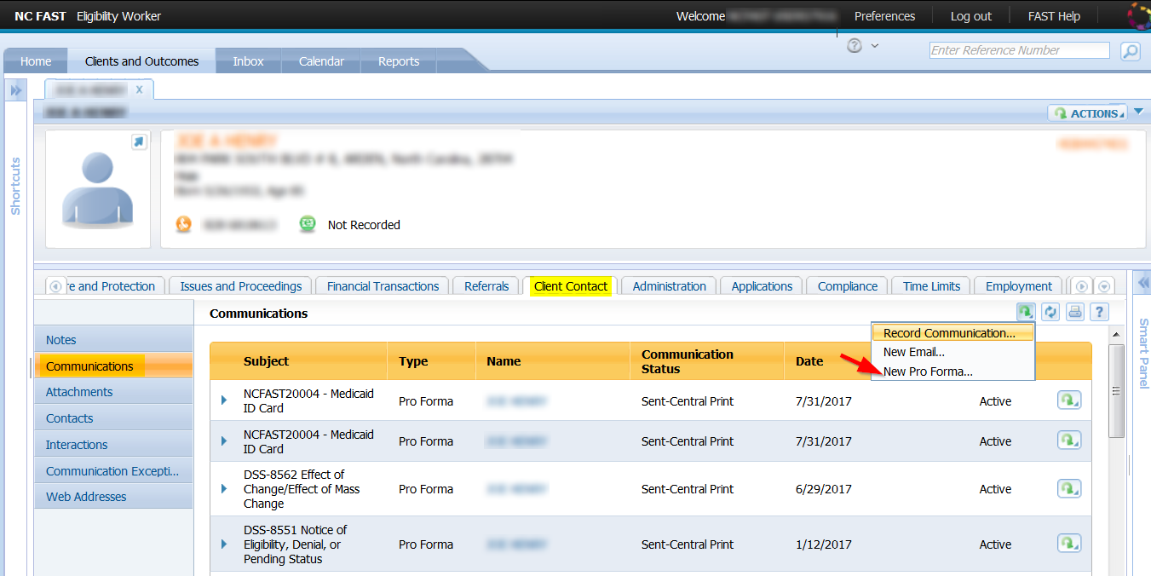
NC FAST Person Page Inquiry Process

Slide 21
Best Practice Alert (BPA)
Any time prior to the application being submitted the caseworker can close the Guided Interview and go to Person page > client contact tab > communications folder > page action menu > new pro forma and select DMA-5095.

Slide 22
Questions?
ost.policy.questions@dhhs.nc.gov

Slide 23
Why do we have Application Monitoring?
In 1974 a court action was filed against North Carolina
In 1983 the court order Alex v Hill was issued
On February 5, 2002, a judge dismissed the court order, however there was a plan to ensure that applications are processed correctly and that plan is referred to as the “exit plan.”
The exit plan details provisions the counties must follow on applications and the State is tasked with monitoring counties to ensure they meet the requirements
Application Monitoring is a result of the exit plan

Slide 24
What is Application Monitoring
Review of applications processed by counties to ensure requirements of Exit Plan and application policy are followed
Each county should be monitored every other year; if they fail to meet certain requirements, they can be monitored yearly
The monitors pull reports and send the county a letter listing the cases, application logs and inquires that they need to review
The monitors review the cases, cite any errors found, compile a report and send a letter back to the county with the results

Slide 25
Current Areas under Review
Cases to make sure that local agencies followed all policy in the application section of the manual
Looking to ensure local agencies did not discourage the applicant
Looking to ensure proper notices were sent
Looking to ensure local agencies evaluated for all programs and evaluated for the greater benefit
Evaluating if stop processing timers and timers applied correctly
Approvals, denials, withdrawals, and inquiries are reviewed

Slide 26
County Responsibilities When Being Monitored
Local Agencies receive a letter requesting cases, inquiries and logs
If all information is in NC FAST, agency should notify the monitors that this information is in NC FAST
If the local agency does not have this information in NC FAST, it must be sent to DMA

Slide 27
Monitoring
Monitoring thresholds are 80% for each category of denials, withdrawals, inquiries and discouragement
Failure to meet thresholds could result in annual monitoring
Failing the Adjusted Application Report Card threshold for one or two months in any Medicaid category may result in annual monitoring
Failing the report card three or more times in a year could result in annual monitoring regardless of the reason for delay, or whether waivers are approved

Slide 28
County Responsibility Upon Receipt of Results Letter
Letter contains results – whether thresholds were met
The cases cited for improper/discouragement that need to be reopened
will need to be documented on the DMA 5168
The Results letter may request a corrective action plan. If so, you will need to develop a plan (similar to QA corrective action plans) and submit it to your OST Representative within 30 days. Include the DMA 5168 with the corrective action plan
Notes:
The letter will cites cases called in error and notate if you need to reopen them
If you disagree with any of the decisions, you will need to rebut the errors within 10 days. You must provide all documentation to your request to the Supervisor..

Slide 29
Common Errors Found By the Monitors
Not evaluating for FPP, especially on MAD - DDS applications
Requesting unnecessary information
Requesting client apply for UIB or RSDI prior to approval
Requesting bank information prior to running AVS
Requesting income prior to running electronic matches
Missing documentation
Timers applied to an application without sending a 5098
Requiring an interview

Slide 30
Questions?
ost.policy.questions@dhhs.nc.gov

