Slide 1
Understanding the Permanency Performance Profile
Rita Bland, Child Welfare Consultant
John Ragosta, Child Welfare Data Team Manager
NCDSS Performance Management
Kiesha Crawford, Manager,
Juvenile Court Improvement Program
March 22, 2019
Notes:
Hello my name is John Ragosta. I have been asked to help everyone in this room to better understand the Permanency Performance Profile, it’s purpose, the data points contained within it, and how to use going forward.

Slide 2
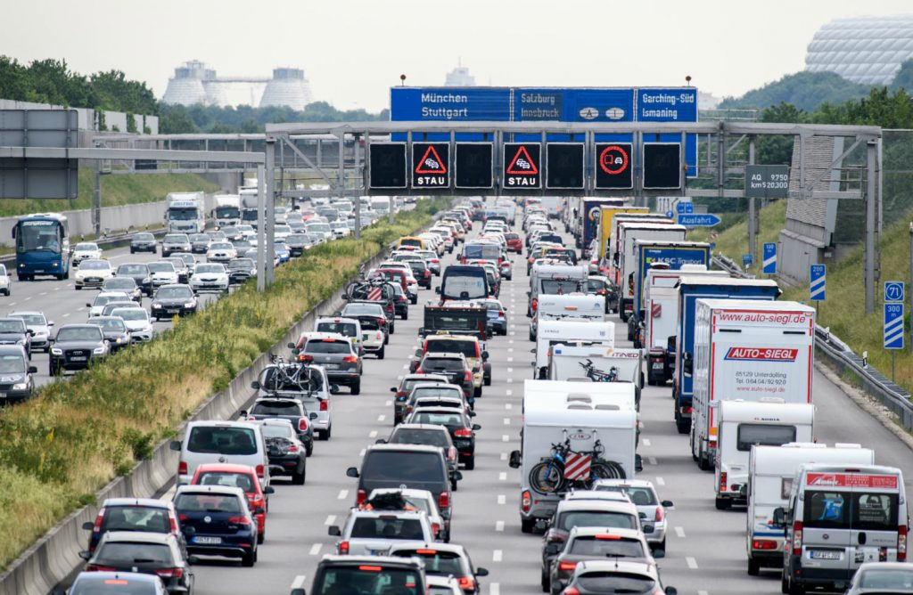
This Photo by Unknown Author is licensed under CC BY-NC
Notes:
Your morning? Outcome was to get to this meeting place safely and on time

Slide 3
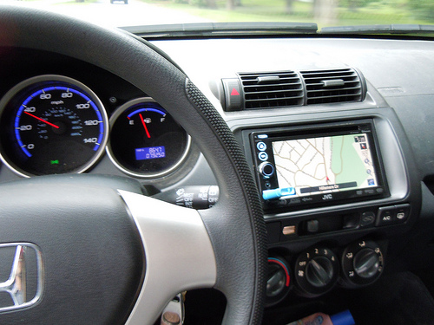
Using Data Everyday…
Notes:
Devices you may have used to guide your travels to meet your outcome, GPS, gas gauges, speed odometer…this is data we commonly use in our everyday life to meet our outcome! What if we all used meaningful data in our everyday work to guide us to meet the outcome that children have a safe permanent home in a timely manner?

Slide 4
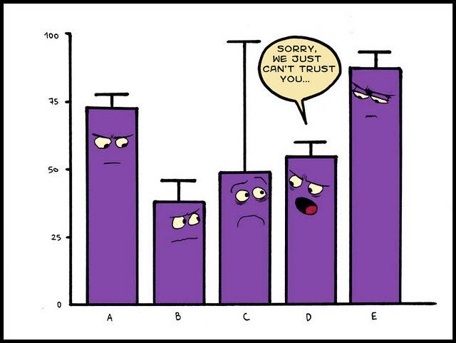
Why don’t we like data?
Maybe…
We see it too much
It has no meaning in our day-to-day work
Data isn’t accurate
There is no consistent way to use if effectively
We spend too much time analyzing a problem and not looking for solutions
Data is often used in a punitive way
Notes:
Let’s look at some reasons why we don’t’ use data in our work place

Slide 5
Challenges to Effectively Using Data
Have you ever heard co-workers say…
  “I don’t like math”
  “I don’t understand data”
  “I care about people, not numbers”
  We do care deeply about what happens to the families we work with…
  …And Data is a valuable tool to help us do our work better
Notes:
Give the example of mine and John’s recent conversation about “unknown” data on children where incorrect demographic data had been entered into the system. Every number represents a child, we should not loose sight of their importance no matter how small.
Including meaningful data in our daily work to can move children in our system to permanent homes in a timely manner!

Slide 6
Why Use Data:
Data is most relevant and useful when it is connected to certain goals (outcomes)
It provides us with feedback on the extent to which we are achieving the goals
Measuring our progress toward goals helps us to be more purposeful in our actions.
“Is what we doing getting the intended results…timely permanency for children?”

Slide 7

Data’s Golden Rule
“Data should be used like a flashlight…
This Photo by Unknown Author is licensed under CC BY-NC-ND
…Not a hammer.”
Notes:
I’m sure we all have experienced a time when you felt data was used in a punitive way. We encourage you to see data as a mean to spotlight and celebrate what is working in your work to achieve permanency outcomes for children but equally important to use data to finds areas you can improve permanency outcomes.

Slide 8

District Permanency Collaborative Meetings
Planned meeting agenda/Time & Place/Meet at least quarterly
Identifying key Collaborative members
Collaborative member’s roles and responsibilities
This Photo by Unknown Author is licensed under CC BY-SA
Notes:
Here again is what we are asking each District to do, you will be given the chance this afternoon to jump start this dialogue in your district; there are a couple of handouts in your packet that you may use in the planning your meeting agenda and tracking your progress on outcomes and measurements you set to improve permanency for children in your district.

Slide 9
Applying the CQI Cycle of Learning
Notes:
We encourage you to apply a CQI mindset to your work in your Permanency Collaborative Meetings; 1) Identifying and Understanding the Problem, no leap too quickly!; 2) Research Solutions, have they been known to get the results for the problem you have identified?; 3) Develop a Theory of Change, how will your actions impact the problem identified; 4) Adapt or develop the solution-agreement reached by your team to adopt the solution; 5) Implement, time to put in action and 6) Monitor and Assess the solution, is it moving permanency outcomes for children in your district
Implementation Tip Guide in your packet---don’t fear, it may seem a lot but the important thing is that you are being strategic in your planning so to know that your time and resources are getting the intended results

Slide 10
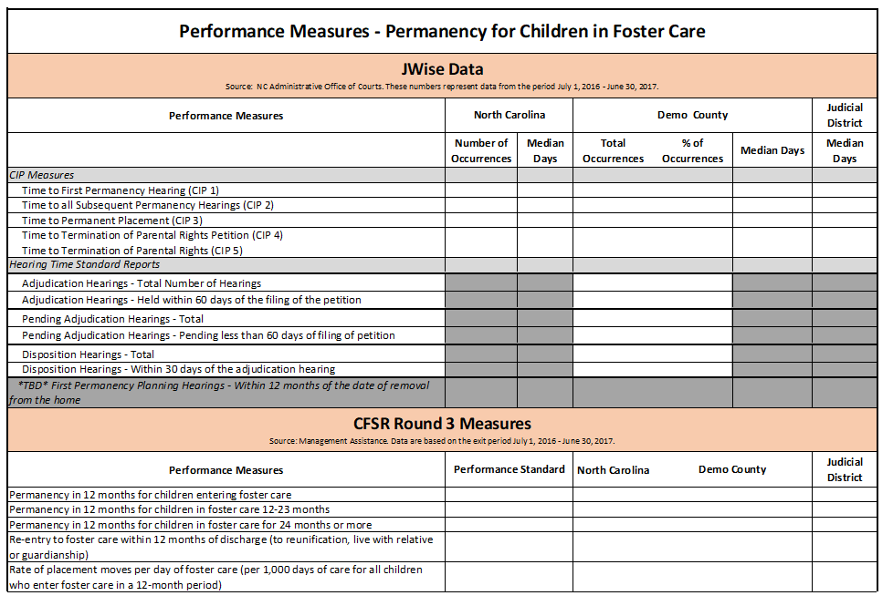
Permanency Performance Profile Template, Page 1
Notes:
This is the state’s PPP that they have committed to providing you updated data on a monthly bases. This data is being provided to assist your District Permanency Collaborative Teams in your efforts to meet your permanency outcomes.
You have or will get populated version of this profile for you to review in your groups
The report contains administrative data from the court system, or Jwise Data
Administrative data from the child welfare system, summarized in the CFSR Round 3 Measures

Slide 11
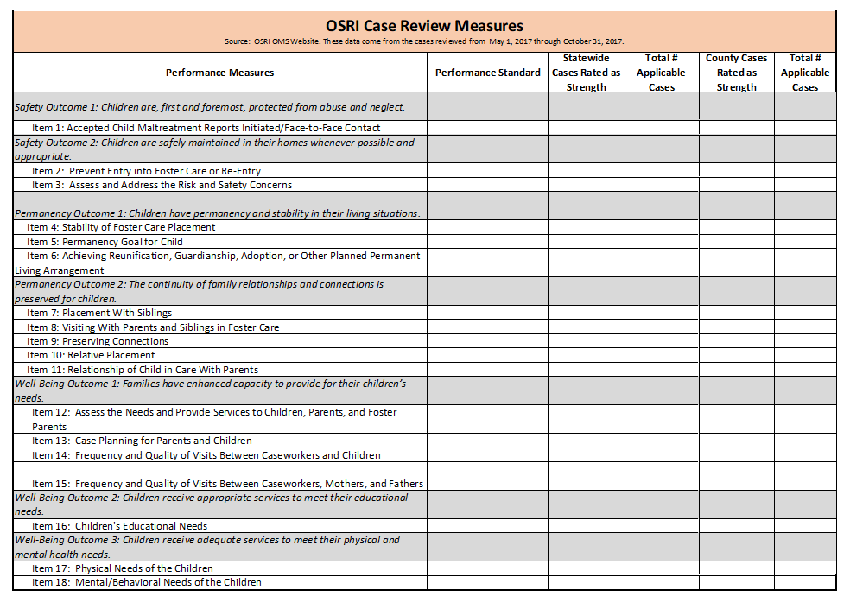
Permanency Performance Profile Template, Page 2
Notes:
This is the And child welfare case review data from the Onsite Review Instrument, or OSRI
You will be hearing more about this data in just a few minutes
We will talk in detail over the next 35 minutes about each and explore each in greater depth in your break out groups.
I will now pass the mic to Kiesha Crawford

Slide 12

Using Performance Profile Data
Populating a new Profile quarterly on the first of each month on the TA Gateway
Focal point of quarterly meetings to guide the dialogue and monitor your progress
Resources on the TA Gateway-this presentation and handouts
Notes:
As we’ve mentioned, NC DSS will be posting updated templates on the TA Gateway quarterly. We’re posting all counties on Feb 1st (that’s today!) and then May, August, and November going. Your local collaboratives job is to ensrue that for every quarterly meeting your County profiles are populated with District and County data.
Among the many issues prioritized at your quarterly collaboration meetings, the data should points included in the profile will be one.
We’ve found that this initial meeting served as an opportunity to begin getting into the meaning behind the data. Including whether what is summarized in the profile is actually refelective of the work that is being done in your District. So verifying the accuracy of the data and if it is not, what needs to be done to improve the quality is the first step in

Slide 13
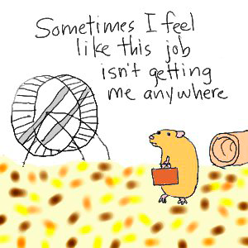
If you always do what you always did…
This Photo by Unknown Author is licensed under CC BY-SA-NC
…You will always get what you always got!
Notes:
Just keep this in mind as you review your profiles, using the data and applying a CQI mindset can and will make a difference in the lives of children in our systems! You can get off the wheel!

Slide 14
Permanency Performance Profile Template, Page 1

Slide 15
Measures and Data Sources – JWise
There are three NC Key Time Standard Reports, which are based on the statutory standards for each of these hearings:
  the adjudication hearings;
  the disposition hearings; and
  the first permanency planning hearings.
In order to maintain the Permanency Performance Profile for a particular county, a user should generate an on-demand report. On-demand reports are generated by the user for a specific date range. In an effort to keep JWise running optimally, the team ask that users only request one year of data at a time.
Once requested, the report will be available the next day (allow 24 hours). All petition based reports can be generated in both PDF and Excel formats. PLEASE DO NOT RUN THESE REPORTS UNTIL THE END OF THE BUSINESS DAY AS MULTIPLE REQUESTS WILL CAUSE THE JWISE APPLICATION TO SLOW DOWN.

Slide 16
How to Access Reports – JWise
On-Demand Reports

Slide 17
Adjudication Hearings Report
North Carolina law requires adjudication hearings to be held within 60 days from the date a juvenile petition is filed in court. The adjudication hearings report will track completed adjudication hearings for both open (pending) and closed (completed) cases.
This report will print detailed information about the juvenile case as well as calculate the total number of cases in each of the following categories:
  1) Adjudication Hearings that have not been held but have not exceeded the time standard;
  2) Adjudication Hearings that have not been held and have exceeded the time standard;
  3) Adjudication Hearings that were held and did not exceed the time standard; and
  4) Adjudication Hearings that were held but exceeded the time standard.
Access to the Adjudication Hearings Report will be available to the following JWise user roles with security approval: Clerks, GAL staff, Family Court staff, Judges, and those with View Only access.
The last section of the adjudication hearings report provides case information that was not able to be listed in the first three sections of the time standard report because the information in JWise is not complete. For the adjudication hearings report, cases which have a completed adjudication hearing but do not have a previously matching petition filed (AND/FILE) are listed in this section.
(Note: The AND/FILE event is a system generated event as of January 2011.) Clerks can correct this
data in JWise and once corrected, these cases will not appear in the last section on any future
reports.

Slide 18
Disposition Hearings Report
North Carolina law requires disposition hearings to be held within 30 days from the conclusion of the adjudication hearing. The disposition hearings report will track completed disposition hearings for open (pending) and closed (completed) cases.
This report will print detailed information about the juvenile case as well as calculate the total number of cases in each of the following categories:
  1) Disposition Hearings that have not been held but have not exceeded the time standard;
  2) Disposition Hearings that have not been held and have exceeded the time standard;
  3) Disposition Hearings that were held and did not exceed the time standard; and
  4) Disposition Hearings that were held but exceeded the time standard.
Access to the Disposition Hearings Report will be available to the following JWise user roles with security approval: Clerks, GAL staff, Family Court staff, Judges, and those with View Only access.
The last section of the disposition hearings report provides case information that was not able to be listed in the first three sections of the time standard report because the information in JWise is not complete. For the disposition hearings report, cases which have a completed disposition hearing but do not have a previously completed adjudication hearing are listed in this section. Clerks can correct this data in JWise, and once corrected, these cases will not appear in the last section on any future reports.
Note: Some counties hold adjudication and disposition hearings on the same day. That will not effect the reports.

Slide 19
First Permanency Planning Hearings Report
North Carolina law requires the first permanency planning hearing to be held within 12 months from the date the juvenile is removed from the home. The event code REMV is used in conjunction with the event PPH or PPREV to calculate compliance with the permanency planning timeframes. GAL staff are responsible for entering the removal code for cases to which volunteers are appointed. If the GAL Program is not appointed to a case and a child is removed, the Clerks should enter the removal code.
This report tracks the first permanency planning hearing for both open (pending) cases and closed (completed) cases. This report will print detailed information about the juvenile case as well as calculate the total number of cases in each of the following categories:
  1) First Permanency Planning Hearing that has not been held but has not exceeded the time standard;
  2) First Permanency Planning Hearing that has not been held and has exceeded the time standard;
  3) First Permanency Planning Hearing that was held and did not exceed the time standard; and
  4) First Permanency Planning Hearing that was held but exceeded the time standard.

Slide 20
First PPH Report, con’t
Access to the First Permanency Planning Hearings Report will be available to the following JWise user with security approval: Clerks, GAL staff, Family Court staff, Judges, and those with View Only access.
The last section of the First Permanency Planning Hearing Report provides case information that was not able to be in first three sections of the time standard report because the information in JWise is not complete. For the First Permanency Planning Hearing Report, cases which have a completed permanency planning hearing but do not have a previous removal code (REMV) are listed in this section. GAL staff or Clerks can correct the data in JWise for these cases and once corrected, the cases will not appear in the last section on any future reports.

Slide 21
CIP Reports for Federal Timeliness Measures
In an effort to comply with federal funding mandates, the Juvenile Court Improvement Program (CIP) staff worked with staff from the Technology Services, Training and Development (formerly Court Services), Guardian ad Litem, and Court Programs Divisions to create reports that provide data on five (5) federal timeliness measures. The full explanation of the measures can be found in the Court Performance Measures in Child Abuse and Neglect Cases Key Measures Bulletin.

Slide 22
CIP Measures
Measure 1: Time to First Permanency Hearing: The median length of time in days from the filing of the original petition to first permanency hearing (how long it takes to complete the first permanency hearing). Note: If there is a First Permanency Planning Hearing entered in JWise with no corresponding removal date, the query will use the date of the filing of the latest petition (AND/FILE). This differs from the Key Time Standard report that will only calculate from a removal code.
Measure 2: Time to all Subsequent Permanency Hearings: The median length of time in days between each subsequent permanency hearing that occurs until final permanency is achieved. For example, the number of days between the first permanency hearing and the second permanency hearing, the second permanency hearing and third, etc., for each hearing that occurs while the child remains in care. Note: The JWise report only measures the median days to the second permanency hearing.
Measure 3: Time to Permanent Placement: The median length of time in days from filing of the original petition to legal permanency (how long it takes for children in abuse and neglect cases to achieve legal permanency, following the filing of the original petition). “Legal Permanency” means that there is a permanent and secure legal relationship between the adult caregiver and the child, including reunification, adoption, legal guardianship, or placement with a fit and willing relative.

Slide 23
CIP Measures, cont.
Measure 4: Time to Termination of Parental Rights Petition: Where reunification has not been achieved, the median length of time in days from the filing of the original petition to the filing of the petition (or motion) to terminate parental rights (how long it takes from the date the original child abuse or neglect petition is filed to the date the termination of parental rights petition (or motion) is filed).
Measure 5: Time to Termination of Parental Rights (TPR): Where reunification has not been achieved, the median length of time in days from the filing of the original child abuse and neglect petition to the termination of parental rights (how long it takes from the date the original child abuse and neglect petition (or motion) was filed to the date the termination of parental rights proceeding is completed). Note: For the sake of consistency and to meet legal standards, the JWise team elected to chose the date the TPR order is entered as the measure of when a TPR proceeding is completed.

Slide 24
CIP Measures, cont.
There are county level reports and statewide reports. In an effort to maintain the same policies regarding JWise generated reports, all JWise users will maintain their current county level access. However, only a select group of state level NCAOC staff will have access to the statewide reports for program planning.
Once requested, the report will be available the next day (allow 24 hours). All CIP federal measure reports will be generated in both PDF and Excel formats. PLEASE DO NOT RUN THESE REPORTS UNTIL THE END OF THE BUSINESS DAY AS MULTIPLE REQUESTS WILL CAUSE THE JWISE APPLICATION TO SLOW DOWN.

Slide 25
How do I access the reports?

Slide 26
Why MEDIAN days?
The calculation of median is a popular technique in summary statistics and summarizing statistical data, since it is simple to understand and easy to calculate, while also giving a measure that is more robust in the presence of outlier values than is the mean.*
In child welfare cases, we can often have a few cases that conclude quickly or languish in the system. These are not the norms and by using median as the measure, the data is not skewed by these outliers.
*https://learnandteachstatistics.wordpress.com/2013/04/29/median/

Slide 27
Additional Reminders
Remember the only events that will appear in a report are the ones that occurred during the dates requested. The search request can only be for a maximum of one year.
If users need to review data over a larger period of time, users will need to run multiple reports. The decision to not allow searches over one year was made by the team to ensure the data in the reports was manageable.

Slide 28
For questions and technical assistance, please contact your divisions liaison:
Training & Development-
DeShield Greene, DeShield.Greene@nccourts.org, 828-788-5241
Nicky Melton, Nichole.Melton@nccourts.org, 919-890-1382
Dori Wynter-Mitchell El, Dorinda.G.Wynter-MitchellEl@nccourts.org, 704-461-1590
Guardian ad Litem-
Sandra Paul, Sandra.W.Paul@nccourts.org, 919-890-1256
Family Court-
Lori Cole, Lori.C.Cole@nccourts.org, 919-890-1207
Stephanie Nesbitt, Stephanie.A.Nesbitt@nccourts.org, 919-890-1204
Juvenile CIP-
Kiesha D. Crawford, Kiesha.D.Crawford@nccourts.org, 919-890-1281
Alexia Stith, Alexia.C.Stith@nccourts.org, 919-890-1216

Slide 29
Measures and Data Sources – CFSR Round 3
Children and Family Services Reviews (CFSR) Round 3 Measures
  Statewide data indicators
  Federal methodology
  Five measures relevant to Permanency Performance Profile:
Notes:
CFSRs are the process by which the federal gov evaluates the child welfare systems in each state.
There have been 3 round, and with each “round” the feds issue a series of data indicators. States are judged on their performance on these indicators.
The methodology for calculating each measure comes from the federal approach.
The 5 in the profile are those that are most directly aligned with the goal of this collaboration.
3 of the measures you’ll recognize from the HB630 MOU performance measures.
The data for these measures come from administrative data that social workers enter in the legacy system (5094) and NCFAST.
While I will give you a quick verbal description, we will provide you with a more detailed description of each measure in our Perm Profile Usage Guide. I’ll touch on this later
These measures were designed to take advantage of the benefits of looking at outcomes based on entry cohorts. The benefit of entry cohorts is that we can look at a groups of children who received services at the same time. And track them longitudinally. There are challenges as well.
One of which is to describe these measures verbally, and I’ve found that most people need to review the descriptions a number of time sprior to fully understanding. I’ll do my best, and have some graphics to help you follow along. Ready?

Slide 30
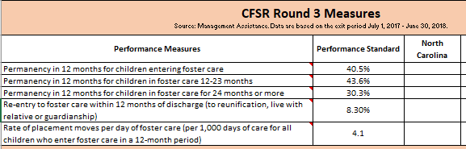
Measures and Data Sources – CFSR Round 3
Permanency in 12 Months for children entering foster care during a 12 month period
Notes:
Read the bullet.
Of all children who enter care in a 12 month period, what percentage exit to permanency within 12 months
You’ll notice in the screen shot (or you won’t b/c it’s small but I’ll tell you) that is says “Data are based on the exit period 7/1/2017 to 6/30/2018.”
All of the children in that cohort will have

Slide 31
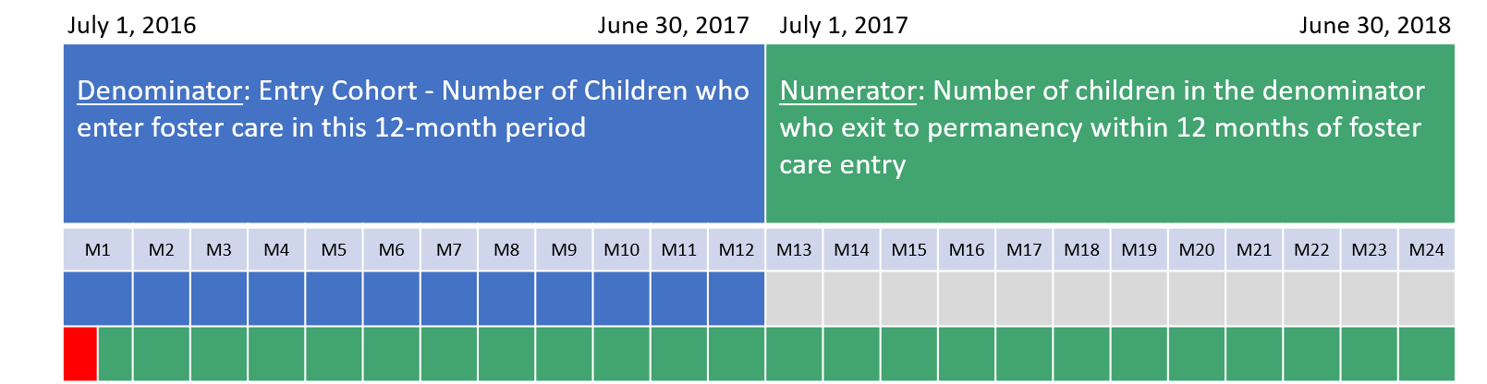
Measures and Data Sources – CFSR Round 3
Permanency in 12 Months for children entering foster care during a 12 month period
Notes:
So for an exit period of SFY 2017-18, we have to look at an entry cohort of children from 2016-17. Here’s why.
We’ll start with a child who entered on July 1, 2016. He’s in the Denominator.
To be counted in the numerator, he has to achieve permanency on or after July 1, 2017.
However, if he achieves permanency by July 9, 2016, he can also be counted in the numerator (that’s why M1-M12 are shaded green as well.) I say July 9th, because children in care less than 8 days are excluded.
But what’s driving the two year time frame, is the child who entered on June 30, 2017 (Month 12 in blue)….if he remains in care the entire time, we cannot rule out his exit to perm until June 30, 2018.

Slide 32
Measures and Data Sources – CFSR Round 3
Permanency in 12 Months for children in foster care for 12-23 Months
Notes:
Read Bullet
Of all children who enter care in a 12 month period AND are still in care on the first day of the exit period, what percentage achieve permanency in the next 12 months.

Slide 33
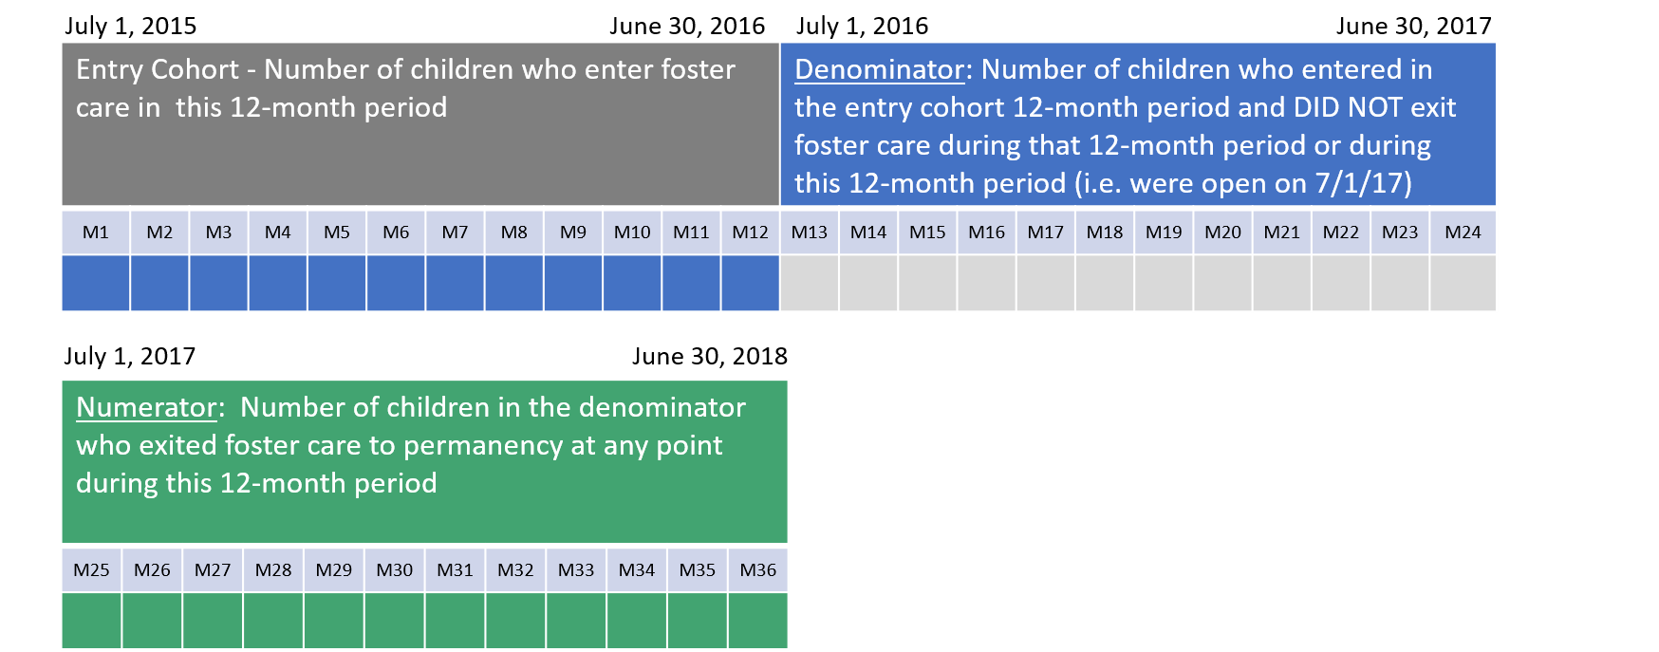
Measures and Data Sources – CFSR Round 3
Permanency in 12 Months for children in foster care for 12-23 Months
Notes:
The simplest way to think of this is that of the children who entered during our entry year (in blue), all of those who are still open on the first day of the exit window (green) are counted in the denominator.
If a child entered on month 13 July 16 they are not included in this measure.
To be counted in the numerator, they just need to exit within the 12 month exit window (green).
Are we following?

Slide 34
Measures and Data Sources – CFSR Round 3
Permanency in 12 Months for children in care for 24 months or more
Notes:
Of all children in care for over 24 months on the first day of the exit period, what percentage exit to permanency within the exit period?.

Slide 35
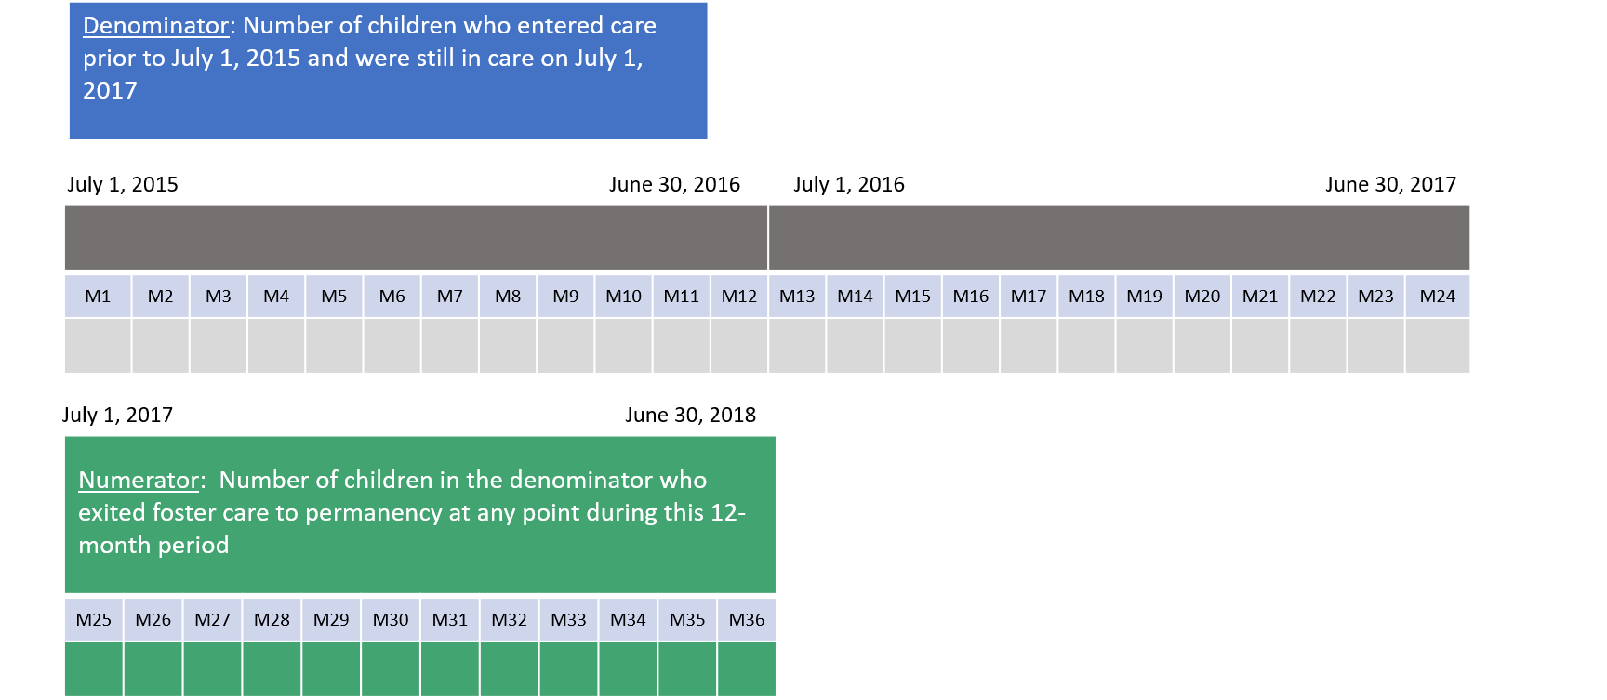
Measures and Data Sources – CFSR Round 3
Permanency in 12 Months for children in care for 24 months or more
Notes:
There is no 12-month entry cohort for this one. It’s all children who entered prior to July 1, 2015. The entry cohort for 12-24 months was 7/1/15-and 6/30/16
Instead it’s All children who entered more than two years before 7/1/17 AND remain in care on 7/1/2017.
Make Sense?

Slide 36
Measures and Data Sources – CFSR Round 3
Re-entry to foster care within 12 months of discharge to permanency
Notes:
Reentry: Of all children who enter care in a 12 month period AND exit to perm w/in 12 mos., percentage who re-enter care w/in 12 mos. of exit date.

Slide 37
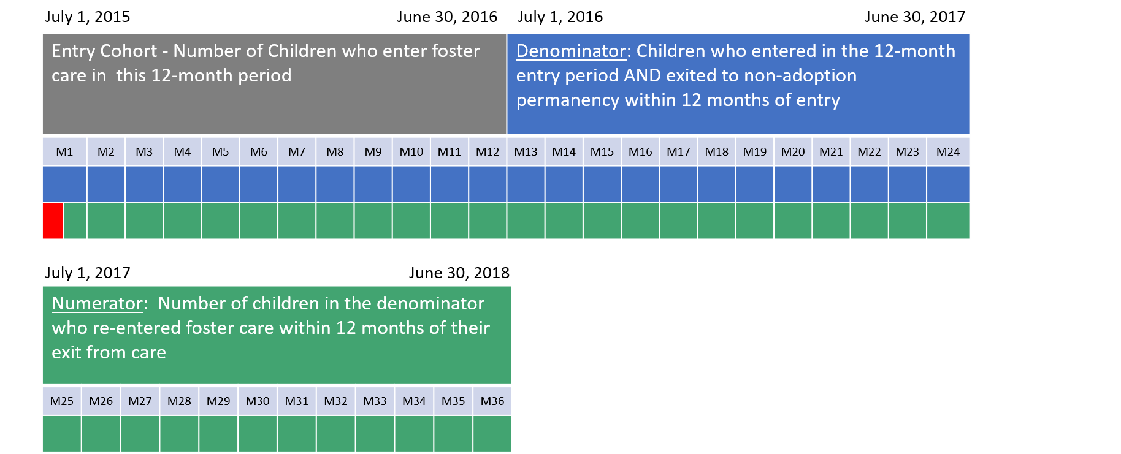
Measures and Data Sources – CFSR Round 3
Re-entry to foster care within 12 months of discharge to permanency
Notes:
This is like Permanency in 12 + did they reenter.
There’s a lot of green (think numerator) for this one. Why?
Our child enter July 1, 2015 (month 1 in blue) and he exited to perm on July 9, 2015. That’ll get him counted in the Denominator. He then has until July 9, 2016 to be included in the numberator. But he can reenter on July 10, 2015 as well to be counted as.
Now we have a child who enters on June 30, 2016 (Month 12 in blue), we have to wait until 6/30/17 (M24 white) to determine whether achieves Perm in 12. Say he does on on June 28 2017 (month 24) then we’ll need to wait until June 28, 2018 (M36) to determine whether he reentered
You with me?
It’s important to keep one other thing in mind for this measure:
And two with the exception of children were discharged to adoption.

Slide 38
Measures and Data Sources – CFSR Round 3
Rate of placement moves per day in foster care (per 1,000 days of care for all children who enter foster care in a 12-month period)
Notes:
Placement Moves: Of all children who enter care in a 12 month period, the number of moves that occurred during that 12 month period divided by the number of days children were in care during that 12 month period…..multiplied by 1000 days.
This one is nice because the “exit period” is the same as the entry period. Thus for this using 2017-18, all the kids who entered care in 17-18 it’s the number of moves those children had during 17-18 divided by to total number of days that that child’s case was open during that year.
So if a child only had one placement (the first placement) then they would add 0 to the numerator. If the child moved 3 times after the initial placement, 3 would be added to the numerator.
For the days in care, we only count the days during that year. So if a child entered on 7/1/2017 and remained in care until the last day of the year, then they would add 365 days to the denominator. If they entered on 6/30/18, then only 1 would be added. And so on and so forth.

Slide 39
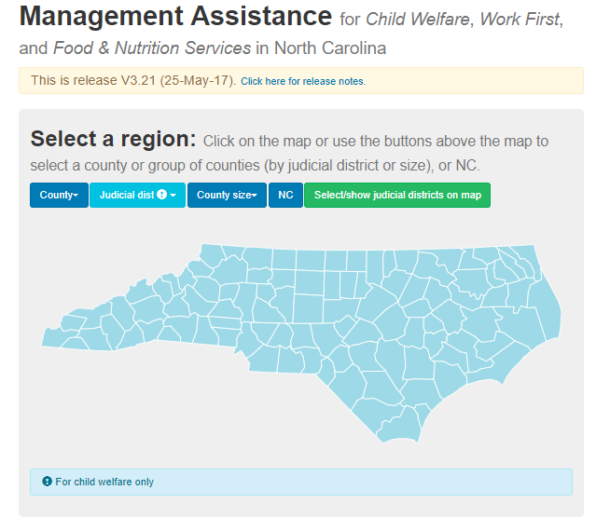
Accessing the Data
http://ssw.unc.edu/ma/
Notes:
Today we have populated your profiles with your county-level and district-level performance. However, going forward, we will post your profile templates without.
You will get your numbers by going to UNC’s Mangement Assistance website, with which most of you are familiar
Click on your county or go to drop down menu.

Slide 40
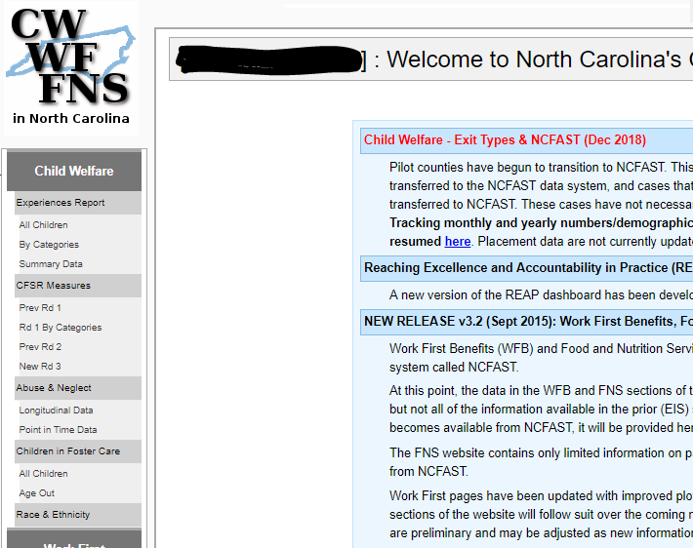
Accessing the Data

Slide 41
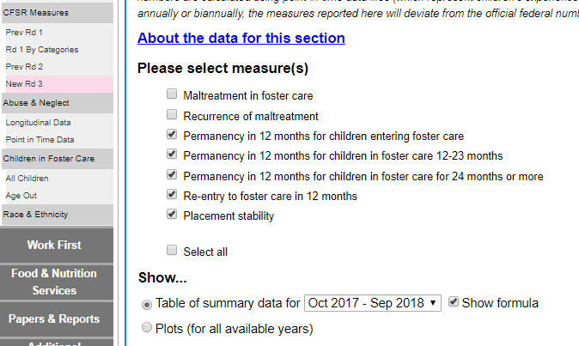
Accessing the Data

Slide 42
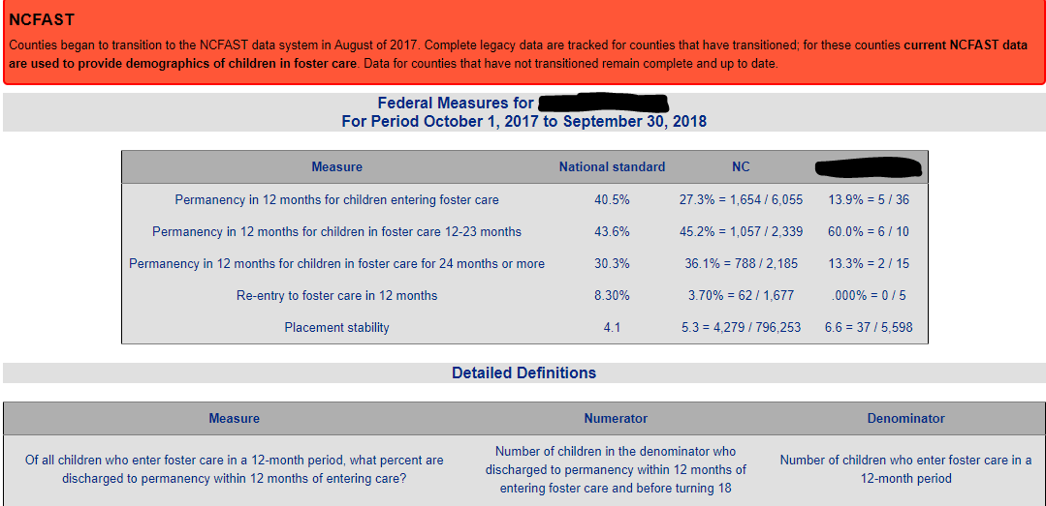
Accessing the Data

Slide 43
Measures and Data Sources – OSRI
Onsite Review Instrument (OSRI)
  Case review data
  Children’s Bureau evaluates statewide performance
  Assessment of 18 items from three CFSR outcome domains: Safety, Permanency and Well Being
  8 items pertain directly to Permanency
  ~125 foster care cases review annually
Notes:
Finally on page 2 of the Profile, you’ll find a summary of the state and county performance on the Onsite Review Instrument
which is the primary case review instrument used by North Carolina.
This tool was designed by the Admin Children and Families and used during the CFSR process, and they evaluate our improvement based on our OSRI performance.
In completing the instrument, reviewers conduct case file reviews and case-related interviews with children, parents, foster parents, caseworkers, and other professionals involved with the child.
Based on a rubric provided in the instrument and supporting materials, for each item on a case a reviewers either assign a value of “Strength” or “Area Needing Improvement”.
Annually we review about 125 foster care cases and about 90 in-home cases. The Profile only includes data from the foster care case reviews.

Slide 44
Permanency Performance Profile Template, Page 2
Notes:
Counties will not need to populate these data for their counties. As we post new templates for a given quarter, the OSRI data will be in there already. The reason: only CFSR pilot counties have access to the data source, OMS.
Many counties will have about 1 or maybe two cases reviewed during a 12 month period. So drawing conclusions on a county level for these measures.
You’ll also notice performance standards. Those were determined by the ACF based on North Carolina’s previous performance on this tool. Those standards applicable to 10 of the 18 item
Our success with our Program Improvement Plan (which came out fo the CFSR) is largely determined by the our performance.
You’ll notice on your profiles, that the state has surpassed the performance standard for 5 of the 10 items. While not official yet (it requires and official review by the ACF) this is great news.

Slide 45
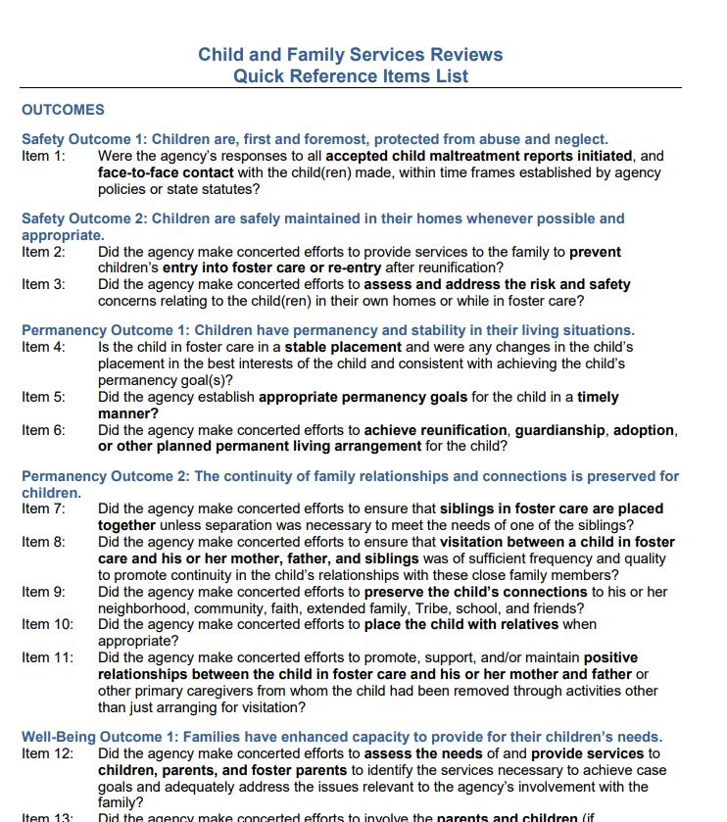
Measures and Data Sources – OSRI
Notes:
This is just a screen shot of an OSRI quick reference document that we have posted for you to access….speaking of posting

Slide 46
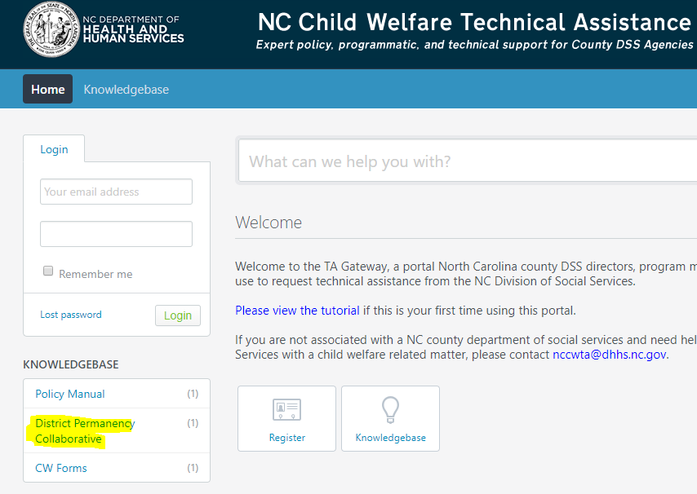
Accessing Profiles and Resources
TA Gateway Knowledge Base
  https://nccwta.org/
Notes:
How are you getting updated profiles and other resources to you? Through our website, the TA Gateway.
At the top you will see the URL for the TA Gateway, which is available to the public. The Knowledgebase is where you will find all of the resources.\
We post the partially populated (and the profiles for today’s meeting) profiles on a quarterly basis: Feb1st, May 1st, Aug 1st, and Nov 1st.
You’ll also find a number of resourrces, including a Permanency Profile Usage Guide and the reporting tool that we will review with you in your breakout sessions.

Slide 47
Technical Assistance & Questions
For questions and technical assistance, please reach out to your NC DSS CPR or contact the Child Welfare Data Team directly:
John Ragosta, john.ragosta@dhhs.nc.gov, 919-527-6406
Joy Smith, Joy.h.smith@dhhs.nc.gov, 919-527-6433

