Slide 1
NC Department of Health and Human Services
Civil Rights Training
Carlotta Dixon, Title VI/ADA-Civil Rights Coordinator
2019
Notes:
The training conducted today will be accepted as the annual civil rights training required by US HHS & USDA.

Slide 2
Agenda
Discrimination, Civil Rights, and Legal Authorities
Civil Rights Training for County Departments of Social Services
Areas of Compliance
Assurances
Non-Discrimination
Public Notification
Racial and Ethnic Data Collection
Complaints of Discrimination
Civil Rights Training
Limited English Proficiency
Disability Discrimination
Compliance Reviews
Resolution of Noncompliance
Conflict Resolution and Customer Service
Notes:
The agenda for this presentation.
An overview of discrimination, civil rights laws, and legal authority applicable to us hhs and usda programs will be presented today.
This training is posted on the NC DSS Program Compliance Training webpage and the link is provided.
This training is usually 4 hours. Today, we will only provide an overview.

Slide 3
What is discrimination?
“Different treatment which makes a distinction of one person or a group of persons from others; either intentionally, by neglect, or by the actions or lack of actions...”
Protected classes under US HHS and USDA SNAP are the following:
Race Color
National Origin
Age
Disability Sex Religion
Political Beliefs
Notes:
We will overview all 8 protected classes.

Slide 4
Civil Rights Legal Authorities
Title VI of the Civil Rights Act of 1964
Race, Color, and National Origin
US HHS and USDA, as amended (42 USC § 2000d), prohibits discrimination on the basis of race, color, or national origin 45 CFR 80.
Title VI protects people of every race, color, or national origin from unlawful discrimination in USDA and HHS-funded programs and activities.
The Personal Responsibility and Work Opportunity Reconciliation Act of 1996
Enforces Title VI of the Civil Rights Act of 1964 and related statutes in block grant type Programs.
Civil Rights Restoration Act of 1987
Clarifies the scope of the Civil Rights Act of 1964
Notes:
The basis of Civil Rights starts with Civil Rights Act of 1964. And Tile VI of the Civil Rights Act first identifies Race, Color, and National Origin protected classes.
As I cover the topic areas, the citation links are provided on the topic slide for ease instead of a separate resource list.

Slide 5
Civil Rights Legal Authorities
Section 504 of the Rehabilitation Act of 1973; Americans w/Disabilities Act of 1990; and the Americans with Disabilities Act Amendments Act of 2008
Disability
US HHS, Section 504 of the Rehabilitation Act of 1973, as amended (29 USC § 794), prohibits discrimination against otherwise qualified individuals on the basis of disability in:
Programs and activities receiving financial assistance from HHS 45 CFR 84;
Programs or activities conducted by HHS 45 CFR 85.
HHS OCR enforces laws and regulations that prohibit discrimination on the basis of disability in programs, services, activities, and facilities.
USDA (7CFR 15b)
Notes:
Next protected class identified is disability and the citations that define the class under HHS and USDA.

Slide 6
Civil Rights Legal Authorities
Title II of the Americans with Disabilities Act
28 CFR Part 35: Nondiscrimination on the Basis of Disability in State and Local Government Services
2010 ADA Standards for Accessible Design
US HHS and USDA, as amended, (29 USC § 794(d)) prohibits discrimination on the basis of disability in electronic and information technology as they relate to programs and activities conducted by HHS and USDA. See the Accessibility Board 508 Homepage for more information.
Notes:
Additionally, under ADA, Title II requires government to ensure equal access within areas of:
Integration
Effective Communication
Building Accessibility
Program Accessibility
Web Accessibility
Emergency Preparedness
We will discuss further about disability protected class.

Slide 7
Civil Rights Legal Authorities
Title IX of the Education Amendments of 1972
Sex
US HHS and USDA, as amended, (20 USC § 1681) prohibits discrimination on the basis of sex (gender) in Federally-Assisted Education Programs 45 CFR 86.
US HHS and USDA OCR enforces laws and regulations that prohibit discrimination on the basis of sex in many HHS and USDA-funded programs and activities.
Notes:
Next identified protected class is sex and the citations defined under HHS and USDA.

Slide 8
Civil Rights Legal Authorities
Age Discrimination Act of 1975
Age
US HHS and USDA, as amended (42 USC § 6101), prohibits discrimination on the basis of age in:
Programs or activities receiving Federal financial assistance 45 CFR 90; and
Programs or services receiving HHS financial assistance 45 CFR 91.
US HHS and USDA OCR enforces the Age Discrimination Act of 1975 (Age Act), which prohibits discrimination on the basis of age in HHS-funded programs and activities.
Notes:
Next identified protected class is age and the citations defined under HHS and USDA.

Slide 9
Civil Rights Legal Authorities
7 CFR Part 16, “Equal Opportunity for Religious Organizations”
Religion
Gives equal footing to religiously affiliated organizations
Executive Order 13166 - "Improving Access to Services for Persons with Limited English Proficiency"(August 11, 2000)
National Origin
USDA LEP Policy Guidance - “USDA Guidance to Federal Financial Assistance Recipients Regarding the Title VI Prohibition Against National Origin Discrimination Affecting Persons With Limited English Proficiency” (79 Fed. Reg. No, 229, Friday, [p. 70771 – 70784]
Notes:
Religion and National Origin are the last two protected classes identified and citations defined under HHS and USDA
We will discuss more about National Origin in the presentation.

Slide 10
Civil Rights Legal Authorities
Under USDA
7 CFR Parts 15, 15a, 15b
Gives USDA agencies authority to develop Civil Rights requirements
Food and Nutrition Act of 2008, as amended
Prohibits discrimination on the basis of race, color, sex, age, national origin, religion, political beliefs or disability
7 CFR Part 271-285
Defines SNAP regulations
SNAP Guidance on Non-Citizen Eligibility (June 2011)
Clarifies SNAP policy on non-citizen eligibility
Notes:
These laws establish the authority for USDA SNAP.

Slide 11
Civil Rights Legal Authorities
USDA Departmental Regulation 4330-2
Prohibits discrimination in programs and activities funded in whole or in part by the USDA
FNS Instruction 113-1 and Appendix A (SNAP)
Provides information on Civil Rights compliance and enforcement
The Food Stamp Act of 1977, as amended
Establishes Food Assistance Programs
USDA Civil Rights Accountability Policy and Procedures
Establishes the civil rights accountability policy and procedures

Slide 12
Civil Rights Legal Authorities
Under US HHS
Section 1557 of the Affordable Care Act Section 1557 of the Patient Protection and Affordable Care Act (42 USC § 18116 - PDF), which provides that an individual shall not be excluded from participation in, be denied the benefits of, or be subjected to discrimination on the grounds prohibited under Title VI of the Civil Rights Act of 1964, 42 USC § 2000d et seq. - PDF (race, color, national origin), Title IX of the Education Amendments of 1972, 20 USC § 1681 et seq. - PDF (sex), the Age Discrimination Act of 1975, 42 USC § 6101 et seq. (age), or Section 504 of the Rehabilitation Act of 1973, 29 USC § 794 - PDF(disability), under any health program or activity, any part of which is receiving Federal financial assistance, or under any program or activity that is administered by an Executive Agency or any entity established under Title I of the Affordable Care Act or its amendments. OCR has enforcement authority with respect to health programs and activities that receive Federal financial assistance from the Department of Health and Human Services (HHS) or are administered by HHS or any entity established under Title I of the Affordable Care Act or its amendments.
Notes:
Essentally, Section 1557 prohibits discrimination on the basis of race, color, national origin, sex, age, or disability in HHS-funded programs and activities and ACA Marketplaces.
Section 1557 builds on prior Federal civil rights laws to prohibit sex discrimination in health care.
The final rule requires that women be treated equally with men in the health care they receive and also prohibits the denial of health care or health coverage based on an individual’s sex, including discrimination based on pregnancy.
For individuals with disabilities, the final rule requires covered entities to make all programs and activities provided through electronic and information technology accessible; to ensure the physical accessibility of newly constructed or altered facilities; and to provide appropriate auxiliary aids and services for individuals with disabilities. Covered entities are also prohibited from using marketing practices or benefit designs that discriminate on the basis of disability and other prohibited bases.
Covered entities must take reasonable steps to provide meaningful access to each individual with limited English proficiency eligible to be served or likely to be encountered in their health programs and activities. In addition, covered entities are encouraged to develop and implement a language access plan.-We will talk more about the LEP Plan.
Also, the final rule on Section 1557 does not include a religious exemption; however, the final rule does not displace existing protections for religious freedom and conscience.

Slide 13
Civil Rights Legal Authorities
Hill-Burton The Hill-Burton Act prohibits discrimination on the basis of race, color, national origin, creed, and other grounds in certain medical facilities.
Section 1553 of the Affordable Care Act Section 1553 of the Affordable Care Act prohibits discrimination against individuals or health care entities that do not provide assisted suicide services.
Notes:
The remaining listed civil rights legal authorities are pertinent as NC moves to Medicaid Transformation.

Slide 14
Civil Rights Legal Authorities
Federal Health Care Conscience Protection Statutes: Prohibits recipients of certain Federal funds from discriminating against certain health care providers who refuse to participate in certain health care services on religious or moral grounds.
Church Amendments - PDF (42 USC § 300a-7)
Public Health Service (PHS) Act - PDF (42 USC § 238n)
Weldon Amendment - PDF(Continuing Appropriations Resolution, Pub. L. No. 113-164, Sec. 101(a) (Sept. 19, 2015)
Regulation for the Enforcement of Federal Health Care Provider Conscience Protection Laws - PDF

Slide 15
Areas of Compliance Assurances
To qualify for Federal financial assistance, an application (Plan) must be accompanied by a written assurance that the entity to receive financial assistance will be operated in compliance with all nondiscrimination laws, regulations, instructions, policies, and guidelines.
A Civil Rights assurance statement must be incorporated in all
agreements between
-US HHS Federal and State Agencies (Federal-State Agreement)
-Federal and SNAP State agencies (Federal-State Agreement)
-SNAP State agencies and implementing agencies
-Implementing agencies and subrecipients (if applicable)
Notes:
Now that we have quickly covered what does discrimination mean, civil right laws and legal authorities, we now will present how to comply with those laws and legal authorities as we move into the areas of compliance.
As States, counties and subrecipients (contractors) must have plans outlining how they will work and they must also have an assurance statement attesting to the federal laws as recipients of federal funds.

Slide 16
SAMPLE ASSURANCES OF NONDISCRIMINATION FOR STATE AGENCY AGREEMENTS AND CONTRACTS IN SNAP
The State Agency or [Contractor/Subrecipient] agrees to comply with Title VI of the Civil Rights Act of 1964
(Pub.L. 88-352), section 11(c) of the Food and Nutrition Act of 2008, as amended, the Age Discrimination Act of 1975 (Pub.L. 94-135), and the Rehabilitation Act of 1973
(Pub.L. 93-112, sec. 504), and all requirements imposed by the regulations issued pursuant to these Acts by the Department of Health and Human Services or Department of Agriculture to the effect that, no person in the United States shall, on the grounds of sex, race, color, age, political belief, religion, handicap, or national origin, be excluded from participation in, be denied the benefits of, or be otherwise subject to discrimination under the Administration of Children and Family or Supplemental Nutrition Assistance Program (SNAP).

Slide 17
Public Notification
All HHS and FNS assistance programs must include a public notification system.
The purpose of this system is to inform applicants, participants, and potentially-eligible persons of:
program availability
program rights and responsibilities
the policy of nondiscrimination
the procedure for filing a complaint

Slide 18
Elements of Public Notification
Program Availability
Inform applicants, participants, and potentially eligible persons of their program rights and responsibilities and the steps necessary for participation
Complaint Information
Must advise applicants and participants at the service delivery point of their right to file a complaint, how to file a complaint, and the complaint procedures
Nondiscrimination Statement
All information materials and sources, including websites, must contain a nondiscrimination statement. The statement is not required to be included on every page of the program website. At a minimum the nondiscrimination statement or a link to it must be included on the home page of the program information.

Slide 19
Elements of Public Notification
State agencies and their subrecipients must:
Make program information available to the public upon request
Prominently display the “And Justice for All” poster
Inform potentially eligible persons, applicants, participants and grassroots organizations of programs or changes in programs
Convey the message of equal opportunity in all photos and other graphics that are used to provide program or program-related information
Provide appropriate information in alternative formats for persons with disabilities and in the appropriate language(s) for LEP persons

Slide 20
Nondiscrimination Statement
This institution is prohibited from discriminating on the basis of race, color, national origin, disability, age, sex and in some cases religion or political beliefs.
The U.S. Department of Agriculture also prohibits discrimination based on race, color, national origin, sex, religious creed, disability, age, political beliefs or reprisal or retaliation for prior civil rights activity in any program or activity conducted or funded by USDA.
Persons with disabilities who require alternative means of communication for program information (e.g. Braille, large print, audiotape, American Sign Language, etc.), should contact the Agency (State or local) where they applied for benefits. Individuals who are deaf, hard of hearing or have speech disabilities may contact USDA through the Federal Relay Service at (800) 877-8339. Additionally, program information may be made available in languages other than English.
To file a program complaint of discrimination, complete the USDA Program Discrimination Complaint Form, (AD-3027), found online at: http://www.ascr.usda.gov/complaint_filing_cust.html, and at any USDA office, or write a letter addressed to USDA and provide in the letter all of the information requested in the form. To request a copy of the complaint form, call (866) 632-9992. Submit your completed form or letter to USDA by:
(1) mail: U.S. Department of Agriculture
Office of the Assistant Secretary for Civil Rights
1400 Independence Avenue, SW
Washington, D.C. 20250-9410
(2) fax: (202) 690-7442; or
(3) email: program.intake@usda.gov.
For any other information dealing with Supplemental Nutrition Assistance Program (SNAP) issues, persons should either contact the USDA SNAP Hotline Number at (800) 221-5689, which is also in Spanish or call the State Information/Hotline Numbers (click the link for a listing of hotline numbers by State); found online at: http://www.fns.usda.gov/snap/contact_info/hotlines.htm.
To file a complaint of discrimination regarding a program receiving Federal financial assistance through the U.S. Department of Health and Human Services (HHS), write: HHS Director, Office for Civil Rights, Room 515-F, 200 Independence Avenue, S.W., Washington, D.C. 20201 or call (202) 619-0403 (voice) or (800) 537-7697 (TTY).
This institution is an equal opportunity provider.

Slide 21
Nondiscrimination Statement (Spanish)
Se prohíbe a esta institución discriminar sobre la base de raza, color, nacionalidad, discapacidad, edad, sexo y, en algunos casos, creencias religiosas o políticas.
El Departamento de Agricultura de los EE. UU. también prohíbe la discriminación por motivos de raza, color, nacionalidad, sexo, credo religioso, discapacidad, edad, creencias políticas, o en represalia o venganza por actividades previas de derechos civiles en algún programa o actividad realizados o financiados por el USDA.
Las personas con discapacidades que necesiten medios alternativos para la comunicación de la información del programa (por ejemplo, sistema Braille, letras grandes, cintas de audio, lenguaje de señas americano, etc.), deben ponerse en contacto con la agencia (estatal o local) en la que solicitaron los beneficios. Las personas sordas, con dificultades de audición o discapacidades del habla pueden comunicarse con el USDA por medio del Federal Relay Service [Servicio Federal de Retransmisión] al (800) 877-8339. Además, la información del programa se puede proporcionar en otros idiomas.
Para presentar una denuncia de discriminación, complete el Formulario de Denuncia de Discriminación del Programa del USDA, (AD-3027) que está disponible en línea en: http://www.ocio.usda.gov/sites/default/files/docs/2012/Spanish_Form_508_Compliant_6_8_12_0.pdf. y en cualquier oficina del USDA, o bien escriba una carta dirigida al USDA e incluya en la carta toda la información solicitada en el formulario. Para solicitar una copia del formulario de denuncia, llame al (866) 632-9992. Haga llegar su formulario lleno o carta al USDA por:
(1) correo: U.S. Department of Agriculture
Office of the Assistant Secretary for Civil Rights
1400 Independence Avenue, SW
Washington, D.C. 20250-9410
(2) fax: (202) 690-7442; o
(3) correo electrónico: program.intake@usda.gov.
Para obtener información adicional relacionada con problemas con el Programa de Asistencia Nutricional Suplementaria (SNAP, por sus siglas en inglés), las personas deben comunicarse con el número de línea directa USDA SNAP Hotline al (800) 221-5689, que también está disponible en español, o llame a los números de información/líneas directas de los estados (haga clic en el vínculo para ver una lista de los números de las líneas directas de cada estado) que se encuentran en línea en: http://www.fns.usda.gov/snap/contact_info/hotlines.htm
Para presentar una denuncia de discriminación relacionada con un programa que recibe asistencia financiera federal a través del Departamento de Salud y Servicios Humanos de los EE. UU. (HHS, por sus siglas en inglés), escriba a: HHS Director, Office for Civil Rights, Room 515-F, 200 Independence Avenue, S.W., Washington, D.C. 20201, o llame al (202) 619-0403 (voz) o al (800) 537-7697 (sistema TTY).
Esta institución es un proveedor que ofrece igualdad de oportunidades.

Slide 22
Nondiscrimination Statement
US HHS and USDA Nondiscrimination Statement
Short versions
This institution is an equal opportunity provider.
Esta institución es un proveedor que ofrece igualdad de
oportunidades. (Spanish)
*Can be used in special circumstances only
Translations
Available on the DHHS DSS FNS Website
Notes:
Abbreviated version of the non-discrimination statement is shown.

Slide 23
“And Justice For All” Poster
Display the poster in a prominent location for all to view
Required version: AD-475B is for SNAP & FDPIR
Notes:
Justice for all poster mention and must be displayed in all lobby areas.

Slide 24
Race/Ethnicity Data Collection
As a means of monitoring Civil Rights compliance, state agencies shall
establish a system for the collection of racial/ethnic data of each
person applying for and receiving benefits.
Purpose:
To determine how effectively specifically FNS programs are reaching potentially eligible persons and participants,
To identify areas where additional outreach or services are needed,
To assist in the selection of locations for compliance reviews, and
To complete reports, as required.
Notes:
Specifically for USDA SNAP Programs, Race/Ethnicity data collection is required.

Slide 25
Complaints of Discrimination
Participants have the right to file discrimination complaints.
HHS and SNAP agencies are required to inform participants of the option to file a complaint with the US HHS or USDA.
HHS and SNAP State agencies are responsible for conducting the investigation if they have an approved complaint process.

Slide 26
Complaints Should Include
Name, address, and telephone number of the complainant
The location and name of the organization or office
The nature of the incident or action
The names, titles, and business addresses of persons who may have knowledge of the discriminatory action
The date(s) during which the alleged discriminatory actions occurred
The basis for the alleged discrimination

Slide 27
Complaint Processing Procedures
Complaints must be filed within 180 days from the alleged act of discrimination.
Upon receipt of a verbal or written Complaint must be accepted and forwarded to NC DSS Civil Rights Coordinator (Dear County Director Letter explains the time frame. https://www2.ncdhhs.gov/dss/dcdl/programcompliance/PC-01-2018.pdf )
Age-based Complaints involve Federal Mediation and Conciliation Service (FMCS) and will be referred to US HHS or USDA FNS Civil Rights Division.
Complaints may be written, verbal, or anonymous.
Confidentiality is extremely important and must be maintained.
Agencies must maintain a separate log reflecting only civil rights complaints.

Slide 28
Complaints of Discrimination
NC DHHS, Division of Social Services:
NC DSS Complaint Form – English and Spanish
USDA, Office of the Assistant Secretary for Civil Rights:
USDA Program Discrimination Complaint Form - English USDA Program Discrimination Compliant Form - Spanish
US DHHS, Office For Civil Rights:
DHHS Civil Rights Discrimination Complaint Form - English DHHS Civil Rights Discrimination Complaint Form - Spanish
Notes:
The forms listed are the approved complaints forms that should be available in all lobby areas of the agency or signage for the participant to obtain the forms.

Slide 29
Civil Rights Training
State agencies are responsible for training subrecipient agencies on an annual basis.
Subrecipient agencies are responsible for training their local sites, including “frontline staff” who interact with participants on an annual basis.
New employees before participating in program activities must receive training.
Volunteers must receive training appropriate to their roles and responsibilities.

Slide 30
Civil Rights Training
All staff should receive training on all aspects of Civil Rights compliance, including, but not limited to:
Collection and use of data
Effective public notification system
Complaint procedures
Compliance review techniques
Resolution of noncompliance
Requirements for reasonable modifications for persons with disabilities
Requirements for language assistance for individuals with limited English proficiency
Conflict resolution
Customer service

Slide 31
Limited English Proficiency (LEP) and Program Access
Who are persons with LEP?
Individuals who do not speak English as their primary language and who have a limited ability to read, speak, write, or understand English because of their national origin
Recipients of Federal financial assistance have a responsibility to take reasonable steps to ensure meaningful access to their programs and activities by persons with LEP.
Failure to provide “meaningful” access to persons with LEP
could be discrimination on the basis of national origin.

Slide 32
LEP Requirements
Title VI and its implementing regulations require recipients of Federal financial assistance (State agencies, local agencies, or other subrecipients), to take reasonable steps to ensure “meaningful” access to their programs and activities for individuals with limited English proficiency (LEP).
(FNS Instruction 113-1, Section VII)

Slide 33
LEP Requirements
Factors to consider when ensuring “meaningful” access:
Number or proportion of LEP persons eligible to be served or likely to be encountered within the area serviced by the recipient
Frequency with which LEP individuals come in contact with the program
Nature and importance of the program, activity, or service provided by the program
Resources available and their costs

Slide 34
Limited English Proficiency (LEP) and Program Access
State agencies must conduct assessments to determine language profile for their State, taking into account regional differences and updating as appropriate.
Translation of vital documents is required.
Oral translations and notification of free interpretation services
is required.
Staff training regarding how to provide LEP populations with meaningful access is paramount (frontline staff).
Notes:
Forms, websites that require a participant to use to be inform or complete to obtain benefits are examples of vital information that must be translated.

Slide 35
Limited English Proficiency (LEP) and Program Access
Language services:
Applicants and participants cannot be asked to bring their own interpreters
Children under 18 cannot be used as interpreters
Use qualified, competent language resources
Examples of language services:
Bilingual staff
Telephone interpreter lines
Oral interpretation services
Written language services
Community organizations and volunteers

Slide 36
LEP Population and Data Sources
Population data sources:
Department of Justice site: LEP.GOV http://www.lep.gov/maps/
US Census Data http://www.census.gov/2010census/data/
American Community Survey http://www.census.gov/acs/
Migration Policy Institute’s National Center on Immigrant IntegrationPolicy http://www.migrationpolicy.org/

Slide 37
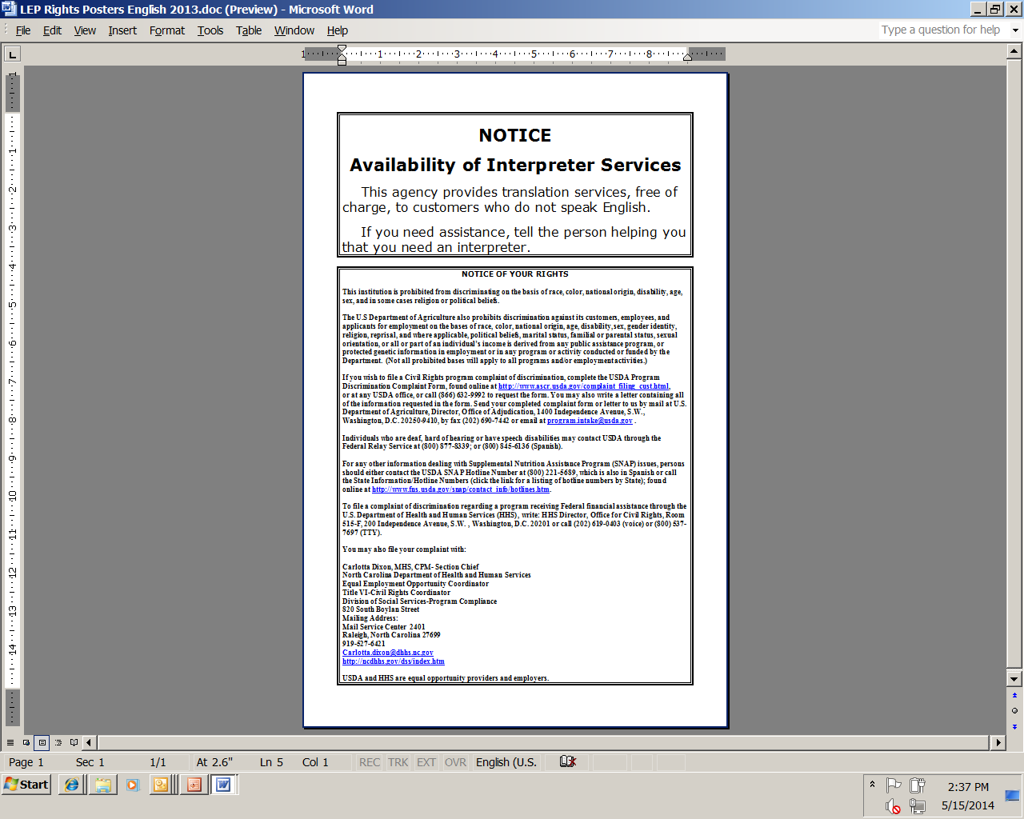
This poster should be displayed in the lobbies and waiting areas of each DSS office and Contractor Office
EnglishVersion SpanishVersion

Slide 38
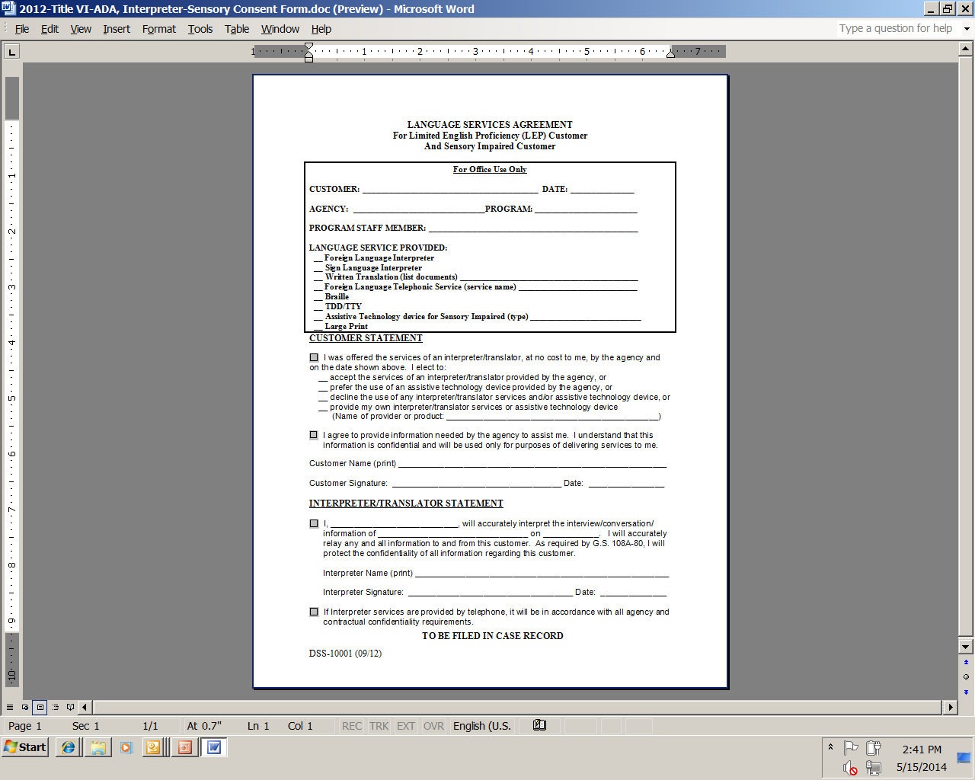
Language Services Agreement
The DSS – 10001 “Language Services Agreement For Limited English Proficiency” Form
Client/Recipient/Customer and the Interpreter must sign this form each occurrence

Slide 39
LEP RESOURCES
Resources:
https://www.lep.gov/
NC DSS- Title VI, Limited English Proficiency
dss-10001 | Language Services Agreement
dss-10001ins | Instructions for completing the DSS-10001
Telephone Interpreter Service State Contract: https://telelanguage.com/
Account Number- 9090-4440
In-Person Interpreter Service State Contract: http://www.fluentls.com/

Slide 40
Disability Discrimination
What is the definition of disability?
A person who has a physical or mental impairment which substantially limits one or more major life activity, has a record of such an impairment, or is regarded as having such an impairment.
Major life activity means functions such as caring for one’s self, performing manual tasks, walking, seeing, hearing, speaking, breathing, learning and working.
Functions of the immune system, normal cell growth, digestive, bowel, bladder, neurological, brain, respiratory, circulatory, cardiovascular, endocrine, and reproductive functions.

Slide 41
Disability Discrimination
Reasonable Modifications
A public entity shall make reasonable modifications in policies, practices, or procedure when the modifications are necessary to avoid discrimination on the basis of disability, unless the public entity can demonstrate that making the modifications would fundamentally alter the nature of the service, program, or activity. [28 CFR 35.130(b)(7)(i)]
Notes:
Reasonable Modification is under Title II of the ADA a difference from Reasonable Accommodation under Title VII.
35.130(b) (7) clarifies the following:
Limits the species of services animals to dogs
Makes clear that comfort or emotional support animals are not covered
Makes clear that individuals with physical, sensory, psychiatric or other mental disabilities can use service animals.

Slide 42
Disability Discrimination
Accessibility
As programs and offices modernize, it is imperative that websites, including State and local agency websites, and online application systems are readily accessible to and useable by persons with visual impairments and other disabilities.
In addition, programs must ensure physical accessibility for buildings and facilities, particularly to persons in wheelchairs and Other Power-Driven Mobility Devices.
Programs must provide access for service animals. (Part 35.104 in Title II, Part 36.104 in Title III, and Part 35.136 in Title II) https://www.ada.gov/regs2010/titleII_2010/titleII_2010_regulations.htm#a35136
Notes:
Part 35.104 in Title II provides the legal definition of a service animal- dogs or miniature horses
Part 35.136 in Title II clarifies the following:
Provides when a service animal can be excluded
The animal is out of control and the handler does not take effective action to control it
The animal is not house broken
Requires animal to be under handler’s control
The animal must have a harness, leash, or other tether or under handler’s control
Provides guidance on inquiries-Only 2 questions can be asked
Whether the animal is required because of a disability
What work or task the animal has been trained to perform
Care and Supervision
Access to all areas open to public
Cannot Surcharge or require a fee for service animals

Slide 43
Disability Discrimination
Accessibility
There is an obligation to ensure communication with individuals with disabilities is as effective as communication with others. (Part 35.160 in Title II)
Providing qualified sign language interpreters or other auxiliary aids and services for persons with hearing disabilities may be necessary to effectively communicate with these applicants and participants.
Ensure that members of the public are provided reasonable modifications and auxiliary aids and services in order to access program information, applications and assistance (i.e. Braille, large print, and audio tape).
Notes:
Examples of additional auxiliary aids:
Qualified Interpreters through video remote interpreting services
Voice, text, and video-based telecommunications products and systems
Real-time computer-aided transcription services
Accessible electronic and information technology
Braille or tactile displays
Large Print Material
Screen reader software

Slide 44
ADA RESOURCES
Resources:
https://www.ada.gov/
https://www.adaactionguide.org/ada-title-ii-requirements#introduction
https://askjan.org/
Services for the Deaf and Hard of Hearing https://www.ncdhhs.gov/divisions/dsdhh
Services for the Blind https://www.ncdhhs.gov/divisions/dsb
Vocational Rehabilitation Services https://www.ncdhhs.gov/divisions/dvrs

Slide 45
Compliance Reviews
Examine the activities of State agencies, subrecipients, and local sites to determine Civil Rights compliance.
US HHS and USDA FNS Civil Rights and Program staff review State agencies.
State agencies review local agencies.
Local agencies review their subrecipients.
Significant findings must be provided in writing to the reviewed entity.

Slide 46
Compliance Reviews
There are three types of compliance reviews:
Pre-Award Compliance Reviews
Routine (Post-Award) Compliance Reviews
Special Compliance Reviews

Slide 47
Pre-Award Compliance Reviews
State agencies, subrecipient agencies, and local sites must be in compliance with Civil Rights requirements prior to approval for Federal financial assistance.

Slide 48
Routine/Post-Award Reviews
FNS and State agencies must conduct routine compliance reviews as identified by FNS Instruction 113-1 and program-specific regulations and policies.
Assess all of the Civil Rights compliance areas.
Sample post-award review questions:
Do printed materials contain the nondiscrimination statement?
Is the “And Justice For All” poster displayed appropriately?
Are program informational materials available to all?
Is data on race and ethnicity collected appropriately?
How are applicants and participants advised of their right to
file a Civil Rights complaint of discrimination?
Are reasonable modifications appropriately made for people with disabilities?
How does the agency provide interpreter services?
Did the agency provide the Assurance Statement and the LEP Agreement annually due in August?

Slide 49
Special Compliance Reviews
May be scheduled or unscheduled
To follow-up on previous findings of noncompliance
To investigate reports of noncompliance by other agencies, media, or grassroots organizations
May be specific to an incident or policy
History of statistical underrepresentation of particular group(s)
Pattern of complaints of discrimination

Slide 50
Resolution of Noncompliance
A factual finding that any civil rights requirement, as provided by law, regulation, policy, instruction, or guidelines, is not being adhered to by a State agency, subrecipient agency, or a local site.
Steps must be taken immediately to obtain voluntary compliance.
A finding’s effective date is the date of notice to the reviewed
entity.

Slide 51
Questions

Slide 52
Contact Information
Carlotta Dixon, MHS, CPM
Section Chief
Title VI/ADA-Civil Rights Coordinator
NC Division of Social Services-Program Compliance
North Carolina Department of Health and Human Services
919-527-6421 Office
919-334-1198 Fax
Carlotta.dixon@dhhs.nc.gov
820 South Boylan Avenue, McBryde Building
Raleigh, North Carolina 27603

Slide 53
Contact Information
OR
Gail A Hoffman, Regional Civil Rights Director,
Southeast Regional Office
Food and Nutrition Service
61 Forsyth St. SW, Suite 8T36
Atlanta, GA 30303
POC Gail.Hoffman@fns.usda.gov Office: (404)562-7033

Slide 54
THANK YOU

