Slide 1
NC Department of Health and Human Services
Office of Rural Health
SFY 2026 & 2027
Medication Assistance Program (MAP)
Request for Application (RFA)
April 2025

Slide 2
Programs at Office of Rural Health
NC Community Health Grants
NC Farmworker Health Program
Rural Health Information Technology Program
Placement and HPSA Services
NC Rural Health Centers
Supports the primary care safety net system with increasing access to health care for vulnerable populations
Provides technical assistance to improve the use of Electronic Health Record (EHR) Systems and the use of health information exchange
Recruit providers and designates health professional shortage areas
Supports state designated rural health centers that serve the entire community
Supports medical, dental and educational services for members of the North Carolina agricultural labor force and their families
NC Rural Hospital Program
NC Medication Assistance Program
NC Statewide Telepsychiatry
Program
NC Analytics & Innovations
Community Health Worker Program
Funds operational improvement projects for the benefit of all critical access hospitals and eligible small rural hospitals
Provides free and low-cost medications donated by pharmaceutical manufacturers to patients who cannot afford them
Supports psychiatric evaluation of patients through videoconferencing technology in emergency departments
Support data analytics, shortage designations, and pioneering
efforts to improve health
Support North Carolinians by connecting them to medical and social support resources

Slide 3
Objective
Medication Assistance Program RFA
Purpose
Eligibility
Reimbursement
Deadlines
Scoring Per Section
Performance Measures

Slide 4
Medication Assistance Program RFA
NC General Assembly
Office of Rural Health
Medication Assistance Program
Increase access to medication
Purpose
Create access to help uninsured, low-income citizens evaluate their optimal prescription drug choices and apply for free, discounted, and low-cost drugs through public and private medication assistance programs.

Slide 5
Who’s Eligible?
Federally Qualified Health Centers and Look-Alikes
Free and Charitable Clinics
Health Departments
Hospital Owned Primary Care Clinics
State Designated Rural Health Centers
School-Based and School-Linked Health Centers
AHEC Clinics
Other Non-Profit Community Organizations
All safety net organizations that provide or will provide medication assistance programs for uninsured, low-income patients are eligible to apply.

Slide 6
RFA, cont’d
NEW SFY2026 & 2027 applicants will receive a two-year award, based on applicant scores.
ORH expects to receive more requests than can be funded. Therefore, submission of a grant application does not guarantee receipt of an award.
Furthermore, grants that are awarded may not be funded at the requested amount. Final awards will be commensurate with the size and scope of the proposed activities.
Applicants are expected to only submit ONE application per EIN.
Maximum Award Amount: $28,850

Slide 7
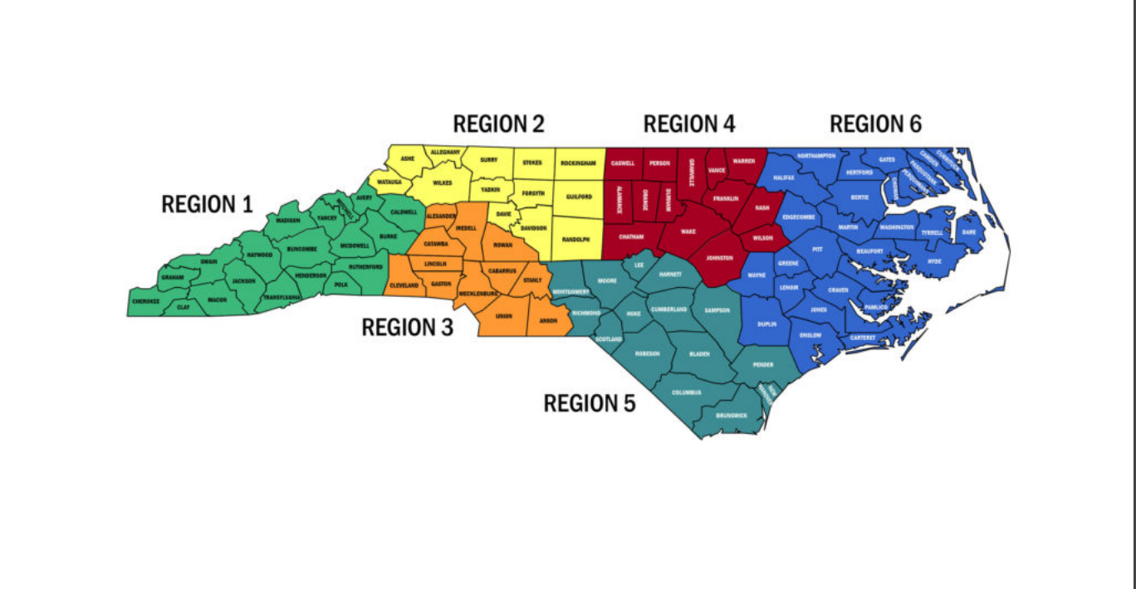
Medicaid Region Map and Contacts
Region 1: Deneen Gill deneen.gill@dhhs.nc.gov
Region 2: Trenesse Michael trenesse.michael@dhhs.nc.gov
Region 3: Bianca Revis bianca.revis@dhhs.nc.gov
Region 4: Nina Baccanari nina.baccanari@dhhs.nc.gov
Region 5: Sharema Williams sharema.williams@dhhs.nc.gov
Region 6: Liliana Andrade liliana.andrade@dhhs.nc.gov
Financial Reviewer: Angelia Lightfoot angelia.lightfoot@dhhs.nc.gov
Financial Reviewer: Kayla Taylor kayla.n.taylor@dhhs.nc.gov
Program Manager: Nicole Fields-Pierre nicole.fields-pierre@dhhs.nc.gov

Slide 8
Application Deadline
April 17, 2025
Anticipated Notice of Awards
June 2025
Maximum Award
$28,850
August 1, 2025 -
July 31, 2027
Instructions and Budget Template
Medication Assistance Program SFY 2026 - 2027 RFA Document
Medication Assistance Program SFY 2026 Budget Template
Survey Link
Contract Period
Request Unique Application Link
Only one application may be submitted per eligible organization. An eligible organization must submit one application rather than applications by service site, “doing business as,” or under separate EINs that are all connected to the same eligible organization.

Slide 9
How To Apply
Request Unique Application Link
Create profile with a username/password to access application https://webportalapp.com/sp/ncorh_medication_assistance
Application Deadline
Submit application electronically via Zengine portal by close of business April 17, 2025
Notes:
Kim

Slide 10
Medication Assistance Program Portal

Slide 11
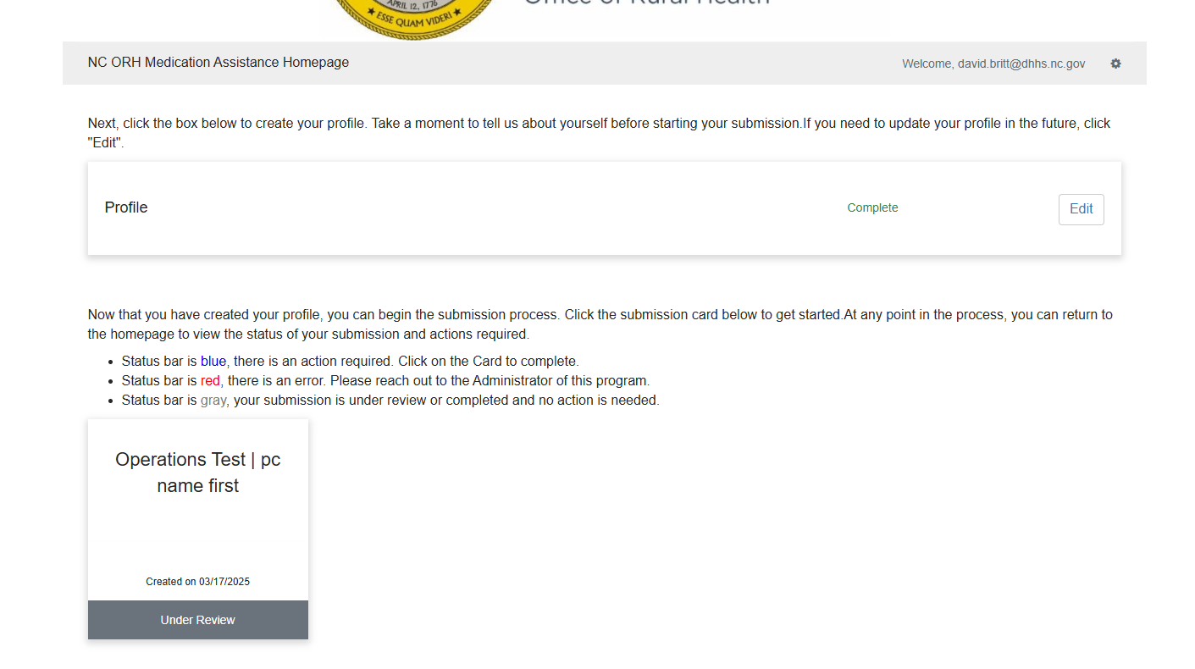
Portal Homepage (Previous Zengine Applicants)

Slide 12
Portal Homepage

Slide 13
Profile

Slide 14
Profile (Cont.)

Slide 15
Profile (Cont.)

Slide 16
Expectations
All safety net organizations that provide medication assistance programs for uninsured, low-income patients are eligible to apply.
Only one application may be submitted per eligible organization. An eligible organization must submit one application rather than applications by service site, “doing business as,” or under separate EINs that are all connected to the same eligible organization.
As a condition of receiving a grant award, successful applicants must:
Complete the contract process
Use an electronic financial software application (EXCEL spreadsheets are not acceptable formats)
Dispense prescription drugs according to NC Board of Pharmacy dispensing policies
Comply with ORH’s policies and procedures for contract development, execution, and management
Connect or have a plan to connect to NC HealthConnex
Grantees will submit Monthly Expenditure Reports (MERs) to request reimbursement
The Pharmacy Connection (TPC) web-based application will be utilized to determine eligibility for free or low-cost prescription drug programs offered through pharmaceutical companies.
The Pharmacy Connection user and license fee is a reimbursable line-item expense of this grant.
Grantees are required to participate in Monthly Technical Assistance Sessions, which provide dedicated time for technical support, grant topic discussions, collaboration and Q&A.

Slide 17
Application Overview
Application Areas to be Completed | Points
Overview of Organization | 5 Points
Community Need and Patient Population | 15 Points
Addressing Community Need | 15 Points
Utilization of Funds | 15 Points
Use of State Dollars | 15 Points
Community Partnerships | 10 Points
Insurance Breakdown of Patients | 5 Points
Budget | 20 Points
 | Total Points 100

Slide 18
5 Points Give a general summary of your organization. There are set questions regarding hours your clinic is open, patient services, and capacity, etc.
Overview of Organization

Slide 19
15 Points Describe the population served by this grant proposal. Include the population’s: - healthcare needs, - service area needs, - incidence of poverty, - unemployment, - uninsured rates, and - chronic disease rates. Describe other pertinent demographic data that support the necessity for grant funding. **Essay should not include bullets or tables**
Community Need and Patient Population

Slide 20
15 Points Describe how these funds will address the need for medication assistance in the communities your organization serves. **Essay should not include bullets or tables**
How will access to MAP funds address community need?

Slide 21
15 Points Describe the purpose of the grant. The project description should be specific on what medication assistance related services you plan to fund with this grant. Include proposed activities, timelines to implement grant activities, and anticipated outcomes. Will your dispensing plan be compliant with the NC Board of Pharmacy? **Essay should not include bullets or tables**
How will your agency utilize these funds?

Slide 22
15 Points Describe the process you will use to evaluate how the proposed use of funds affects the population and/or community need. **Essay should not include bullets or tables**
Why is the proposed project a good use of State dollars?

Slide 23
10 Points Describe all project partners and their respective roles. How will partnering with other community agencies increase the number of patients receiving medication assistance? **Essay should not include bullets or tables**
Current community partnerships and responsibilities of each agency.

Slide 24
5 Points List the current number of patients receiving pharmacy services who use private insurance, public insurance or are uninsured.
What is the insurance breakdown of patients receiving services at the pharmacy?

Slide 25
20 Points Proposed budget should align with the project Include accurate calculations
Budget – Reimbursement for eligible expenses

Slide 26
Budget Template
Guidance
Budget Template is located on RFA website, along with the application
Please be sure to use current version of SFY2026 & 2027 Budget Template
Template has specific instructions, including:
Things not to include in your salary costs, such as bonuses of any kind.
Fringe cannot exceed 30% of total line item for salary allocated to the grant.
Fringe only includes employer paid benefits.
Three tabs to complete
Personnel
Line-Item Budget
Budget Narrative
Must include $3,000 TPC user and license fee.

Slide 27
Performance Measures Our performance measures are required for all applicants

Slide 28
Performance measures, cont’d. For each measure, you will need to include the following information: Data Source: where will you obtain the information you report for your performance measures? (Reports from TPC Software) Collection Process and Calculation: what method will you use to collect the information? (Reports from TPC Software) Collection Frequency: how often will you collect the information? (We provide the answer to this!) Data Limitations: what may prevent you from obtaining data for your performance measures?

Slide 29
Measure Description | Number of Unduplicated Patients Served
Guidance | Patients are individuals who have at least one visit during the reporting period. Shot clinics are excluded.

Slide 30
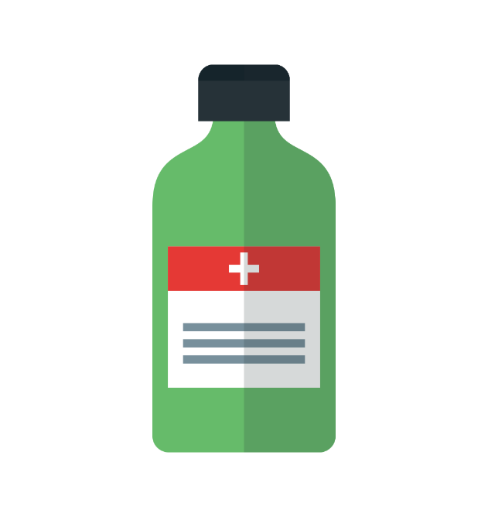
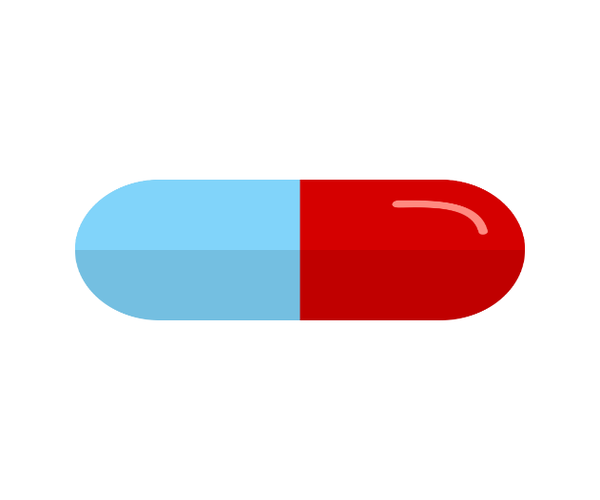
Measure Description | Value of Medications Received
Guidance | Value is defined as the cumulative average wholesale price of drugs received during SFY. TPC generates wholesale price based on patient prescription information entered into software platform by grantee.

Slide 31
Presented by: Lisa Hueston,
Program Manager

Slide 32
What is the Virginia Health Care Foundation & The Pharmacy Connection?
The Virginia Health Care Foundation (VHCF) is a mission-driven public/private partnership dedicated to helping uninsured Virginians and those who live in underserved communities obtain medical, dental and mental health care.
In addition to grants, VHCF has developed tools to make free and discounted prescription medicines available to those with chronic illnesses who can’t afford them. Created more than 25 years ago, The Pharmacy Connection (TPC) is VHCF’s flagship prescription access initiative.
TPC is currently used by 260 organizations in 15 states.

Slide 33
Background
VHCF, North Carolina Office of Rural Health (ORH), and Foundation for Health Leadership and Innovation (FHLI) have been in partnership since 2016.
ORH in partnership with FHLI previously supported a medication assistance software (MARP-Medication Access and Review Program) which was discontinued in 2016
Over 100 organizations transitioned from MARP to TPC
VHCF currently supports over 300 users/staff in North Carolina

Slide 34
Benefits of The Pharmacy Connection
TPC is a web-based application that makes it easier for health care providers to obtain free medications for chronically ill patients through pharmaceuticals company Patient Assistance Programs (PAPs).
Expedites access to more than 3,500 chronic disease medicines available via more than 370 free PAPs and low-cost generic programs including:
Specialty drugs, cancer treatments, Hepatitis C, HIV and vaccines
NC MedAssist, a statewide non-profit pharmacy in North Carolina that provides free prescription brand name, generic and over-the-counter medications at no cost to eligible NC residents.
Certain medical supplies and equipment (CPAP equipment, nebulizers, medical id bracelets, eyeglasses, nutritional supplements, diabetic testing supplies and more!)
Access to over 70 reports including the ability to track the number of unduplicated patients served, number of medications received, and the average wholesale dollar value of medications received.

Slide 35
Key Software Features
Database for patient & provider demographics - only needs to be entered once
Contains PAP eligibility criteria and pre-determines patient eligibility for each PAP
Auto populates PAP application forms
Tracks the status of applications
Has a user message center
Has a mobile medication app for easy medication lookup
Automates medication reorder reminders
Provides ability to print prescriptions for signature
Provides ability to print labels (ie: address labels, chart labels, medication bottle labels)
Includes ability to add custom letters for mailings
Includes Data Reports (over 70)
Is password protected and HIPAA compliant
And much more!

Slide 36
TPC Website Search Engine
Displays medications available in TPC at-a-glance by brand name, generic, class and subclass
Accessible from any device with internet access
No login required

Slide 37
Support & Technical Assistance
Beginner & Advanced TPC Training
Training manual, comprehensive manual & help videos
Monthly support calls
Semi-annual Roundtables
Phone/email support
Daily updates & regular enhancement upgrades
Quarterly e-newsletter

Slide 38
Next Steps
For organizations selected as a grantee, you are required to:
Use TPC to determine eligibility for free or low-cost prescription medications offered through PAPs
Sign a VHCF Business Associate Agreement
Sign a VHCF License Agreement
Attend a VHCF Training

Slide 39
QUESTIONS? Lisa Hueston Program Manager, The Pharmacy Connection Virginia Health Care Foundation 707 East Main Street, Suite 1350 Richmond, VA 23219 Phone: (804) 828-5803 Fax: (804) 828-4370 Email: lisa@vhcf.org tpc@vhcf.org

Slide 40
Funding Agency Contact/Inquiry Information:
Nicole Fields-Pierre at nicole.fields-pierre@dhhs.nc.gov
For assistance with the application link:
Sharema Williams, sharema.williams@dhhs.nc.gov
North Carolina Department of Health and Human Services Website
North Carolina Office of Rural Health Website

Slide 41
Questions?
This Photo by Unknown Author is licensed under CC BY-SA

