Slide 1
CHSA Update
Ginger Yarbrough, MPA, CPHQ, NADD-DDS Director – IDD, TBI & Olmstead
DMH/DD/SUS
May 10, 2024

Slide 2
Agenda
Introductions
MH/SU/IDD/TBI System Announcements & Updates
Inclusion Connects
Q&A

Slide 3
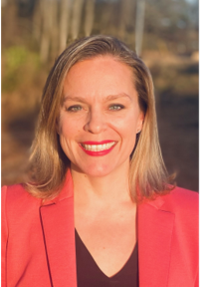
Ginger Yarbrough, MPA, CPHQ, NADD-DDS Director, IDD, TBI & Olmstead, DMH/DD/SUS
24 years in IDD/TBI & dual diagnosis (DD & MH) field
Experience as a Direct Support Professional, Care Manager, and Quality Management
DMHDDSUS since March 2023

Slide 4
MH/SU/IDD/TBI System Announcements & Updates

Slide 5
May Community Collaboration Topic: Inclusion Connects
If you’re interested in joining an advisory committee, please fill out this form!
Side by Side
5/6
SCFAC
LME/MCO Clinical
Providers & Associations
NCHA BH Workgroup
5/8
5/21
5/21
5/16
Workforce
(Peers)
5/9
5/1
Crisis System
Child Behavioral
Health
Advisory Committees
Workforce
(DSPs)
Supports for Justice-Involved Individuals
5/20
5/14
5/17
Notes:
Groups will be representative of the SCFAC, LME Clinical, and Provider groups
Design groups will present to
Other stakeholders: other advocates, mobile crisis providers (if not already captured under providers), DPH, etc., 911/988 operator
While design group will present to larger committees, the advisory committee will be opportunity to really dig deep on the targeted recommendations.

Slide 6
Samantha R. et al. vs. NCDHHS and the State of North Carolina
On April 10th, NCDHHS & Disability Rights North Carolina (DRNC) announced an agreement in the litigation. Click here to read the press release.
If the Samantha R. et al. vs. NCDHHS and the State of North Carolina litigation is approved by the Court, NCDHHS and DRNC will jointly discuss the consent order during two webinars in May
The webinars will present the same information so if you’re interested in joining, you only need to attend one of the webinars (*but you are welcome to attend both if that is your preference)
Samantha R. Webinar
May 9, 2024
Date/time: May 9, 2024, 6:00-7:00pm
Join Link: Register for the webinar
Samantha R. Webinar
May 10, 2024
Date/time: May 10, 2024, 2:00-3:00pm
Join Link: Register for the webinar

Slide 7
Tailored Plans &
The Accessible Communications Campaign

Slide 8
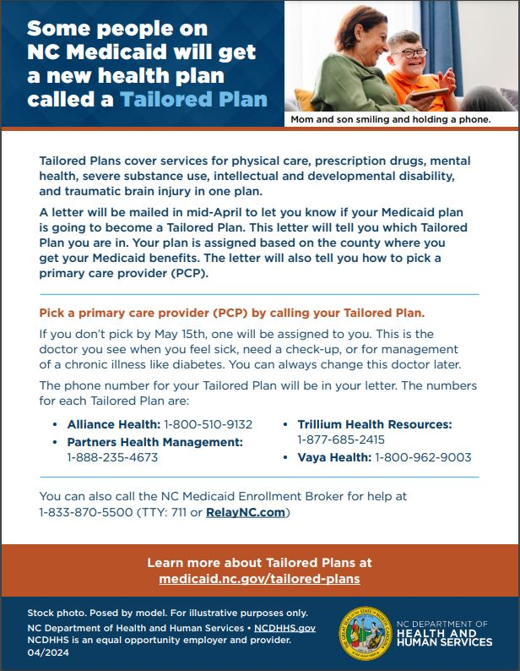
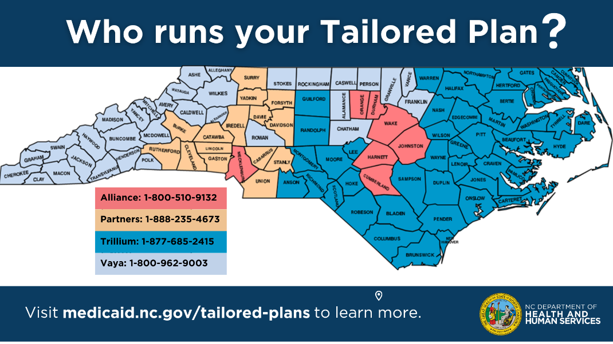
Accessible Communications Campaign
Materials for the July 1 Launch of Tailored Plans
Essentials deck in English and Spanish
One-page bilingual flyer
Social media posts in English and Spanish
Tailored Plan landing page
Tailored Plans communications toolkit

Slide 9
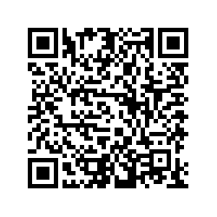
Priority Communications Survey
Share your input to help us determine what we develop in partnership with Division of Health Benefits and Neimand Collaborative next!
What is the top communications need for Tailored Plans?
Answer here.
Or scan to answer ⤴

Slide 10
Inclusion Connects

Slide 11
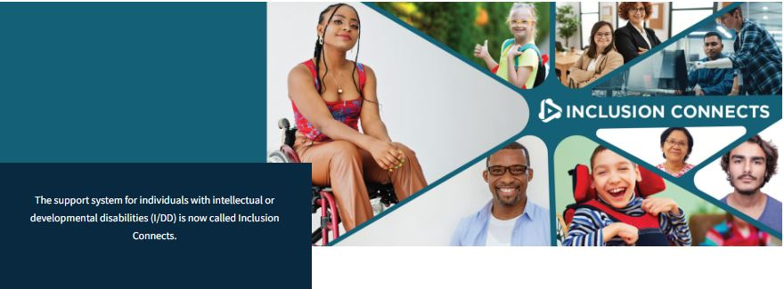
Inclusion Connects Launched on 3/14!
NCDHHS initiative providing resources for connecting individuals with I/DD to services and supports available to live, work and play in their chosen communities.
Click here to visit the Inclusion Connects website and click here to read the press release
Inclusion Connects focuses on:
Improving access and enhancing the housing array for individuals with I/DD.
Promoting access to services for all individuals in need of services, including those on the Innovations Waiver Waitlist.
Addressing the Direct Support Professional (DSP) Workforce Shortage, including connecting DSPs with providers and individuals with I/DD.

Slide 12
What is Inclusion Connects?
The I/DD support system in North Carolina is evolving into ‘Inclusion Connects’, a name that reflects the Department’s deepened commitment to fostering community connections through inclusivity.
The goals of Inclusion Connects are focused on five key points:
Building a system for everyone, together.
Making sure everyone has what they need to live, work, and play where they want.
Helping people live the lives they want.
Improving career opportunities and benefits for DSPs.
Helping everyone in North Carolina thrive.
Notes:
Inclusive Policy Making: Underlining the importance of inclusive policy-making that involves individuals with I/DD, their families, caregivers, and members of their support network, in the decision-making process to ensure policies meet their needs and rights.
Centralized Access to Resources: Providing resources and information about available services for individuals with I/DD in a centralized, user-friendly format.
Streamlined Transition to Community-based Care: Enhancing access to the full spectrum of community-based settings for individuals who choose to transition from institutionalized care into the community.
Strengthening the Direct Support Professional Workforce: Improving career opportunities and benefits for DSPs to build a robust workforce that delivers high-quality care and support to individuals with I/DD.
Statewide Accessibility and Awareness: Increasing statewide accessibility and awareness, ensuring that every individual, regardless of their disability or location, can thrive in North Carolina.

Slide 13
NC DHHS: Inclusion Connects
The NC DHHS Inclusion Connects initiative is working to build a more robust community-based service system that supports the ability of individuals with I/DD to live in an integrated setting of their choice.
Inclusion Connects focused on promoting access to available services for individuals on the Innovations Waiver waitlist, supporting people with I/DD to live in the community they choose, and building a robust high-quality DSP workforce.
Access to Services
As of November 2023, 17,500+ individuals are on the NC Innovations Waiver Waitlist. NC DHHS is committed to improving access to services and supports to all people with I/DD, including those on the Innovations Waitlist.
Transition / Housing
DHHS is committed to expanding and enhancing innovative supports and services that support individuals with I/DD to live and thrive in the community they choose.
DSP Workforce
A crucial key to access of services includes building a robust workforce of well-trained, high-quality Direct Support Professionals (DSP). NC DHHS is committed to supporting these critical members of the support team.
Cross-Divisional Engagement: The Inclusion Connects DHHS Team consists of a diverse group of subject-matter experts from across the Department to support detailed planning efforts, including representatives from DSOHF, DMHDDSUS, DHB / Medicaid, Office of the Secretary, Legal, Communications, Budget & Finance, and Data & Reporting.
Community and Stakeholder Engagement: Inclusion Connects includes a stakeholder advisory group called the Inclusion Connects Advisory Committee (ICAC) which will launch May 2024. ICAC will consist of people with lived experience, caregivers, advocates, MCO reps, providers, and DSPs. This committee will guide our initiatives to support inclusive policy-making.

Slide 14
Direct Support Professionals (DSPs): Why Do We Need a Strategy?
Without changes, by 2030, North Carolina is projected to have a total of 182,400 direct care job openings
In 2021, the average turnover rate among DSPs was 43%
People on the Innovations wavier are not getting all of their authorized services.
We have the iOption and new waiver slots
Of I/DD providers surveyed:
66% turned away new referrals
34% discontinued services
Notes:
14.5% of men and 31.0% of women in jails have a serious mental illness

Slide 15
DSP Workforce
The DSP Workforce Framework is structured around a common goal intended to improve key outcomes that are tied to getting services to individuals with I/DD.
Objective: Mitigate the shortage of the DSP Workforce through strategic recruitment, enhanced training, and improved worker retention.
Year 1 Initiatives:
Awareness & Recruitment Campaign
Targeted efforts to raise awareness and attract new candidates to the DSP field.
Core Competency Curriculum
Development of essential skills and knowledge for DSP professionals.
DSP Certificate Program with Practicum
Credentialing process inclusive of hands-on experience.
Year 2 and Beyond Initiatives:
Supplemental Benefits
Additional perks and benefits to support DSP staff.
Workforce Enhancement through Technology
Leveraging tech solutions to improve DSP work processes.
DSP Directory Program
A listing or network to connect DSPs with service opportunities.
Key Outcomes Expected:
Increased Community Living Support (CLS) utilization rate.
Decreased wait time for services due to DSP availability.

Slide 16
Q&A

Slide 17
Appendix

Slide 18
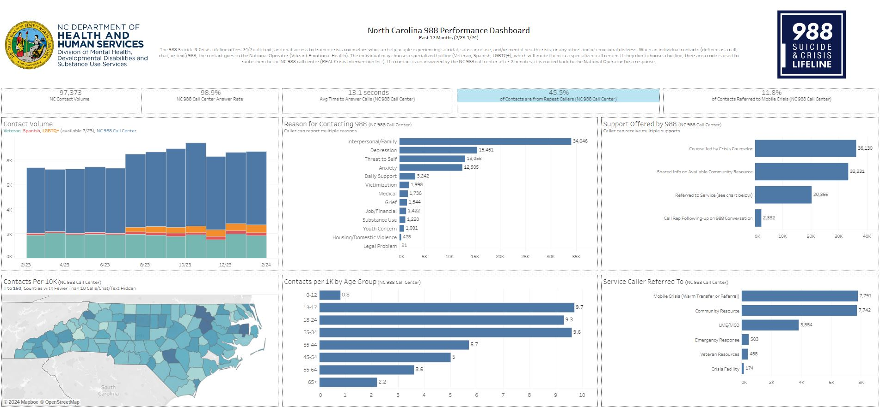
988 Performance Dashboard
You can access the dashboard on the DMHDDSUS website and the press release on the DHHS website

Slide 19
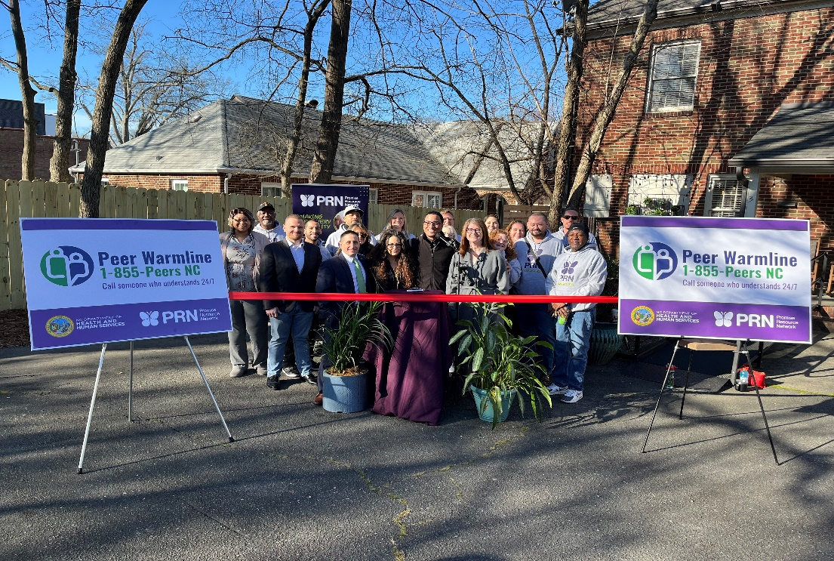
The Statewide Peer Warmline Launched on 2/20!
People are calling 988 looking for support and resources.
40% of people are repeat callers
The Peer Line is open 24/7/365
People can call the Peer Warmline Directly OR 988 can do a warm transfer
Peer Support Specialists are people living in recovery with a mental illness and/or substance use disorder
offer non-clinical support and resources to those who reach out
offer a unique perspective of shared experiences
Read the press release here!

Slide 20
On 4/8, NCDHHS Announced a $15M Investment in 9 Behavioral Health Urgent Care Centers (BHUCs) throughout the state
*To read the press release, click here

Slide 21
NCDHHS Invests $22 Million in Community Crisis Centers and Peer Respite in North Carolina
*Click here to read the press release!
Community Crisis Centers
Peer Respite in Wake County
Provide short-term inpatient mental health stabilization and substance use detox for people in the community
Adding 5 centers for adults in Alamance, Forsyth, New Hanover, Pitt and Vance Counties
Adding 3 centers for children in Gaston, Pitt, and Vance counties
Voluntary resource for people seeking mental health, substance use or behavioral health crisis support
Offers 24/7 access to Peer Support Specialists who provide support from the perspective of lived experience

Slide 22
Medicaid Expansion Launched on Dec. 1!
You can access the Medicaid Expansion Toolkit, trainings, and FAQs on the NC Division of Health Benefits (Medicaid)’s website

Slide 23
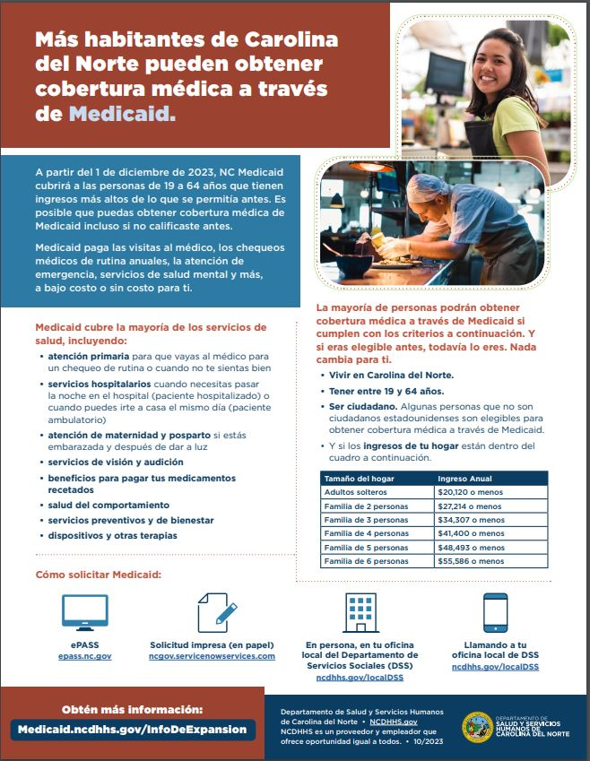
Learn How to Apply With ePASS (Spanish and English versions)

Slide 24
Medicaid Expansion Dashboard
On December 20th, DHHS released a dashboard to track monthly enrollment in Medicaid for people eligible through expansion. You can read the press release here.

Slide 25
LME/MCO Dashboard
Department-wide monthly dashboard of key outcomes for the Behavioral Health System.
Our goal is a tool that highlights our shared priorities and opportunities for improvement.
If we can better define the problem, we can better work together to solve it.
The key measures are:
Medicaid, Children in ED & DSS Settings
Medicaid, Children in Psychiatric Residential Treatment Facilities (PRTFs)
Consumers in State Psych Hospitals Ready for Discharge
People on Innovations Waitlist Receiving Any Medicaid or State BH/IDD Service
Follow-up Within 7 Days After Inpatient Discharge
We reviewed the dashboard in the October 2023 Side by Side webinar.
The most recent report was published in November 2023 on DMH/DD/SUS’ website at: Reports | NCDHHS.

Slide 26
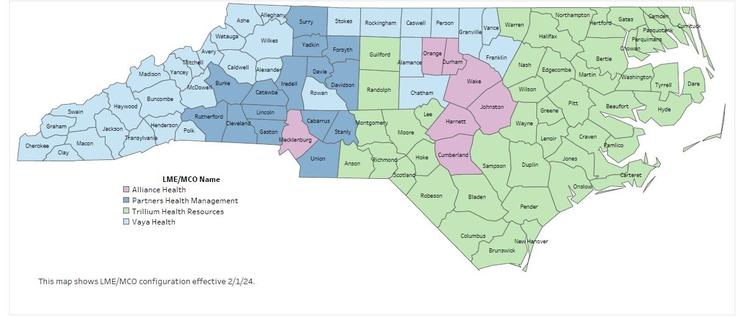
February 1, 2024: LME-MCO System
LME/MCOs serve as the public behavioral health infrastructure. They manage the care of NC beneficiaries who receive publicly-funded mental health and substance use services. LME-MCOs will operate Tailored Plans.

Slide 27
Behavioral Health Budget Provisions
Provision | FY24 | FY25
Crisis System (e.g. mobile, FBCs) | $30M | $50M
Crisis Stabilization (short-term shelter) | ~$3M | ~$7M
Non-Law Enforcement Transportation Pilot Program | $10M | $10M
BH SCAN | $10M | $10M
Justice-Involved Programs Community-based pre-arrest diversion and reentry programs; fund partnerships between law enforcement, counties, and BH providers Community-based and detention center-based restoration programs | $29M | $70M
Behavioral Health Workforce Training | ~$8M | $10M
NC Psychiatry Access Line (NC PAL) | ~$4M | ~$4M
Behavioral Health Rate Increases | $165M | $220M
State Facility Workforce Investment | $20M | $20M
Electronic Health Records for State Facilities |  | $25M
Child Welfare and Family Well-Being | $20M | $60M
Collaborative Care | $2.5M | $2.5M
Crisis
Justice
Workforce /Wellness/ Recovery

Slide 28
BH Reimbursement Rate Increases
Link: Behavioral Health Reimbursement Rates Increased for the First Time in a Decade
The rate increases represent an approximate ~20% increase in overall Medicaid funding for behavioral health across all impacted services
Rate increases should:
Recruit more BH providers into the public BH system
Improve access to inpatient psychiatric care in community hospitals
Invest in recovery-oriented services in the community

Slide 29
I/DD & TBI Budget Provisions
Provision | FY24 | FY25
350 new Innovations slots | $29.33M | $29.33M
Innovations Direct Support Professional Wage increases | $176M | $176M
Competitive Integrated Employment | $5M | $5M
Personal Care Service (PCS) Rate Increases | $176M | $176M
Authority to expand TBI waiver statewide​

Slide 30
NC Medicaid Innovations Waiver Provider Rate Increase
Link: Innovations Rate Increases for DSPs​
The NC General Assembly appropriated $176 million in state and federal recurring funding to raise NC Medicaid Innovations waiver services rates for DSPs​.
Services with an increase:​
Residential Supports​
Supported Employment​
Respite Care​
Community Living and Supports​
Day Supports​
Supported Living

Slide 31
Private Duty Nursing
Jennifer Moore, MA, LCMHC
5/8/24

Slide 32
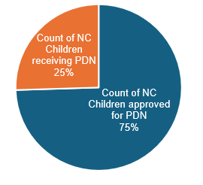
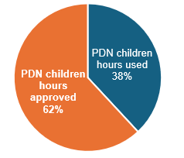
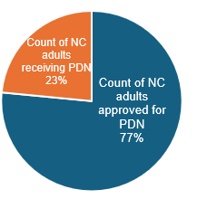
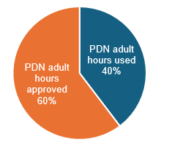
Total PDN Population SFY 2023
Sources: DR# 2024.2475, DR# 2024.2776
Data Element | PDN PEDIATRICS | PDN ADULTS | Total
NC population approved for PDN | 1,234 | 437 | 1,671
NC population receiving PDN | 422 | 134 | 556
PDN Hours Used | 1,433,035 | 570,585 | 2,003,620
PDN Hours Approved | 2,330,030 | 867,450 | 3,197,480
Hourly payment rates for PDN to agencies | $52.00 per hour | $52.00 per hour | N/A
Total Appeals Report for PDN, Home Health and Hospice: March 2024
Source: Members Appeals Clearinghouse March 2024
Program | Adverse Letters | Hearing Requests | Mediations
PDN | 13 | * | *
Home Health Services | * | N/A | N/A
Hospice Services | N/A | N/A | N/A
PDN Pediatrics Data SFY 2023
% of NC Children receiving and approved for PDN
% PDN Children hours used and approved
PDN Adults Data SFY 2023
% of NC adults receiving and approved for PDN
% PDN adults hours used and approved
Notes:
Reasons for unused PDN hours by category: DHB does not track reasons for unused PDN hours
Percentage of agency payment passed on to nurses: DHB does not have data available regarding percentage of payment passed on to nurses employed by a PDN agency.

Slide 33
Questions:
What data is collected from the PDN providers?
Information collected from PDN providers aligns with CCP (Clinical Coverage Policy 3G-1 and 3G-2, Section 5.0 Requirements for and Limitations on Coverage) specific to clinical and/or administrative documentation required for prior authorization review.
Who is accountable for authorizing PDN hours and communicating/directing the PDN providers?
PDN prior approval requests are reviewed by Medicaid Nurse Consultant staff. Any decisions adverse to the member are completed by the Medicaid CMO (Chief Medical Officer).
Who can consumers contact regarding PDN issues?
For PDN issues, Medicaid encourages members and families to reach out to their PDN provider(s). Additionally, members and families may also reach out to the NC Medicaid Contact Center at 888-245-0179

