Slide 1
MEDICINE, AGE, AND YOUR BRAIN
North Carolina Building Our Largest Dementia (NC BOLD) Infrastructure Project

Slide 2
MEDICINE, AGE, AND
YOUR BRAIN
A presentation by:
North Carolina Building Our Largest Dementia (NC BOLD) Infrastructure Project

Slide 3
YOUR BODY AND BRAIN CAN CHANGE WITH AGE
The aging process is normal:
Your brain’s physical structure and abilities change.
Your circulatory and digestive systems, kidneys, and liver slow down.
Your body’s ability to break down and use medicine changes.
All of this means your reactions to medicines change, too.

Slide 4
AGING AND HEALTH PROBLEMS
Aging is linked to multiple health problems.
80% of older adults have at least one chronic health problem
50% have at least two
Health problems may require medicines that interact with each other in harmful ways.
Medicines can also interact with food, supplements, natural products, alcohol, or even with another health condition. These interactions can cause problems.
Some of these medicines and interactions can affect how your brain functions.
Notes:
A drug interaction happens when one medicine affects how another works when a person takes the medicines together.

Slide 5
MEDICINES AND YOUR BRAIN
Some reactions to medicines can affect your cognition—your ability to think, understand, learn, plan, and remember.
Cognitive reactions or side effects can include confusion, memory loss, hallucinations, and delusions.
Some people mistake cognitive side effects for a form of dementia, like Alzheimer’s disease.

Slide 6
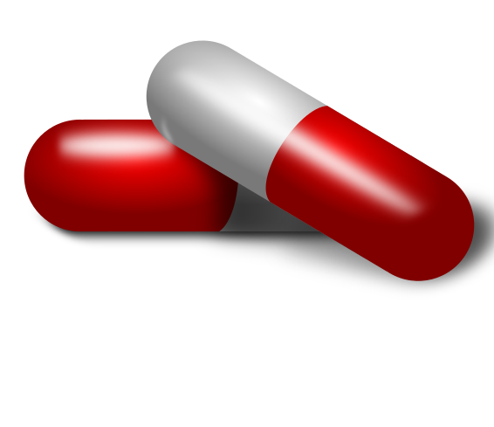
MEDICINES AND COGNITIVE SIDE EFFECTS
The U.S. Institute of Medicine lists some groups of drugs that can harm an older adult's cognition:
Antihistamines for allergy relief
Anti-anxiety and antidepressant medicines
Sleep aids
Antipsychotics
Muscle relaxants
Antimuscarinics to promote control of urination
Antispasmodics for relief of cramps in the stomach, intestines, and bladder
You may need some of these medicines to treat your health problems, or you may be able to use alternatives.

Slide 7
YOU CAN HELP PREVENT COGNITIVE SIDE EFFECTS
Discuss your list of medicines—including over-the-counter drugs, vitamins, supplements, and any natural products—with your health care professional.
Describe any new or existing problems with your cognition, even if you don’t think they are related to what you take.
Your health care provider will use this information to work with you to get the best treatments possible.
Do not stop taking medicines without talking with your doctor—stopping medicines can be risky.
Notes:
Health care professionals can be doctors, nurse practitioners, physician assistants, nurses, or pharmacists, among others.

Slide 8
QUESTIONS TO ASK YOUR HEALTH CARE PROFESSIONAL
What is the name of this medicine and why am I taking it?
How should I take this medicine?
How long will this medicine take to work? When can I stop it?
Does this medicine have any side effects on my body or brain and when should I call you about them?
Could this medicine affect my cognition? How can I protect myself against this?
Can I safely mix this medicine with the remedies, vitamins, natural products and other drugs I take?
Is there another drug or a non-drug treatment that might be safer or more effective for my body and brain?
Do I still need to be on all my medicines?

Slide 9
MORE INFORMATION
Free Consumer Information from the American Geriatric Society: http://geriatricscareonline.org/ProductAbstract/american-geriatrics-society-updated-beers-criteria-for-potentially-inappropriate-medication-use-in-older-adults/CL001
Note: You must register to get the information.
Centers for Disease Control and Prevention (CDC) webpage on older adults and medicinal side effects: http://cdc.gov/MedicationSafety/Adult_AdverseDrugEvents.html
The Food and Drug Administration (FDA) guide for older adults: http://fda.gov/Drugs/ResourcesForYou/ucm163959.htm
Institute of Medicine’s Consumer Brain Health Guide: https://iom.nationalacademies.org/~/media/Files/Report%20Files/2015/Cognitive_aging/Action%20Guide%20for%20Individuals%20and%20Families_V3.pdf
National Institutes of Health fact sheet on taking medicines safely:
English: https://www.nia.nih.gov/health/publication/medicines
Spanish: https://www.nia.nih.gov/espanol/publicaciones/medicamentos

Slide 10
Thoughts and Questions?
North Carolina Building Our Largest Dementia (NC BOLD) Infrastructure Project

