Slide 1
2023 NORTH CAROLINA DEMENTIA CAREGIVER DATA BRIEF
North Carolina Building Our Largest Dementia (NC BOLD) Infrastructure Project

Slide 2
2023 NORTH CAROLINA DEMENTIA CAREGIVER DATA BRIEF
North Carolina Building Our Largest Dementia (NC BOLD) Infrastructure Project

Slide 3
“There are only four kinds of people in the world. Those who have been caregivers. Those who are currently caregivers. Those who will be caregivers, and those who will need a caregiver.”
Rosalyn Carter
2023 NORTH CAROLINA DEMENTIA CAREGIVER DATA BRIEF: COSTS, UNIQUE CHALLENGES AND FUTURE IMPLICATIONS
North Carolina Building Our Largest Dementia (NC BOLD) Infrastructure Project

Slide 4
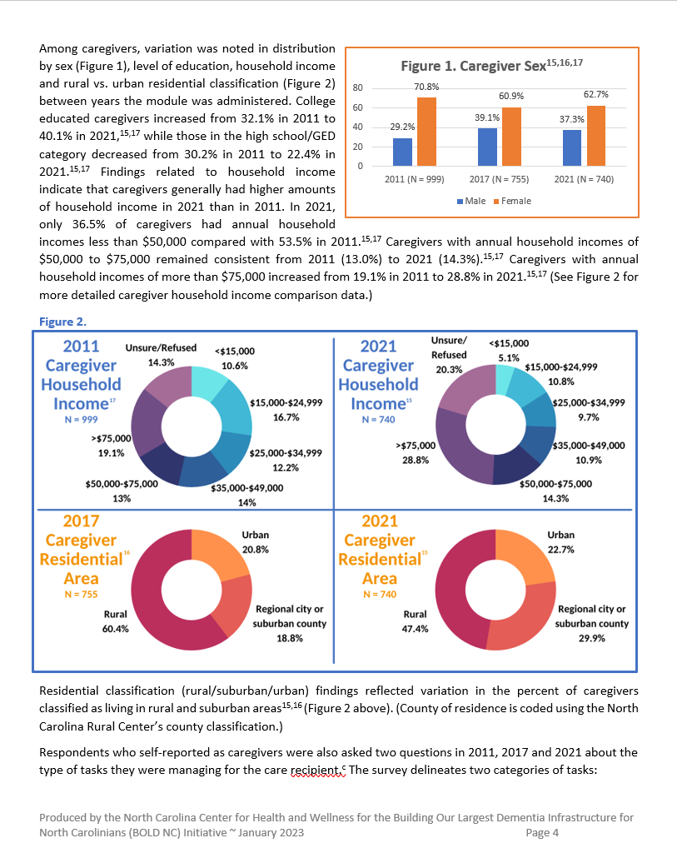
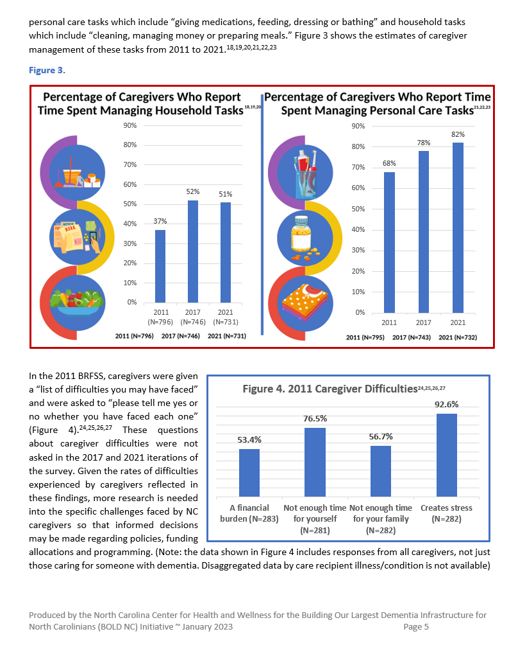
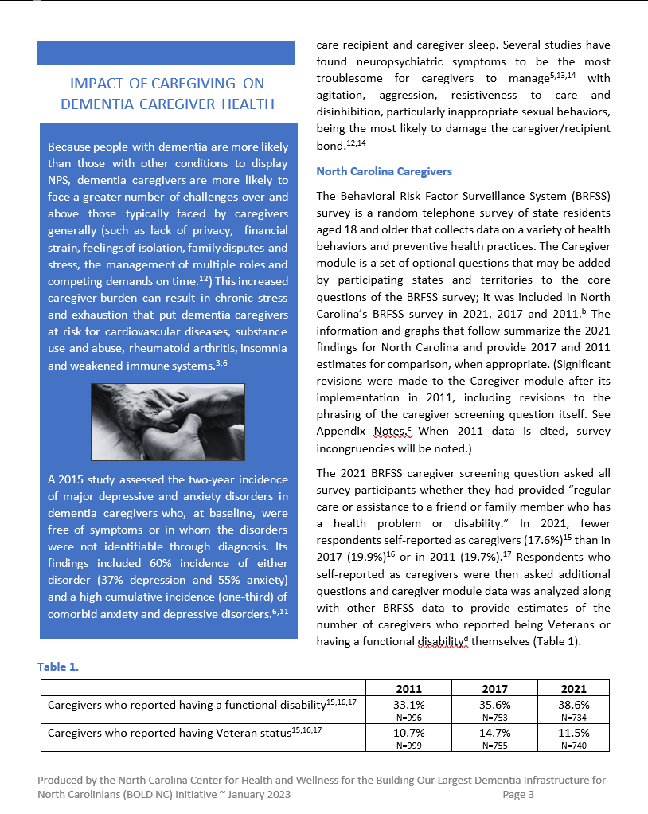
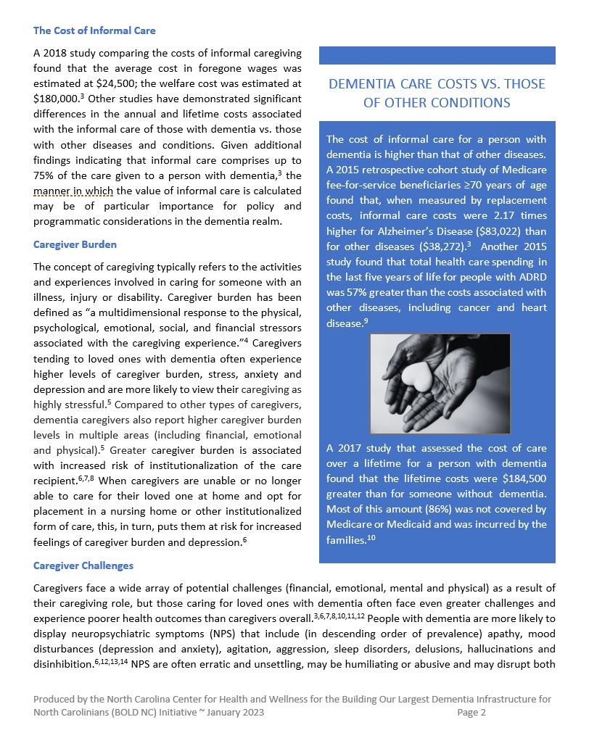
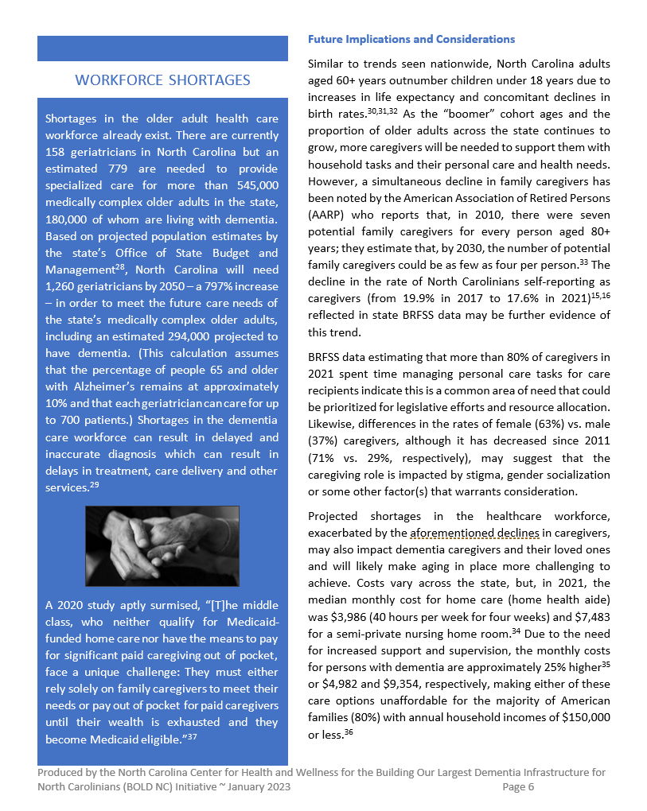
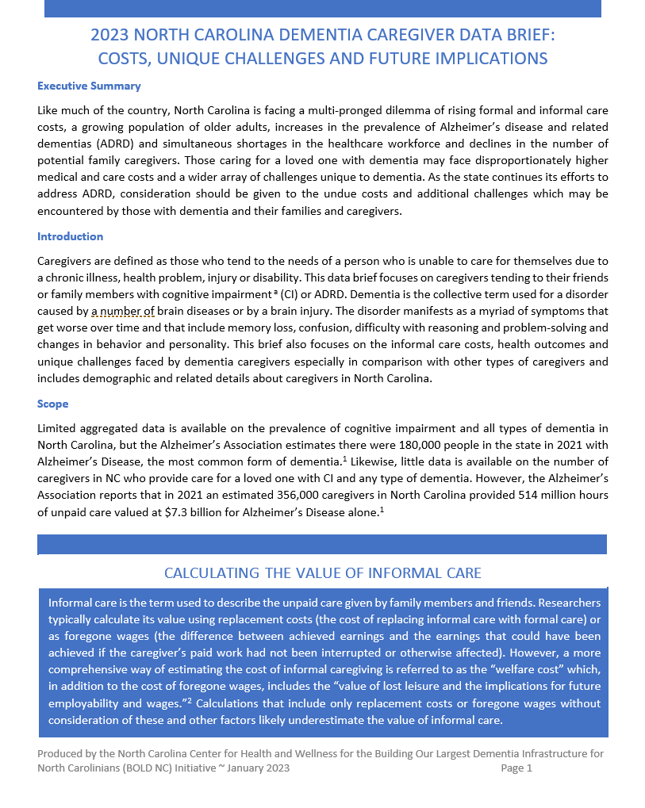
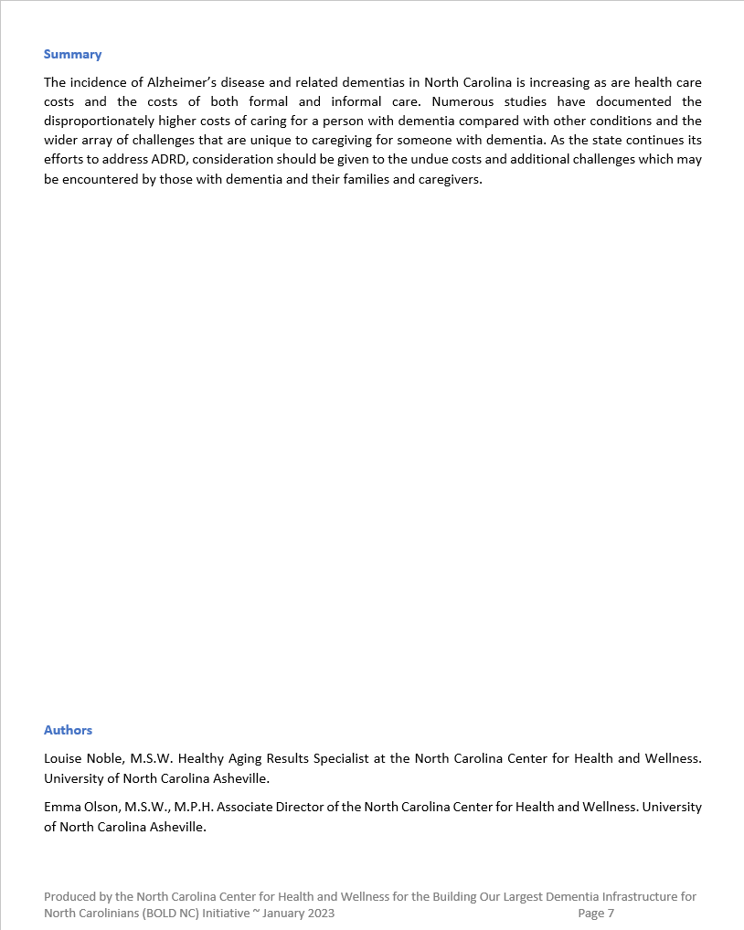
DESIRED RESULTS:
Increase the availability of dementia caregiver and healthcare workforce data to inform state plan priorities and health promotion communication resources
Increase awareness of the unique challenges faced by dementia caregivers
Increase awareness of the costs of informal caregiving
North Carolina Building Our Largest Dementia (NC BOLD) Infrastructure Project

Slide 5
DISEASE PREVALENCE &
CAREGIVING SCOPE (2021 DATA):
180,000 North Carolinians with Dementia + 356,000 providing care for them
514,000,000 hours of informal care
Value of informal care: $7,300,000,000
North Carolina Building Our Largest Dementia (NC BOLD) Infrastructure Project
Alzheimer’s Association. (2022). North Carolina Blog. North Carolina Legislative Update. Retrieved from https://alzheimersnorthcarolina.blog/2022/11/13/north-carolina-legislative-update-november-2022/#:~:text=In%202021%2C%20356%2C000%20North%20Carolina,the%20future%20for%20our%20state

Slide 6
INFORMAL CARE: DEFINITION AND DISTINCTIONS
Unpaid care by family members and friends.
Typically calculated as:
Replacement cost – cost of replacing informal care with formal care
Foregone wages – the difference between achieved earnings and the earnings that could have been achieved
North Carolina Building Our Largest Dementia (NC BOLD) Infrastructure Project

Slide 7
CALCULATING THE TRUE VALUE OF INFORMAL CARE
Replacement cost and foregone wage calculations likely underestimate the value of informal care. The “welfare cost” calculation is more comprehensive. It includes:
Cost of foregone wages
Value of lost leisure
Implications for future employability and wages
A 2018 study comparing the costs of informal caregiving found that the average cost in foregone wages was estimated at $24,500; the welfare cost was estimated at $180,000.
North Carolina Building Our Largest Dementia (NC BOLD) Infrastructure Project
Coe, N., Skira, M., and Larson, E. (2018). A Comprehensive Measure of the Costs of Caring for a Parent: Differences According to Functional Status. Journal of the American Geriatrics Society, 66 (10), 2003-2008. https://doi-org.proxy177.nclive.org/10.1111/jgs.15552

Slide 8
INFORMAL CARE COSTS FOR THOSE WITH DEMENTIA
VS. THOSE WITH OTHER DISEASES & CONDITIONS
Lifetime costs for a person with dementia were $184,500 greater than for someone without dementia. Most of this amount (86%) was not covered by Medicare or Medicaid and was incurred by the families.¹⁰
Total health care spending in the last five years of life for people with ADRD was 57% greater than the costs associated with other diseases.
Informal care costs were 2.17 times higher for Alzheimer’s Disease ($83,022) than for other diseases ($38,272).
Wong, W. (2020). Addressing Unmet Needs in Alzheimer Disease: Implications of Delayed Diagnosis and Examining New and Emerging Therapies. American Journal of Managed Care. 26(8), S177-S183. https://doi.org/10.37765/ajmc.2020.88482.
National Institutes of Health. Health care costs for dementia found greater than for any other disease. Retrieved from: https://www.nih.gov/news-events/news-releases/health-care-costs-dementia-found-greater-any-other-disease#:~:text=In%20the%20last%20five%20years,including%20cancer%20and%20heart%20disease
Jutkowitz, E., Kane, R. L., Gaugler, J. E., MacLehose, R. F., Dowd, B., & Kuntz, K. M. (2017). Societal and family lifetime cost of dementia: Implications for policy. Journal of the American Geriatrics Society, 65(10), 2169–2175. https://doi.org/10.1111/jgs.15043
North Carolina Building Our Largest Dementia (NC BOLD) Infrastructure Project

Slide 9
INFORMAL CARE: POLICY AND PROGRAMMATIC CONSIDERATIONS
Informal care costs 2.17 times higher for ADRD
Lifetime care costs $185k greater
86% not covered by Medicare or Medicaid
Informal care comprises up to 75% of the care given to a person with dementia
For these and other reasons, the way we calculate the value of informal care may be of particular importance for policy and programmatic considerations.
North Carolina Building Our Largest Dementia (NC BOLD) Infrastructure Project

Slide 10
CAREGIVER BURDEN: DEFINITION & CHALLENGES
Caregiver burden – “a multidimensional response to the physical, psychological, emotional, social, and financial stressors associated with the caregiving experience.”
Dementia Caregivers are more likely to view their caregiving as highly stressful and to experience poorer health outcomes. They also experience higher levels of:
Caregiver burden
Stress
Anxiety
Depression
Etters, L., Goodall, D., & Harrison, B. (2008). Caregiver Burden Among Dementia Patient Caregivers: A Review of the Literature. Journal of the American Academy of Nurse Practitioners, 20(8), 423-428. https://doi-org.proxy177.nclive.org/10.1111/j.1745-7599.2008.00342.x
Ruotong Liu, MPP, Iris Chi, DSW, Shinyi Wu, PhD, Caregiving Burden Among Caregivers of People With Dementia Through the Lens of Intersectionality, The Gerontologist, Volume 62, Issue 5, June 2022, Pages 650–661, https://doi.org/10.1093/geront/gnab146
North Carolina Building Our Largest Dementia (NC BOLD) Infrastructure Project

Slide 11
CAREGIVER BURDEN: DEFINITION & CHALLENGES
Dementia caregivers report higher caregiver burden levels in multiple areas (including financial, emotional and physical).
Greater caregiver burden is associated with increased risk of institutionalization of the care recipient.
When caregivers are no longer able to care for their loved one at home and opt for placement, this puts them at risk for increased caregiver burden and depression.
Ruotong Liu, MPP, Iris Chi, DSW, Shinyi Wu, PhD, Caregiving Burden Among Caregivers of People With Dementia Through the Lens of Intersectionality, The Gerontologist, Volume 62, Issue 5, June 2022, Pages 650–661, https://doi.org/10.1093/geront/gnab146
Cheng, ST. Dementia Caregiver Burden: A research update and critical analysis. Curr Psychiatry Rep 19, 64 (2017). https://doi.org/10.1007/s11920-017-0818-2
Eska, K., Graessel, E., Donath, C., Schwarzkopf, L., Lauterberg, J., & Holle, R. (2013). Predictors of institutionalization of dementia patients in mild and moderate stages: a 4-year prospective analysis. Dementia and geriatric cognitive disorders extra, 3(1), 426–445. https://doi.org/10.1159/000355079
Gaugler, J. E., PhD., Wall, M. M., PhD., Kane, R. L., M.D., Menk, J. S., M.S., Sarsour, K., PhD., Johnston, J. A., M.D., Schuh, K., PhD., & Newcomer, R., PhD. (2011). Does caregiver burden mediate the effects of behavioral disturbances on nursing home admission? The American Journal of Geriatric Psychiatry, 19(6), 497-506. http://0-search.proquest.com.wncln.wncln.org/scholarly-journals/does-caregiver-burden-mediate-effects-behavioral/docview/873571423/se-2
North Carolina Building Our Largest Dementia (NC BOLD) Infrastructure Project

Slide 12
CAREGIVER BURDEN: DEFINITION & CHALLENGES
People with dementia are more likely to display neuropsychiatric symptoms (NPS) which may be unsettling, humiliating or abusive and often disrupt sleep. These NPS include:
Apathy
Mood disturbances
Agitation
Aggression
Sleep disorders
Delusions
Hallucinations
Disinhibition
Cheng, ST. Dementia Caregiver Burden: A research update and critical analysis. Curr Psychiatry Rep 19, 64 (2017). https://doi.org/10.1007/s11920-017-0818-2
Cheng, ST., Au, A., Losada, A. et al. Psychological interventions for dementia caregivers: What we have achieved, what we have learned. Curr Psychiatry Rep 21, 59 (2019). https://doi.org/10.1007/s11920-019-1045-9
Kwon, C. Y., & Lee, B. (2021). Prevalence of behavioral and psychological symptoms of dementia in community-dwelling dementia patients: A systematic review. Frontiers in psychiatry, 12, 741059. https://doi.org/10.3389/fpsyt.2021.741059
Lyketsos CG, Lopez O, Jones B, Fitzpatrick AL, Breitner J, DeKosky S. Prevalence of neuropsychiatric symptoms in dementia and mild cognitive impairment: Results From the Cardiovascular Health Study. JAMA. 2002;288(12):1475–1483. doi:10.1001/jama.288.12.1475
North Carolina Building Our Largest Dementia (NC BOLD) Infrastructure Project

Slide 13
CAREGIVER BURDEN: DEFINITION & CHALLENGES
NPS are the most troublesome for caregivers to manage.
NPS that are most likely to damage the caregiver/recipient bond:
Agitation
Aggression
Resistiveness to care
Disinhibition (particularly inappropriate sexual behaviors)
Ruotong Liu, MPP, Iris Chi, DSW, Shinyi Wu, PhD, Caregiving Burden Among Caregivers of People With Dementia Through the Lens of Intersectionality, The Gerontologist, Volume 62, Issue 5, June 2022, Pages 650–661, https://doi.org/10.1093/geront/gnab146
Cheng, ST., Au, A., Losada, A. et al. Psychological interventions for dementia caregivers: What we have achieved, what we have learned. Curr Psychiatry Rep 21, 59 (2019). https://doi.org/10.1007/s11920-019-1045-9
Kwon, C. Y., & Lee, B. (2021). Prevalence of behavioral and psychological symptoms of dementia in community-dwelling dementia patients: A systematic review. Frontiers in psychiatry, 12, 741059. https://doi.org/10.3389/fpsyt.2021.741059
Lyketsos CG, Lopez O, Jones B, Fitzpatrick AL, Breitner J, DeKosky S. Prevalence of neuropsychiatric symptoms in dementia and mild cognitive impairment: Results From the Cardiovascular Health Study. JAMA. 2002;288(12):1475–1483. doi:10.1001/jama.288.12.1475
North Carolina Building Our Largest Dementia (NC BOLD) Infrastructure Project

Slide 14
DETAILED DATA: IMPACT ON CAREGIVER HEALTH
Dementia caregivers are more likely to experience challenges such as:
Lack of privacy
Financial strain
Feelings of isolation
Family disputes and stress
Dementia caregivers face an increased risk of:
Cardiovascular diseases
Substance use and abuse
Rheumatoid arthritis
Insomnia
Wong, W. (2020). Addressing Unmet Needs in Alzheimer Disease: Implications of Delayed Diagnosis and Examining New and Emerging Therapies. American Journal of Managed Care. 26(8), S177-S183. https://doi.org/10.37765/ajmc.2020.88482
Cheng, ST. Dementia Caregiver Burden: A research update and critical analysis. Curr Psychiatry Rep 19, 64 (2017). https://doi.org/10.1007/s11920-017-0818-2
Cheng, ST., Au, A., Losada, A. et al. Psychological interventions for dementia caregivers: What we have achieved, what we have learned. Curr Psychiatry Rep 21, 59 (2019). https://doi.org/10.1007/s11920-019-1045-9
North Carolina Building Our Largest Dementia (NC BOLD) Infrastructure Project

Slide 15
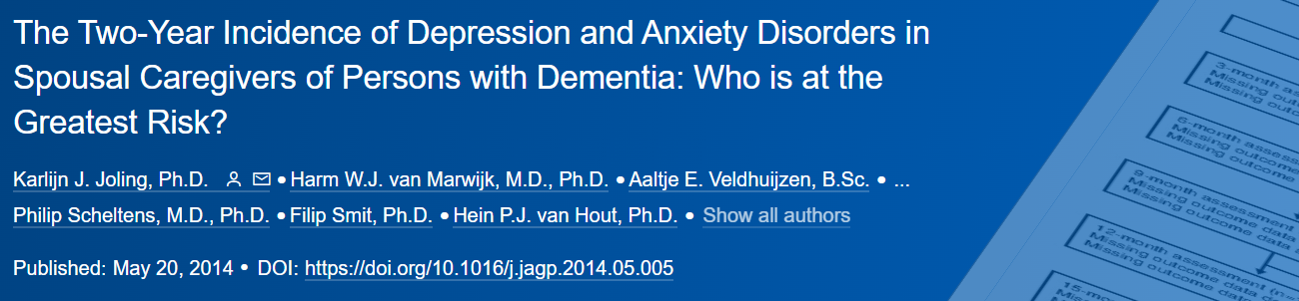
DETAILED DATA: IMPACT ON CAREGIVER HEALTH
In dementia caregivers who were free of symptoms at baseline:
60% incidence of either disorder (37% depression and 55% anxiety)
High cumulative incidence (33%) of comorbid anxiety and depressive disorders
North Carolina Building Our Largest Dementia (NC BOLD) Infrastructure Project
Joling KJ, van Marwijk HW, Veldhuijzen AE, van der Horst HE, Scheltens P, Smit F, et al. The two-year incidence of depression and anxiety disorders in spousal caregivers of persons with dementia: who is at the greatest risk? Am J Geriatr Psychiatry. 2015;23(3):293–303.

Slide 16
 | 2011 | 2017 | 2021
Caregivers who reported having a functional disability | 33.1% | 35.6% | 38.6%
Caregivers who reported having Veteran status | 10.7% | 14.7% | 11.5%
NC DEMENTIA CAREGIVER CHARACTERISTICS
NC BRFSS Caregiver Module Data:
2011, 2017 & 2021
North Carolina State Center for Health Statistics. (2021) 2021 BRFSS Survey Results: North Carolina – Caregiver Module. Retrieved from https://schs.dph.ncdhhs.gov/data/brfss/2021/nc/all/regcare.html
North Carolina State Center for Health Statistics. (2017) 2017 BRFSS Survey Results: North Carolina – Caregiver Module. Retrieved from https://schs.dph.ncdhhs.gov/data/brfss/2017/nc/all/regcare.html
North Carolina State Center for Health Statistics. (2011) 2011 BRFSS Survey Results: North Carolina – Caregiver Module. Retrieved from https://schs.dph.ncdhhs.gov/data/brfss/2011/nc/all/nc06q01.html
North Carolina Building Our Largest Dementia (NC BOLD) Infrastructure Project

Slide 17
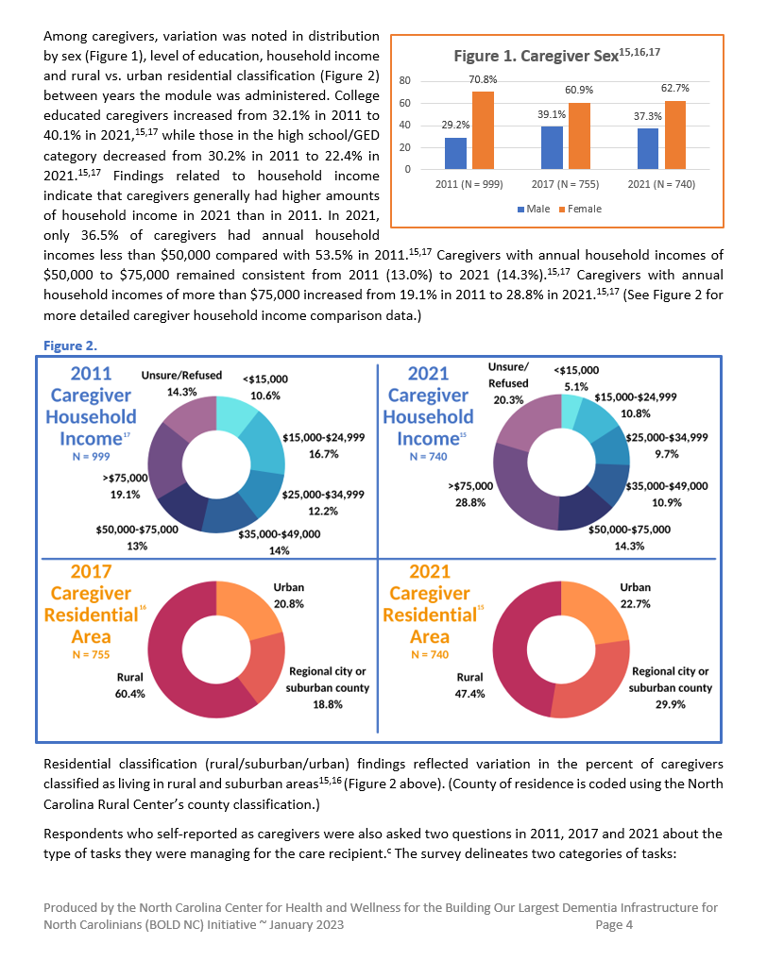
NC DEMENTIA CAREGIVER CHARACTERISTICS:
LEVEL OF EDUCATION
College educated caregivers increased from 32.1% in 2011 to 40.1% in 2021.
Caregivers with a high school education or GED certificate decreased from 30.2% in 2011 to 22.4% in 2021.
North Carolina State Center for Health Statistics. (2021) 2021 BRFSS Survey Results: North Carolina – Caregiver Module. Retrieved from https://schs.dph.ncdhhs.gov/data/brfss/2021/nc/all/regcare.html
North Carolina State Center for Health Statistics. (2011) 2011 BRFSS Survey Results: North Carolina – Caregiver Module. Retrieved from https://schs.dph.ncdhhs.gov/data/brfss/2011/nc/all/nc06q01.html
North Carolina Building Our Largest Dementia (NC BOLD) Infrastructure Project

Slide 18
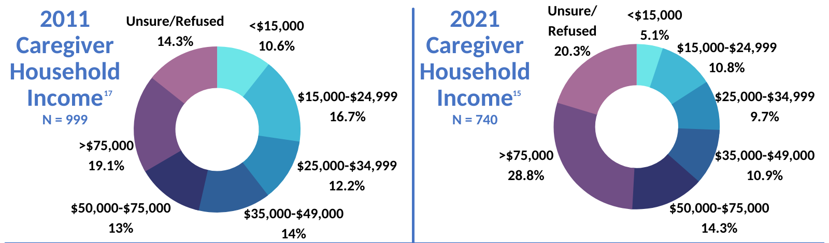
NC DEMENTIA CAREGIVER CHARACTERISTICS: ANNUAL HOUSEHOLD INCOME
Caregiver household incomes generally increased from 2011 to 2021.
Incomes <$50,000 decreased from 53.5% to 36.5%.
Incomes of $50,000 to $75,000 stayed about the same (13% in 2011 and 14.3% in 2021).
Incomes >$75,000 increased from 19.1% to 28.8%.
North Carolina State Center for Health Statistics. (2021) 2021 BRFSS Survey Results: North Carolina – Caregiver Module. Retrieved from https://schs.dph.ncdhhs.gov/data/brfss/2021/nc/all/regcare.html
North Carolina State Center for Health Statistics. (2011) 2011 BRFSS Survey Results: North Carolina – Caregiver Module. Retrieved from https://schs.dph.ncdhhs.gov/data/brfss/2011/nc/all/nc06q01.html
North Carolina Building Our Largest Dementia (NC BOLD) Infrastructure Project

Slide 19
NC DEMENTIA CAREGIVER TASKS: PERSONAL CARE & HOUSEHOLD
Caregivers were also asked about the type of tasks they were managing. The BRFSS survey has two task categories:
personal care tasks – “giving medications, feeding, dressing or bathing”
household tasks – “cleaning, managing money or preparing meals”
North Carolina Building Our Largest Dementia (NC BOLD) Infrastructure Project

Slide 20
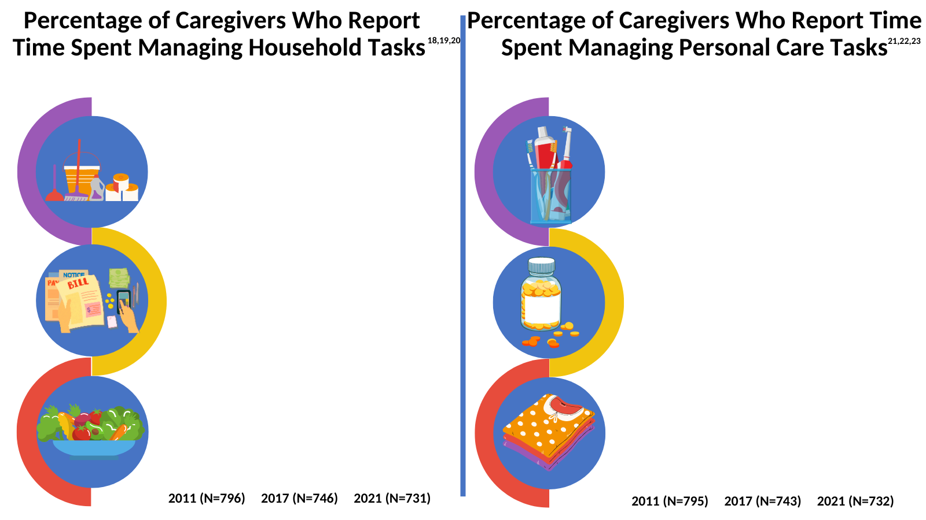
NC DEMENTIA CAREGIVER TASKS: PERSONAL CARE & HOUSEHOLD
North Carolina State Center for Health Statistics. (2011, 2017 and 2021) 2011, 2017 and 2021 BRFSS Survey Results: North Carolina – Caregiver Module. Retrieved from https://schs.dph.ncdhhs.gov/data/brfss/2011/nc/all/NC06Q08b.html, https://schs.dph.ncdhhs.gov/data/brfss/2017/nc/all/householdcare.html, https://schs.dph.ncdhhs.gov/data/brfss/2021/nc/all/householdcare.html, https://schs.dph.ncdhhs.gov/data/brfss/2011/nc/all/NC06Q08a.html
https://schs.dph.ncdhhs.gov/data/brfss/2017/nc/all/managecare.html, https://schs.dph.ncdhhs.gov/data/brfss/2021/nc/all/managecare.html
North Carolina Building Our Largest Dementia (NC BOLD) Infrastructure Project

Slide 21
NC DEMENTIA CAREGIVER DIFFICULTIES
Caregivers were asked to “please tell me yes or no whether you have faced each one.”
Data includes responses from all caregivers.
Disaggregated data by care recipient illness/ condition is not available.
These questions about difficulties were not asked in the 2017 and 2021 iterations of the survey.
North Carolina State Center for Health Statistics. (2011) 2011 BRFSS Survey Results: North Carolina – Caregiver Module. Retrieved from https://schs.dph.ncdhhs.gov/data/brfss/2011/nc/all/NC06Q11a.html, https://schs.dph.ncdhhs.gov/data/brfss/2011/nc/all/NC06Q11b.html, https://schs.dph.ncdhhs.gov/data/brfss/2011/nc/all/NC06Q11c.html, and https://schs.dph.ncdhhs.gov/data/brfss/2011/nc/all/NC06Q11d.html
North Carolina Building Our Largest Dementia (NC BOLD) Infrastructure Project

Slide 22
CAREGIVERS AND NC WORKFORCE SHORTAGES
Typically 700 patients per geriatrician
>545,000 medically complex older adults in NC
158 geriatricians available ~ 779 needed
Based on population estimates, 1,260 needed by 2050 ~ a 797% increase
Shortages often result in delayed and inaccurate dementia diagnosis
Delayed/inaccurate diagnosis results in delays in treatment, care delivery and other services
North Carolina State Government. Office of State Budget and Management. (2022). NC’s population to reach 14.0 million by 2050: Three key takeaways in latest population projections. Retrieved from https://www.osbm.nc.gov/blog/2022/12/30/ncs-population-reach-140-million-2050
Alzheimer’s Association. (2022) 2022 Alzheimer’s Disease facts and figures special report. More than normal aging: Understanding mild cognitive impairment. Retrieved from https://www.alz.org/media/Documents/alzheimers-facts-and-figures.pdf
North Carolina Building Our Largest Dementia (NC BOLD) Infrastructure Project

Slide 23
CAREGIVERS: FUTURE IMPLICATIONS AND CONSIDERATIONS
Increases in life expectancy
Increases in older adult cohort
Declines in family caregivers
Declining birth rates
Declines in BRFSS self-reported caregivers
More caregivers needed as “boomer” cohort ages
AARP reports simultaneous decline in family caregivers for adults aged 80+
2010: 7 potential family caregivers
by 2030: as few as 4
Declines in the rate of North Carolinians self-reporting as caregivers on BRFSS
19.9% in 2017
17.6% in 2021)
North Carolina Department of Health and Human Services. Division of Aging and Adult Services. (2021). NC State Aging Profile 2020. Retrieved from https://www.ncdhhs.gov/media/14887/open
United States Census Bureau.(2018). Older people projected to outnumber children for first time in U.S. history. Retrieved from https://www.census.gov/newsroom/press-releases/2018/cb18-41-population-projections.html
The Gerontechnologist.(2022). 2022 Age tech market map. Retrieved from https://thegerontechnologist.com/
American Association of Retired Persons.(2020). North Carolina family caregivers provide $13.1 billion annually in unpaid care to family, friends at home. Retrieved from https://states.aarp.org/north-carolina/north-carolina-family-caregivers
North Carolina State Center for Health Statistics. (2021) 2021 BRFSS Survey Results: North Carolina – Caregiver Module. Retrieved from https://schs.dph.ncdhhs.gov/data/brfss/2021/nc/all/regcare.html and from 2017 BRFSS Survey Results: North Carolina – Caregiver Module. Retrieved from https://schs.dph.ncdhhs.gov/data/brfss/2017/nc/all/regcare.html
North Carolina Building Our Largest Dementia (NC BOLD) Infrastructure Project

Slide 24
CAREGIVERS: FUTURE IMPLICATIONS AND CONSIDERATIONS
Personal care task management is a common need (80% of caregivers in 2021). This could be prioritized for legislative efforts and resource allocation.
Costs vary across the state, but the median monthly cost (2021) for a home health aide was $4,982 and $9,354 for a semi-private nursing home room.
Annual costs of paid home care ($60k) or a nursing home ($112k) are unaffordable for most American families (80%) with annual household incomes of $150,000 or less.
Genworth.com. (2022). Cost of care survey. Retrieved from https://www.genworth.com/aging-and-you/finances/cost-of-care.html
Paying for Senior Care.com.(2021). Paying for assisted living and home care in North Carolina. Retrieved from https://www.payingforseniorcare.com/north-carolina
Statista.com.(2022). Percentage distribution of household income in the United States in 2021. Retrieved from https://www.statista.com/statistics/203183/percentage-distribution-of-household-income-in-the-us/
North Carolina Building Our Largest Dementia (NC BOLD) Infrastructure Project

Slide 25
CAREGIVERS: FUTURE IMPLICATIONS AND CONSIDERATIONS
Workforce shortages, declines in caregivers and the astronomical cost of paid care will likely make aging in place difficult to achieve.
“[T]he middle class, who neither qualify for Medicaid-funded home care nor have the means to pay for significant paid caregiving out of pocket, face a unique challenge: They must either rely solely on family caregivers to meet their needs or pay out of pocket for paid caregivers until their wealth is exhausted and they become Medicaid eligible.” – Reckrey, et al.
Reckrey, J. M., Morrison, R. S., Boerner, K., Szanton, S. L., Bollens-Lund, E., Leff, B., & Ornstein, K. A. (2020). Living in the community with dementia: who receives paid care?. Journal of the American Geriatrics Society, 68(1), 186–191. https://doi.org/10.1111/jgs.16215
North Carolina Building Our Largest Dementia (NC BOLD) Infrastructure Project

Slide 26
THOUGHTS? QUESTIONS?
“2023 North Carolina Dementia Caregiver Data Brief: Costs, Unique Challenges and Future Implications”
For further information or to download the caregiver brief: https://ncchw.unca.edu/wp-content/uploads/sites/38/2023/04/BOLD-NC-2023-Dementia-Caregiver-Data-Brief.pdf?x55038
North Carolina Building Our Largest Dementia (NC BOLD) Infrastructure Project

