Slide 1
NC State Board of Elections
August 2021
Notes:
Good afternoon. Thank you for joining us today. I am Kori House, Voter Registration Program Specialist at the NC State Board of Elections also known as the SBE. I am also the SBE NVRA Coordinator.
I would like to say thanks for the wonderful cooperation and support that we have received from State DHHS and the local agencies over the past several years. We value our partnership.
Next, the State Board of Elections wants to stress our commitment to this state’s NVRA Program. And it is a program. It’s a dedicated and core mission of this agency. We absolutely want to ensure that every eligible citizen has the opportunity to register to vote. It is also extremely vital that voters have their correct name and address on their voter record. You can assist us with this, and we are appreciative of your help.

Slide 2
overview
NVRA Agencies and Rules
Covered Transactions Conducted at County DSS Offices
In-Person Transactions
Remote Transactions
Assistance & Review
NVRA Submission to County Boards of Elections
Data Analysis & Compliance
NVRA Supplies
Notes:
Today we will review important aspects of NVRA Agency Basics and those specific to County DSS Offices.
We will discuss the requirements of the NVRA in various DSS Programs and local agency staff’s role in meeting these requirements.
The following topics will come up throughout this presentation:
NVRA Agencies and Rules
Covered Transactions Conducted at County DSS Offices
In-Person Transactions
Remote Transactions
Assistance & Review of the Voter Registration Application
NVRA Submission to County Boards of Elections
Data Analysis & Compliance
NVRA Supplies

Slide 3
NVRA Agencies & Rules
Notes:
Let’s begin with discussion on the laws that govern the NVRA process in our state.

Slide 4
History & Purpose of the national voter registration Act (NVRA)
The NVRA is a federal statute that mandated dramatic changes to states' voter registration procedures by January 1, 1995.
The NVRA has often been called the "motor voter" bill because it required driver license offices to take applications for voter registration. It also included other agencies and a mail registration program.
Purpose of NVRA
Increase the number of eligible citizens who register to vote
Enhance the participation of eligible citizens who register to vote
Protect the integrity of the electoral process
Ensure that accurate and current voter registration rolls are maintained
Notes:
The NVRA created new opportunities for historically underrepresented citizen groups to make initial application to register to vote. Certain groups that may not have had the opportunity to apply to register to vote were offered the voter registration service when applying for services at several state agencies.

Slide 5
NVRA Assistance
The State Board of Elections is committed to ensuring the success of North Carolina’s NVRA Program.
Notes:
The State Board of Election’s partnership with the NVRA agencies extends to coordinating the training and compliance efforts of local departments of social services and public health agencies all over the state, as well as the regional offices for several state agencies. These local NVRA agencies also work directly with this state’s 100 county boards of elections.

Slide 6
NVRA COORDINATION
The Executive Director of the NC State Board of Elections is the Chief Election Official for purposes of administering the National Voter Registration Act (NVRA). If you need help or assistance with your NVRA duties, you should contact the State Board of Elections.
Notes:
The NC NVRA Program falls under the jurisdiction of the NC State Board of Elections. The Executive Director of the NC State Board od Elections is the Chief Election official for purposes of administering the National Voter Registration Act (NVRA). Local agencies should contact the State Board of elections with coordinating these efforts.

Slide 7
Ncgs § 163-82.20(a) – Voter registration agencies
Voter Registration Agencies. - Every office in this State which accepts:
(1) Applications for a program of public assistance . . . ;
(2) Applications for State-funded State or local government programs primarily engaged in providing services to persons with disabilities . . .
(3) Claims for benefits under . . . , the Employment Security Law,
Notes:
It’s based on Applications! NC Law follows the guidance of the federally mandated NVRA law by defining certain state agencies that must administer voter registration services. The programs for public assistance such as Food and Nutrition Services, Low Income Energy Assistance Program and the Medical Assistance Program among many others would fall under section 1 of this law. The NC WIC Program under the Local Health Department also falls under Public Assistance Programs and is categorized with the services provided by the county Department of Social Services.

Slide 8
Certain agencies must offer voter registration services
Public Assistance Agencies
Disability Services Agencies
Division of Employment Security
01
02
03
Notes:
So which agencies are affected by NVRA? Although NVRA is known as the “motor voter bill,” other agencies besides the Department of Motor Vehicles also must offer voter registration services and here are a few. County Departments of Social Services fall under Public Assistance Agencies, 01 is the designation given on these agencies coded voter registration applications and statistics.

Slide 9
Ncgs § 163-82.20(b) – Duties of voter registration agencies
Duties of Voter Registration Agencies. – A voter registration agency shall, unless the applicant declines, in writing, to register to vote, distribute with each application for service or assistance, and with each recertification, renewal, or change of address relating to such service or assistance:
A voter registration application;
Provide a form that contains the statements required by the National Voter Registration Act;
Provide to each applicant who does not decline to register to vote the same degree of assistance with regard to the completion of the registration application as is provided by the office with regard to the completion of its own forms.
Notes:
North Carolina law also codifies the duties of voter registration agencies with requirements on when and how they must offer voter registration services.
Unless the client declines in writing, voter registration services must be offered during what is referred to as “Covered Transactions.” The covered transactions are as followed:
Initial application for service
Recertification or renewal for service
Change of Address
NVRA agencies must supply the following:
A Voter Registration Application
A form that contains the NVRA Statements
Assistance in completing the voter registration application
We will discuss these duties later in the presentation

Slide 10
Required NVRA Statements
"Applying to register or declining to register to vote will not affect the amount of assistance that you will be provided by this agency."
"If you would like help in filling out the voter registration application form, we will help you. The decision whether to seek or accept help is yours. You may fill out the application form in private."
"If you believe that someone has interfered with your right to register or to decline to register to vote, your right to privacy in deciding whether to register or in applying to register to vote, or your right to choose your own political party or other political preference, you may file a complaint with the NC State Board of Elections."
Notes:
These are the federally required NVRA statements that must be on an agency’s application for service or some other documentation when presenting to individuals for voter registration services. For the county DSS office, these statements are placed on the back of the Voter Registration Application.

Slide 11
NCGS § 163-82.20(e): prohibitions
Prohibitions. – Agency staff shall not:
Seek to influence an applicant's political preference or party registration;
Display any such political preference or party allegiance;
Make any statement to an applicant or take any action the purpose or effect of which is to discourage the applicant from registering to vote; or
Make any statement to an applicant or take any action the purpose or effect of which is to lead the applicant to believe that a decision to register or not to register has any bearing on the availability of services or benefits.
Notes:
The law also provides directives on exclusions regarding NVRA agency staff behavior.

Slide 12
Ncgs § 163-82.20(f): confidentiality
Confidentiality of Declination to Register. – No information relating to a declination to register to vote in connection with an application made at a voter registration agency may be used for any purpose other than voter registration.
Notes:
In addition, the law provides a layer of protection to agency participants that decline voter registration services in which information may only be use for voter registration purposes.

Slide 13
NCGS § 163-82.20(g): coordination with boards of elections
Transmittal From Agency to Board of Elections. – Any voter registration application completed at a voter registration agency shall be accepted by that agency in lieu of the applicant's mailing the application. Any such application so received shall be transmitted to the appropriate board of elections not later than five business days after acceptance, according to rules which shall be promulgated by the State Board of Elections.
Notes:
Additionally, NC General Statutes requires that NVRA agencies submit completed applications no later than 5 business days after acceptance.

Slide 14
The North Carolina NVRA PROCESS
Agency
County Board
State Board
Offer voter registration
Process registrations
Send registrations to CBEs
NVRA supplies
Reporting
Training
Compliance
Notes:
Here is a visual representation of the NVRA process in North Carolina:
The State Board provides the local NVRA agencies with supplies, training and guidance. We’re also responsible for reporting voter registration data and any issues of compliance.
NVRA agencies offer voter registration services and send the completed registrations to the county board of elections within 5 business days of receipt.
The County boards process the voter registration applications and report any issues of compliance to the SBE.

Slide 15
Covered Transactions Conducted at county dss offices
Notes:
The NVRA Settlement Agreement was finalized in the Summer of 2018 and updated a variety of rules regarding NVRA procedures at the local Public Assistance Agencies. For the rest of the presentation, we will discuss the following items:
providing voter registration services during covered transactions
data collection and analysis practices
measures of compliance
corrective actions

Slide 16
When do I offer voter registration services?
Distribute with each:
Application for service or assistance
Recertification or renewal
Change of address
NVRA Statements
Assistance
Voter Registration Application
Covered Transactions
Notes:
For every application for service, recertification, renewal or change of address, DSS agencies must provide their clients:
NVRA Statements that are found on the Laminated form also known NVRA Information Sheet (this may have been modified due to COVID-19, instead agencies may handout one time use NVRA Info sheet)
a voter registration application
the same assistance with completing the voter registration application as is provided for completion of the agency’s own forms

Slide 17
Who’s covered under nvra?
GS § 163-82.20(i)
Ineligible Applications Prohibited. – No person shall make application to register to vote under this section if that person is ineligible on account of age, citizenship, lack of residence for the period of time provided by law, or because of conviction of a felony
Covered person must be a U.S. citizen.
Covered person must be at least 16 years of age.
Notes:
When offering voter registration services, remember that the NVRA covers only those United States citizens who are at least 16 years of age.
Under North Carolina law, no one shall make application to register to vote if he or she is ineligible because of age, citizenship status, lack of residence for the required period, or due to felony conviction.

Slide 18
Additional info about voter eligibility
Who is responsible for determining the eligibility of a person to register to vote?
It is the responsibility of the boards of elections, and not agency personnel to determine the eligibility of clients to register and vote in North Carolina. If a client is unsure about their eligibility, the best procedure is to instruct the participant to contact the State Board of Elections for direct inquiry. Our contact information is found on the back of the Voter Registration Application. Although the client should not register at the agency, they may be given the application to review later.
Notes:
The situation may arise when a participant is unsure about their citizenship status. It is a felony to register to vote if you are not an American citizen. In such cases, the participant will need to proceed with caution. Agency personnel should not assist the client to complete the application inaccurately, if agency personnel are aware the information is untrue. Refer the client to the State Board of Elections to inquire further. We will review the qualifications and investigate with other agencies, if necessary.
*Special Update*
Not be in jail or prison for a felony conviction.
Note: Due to a court order, anyone who is on probation, parole, or post-release supervision for a felony conviction is now eligible to register and vote.

Slide 19
How do I offer voter registration services?
At every covered transaction, ask the participant the NVRA Question:
“If you are not registered to vote where you live now, would you like to apply to register to vote here today?’’
Must use exact wording!
Notes:
This next statement is EXTREMELY IMPORTANT for North Carolina’s NVRA program:
When offering voter registration services, county DSS agency staff must ask every covered applicant the NVRA question: “If you are not registered to vote where you live now, would you like to apply to register to vote here today?”
This is THE question required under NVRA and should not be altered or shortened. In NC, the act of voting is based on a person’s address of residency. It is important that person is registered to vote based on their residential address because the address determines their eligible candidates and jurisdictions.
Again, the “NVRA Question” is “If you are not registered to vote where you live now, would you like to apply to register to vote here today?”
The NVRA Question must be asked during each covered transaction, whenever clients apply for new benefits, apply to renew their current benefits or change their address.

Slide 20
Do not paraphrase the NVRA Question!!!
“Are you registered to vote at your new house? Would you like to update your voter registration information?”
“If you’re not registered where you live now, would you like to register to vote here today?”
“Are you registered to vote? Would you like to register today?”
“Do you want to register to vote today?
Notes:
Here are some examples of paraphrasing that have been used in the past by some agency staff. Sometimes the changes are subtle and other times staff have a totally unique way of asking the question, either way both are not in compliance with the NVRA requirements as the questions must be asked using the exact wording provided.
We understand that the NVRA Question can be a bit awkward and paraphrasing or putting the question into your own words to make it more conversational is tempting and easy to do.
It’s imperative that staff understand that the NVRA requires staff to ask the NVRA question using the exact wording. We will discuss offering voter registration services to clients later in this presentation.

Slide 21
In-Person transactions
In-person transactions are Covered Transactions that take place in person in the county DSS office.

Slide 22
Agency NVRA Process
Distribute with each:
Application for service or assistance
Recertification or renewal
Change of address
Laminated Form
Assistance
Voter Registration Application
Covered Transactions
Notes:
For every application for service, recertification, renewal or change of address with respect to such services or assistance, DSS agencies must provide their clients:
the laminated form that is double sided, with English language on one side and Spanish on the other
a voter registration application
the same assistance with completing the voter registration application as is provided for completion of the agency’s own forms

Slide 23
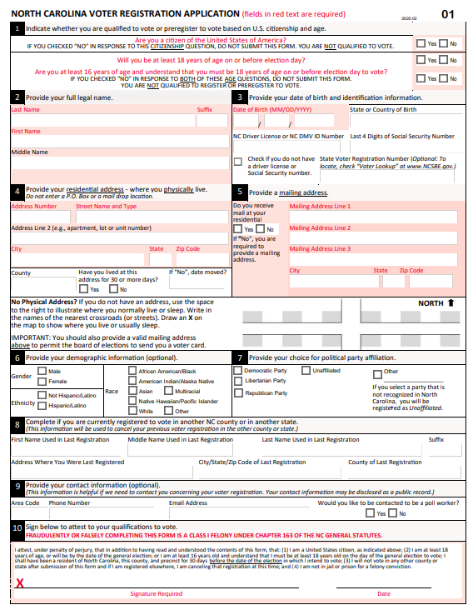
Every participant with a covered transaction must be offered a Voter Registration Application.
Notes:
Effective since 2017, distribute a voter registration application to ALL covered clients. Let’s discuss the importance of this measure on the next couple of slides….

Slide 24
NVRA Statements
1
2
3
NC State Board of Elections
PO Box 27255
Raleigh, NC 27611-7255
Applying to register or declining to register to vote will not affect the amount of assistance that you will be provided by this agency.
If you would like help in filling out the voter registration application form, we will help you. The decision whether to seek or accept help is yours. You may fill out the application form in private.’’
If you believe that someone has interfered with your right to register or to decline to register to vote, your right to privacy in deciding whether to register or in applying to register to vote, or your right to choose your own political party or other political preference, you may file a complaint with:
Notes:
The NVRA Statements are now on the back of the voter registration application
Not only the NVRA question is important but making clients aware of their rights, is important as well. We are letting know that applying or declining to register to vote will not affect their benefits, they can get help and to let us if someone messes with their rights.
The information is in their hands.

Slide 25
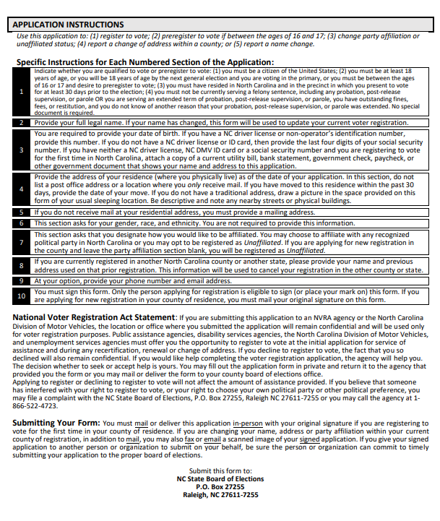
Nvra Statements
Back
Notes:
Here is an example of the NVRA statements on the back of the Voter Registration Application

Slide 26
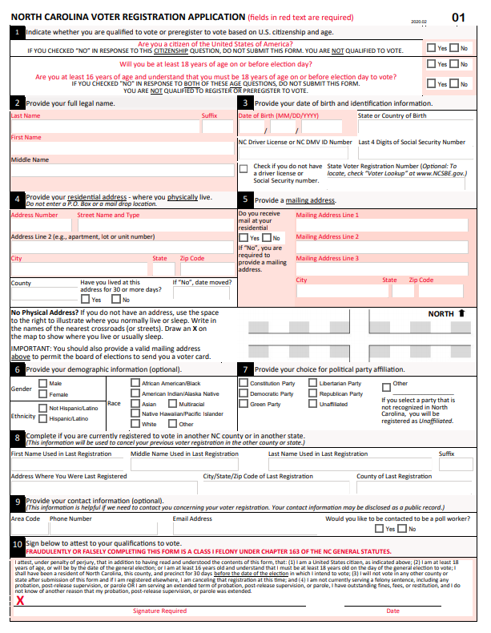
Response to The NVRA Question
“If you are not registered to vote where you live now, would you like to apply to register to vote here today?”
Participant may say ‘Yes’
Participant may say ‘No’
Notes:
Remember, staff must present a NC Voter Registration Application to all individuals during a covered transaction regardless of whether they choose to decline the opportunity to register to vote or they are already registered to vote.
We know that if an individual accepts the opportunity to register to vote, staff must provide the NC Voter Registration Application and offer assistance if needed. But if an individual declines the opportunity to register vote because they are not interested or if they are already registered, Local agency staff must still present the NC Voter Registration Application to the individual and encourage them to keep it in case they change their mind or if they need to update their address or name in the future.
If an individual indicates that they are ineligible to vote, staff should not offer the NC Voter Registration Application.

Slide 27
Other suggested language to use when offering voter registration services
We must offer you an opportunity to register to vote each time you apply for services or renew services. It’s the law.
You may check your voter registration online at www.NCSBE.gov.
You may keep the form in case you change your mind or need to update your address at a later time.
Applying to register or declining to register to vote will not affect the amount of assistance that you will be provided by this agency.
If you are uncertain about your voter registration status, there’s contact information for the board of elections on the back of the form.
There’s information on the back of the form that informs you of your rights.
If you would like help in filling out the voter registration application form, we will help you.
The decision whether to seek or accept help is yours. You may fill out the application form in private.’’

Slide 28
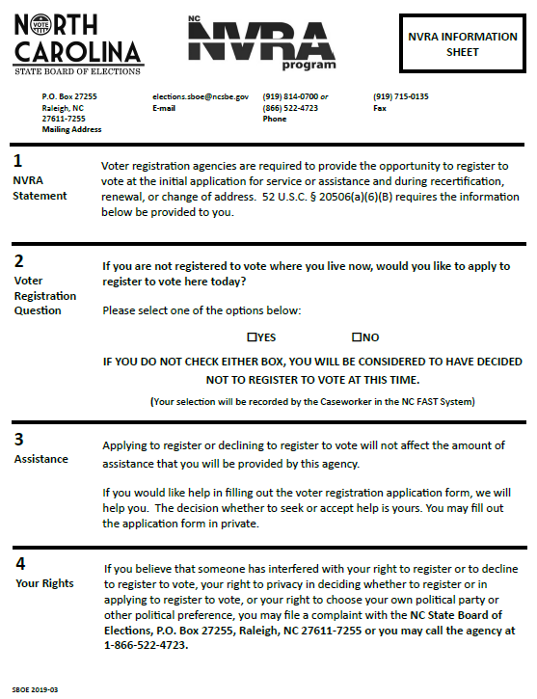
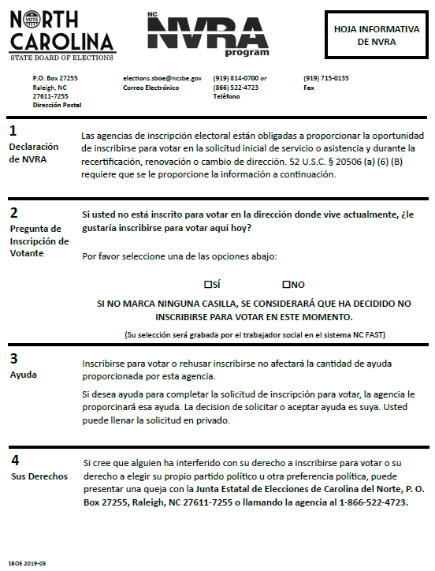
Laminated form
For use in county DSS offices during
In-Person Transactions
Notes:
As mentioned in the previous slide the Laminated form is double sided with an English and Spanish Language version available for use.

Slide 29
In-person Covered transactions in NC fast
Give every client a Voter Registration Application automatically, without regard to his or her response to the Voter Preference Question
Offer to assist the client in completing the application if he or she answered “yes” to the Voter Preference Question
If the client completes a Voter Registration Application, review it for completeness of all mandatory fields necessary to register to vote
Direct each client to review the Laminated Form
Ask each client the Voter Preference Question and record the answer in NC FAST or leave as default to “Please Select” if the client doesn’t answer
Notes:
Under the NVRA Settlement Agreement the following changes were implemented to the NC FAST process:
You must direct each client to review the Laminated Form
You must ask each client the Voter Preference Question and record the answer in NC FAST or leave as default to “Please Select” if the client doesn’t answer
You must give every client a voter registration form automatically, without regard to his/her response to the Voter Preference Question
You must offer to assist the client in completing the voter registration Form if the client answers “yes” to the Voter Preference Question
If the client completes a voter registration form, you must review it for completeness of all mandatory fields, including name, date, date of birth, address(es), identification number, eligibility confirmation and client signature.

Slide 30
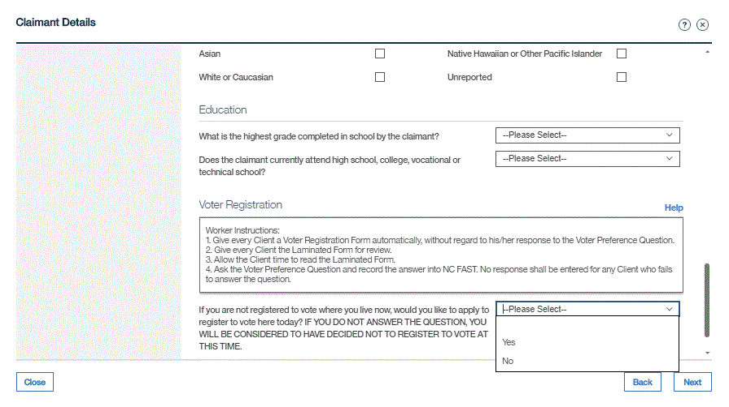
Recording in NC fast: initial Applications for service or benefits
NC FAST displays the same procedure to assist caseworkers through this administrative process
Caseworkers should record the client’s answer to the voter preference question by selecting the “yes”, “no” or leave as default to “Please Select” if the client doesn’t answer
Notes:
NC FAST has the same procedure outlined to assist caseworkers through this administrative process. Caseworkers should record the client’s answer to the voter preference question by selecting the “yes”, “no” or leave as default to “Please Select” if the client doesn’t answer.

Slide 31
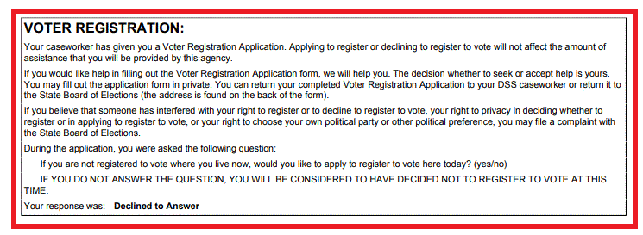
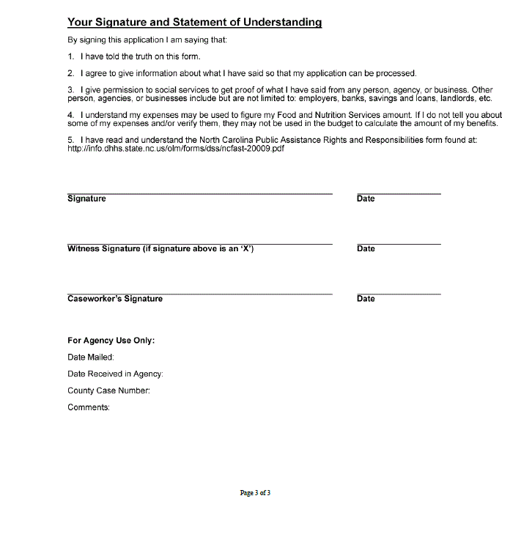
NC FAST: Summary of benefits application
Voter Preference Question is prominently displayed
The client’s response to the Voter Preference Question is displayed
The display box is immediately above the space for the client’s signature.
Notes:
The summary of benefits application that NC FAST generates during an in-person has been revised as follows:
a. The summary document now shows the client’s response to the Voter Preference Question prominently in a black outlined box and the heading “Voter Registration” in bold font.
b. The client’s response is displayed as either “Yes” or “No” based on the client’s response during the interview. If the client did not answer the question, the summary document shows the client’s response as “Declined to Answer.”
c. The box displaying the client’s response to the Voter Preference Question appears in the summary document immediately above the space for the client’s signature.

Slide 32
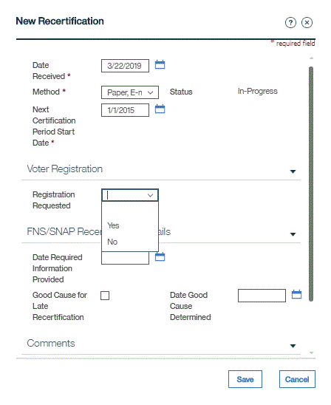
Recording in NC FAST: recertifications
NC FAST has a section that captures voter registration data regarding Recertifications
Use the Voter Registration section to record the client’s response to voter registration services
Notes:
NC FAST has a section that captures voter registration data regarding Recertifications.
Use the Voter Registration section to record the client’s response to voter registration services by selecting “yes” or “no”.

Slide 33
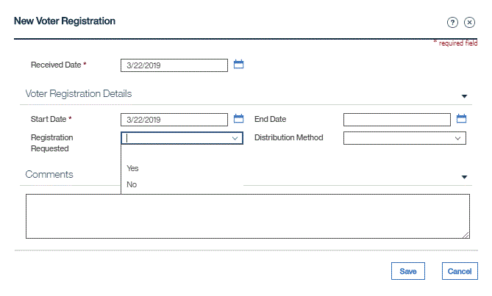
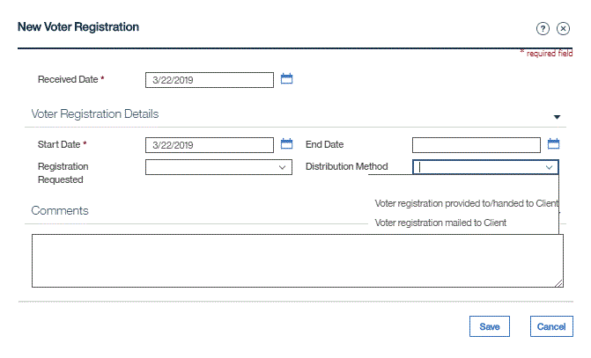
Recording in NC fast: distribution of voter registration Application
Under Voter Registration Details in the Evidence Queue select “yes” or “no” to record if the client requested registration services.
A drop-down box has been added in NC FAST to confirm voter registration services have been provided to a client.
Caseworkers should use the drop-down box to confirm that they have provided a Voter Registration Application during an In-Person Transaction or mailed the required Voter Registration Application to clients following a transaction in which a mailing is required.
Caseworkers have the following dropdown options:
“Voter registration provided to/handed to Client”
“Voter registration mailed to Client.”
Notes:
The legal settlement requires that a record and report be provided to show when a client received a voter registration application.
Under Voter Registration Details in the Evidence Queue, select “yes” or “no” to record whether the client requested registration services.
A drop-down box has been added in NC FAST to the county DSS caseworkers’ evidence queue. This drop-down box allows the caseworker to select one of two (2) options to document their completion of voter registration responsibilities:
“voter registration provided to/handed to Client”
“voter registration mailed to Client.”
This drop-down box is a nonmandatory field to assist the county DSS caseworker’s flow. However, you will use this section in NC FAST to prove that you provided registration services to a client under any covered transaction.

Slide 34
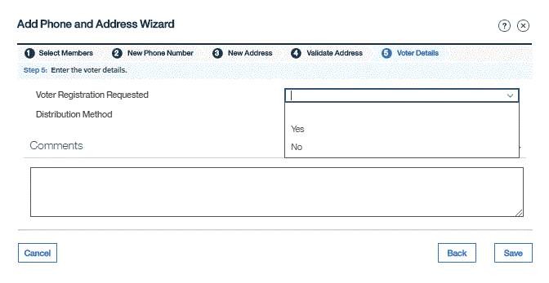
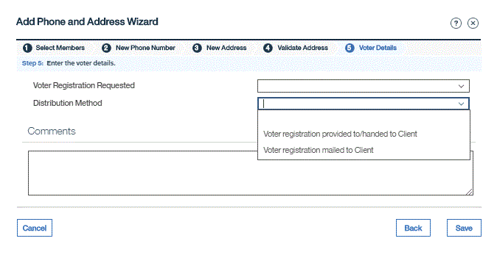
Recording in NC fast: Change of address
When a change of address is reported, caseworkers are required to:
Provide the client with a coded Voter Registration Application
Show the client the Laminated Form
Offer the client assistance in completing the Voter Registration Application
Note voter registration services was requested by selecting “yes” or “no”
Note the distribution method by selecting “Voter registration handed to Client” or “Voter registration mailed to Client”
Notes:
When a change of address is reported, caseworkers are required to provide the client with a coded voter registration form, to show the client the laminated form and to offer the client assistance in completing the voter registration form. Caseworkers must also note that voter registration serves were requested and provided to the client in NC FAST.

Slide 35
Q&A Break

Slide 36
Remote transactions
Remote transactions are Covered Transactions that take place through ePASS, telephone transactions, fax, email or internet.
County DSS staff must offer the same degree of assistance to clients in completing voter registration materials as they would for In-Person Covered Transactions.
Notes:
Remote Transactions are Covered Transactions that take place through ePASS, telephone transactions, fax, email or internet. County DSS Staff must offer the same degree of assistance to clients in completing voter registration materials as they would for In Person Covered Transactions by ensuring the completion of the Voter Registration Application.

Slide 37
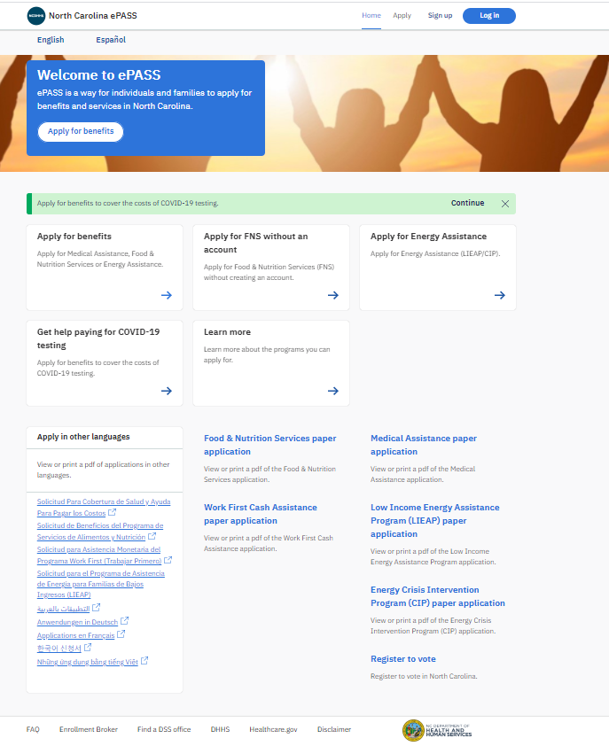
ePASS & Voter Registration Services (Initial applications, Renewals & Recertifications)
On its home page, ePASS has a link to the downloadable voter registration form
Clients also have the option to select voter registration services through ePASS
Caseworkers must mail a Voter Registration Application and DSS Cover Letter to all clients using ePASS for a covered transaction if the client has:
Indicated that they want to register to vote in ePASS
Failed to answer the Voter Preference Question in ePASS
Notes:
On its home page, ePASS has a link to the downloadable voter registration form. In addition, when using ePASS for covered transactions, clients have the option to select “yes” or “no” for voter registration services, in which caseworkers must mail a Voter Registration Form and DSS Cover Letter, to all clients using ePASS for a Covered Transaction if the client has:
Indicated that they want to register to vote in ePASS
Failed to answer the Voter Preference Question in ePASS

Slide 38
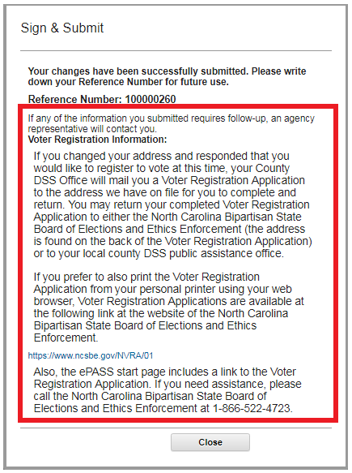
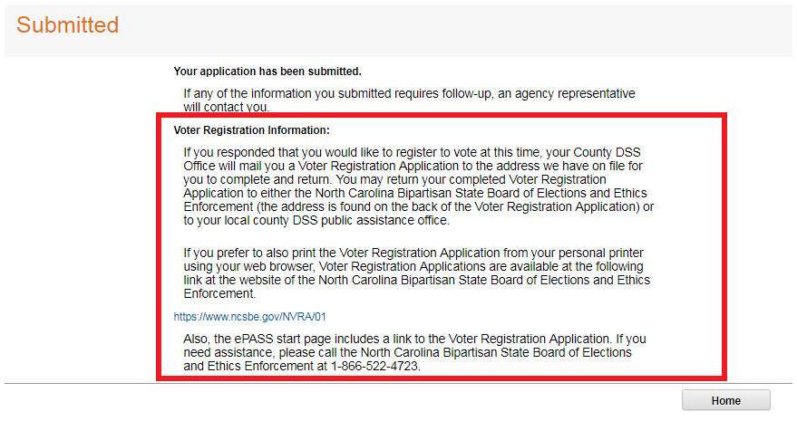
epass: change of address & Application submission confirmation
Change of Address
Application Confirmation
ePASS reports if a client had reported a change of address and responded that they would like to register to vote during that process. After the application is submitted, these screens are presented to clients who selected “Yes,” “No” or declined to register to vote.
Caseworkers must mail a Voter Registration Application and DSS Cover Letter to all clients that report a change of address using ePASS, if the client has:
Indicated that they want to register to vote in ePASS
Failed to answer the Voter Preference Question in ePASS
Notes:
ePASS notes if a client had reported a change in address or circumstances and responded that they would like to register to vote during that process. After the application is submitted, these screens are presented to Clients who selected “Yes,” “No” or declined to respond in response to the Voter Preference Question.
Caseworkers must mail a Voter Registration Application and DSS Cover Letter to all clients that report a change of address using ePASS, if the client has:
Indicated that they want to register to vote in ePASS
Failed to answer the Voter Preference Question in ePASS

Slide 39
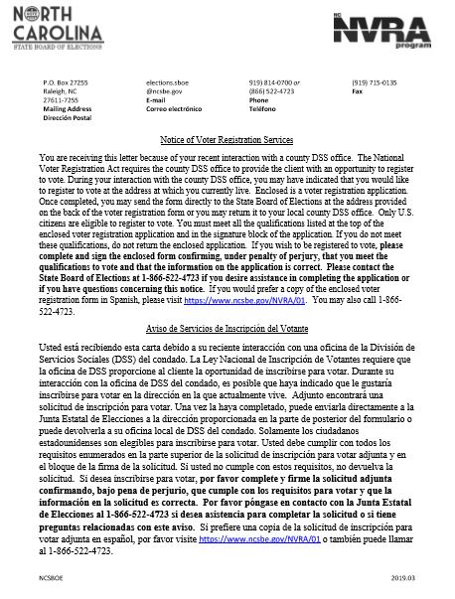
Dss cover letter
Caseworkers must mail a Voter Registration Application and DSS Cover Letter to all Clients using ePASS for a Covered Transaction if the client has:
Indicated that he/she wants to register to vote in ePASS
Failed to answer the Voter Preference Question in ePASS
Notes:
The DSS Cover Letter is a Application combined with both Spanish and English Language to explain why a client is receiving a voter registration application from the County DSS Office
Caseworkers must mail a Voter Registration Application and DSS Cover Letter, to all Clients using ePASS for a Covered Transaction if the client has:
indicated that he/she wants to register to vote in ePASS;
failed to answer the Voter Preference Question in ePASS.
.

Slide 40
Nvra and remote transactions
Telephone Communication
Ask the client the Voter Preference Question and provide client with a Voter Registration Application and DSS Cover Letter by mail or electronically, regardless of the client’s response to the NVRA question.
If a client indicates on an application returned by mail that (s)he desires to register to vote or update their registration, mail the client a Voter Registration Application and DSS Cover Letter
Communication by Mail
ePASS
Caseworkers must mail a Voter Registration Application and DSS Cover Letter to all clients using ePASS if the client has:
Indicated (s)he wants to register to vote
Failed to answer the Voter Preference Question
Change of Address
Caseworkers are required to mail a Voter Registration Application and DSS Cover Letter to each client that reports a change of address through a remote transaction, regardless of the method by which the address change is conducted (i.e. by telephone, fax, email or Internet)
Notes:
Covered Transactions Taking Place via ePASS: County DSS Offices must mail a Voter Registration Application and DSS Cover Letter, to all Clients using ePASS for a Covered Transaction if the client has: (a) indicated that he/she wants to register to vote in ePASS; or (b) failed to answer the Voter Preference Question in ePASS.
Telephone Covered Transactions: caseworkers must mail the DSS Cover Letter and a Voter Registration Application to any client conducting a Covered Transaction by telephone that is a stand-alone transaction (i.e., a transaction that does not serve as a follow up to an ePASS or In-Person Transaction for application or renewal). Ask the client the Voter Preference Question and provide client with a Voter Registration Application and DSS Cover Letter by mail or electronically, regardless of the client’s response to the NVRA question.
Communication by Mail: If a client indicates on an application returned by mail that (s)he desires to register to vote or update their registration, mail the client a Voter Registration Application and DSS Cover Letter
Change in Address: caseworkers are required to send, by U.S. Postal Service mail, Voter Registration Application and a DSS Cover Letter to each client that reports a change of address through a remote transaction, regardless of the method by which the address change is conducted, i.e. by telephone, fax, email or Internet.

Slide 41
Medicaid renewals
Currently NC FAST generates a monthly report of recertifications that includes an individual age 18 and older
Based on the data in this report, a cover letter and voter registration form is mailed
DHB and NC FAST are developing processes and procedures to automate this in NC FAST
Counties will be notified when the automation occurs

Slide 42
Remote transactions & mailings
Evidence Queue – Distribution of Voter Registration Application
Use the drop-down box to select the following option to document the completion of your voter registration responsibilities:
“Voter registration mailed to client”
Notes:
Use the Evidence Queue to note the distribution of a voter registration Application when it is mailed to a client following a transaction in which a mailing is required. Use the drop-down box to select “voter registration mailed to client”

Slide 43
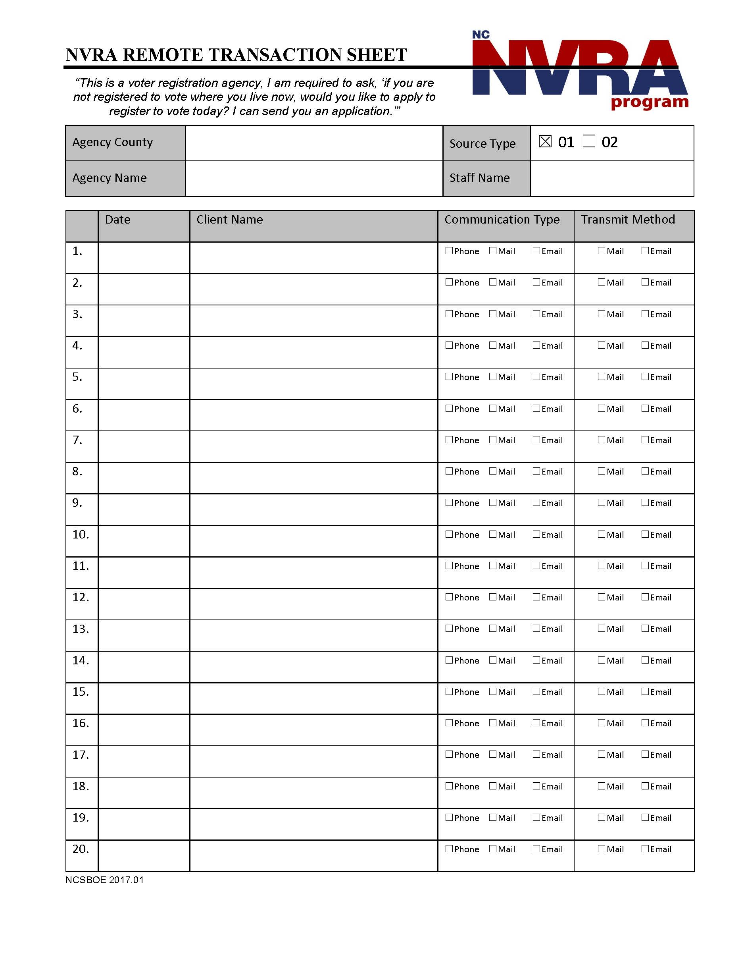
Public Assistance Agencies should discontinue the use of the NVRA Remote Transaction Sheet.
Notes:
Public Assistance Agencies should discontinue the use of the NVRA Remote Transaction Sheet. This information is captured in DHHS Records Management Systems such as ePASS and it also recorded on the Agency Transmittal Sheet.

Slide 44
Assistance & Review Completing & Reviewing the Voter Registration Application

Slide 45
Assistance required for both in-person & remote transactions
Required Elements on the Application are in RED FONT :
Legal Name
Date of Birth
Residential Address & Mailing Address (if different)
Signature Attestation
Eligibility Confirmation (Indication of U.S. Citizenship/Age requirement)
All Items in Red Font
Notes:
DSS Staff must offer assistance to covered clients. Assistance to Clients consists of helping to complete voter registration materials, including completion of the following fields: name, date, date of birth, address(es), identification number, eligibility confirmation (including specifically highlighting what those requirements are, such as that you must be a U.S. citizen to register to vote) and client signature.

Slide 46
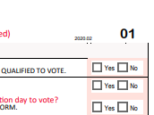
The properly coded NC Voter Registration Application for Public Assistance Agencies uses the designation of “01”
Notes:
Staff must use the correct coded voter registration Application for Public Assistance agencies.
The properly coded NC Voter Registration Application for Public Assistance Agencies uses the designation of “01”
Here is an example of the most recent version of the NC Voter Registration Application

Slide 47
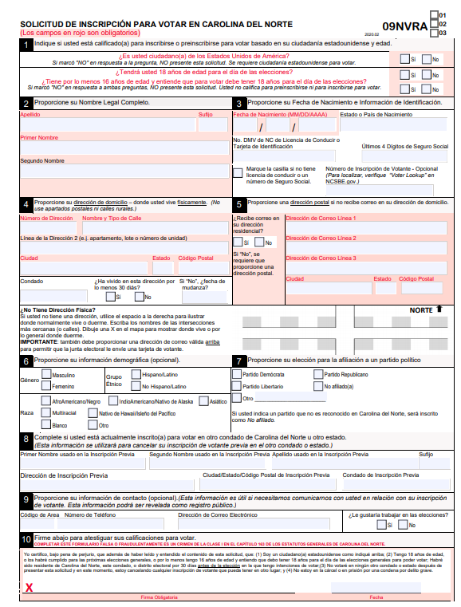
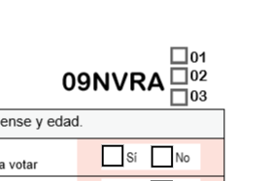
NC Voter Registration Application New Spanish Language Application
New Spanish Language Voter Registration Application for NVRA agencies are coded as “09NVRA”
Check the box for ‘01’ in the top right corner to indicate the application is being submitted via a Public Assistance agency
Notes:
We have introduced a new Spanish language voter registration application for use by NVRA agencies. This Application was created to assist in capturing the amount of Spanish language Applications submitted by these agencies.
For Local WIC agencies, caseworkers should check the box for ’01’ in the top right corner.

Slide 48
Additional info for Completing voter registration services
If any of the required information is left blank, the application still must be turned into the County Boards of Elections within 5 business days of receipt.
The law requires that assistance in completing the applications be offered; however, it is the client’s decision whether or not to accept the help.
Voter registration applicants between the ages of 16 and 17, although they are not qualified by age to vote, may preregister to vote. To preregister to vote, applicants must indicate on their voter registration application that they are at least 16 years of age and understand that they must be 18 years of age on or before election day to vote.

Slide 49
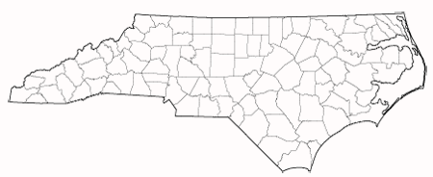
Nvra submission to county boards of elections
ELECTIONS

Slide 50
Agency NVRA transmission & collection
Completed Voter Registration Applications
After acceptance, staff must transmit completed applications to the county board of elections within five business days after acceptance.

Slide 51
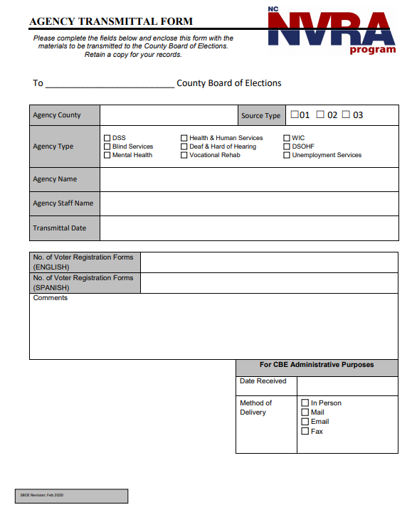
Use the Agency Transmittal Form to submit Voter Registration Applications to the county board of elections
Complete and submit within 5 business days of receipt
Method of delivery:
In Person
Mail
Courier
County Mail
Email transmission is no longer a valid method of delivery
Notes:
Completed Voter Registration Applications along with the NVRA Agency Transmittal form must be sent to your county’s Board of Election office within 5 days. A designated staff person from your agency must send the complete packet to the county board of elections office in person, by mail, courier, or county mail.
Email transmission is no longer a valid method of delivery

Slide 52
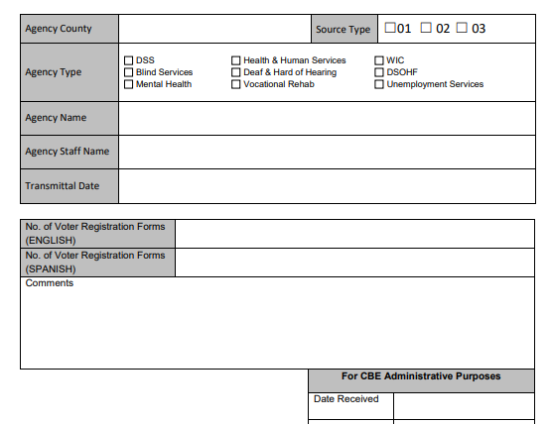
Complete agency information
Transmittal date
Record the number of English and Spanish Voter Registration Forms that are being sent to the County Boards of Elections separately
Notes:
When completing the form be sure to include:
Agency county and source type of “01”
Agency type would be DSS and the Agency Name should include the full name of your local agency.
Agency staff name should be the name of the individual responsible for completing and submitting the Transmittal form.
Transmittal date reflects the date the Transmittal form and the completed voter registration applications are sent to the county board of elections office
The number of completed voter registration applications that are included in the packet collected over the last 5 days should be recorded here along with any comments you need to share with your county board of elections.
In addition, we are asking you to record the amount of English and Spanish forms that are being sent to the County Boards of Elections office separately.

Slide 53
Data Analysis & compliance
Notes:
The NVRA Settlement Agreement uses data driven analysis to develop measures that reinforce compliance with the law

Slide 54
Data collection & website reports
DHHS collects the following statistics:
Covered Transactions
Voter Preference Question
Distribution of the Voter Registration Application
Initial Applications, Renewals and Recertifications (as applicable) for:
Food & Nutritional Services
Work First (TANF)
Total amount of responses to the voter registration question broken down by “yes,” “no” and “please select” (no answer provided) for each of the covered transactions
Total responses in the evidence queue about distribution of the Voter Registration Form, broken down between “voter registration provided to/handed to Client” and “voter registration mailed to Client”
Energy Assistance
Cash Assistance
Special Assistance
Subsidized Childcare Assistance
Special Assistance
Simplified Nutritional Assistance Program
Medical Assistance
Notes:
All data is an aggregate from NC FAST and/or ePASS. Information is grouped by county and month
DHHS collects the following:
Covered Transactions - the total number of initial, renewal and recertifications applications for the following programs:
Food & Nutritional Services
Work First (TANF)
Cash Assistance
Special Assistance
Energy Assistance
Subsidized Childcare
Special Assistance
Simplified Nutritional Assistance Program
Medical Assistance
Data is an aggregate from NC FAST & ePASS.
Voter Registration Question - For all covered transactions processed through NC FAST and ePASS, DHHS collects the totals of the responses to the voter registration question broken down by “yes,” “no” and “please select” (no answer provided). Data is an aggregate from NC FAST & ePASS. One total number will be reported for each response of “yes,” “no” and “please select” for each county for each month for each type of benefits transaction for each program (listed above).
Distribution of the Voter Registration Application - For all Covered Transactions processed through NC FAST and ePASS, DHHS collects the total responses in DSS caseworkers’ evidence queue about distribution of the Voter Registration Application, broken down between “voter registration provided to/handed to Client” and “voter registration mailed to Client” (or substantially similar language).
All data is grouped by county and month

Slide 55
Data collection & website reports
SBE reports the following statistics on our website:
Voter Registration Applications
Voter Preference Question
Distribution of Voter Registration Applications
Total number of Voter Registration Applications coded as being from Public Assistance Clients received by each County Board of Elections
Total of the responses to the question broken down by 'yes' or 'no' and 'please select' (no answer provided) for each of the covered transactions
Total numbers by County of the responses in the evidence queue about distribution of the Voter Registration Application, broken down between “voter registration provided to/handed to Client” and “voter registration mailed to Client”
Ratios by County
Percentage of the total number of submitted voter registration applications to the CBE divided by the total aggregate number of covered transactions for that county
Notes:
SBE reports the following on our website:
Voter Registration Applications: The total number of Voter Registration Applications coded as being from Public Assistance Clients received by each County Board of Elections, broken down by County and by updates, new registrations applications, duplicates and rejected applications.
Voter Preference Question: For all covered transactions processed through NC FAST/ePASS the total of the responses to the question broken down by 'yes' or 'no' and 'please select' (no answer provided) - do not have to provide a breakdown of that came from which system but one total for each type of benefits transactions for each program.
Distribution of Voter Registration Applications: the total numbers by County of the responses in DSS caseworkers’ evidence queue about distribution of the Voter Registration Application, broken down between “voter registration provided to/handed to Client” and “voter registration mailed to Client” (or substantially similar language)
Ratios by County: the total number of submitted voter registration Applications to the CBE/total aggregate number of covered transaction for that county)

Slide 56
To view the statistics for your county and other resources, visit the NC State Board of Elections website Statistics Webpage
Our website address is www.ncsbe.gov
Click the “Registering” tab near the top of the homepage. Scroll toward the bottom of the page and click the box that states “National Voter Registration Act (NVRA)”
To access the monthly statistics on NVRA registrations and to order Voter Registration Applications use the links in the box on the right side of the page

Slide 57
annual statistics for Public Assistance agencies

Slide 58
Nvra semi-annual report
The SBE will provide to each county board of elections and county DSS office the data and analysis described in the previous slide.
The SBE will also review with each local agency the following:
Significant decrease in the number of Voter Registration Applications
Significant decrease in the county’s ratio
Significant changes in the number of Voter Registrations Applications mailed
Significant changes in responses to the Voter Preference Question
Large amount of incomplete Voter Registration Applications
Notes:
Twice a year the State Board of Elections contacts the local NVRA Point Person at each county DSS office and county board of election office to review the data and analysis for the particular county. The review helps identify any issues or potential issues of compliance with the NVRA.
Report will be shared semi-annually with each CBE and county DSS office in which we will review the following statistics:
Significant decreases in Voter Registration Applications submitted over time
Significant decreases in a county’s ratio over time (= total number of submitted voter registration Applications to the CBE/total aggregate number of covered transaction for that county)
Significant changes in the number of Voter Registrations mailed as reported the caseworker dashboard in NC FAST
Significant changes in responses the to the Voter Preference Question as recorded in NC FAST
Significant amount of incomplete Voter Registration Applications over the course of a quarter for a county

Slide 59
Oversight & monitoring corrective action procedures
NVRA Implementation or Compliance Issues
SBE will conduct an investigation of the problem with the affected county board of elections, the DHHS NVRA Point Person and the Local NVRA Point Person
Complaints
All three individuals will use their best efforts to coordinate remedial action (i.e. provide voter registration services to clients that had not received service, additional NVRA trainings, etc.)
Complaints made by the public regarding voter registration must be forwarded by the receiving agency to the following:
Local NVRA Point Person
DHHS NVRA Point Person
State Board of Elections NVRA Staff
Notes:
NVRA Implementation or Compliance Issues
At the SBE’s sole discretion if any of the issues mentioned on the previously slide is found, the SBE will review the data and analysis with the affected County Board of Elections, with the NVRA Point Person for any affected County DSS Office and will notify the DHHS NVRA Point Person.
In consultation with the affected CBE, the DHHS NVRA Point Person and the Local NVRA Point Person of any identified offices, the SBE NVRA Coordinator shall come up with a plan to investigate the existence or extent of NVRA implementation or compliance problems. If a problem is uncovered, all three (3) individuals shall use their best efforts to coordinate remedial action with respect to Clients known to have not received required voter registration services, and to take other potential steps as necessary, which may include additional NVRA trainings by the SBE NVRA Coordinator for the CBE and County DSS Office(s).
Complaints: DHHS will forward any complaints it receives made by the public regarding voter registration by any County DSS Office to the NVRA Point Person County DSS Office, if known, and also forward it to the SBE.

Slide 60
Oversight & monitoring corrective action procedures cont.
Individual Corrective Actions
If an employee of the SBE, CBE , county DSS office or a third party determines that an identifiable client did not receive a Voter Registration Application, the person should notify the Local NVRA Point Person in the relevant office no later than 5 business days from the date of discovery (Medicaid ex parte renewals & recertifications are excluded).
Within 14 days of receiving the notice, the Local NVRA Point Person must send a remedial mailing to the client with an enclosed Voter Registration Application and explanatory notice
He or she is receiving the mailing because (s)he may not have been afforded the opportunity to apply to register to vote
The mailing does not affect the individual’s registration status if the individual is already registered to vote at their current address
Receipt of this mailing does not indicate any information about the individual’s eligibility to register to vote
Clear explanation of the eligibility rules for registering to vote
Assistance in completing the Voter Registration Application is available from the SBE or county DSS office
The letter should be retained based on the office’s retention policy
The explanatory notice should have the following components:
Notes:
Individual Corrective Actions
If the State Board of Elections, County Board of Elections, County DSS Office or a Third-Party determines that an identifiable client did not receive a Voter Registration Application as required, the employee shall notify the Local NVRA Point Person in the relevant office no later than five (5) business days from the date of the discovery. Medicaid ex parte renewals and recertifications are excluded from this additional measure.
Within fourteen (14) days of receiving such notice, the Local NVRA Point Person must send a remedial mailing to the client and enclose a Voter Registration Application and explanatory notice. The explanatory notice should advise the client that:
he/she is receiving the mailing because they may not have been offered the opportunity to apply to register to vote
the mailing does not affect the individual’s registration status if the individual is already registered to vote at the individual’s current address,
receipt of the mailing does not indicate any information about the individua l’s eligibility to register to vote,
it provides a clear explanation of the eligibility rules for registering to vote
assistance in completing the Application is available from the SBE or the Client’s County DSS Office.
A copy of the letter shall be maintained consistent with the relevant office’s document retention polices.
Complaints: DHHS shall forward any complaints it receives made by the public regarding voter registration by any County DSS Office to the NVRA Point Person County DSS Office, if known, and also forward it to the SBE. VIII, B, pg. 59

Slide 61
Notify DHHS of NVRA Point Person Change
When there is a change in the county DSS NVRA Point Person, county DSS offices will:
Provide updated contact information to the DHHS Division of Social Services Civil Rights Administrator
Ensure designated staff review the NVRA webinars
Inform staff on how to obtain properly-coded registration applications/posters/cover letters to complete their NVRA responsibilities in a timely fashion
Notes:
Notify DHHS of NVRA Point Person change
When there is a change in the county DSS NVRA Point Person, county DSS offices will:
Provide updated contact information to the DHHS Division of Social Services Civil Rights Coordinator
Ensure designated staff review the NVRA webinars
Inform staff on how to obtain properly-coded registration Applications/posters/cover letters to complete their NVRA responsibilities in a timely fashion

Slide 62
NVRA Supplies
Notes:
Let’s take a look at the NVRA supply list.

Slide 63
NVRA Supplies
NVRA Item | Online Availability | Reorders | Copy Permissions
Voter Registration Applications coded for Public Assistance Agencies in English (01) | Only use when low on hard copies. An electronic PDF version of the form is available at https://www.ncsbe.gov/registering/national-voter-registration-act-nvra under the NVRA Voter Registration Applications section. Web based versions of the form are designated with the agency code and a “w” in the top right corner. | Place an online request for Voter Registration Applications at https://www.ncsbe.gov/registering/national-voter-registration-act-nvra/request-voter-registration-applications-nvra | Only print blank copies when your agency is low on hard copies; must print in color, both pages with application and instructions
Voter Registration Applications coded for Spanish Language (09NVRA) | Same as above | Same as above | Same as above
Laminated Forms/NVRA Information Sheet | Yes, under the NVRA Forms & Training Materials section at https://www.ncsbe.gov/registering/national-voter-registration-act-nvra | Contact the SBE via email at NVRA@ncsbe.gov | Yes, when your agency is low on hard copies
NVRA Agency Transmittal Form | Yes, under the NVRA Forms & Training Materials section at https://www.ncsbe.gov/registering/national-voter-registration-act-nvra | Print copies using the online resource | Yes
DSS Cover Letter for County DSS Offices | Yes, under the NVRA Forms & Training Materials section at https://www.ncsbe.gov/registering/national-voter-registration-act-nvra | Print copies using the online resource | Yes
NVRA Posters | Yes, under the Training section at on NCDHHS’ website at https://www.ncdhhs.gov/divisions/social-services/county-staff-information/training#program-compliance | Contact the SBE via email at NVRA@ncsbe.gov | Yes, when your agency is low on hard copies
Notes:
The Local NVRA Point Person for your local WIC Office must contact the State Board of Elections when your agency is low on:
Coded Voter Registration Forms (place an order online through the NVRA webpage)

Slide 64
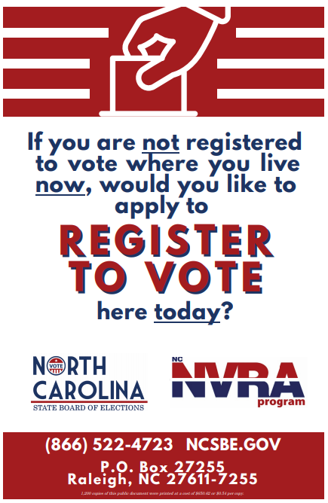
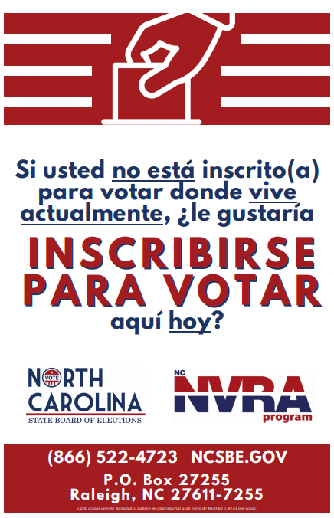
NVRA Poster
Notes:
The NVRA posters and laminated forms are sent to you annually along with your other posters needed for your offices. You can also submit a request for NVRA posters to display throughout your office through the State Board of Elections.

Slide 65
Nvra agency RESOURCES
NVRA Resource Page
NVRA@ncsbe.gov
Email Address
https://www.ncsbe.gov/registering/national-voter-registration-act-nvra
NCDHHS Training Page
https://www.ncdhhs.gov/divisions/social-services/county-staff-information/training#program-compliance
Notes:
Here are a few links to the NVRA Agency Resources
On the NC State Board of Elections website under the National Voter Registration Act section there are numerous NVRA documents and resources
In addition, you can reach the SBE NVRA team by using the NVRA@ncsbe.gov email address
Lastly, on NC DHHS website under Divisions, Social Services, County Staff Information and finally on the Training page, under the Program Compliance section there are resources under the National Voter Registration Act Section.

Slide 66
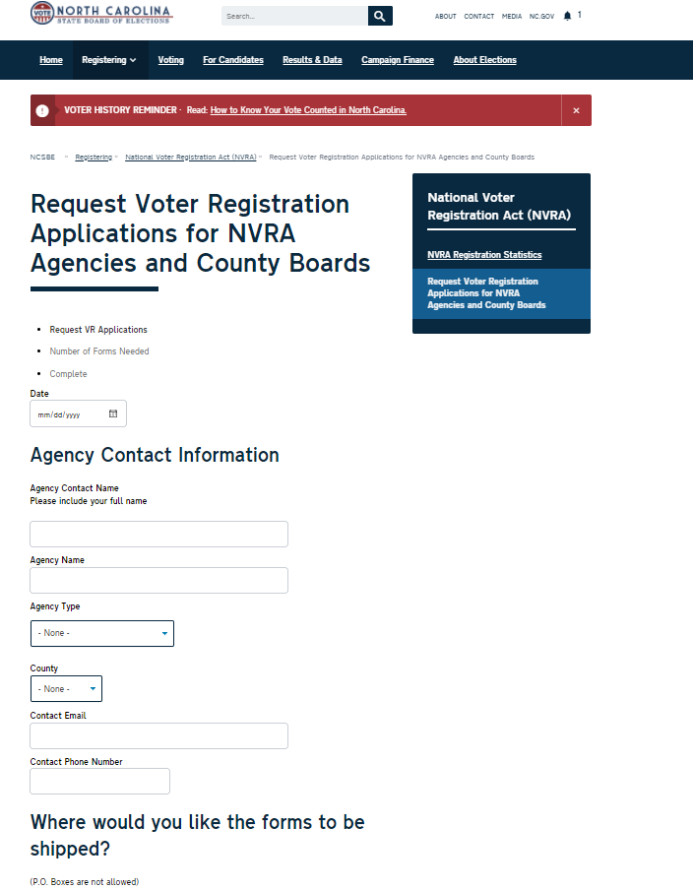
Order Voter Registration Applications online at www.NCSBE.gov

Slide 67
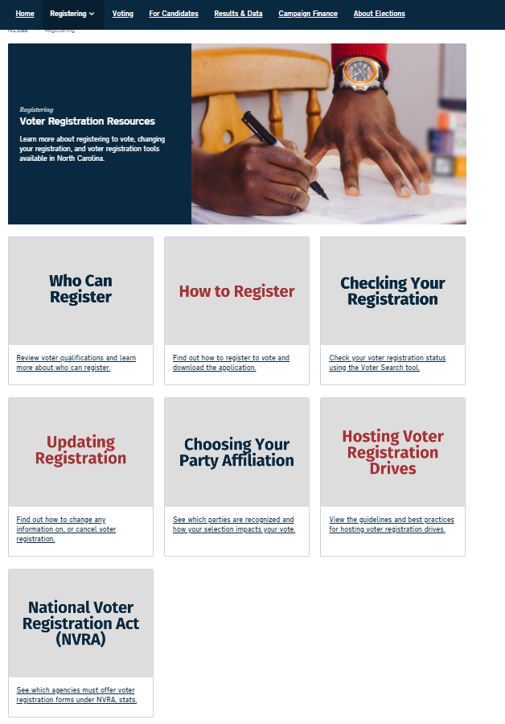
www.NCSBE.gov
Click the “Registering” tab near the top of the homepage. Scroll toward the bottom of the page and click the box that states “National Voter Registration Act (NVRA)” to reach the NVRA Resource Page

Slide 68
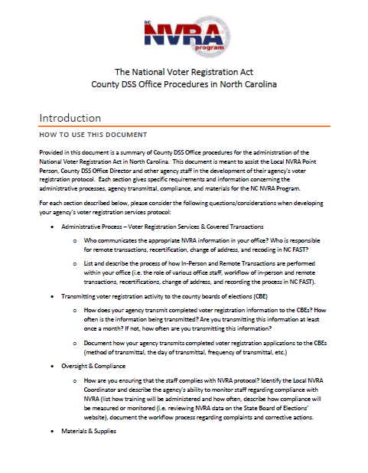
NVRA Protocol guidance
NVRA County DSS Office Procedures - Guidance for Voter Registration Protocol
Review the protocol
Make any necessary adjustments to your local process & submitted protocol document
Notes:
Friendly reminder of the NVRA Protocol that was shared in the Spring of 2020. This document will be uploaded to the DHHS training section of their website and the SBE NVRA webpage

Slide 69
NC State Board of Elections
SBE NVRA Coordinator: Kori House
NVRA@ncsbe.gov
NC Department of Health & Human Services
DHHS NVRA Coordinator: Michael Leach
NVRA@dhhs.nc.gov
NC Department of Health & Human Services
Section Chief, Title VI/ADA -Civil Rights Administrator: Carlotta Dixon
Carlotta.Dixon@dhhs.nc.gov

Slide 70
Questions?

