Slide 1
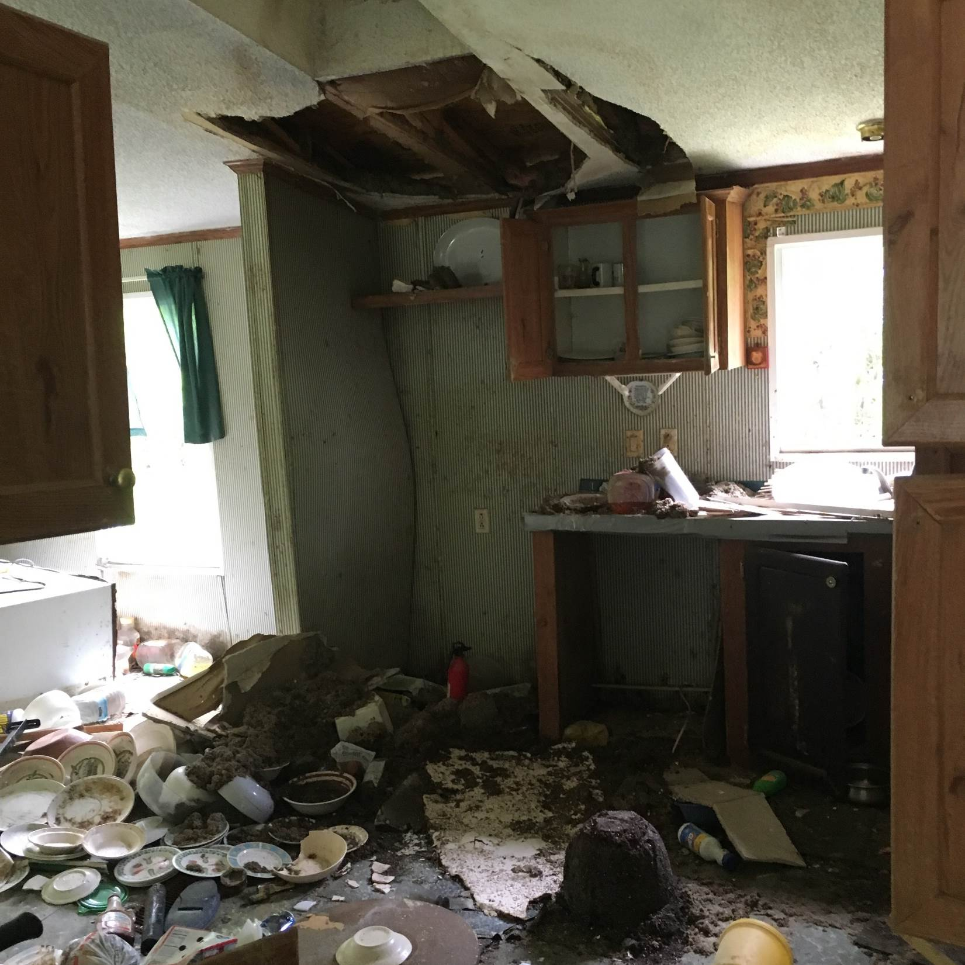
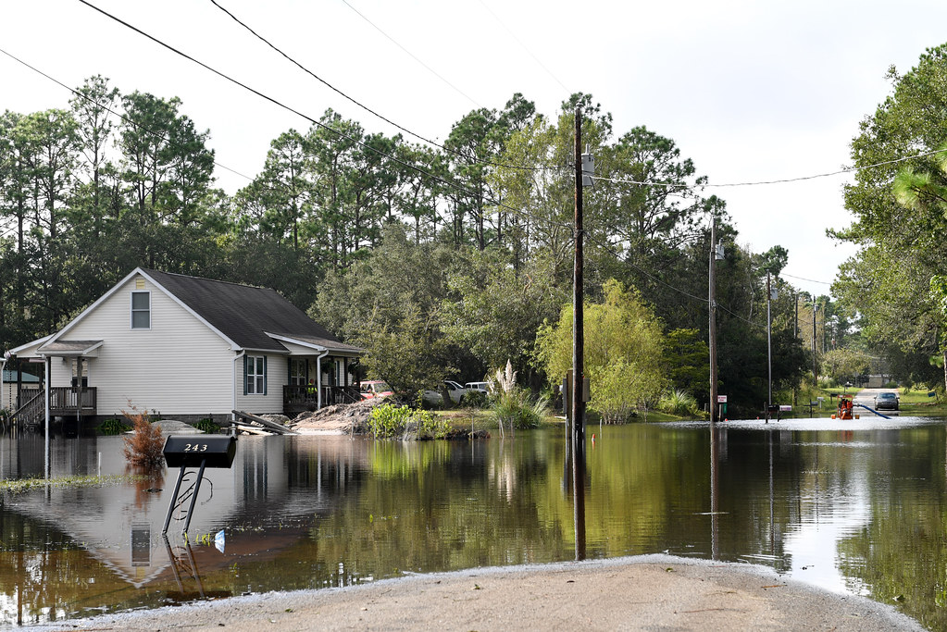
NCDPS- Emergency Management - Recovery
Individual Assistance
Notes:
Instructions

Slide 2
NCEM Individual Assistance Program Overview
The Individual Assistance Program provides financial and direct services to eligible individuals and families who have been impacted by natural or man-made disasters.
Federal –Stafford Act
Notes:
Instructions

Slide 3
Changes to FEMA IA Program

Slide 4
FEMA IA Declaration Factors
The Federal Emergency Management Agency (FEMA) considers several factors when evaluating a Governor’s request for a major disaster declaration authorizing Individual Assistance. These factors include, but are not limited to:
State Fiscal Capacity and Resource Availability
Uninsured Home and Personal Property Losses
Disaster Impacted Population Profile
Impact on Community Infrastructure
Casualties
Disaster Related Unemployment
The maximum amount of assistance for housing assistance and other needs assistance for Federal Fiscal Year 2024 is $42,500.00.

Slide 5
FEMA Individual Assistance
Housing Assistance
Lodging Expense Reimbursement
Rental Assistance
Home Repair
Home Replacement Assistance
Multi-Family Lease and Repair
Direct Housing
Permanent Housing Construction
SBA Low-Interest Loans
Other Needs Assistance (ONA)
Personal Property Assistance
Transportation Assistance
Group Flood Insurance Policy
Funeral Assistance
Medical/Dental Assistance
Childcare Assistance
Miscellaneous and Other Items
Notes:
Instructions

Slide 6
Other Assistance Programs Triggered by an IA Declaration
Legal Services
Disaster Unemployment
Income Tax Assistance
Crisis Counseling Disaster
Disaster Case Management
Voluntary Agency Liaison
DSNAP
Disaster Survivor Assistance

Slide 7
Programs and Terms with IA
Transitional Sheltering Assistance (TSA)
Non-Congregate Sheltering(NCS)
Direct Housing – which is Temp Housing
Rental Assistance
ONA
Disaster Case Management
Disaster Recovery Center (DRC)
FEMA VAL

Slide 8
Type I State Declaration
State Individual Assistance Declaration
By County
Local Declaration of Emergency
NFIP and the adoption of a Hazard Mitigation Plan must be provided to the state.
PDAs exceed the criteria for the SBA Loan Program
Must have 25 primary residences and businesses destroyed or have major damage that are under-insured
SBA grants a disaster declaration and if needed a State Declaration follows
Provides financial assistance

Slide 9
Questions?
Recovery
Yevon Adams
984-365-7270
Yevon.adams2@ncdps.gov
Michele Harrison
984-297-5659
Michele.Harrison@ncdps.gov
Notes:
Light background slide with heading, text and bulleted text

