Slide 1
NC Department of Health and Human Services
Opioid and Prescription Drug Abuse Advisory Committee (OPDAAC)
Topic: Syringe Service Programs (SSPs) in North Carolina
December 5, 2024

Slide 2
Welcome to OPDAAC!
Ellen Stroud, Division of Mental Health, Developmental Disabilities, Substance Use Services

Slide 3
Housekeeping
Take breaks as needed
For questions during the meeting:
Virtual attendees: Please put your questions in the Q&A box, which will be monitored for the duration of the meeting. Note: you need to send to all panelists and attendees to ensure your question is addressed in a timely manner.
In-person attendees: Fill out an index card given at registration with your questions and put in box at the back table.
All attendees: If you would like to ask a question to a specific presenter, please be sure to include their name in your question (either in the Q&A box or on an index card).

Slide 4
Housekeeping, Cont.
Poll Categories
Substance Use Services Providers
Public Health
Health Care Provider
Harm Reduction
Recovery Community Organizations
Law Enforcement Officials
EMS or Fire
Re-entry Programs
Housing Programs
Others

Slide 5
NC Department of Health and Human Services
State Opioid Response (SOR) Harm Reduction Updates
Ellen Stroud, LPC/MSHP (TN)
Assistant Project Director
Division of Mental Health, Developmental Disabilities and Substance Use Services
December 5, 2024

Slide 6
State Opioid Response (SOR) Information
The State Opioid Response is a $36 million federal grant that funds treatment, recovery services, prevention, and harm reduction
SOR 4 funding started September 30
Partnership with the Division of Public Health for training and technical assistance as well as Naloxonesaves.org
SOR 4 Goals for Harm Reduction
Reduce overdose deaths
Centering equity and lived experience in all programmatic activities is key
Support prevention programs in policy creation for storage, distribution, and leave-behind programs

Slide 7
SOR Naloxone Distribution and Saturation Plan
Purpose: Reduce opioid overdose deaths by increasing overdose education and naloxone distribution among communities with high overdose rates and to those at highest risk of experiencing an overdose
Saturation Model: 340 kits distributed per 100,000 people to avert death in 80% of all witnessed overdose deaths = 74,000 doses
Distribution Targets:
people who use drugs
and their close contacts
individuals leaving incarceration are 40 to 50 times more likely to experience an overdose in the two weeks after leaving

Slide 8
SOR Naloxone Distribution and Saturation Plan
Distribution Partners:
Syringe services programs
Local health departments
Treatment service providers
Emergency medical services with naloxone leave behind programs
Detention centers for reentry
Justice involved reentry programs
Organizations serving people experiencing homelessness
Organizations directly serving people that are part of historically marginalized populations particularly American Indian and Black adults

Slide 9
Naloxone Distribution
Total: 1,076,324 doses (IM and Nasal), $24 million
Funding Sources: State Opioid Response and Substance Use Block Grant

Slide 10
Making Progress
EBCI overdoses decrease since 24/7 access to naloxone added
Working with the Lumbee Tribe to see what parts of this program will work for them
DPH training focus with tribes and distribution
Notes:
This slide visualizes overdose data collected by the Tribal EMS and submitted to the Overdose Detection Mapping Application Program, or ODMAP. The bar chart that shows the number of suspected overdoses per month. Look at the dramatic decline in suspected overdoses in the past year since the 24/7 access vending machines were installed! Mary Beth will talk about the overall state data.

Slide 11
SOR Helene Response
112,000 doses sent state-wide from the end of September through November
60,000 of those were for Helene-impacted areas
Local health departments
Syringe Service Programs
Tribes
Shelters
OTPs
FQHCs
First responder leave behind programs
Justice-involved programs
Community-based organizations
Harm Reduction focus that was an expansion from past disasters
Wonderful team effort

Slide 12
2025
$6 million
> 700,000 doses
Overdoses are going down time to make even more of an investment
Partnerships with LME/MCOS and NCHRC
Adding reports on distribution and overdose reversals
Request more often
IM and nasal options
Xylazine test strips
Naloxonesaves.org

Slide 13
Dose of Happiness Operation Gateway Helene Distribution

Slide 14
History and Evolution of NC Safer Syringe Initiative and Harm Reduction In NC
Margaret Bordeaux, Duke University

Slide 16
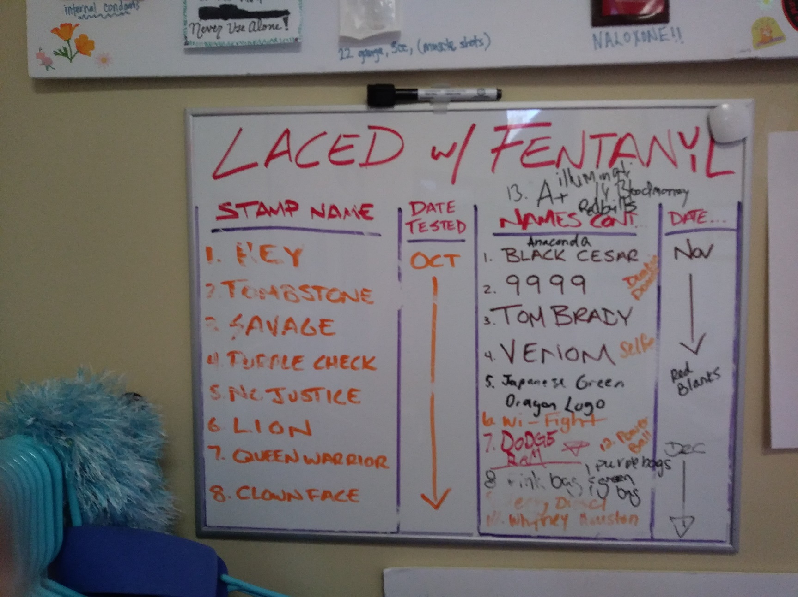

Slide 19
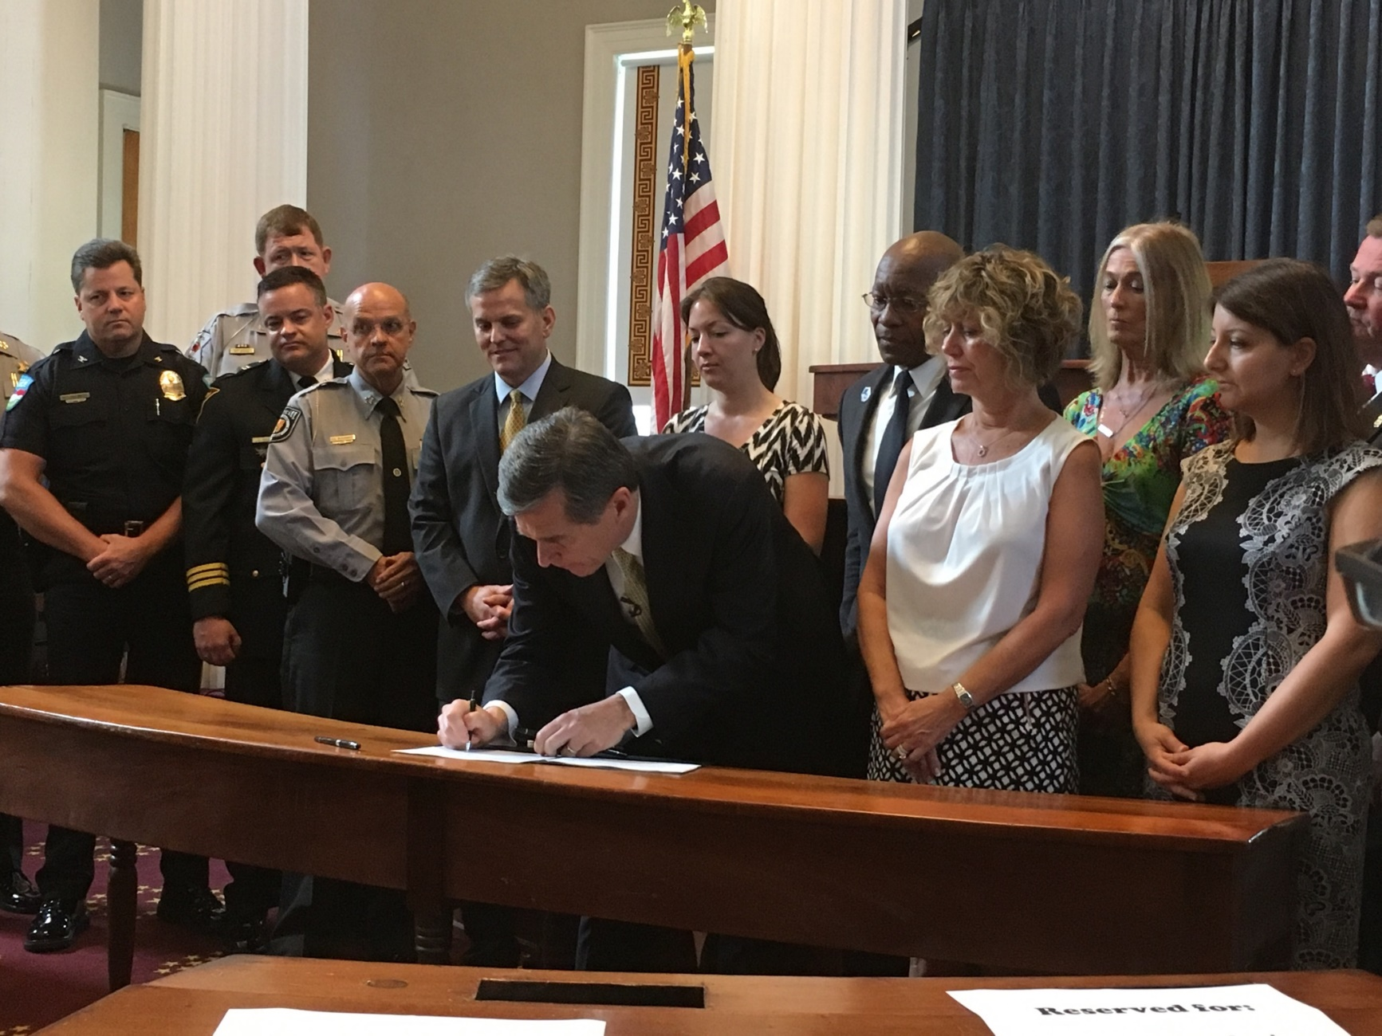

Slide 20
Current Trends In North Carolina: Fact vs. Fiction
Mary Beth Cox, Division of Public Health
Sally Reeske, Division of Public Health

Slide 21
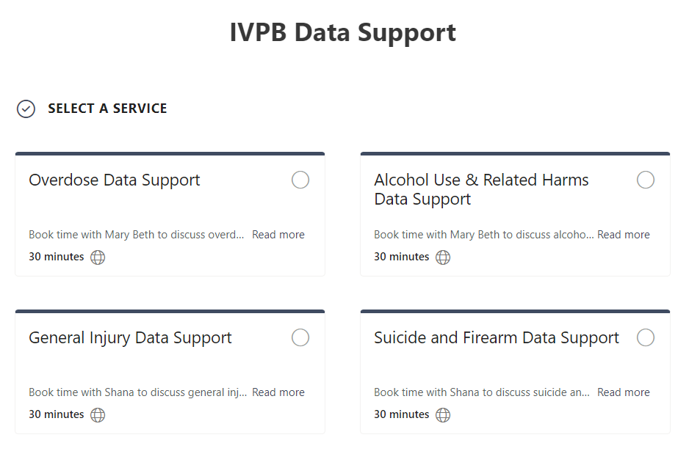
IVPB Data Support
Book time with an IVPB epidemiologist to discuss available data products, to talk through custom data requests, or for general data questions.
Email us at
SubstanceUseData@dhhs.nc.gov.
IVPB Data Request Policy
IVPB Data Support Bookings

Slide 22
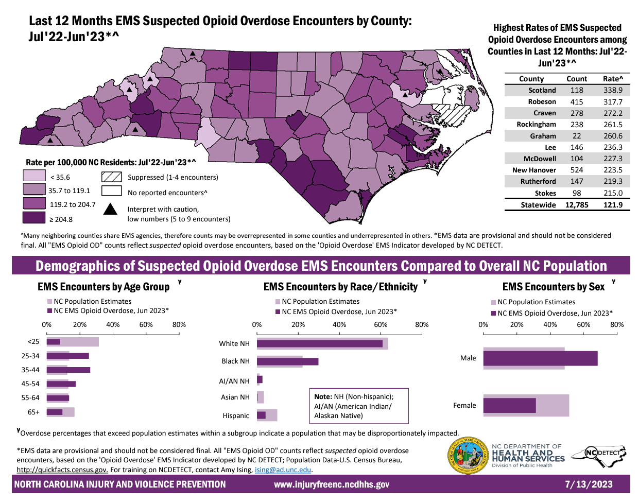
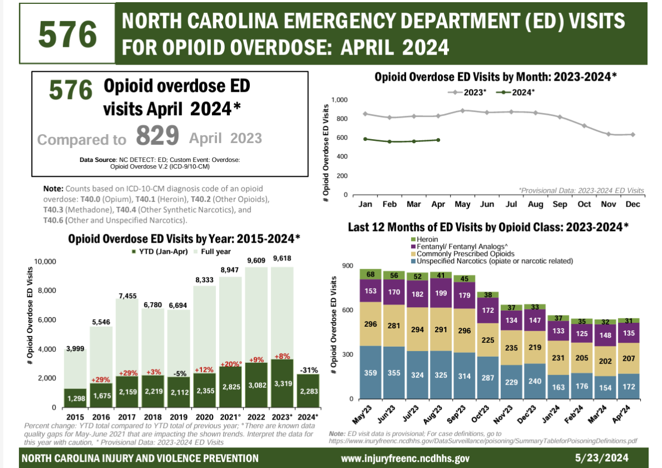
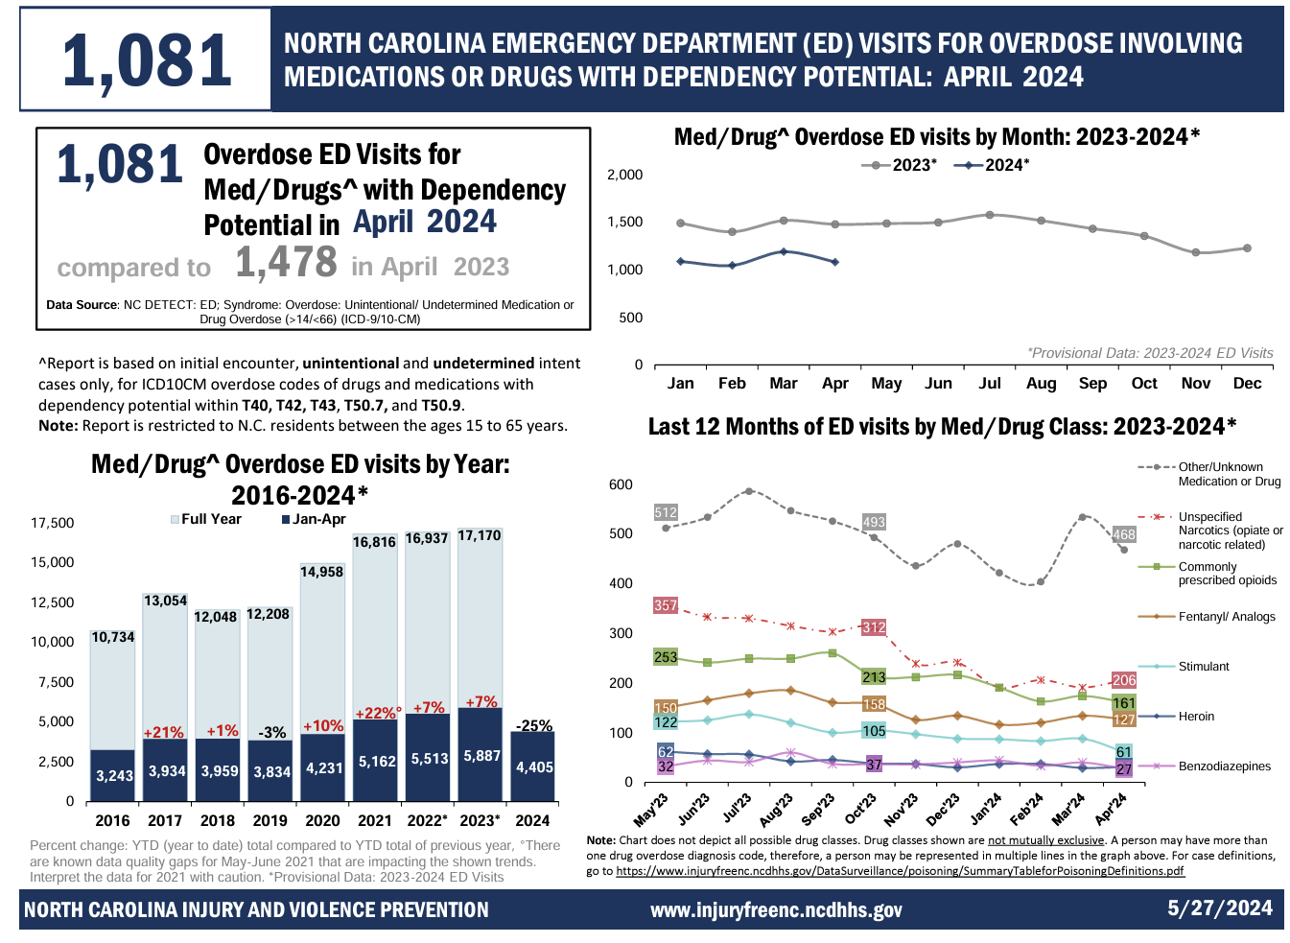
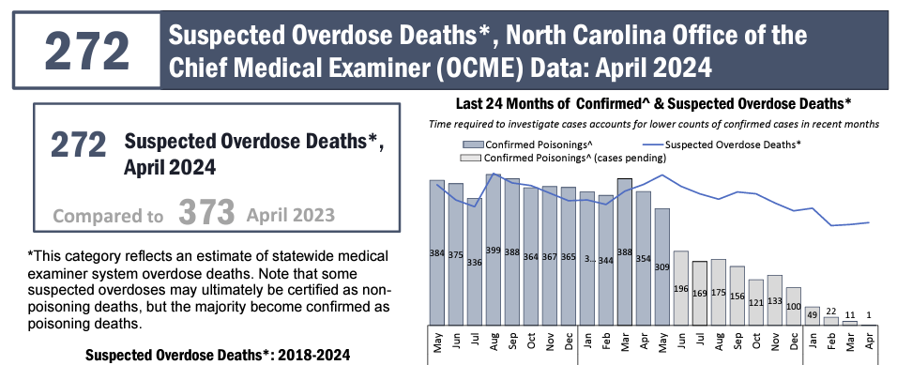
Email SubstanceUseData@dhhs.nc.gov to receive monthly updates

Slide 23
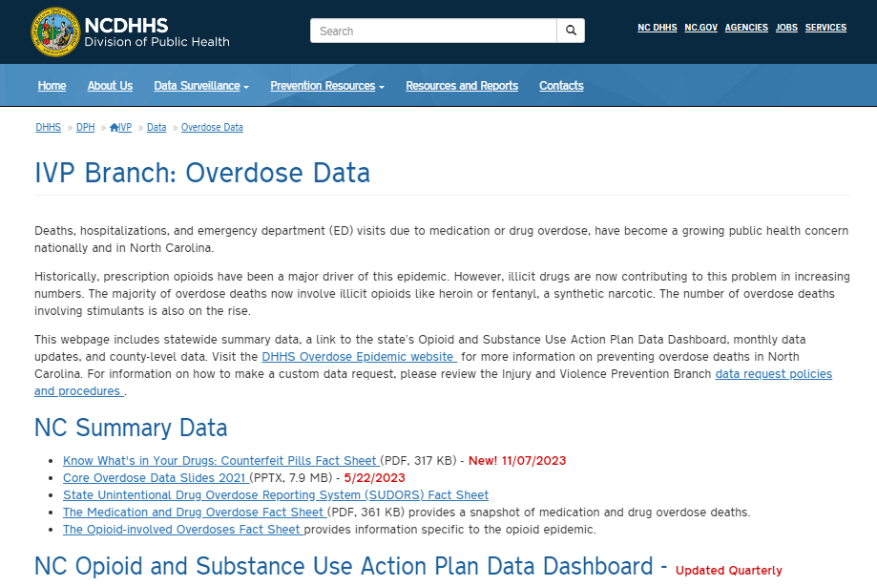
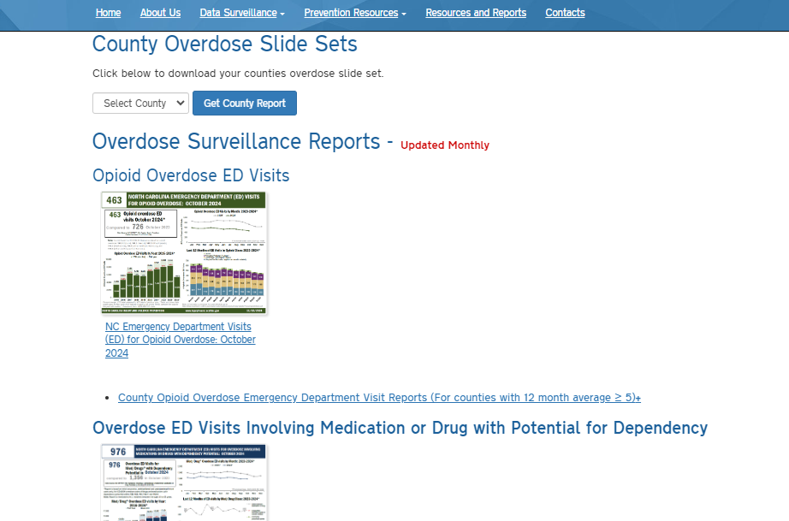

Slide 24
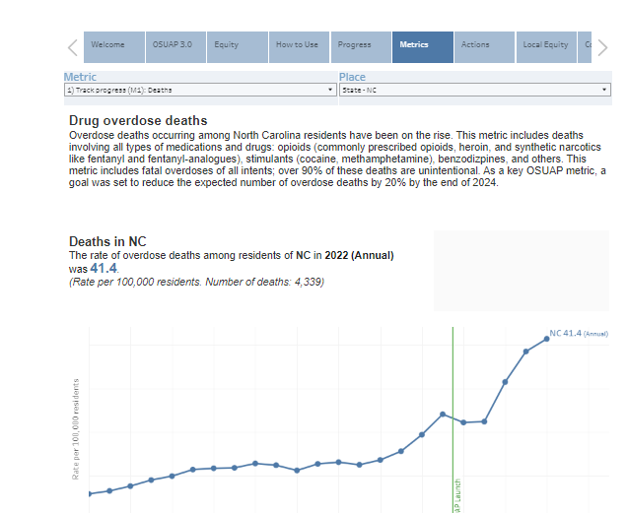

Slide 25
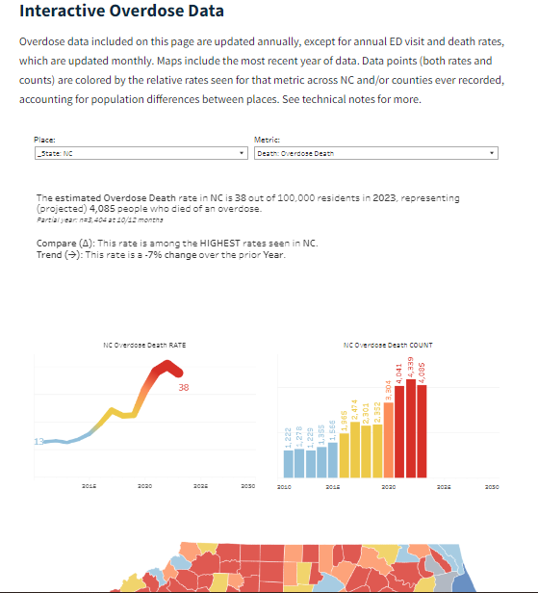
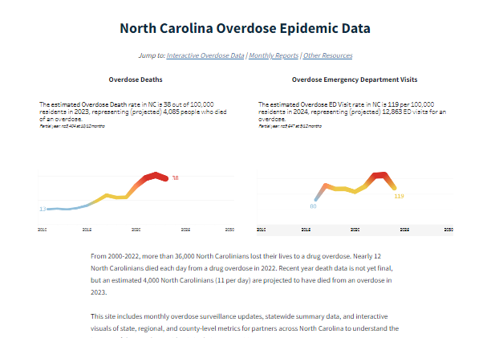
Coming soon…

Slide 26
North Carolina Safer Syringe Initiative
Syringe services were legalized in July 2016. (GS 90-113.27)
Allows for any governmental or non-governmental agencies and organizations that promote scientifically proven strategies for mitigating risks of substance use to establish a Syringe Services Program.
Programs register with the Division of Public Health
Safer Syringe Initiative Registration Survey
Must submit safety and security plan to law enforcement agencies with jurisdiction where services are being offered and update annually
IVPB meets with the program for technical assistance during the registration process and prior to services beginning.
https://www.ncdhhs.gov/divisions/public-health/north-carolina-safer-syringe-initiative
NCGS: 90‑113.27. Needle and hypodermic syringe exchange programs authorized; limited immunity. https://www.ncleg.net/EnactedLegislation/Statutes/PDF/BySection/Chapter_90/GS_90-113.27.pdf

Slide 27
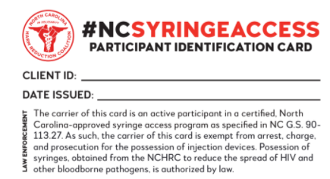
Requirements: Services and Supplies
Syringes and other injection supplies
free of cost
in quantities that are adequate to prevent the sharing and reuse
Syringe disposal
sharps containers
returns
education on appropriate disposal
Education
Overdose prevention
Communicable disease prevention
Substance misuse prevention
Treatment for mental illness and substance use disorders
Referrals and consultations to substance use treatment and mental health as needed
Naloxone access (distribution or referral)
Participant cards for limited immunity
NCGS: 90‑113.27. Needle and hypodermic syringe exchange programs authorized; limited immunity. https://www.ncleg.net/EnactedLegislation/Statutes/PDF/BySection/Chapter_90/GS_90-113.27.pdf

Slide 28
Requirements: Reporting
Annual reporting to Division of Public Health is required
The number of individuals served by the program.
The number of needles, hypodermic syringes, and needle injection supplies dispensed by the program and returned to the program.
The number of opioid antagonist kits distributed by the program.
The number and type of treatment referrals provided to individuals served by the program.
number of individuals referred to other programs that provide access to an opioid antagonist that is approved by the federal Food and Drug Administration for the treatment of a drug overdose.
Additional reporting information is optional
Additional services provided
Additional referrals
Demographics
Program needs
NCGS: 90‑113.27. Needle and hypodermic syringe exchange programs authorized; limited immunity. https://www.ncleg.net/EnactedLegislation/Statutes/PDF/BySection/Chapter_90/GS_90-113.27.pdf

Slide 29
Syringe Service Programs
Health Services for people who use drugs, their friends, family and others
Operate using a harm reduction framework
Harm Reduction is not a new concept, but has been more widely accepted in the recent years
Cost-effective
Safe
Preventative
Communicable/Infectious Disease
Overdose
Crime
More
Access to care
SUD treatment
Testing
Vaccination
Behavioral Health
Nutrition
Housing
Disposal
https://www.cdc.gov/syringe-services-programs/php/index.html#:~:text=Syringe%20services%20programs%20are%20community,drug%20use%20on%20the%20community .
Notes:
Cannot point to 1 specific cause
Covid-19
Declining mental health
Isolation
Limited access to resources for bio-psycho-social needs:
Healthcare
Employment
Housing
Nutrition
Low-barrier SUD Treatment
Limited and restricted access to prescription opioids
Ever-changing, unregulated drug supply
Incarceration

Slide 30
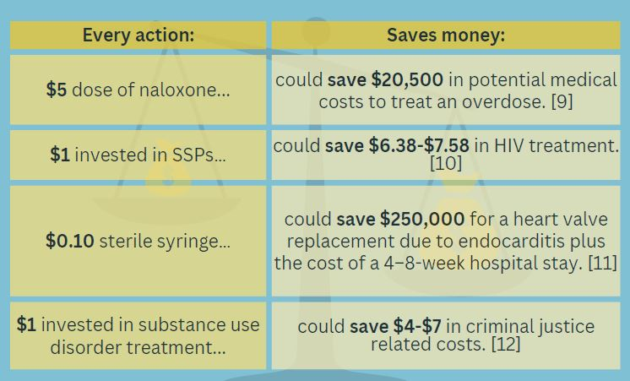
https://www.cdc.gov/syringe-services-programs/php/index.html#:~:text=Syringe%20services%20programs%20are%20community,drug%20use%20on%20the%20community.

Slide 31
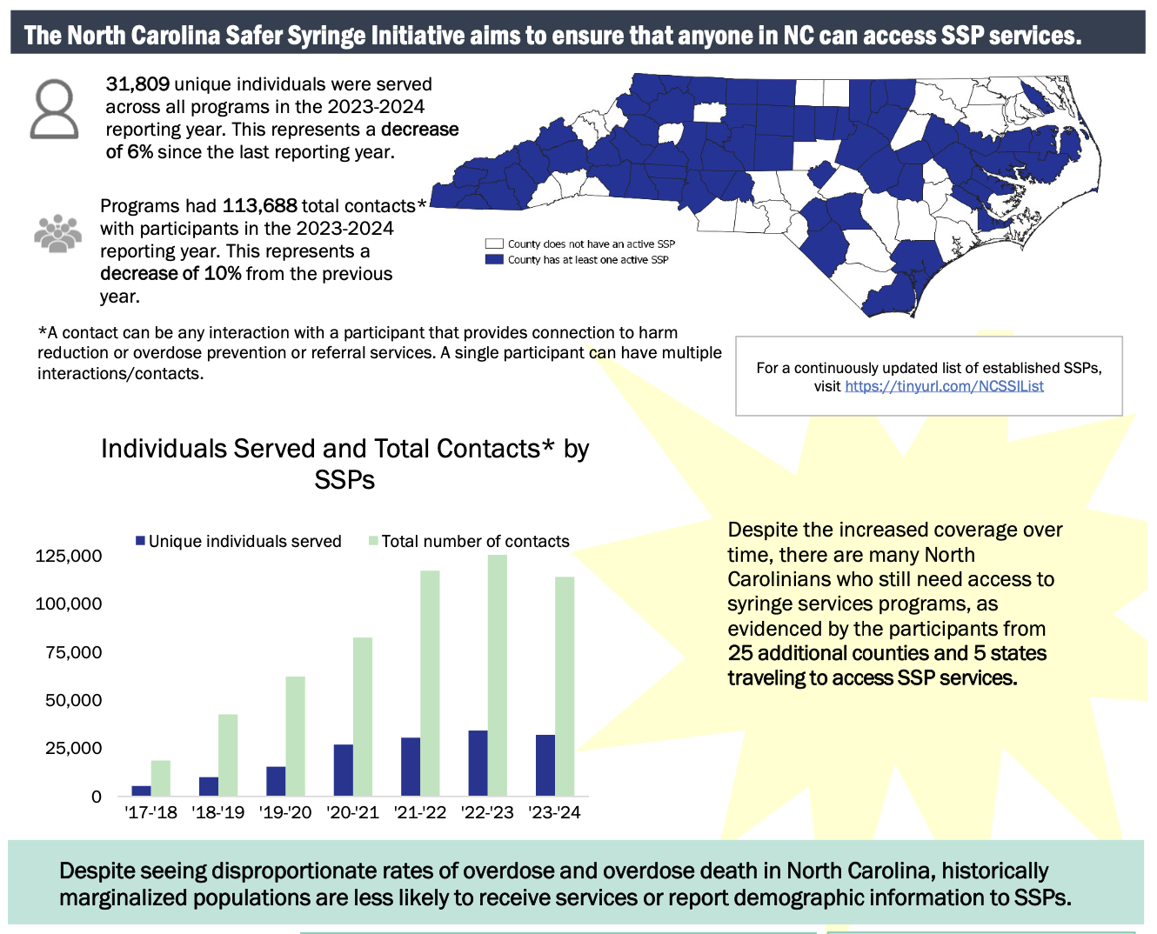
SSP Impact
Source: Annual reporting data submitted by established Syringe Service Programs in North Carolina, 2023-2024 Safer Syringe Initiative Annual Report
Notes:
Over 32,000 unique individuals (2024)
Over 115,000 encounters (2024) Over 32,000 unique individuals (2024)
Over 115,000 encounters (2024)
56% male (including trans-men)
43% female (including trans-women)
79 participants identified as being transgender

Slide 32
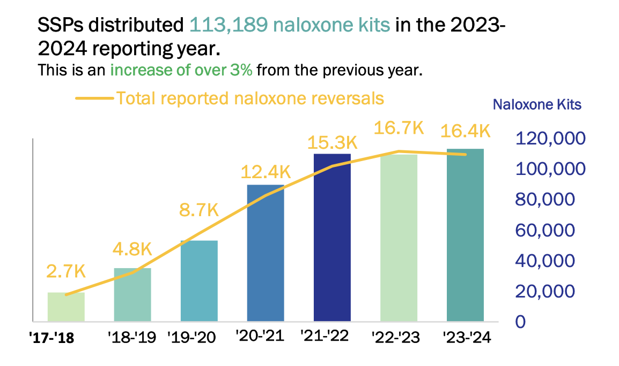
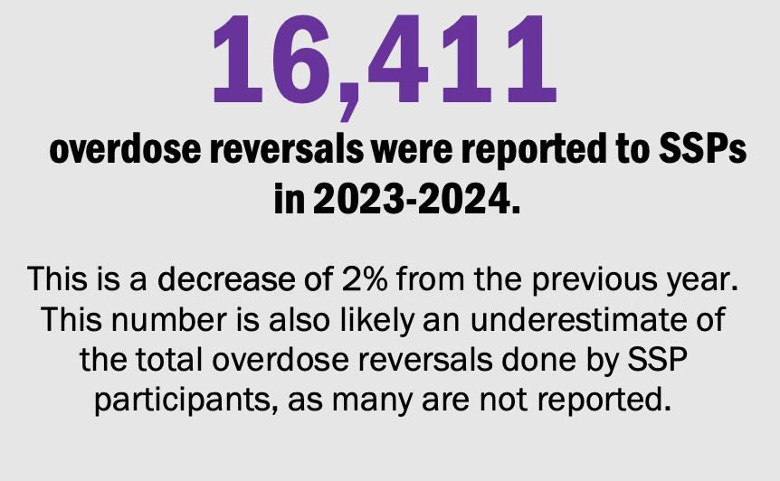
Lives Saved
Source: Annual reporting data submitted by established Syringe Service Programs in North Carolina, 2023-2024 Safer Syringe Initiative Annual Report

Slide 33
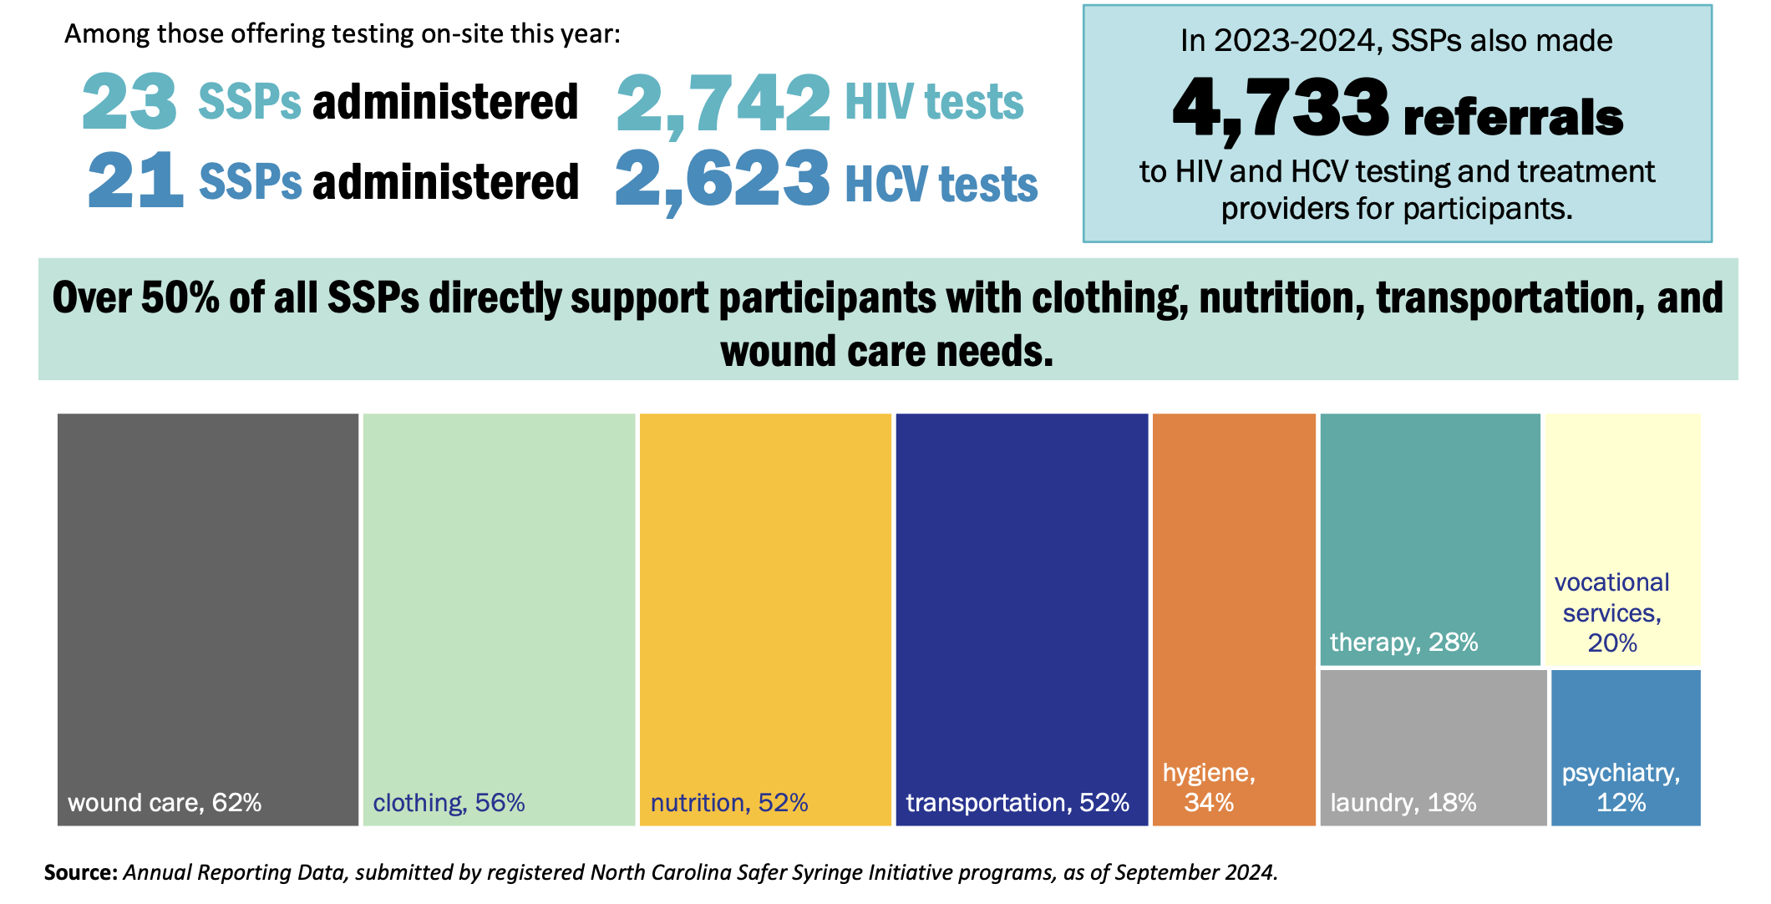
Wrap Around Services
Source: Annual reporting data submitted by established Syringe Service Programs in North Carolina, 2023-2024 Safer Syringe Initiative Annual Report

Slide 34
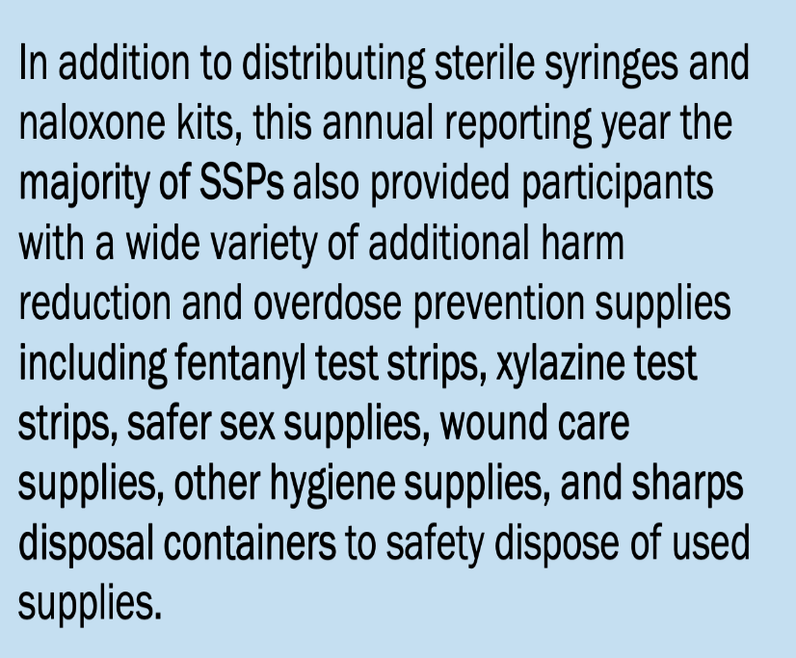
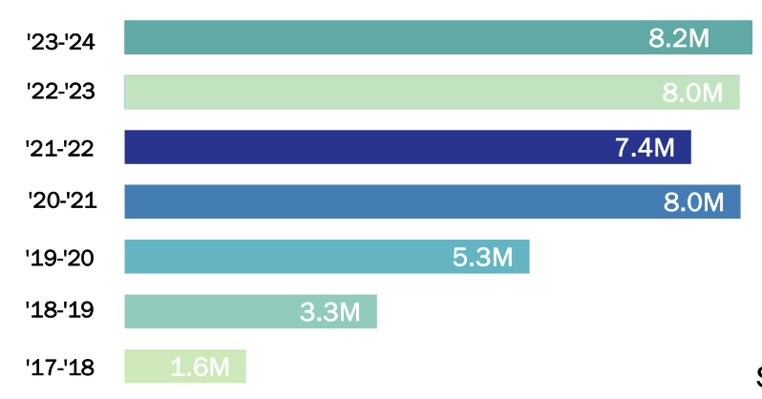
A key purpose of SSPs is to provide participants with sterile syringes and other supplies that are used to mitigate risks associated with substance use while also facilitating the safe disposal of these supplies.
Source: Annual reporting data submitted by established Syringe Service Programs in North Carolina, 2023-2024 Safer Syringe Initiative Annual Report

Slide 35
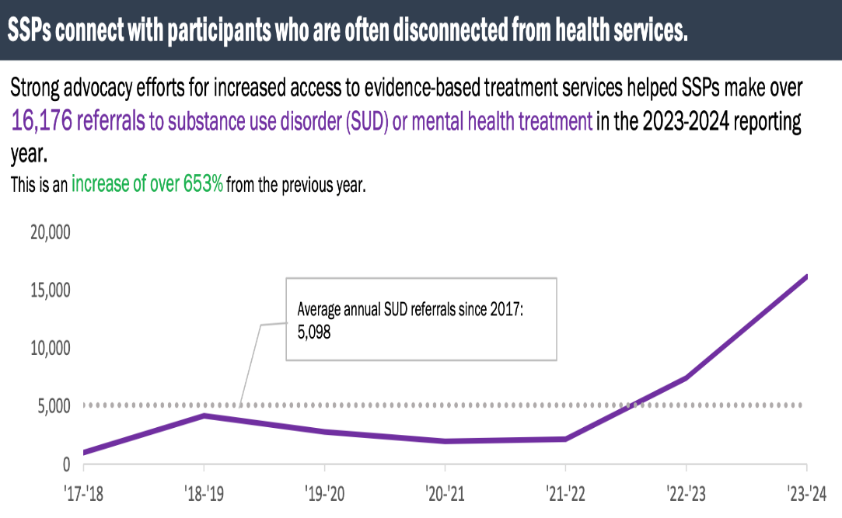
Linkage To Care
In 2023-2024, SSPs made over 8,700 referrals to services that support the personalized needs of participants including food and nutrition providers, primary medical care, housing, employment, education, childcare and MUCH MORE!
Source: Annual reporting data submitted by established Syringe Service Programs in North Carolina, 2023-2024 Safer Syringe Initiative Annual Report

Slide 36
SSP Advisory Group
SSP Learning Collaborative
Group of partners from across the state
Created as part of the state Opioid Action Plan
Meets virtually on a bi-monthly basis
Centers lived experience in our work and ensures community input in NCDHHS priorities and work
Focuses on the current needs of people who use drugs
Shared experiences and support
Training and networking opportunity for all SSPs in NC
Twice per year
Hosted by local SSPs
Led by subject matter experts and community partners
Focus on relevant topics
Wound care
Drug user health equity
Naloxone distribution
Building strong partnerships in the community

Slide 37
Innovation Across The State
EMS-based services
Community-based drug checking
Partnerships with pharmacies
Low-barrier treatment
Wound care
Low-barrier employment
Health hubs
Trainings and technical assistance

Slide 38
What Do We Do?
North Carolina Association of County Commissioners: Opioid Settlement Technical Assistance Team (OSTAT)
Harm Reduction as Transformative Practice Academy
Direct funding to organizations (LHDs, CBOs, others)
Direct technical assistance for new and established SSPs, or other partners who are doing overdose prevention work.
Clinical Memos and Support
Xylazine Update
Xylazine Clinical Memo (Original)
Syringe Services Program Provider Letter
FAQs, One-pagers, toolkits, and other resources:
Counterfeit Pills Resource
Post Overdose Response Teams Toolkit
Naloxone Distribution Toolkit
Jail Health Toolkit
Drug User Health Resource Guide
Harm Reduction Primer
Naloxone In Schools
NC Safer Syringe Initiative Annual Report
Naloxonesaves.org

Slide 39
Questions?
SyringeExchangeNC@dhhs.nc.gov
Tyler.yates@dhhs.nc.gov
Sally.reeske@dhhs.nc.gov

Slide 40
More Than Overdose Prevention: Trends in Infectious Disease
Erika Samoff, Division of Public Health
Pete Moore, Division of Public Health

Slide 41
Outline
Infectious diseases 101
Focus on vaccines
Focus on sexually transmitted disease
Focus on pregnancy

Slide 42
Infectious Diseases Control 101
Goals
Support access to resources and health equity
Ensure educated ready and capable population
Reduce disease
Ingestion
Inhalation
Skin exposure
Blood exposure
Mucosal exposure

Slide 43
SSPs as Health Partners
People who inject drugs experience lower engagement with traditional healthcare systems and often report negative experiences.
SSPs can be important trusted messengers for disease control
For people living with addiction and unhoused people
For both routine health care/vaccination and for fighting vaccine-preventable disease outbreaks
Challenges to engaging SSPs in vaccine access and confidence efforts include:
SSP Staff capacity and training, including how to access to clinical providers/vaccine administrators
Stigma and bias towards people who inject drugs
Free and low-cost healthcare supply
Access to clinical space
Health literacy and intervention/vaccine hesitance among service populations
Ability to enter data into clinical/vaccine information systems
Philosophical differences around harm-reduction
Opportunities include:
Strengthening partnerships among SSPs and LHDs
Funding and capacity-building efforts for SSPs to expand programs
Cross-training staff
Co-location of clinical and testing services with SSPs
https://injuryfreenc.org/

Slide 44
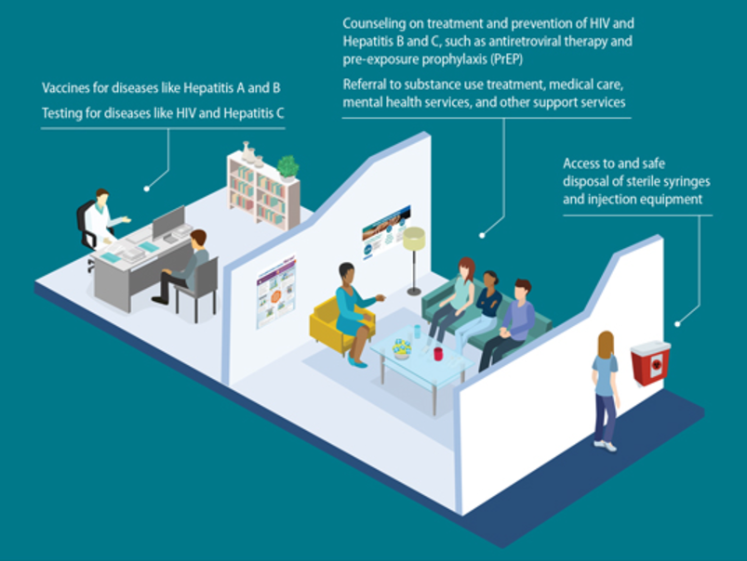
Some key prevention tools that could be offered by SSPs and people working in harm reduction
Communication and information
Testing
Linkage to testing
Rapid or self-administered tests
Linkage to care
Helping with appointments
Hosting care provider
Treatment including vaccination

Slide 45
Some key infectious diseases to be aware of
Hepatitis C
Hepatitis A
Hepatitis B
Wound infections and endocarditis
Syphilis and HIV

Slide 46
Example: HIV

Slide 47
SSPs as support for treatment: HIV controlled by treatment among people who inject drugs
Viral suppression by month
HIV outbreak investigation cases, Western NC, Jan 2018-Feb 2019
Testing and care services offered to a group of drug use partners following an increase in HIV
After offering testing and care services to 65 people:
13 people tested positive for hepatitis C
2 people tested positive for HIV
Person | Jan 2016 |  |  |  |  |  |  |  |  |  |  |  | Jan 2017 |  |  |  |  |  |  |  |  |  |  |  | Jan 2018 |  |  |  |  |  |  |  |  |  |  |  | Jan 19
O-1
O-2
O-3
O-4
O-5
O-6
O-7
N-1
N-2
Deceased
March 2019
No evidence of care; presumed not virally suppressed
Month of diagnosis
In care but not suppressed
In care and suppressed
Notes:
Our goal with the people living with HIV was to link them to care in a way that they could attend consistently. This slide shows linkage to care and viral suppression in this group during the period of the outbreak; the original 7 indicated by O in the first column and the two new by N. You can see that the person at the top was not in care through most of January 2017, then started attending care (shown in pink) in late 2017, and was never virally suppressed. The second person was diagnosed in mid-2016 (blue box), linked to care immediately, and was suppressed from June 2017 forward.
The overall picture here is that for most of these people, linkage to care was successful and they were virally suppressed in 2018. There have been no new diagnoses linked to this cluster, and we presume that this linkage is the fundamental reason for the control of this outbreak, with the important contribution of syringe exchange.

Slide 48
Example: Hepatitis A

Slide 49
SSPs as Vaccination Partners
2018-2020: Nationwide Hep A outbreak with highest rates of infection among
People who inject drugs
People experiencing homelessness
Men reporting sex with men
August 2018:
NC Immunization Program authorized use of state-supplied adult Hep A vaccine by
LHDs to include individuals in any of the three high-risk categories.
Off-site outreach was highly encouraged to reach these vulnerable populations.
SSP vaccination services require partnership with the LHD if using state-supplied vaccine.
Including
Adherence to CDC vaccine storage and handling guidelines
Vaccination Standing Order in accordance with ACIP recommendation
Providing federally-required vaccine information statements (VIS) to persons interested in being immunized
Documentation in the North Carolina Immunization Registry (NCIR) within 24 hours of administration
Close collaboration with LHD can help support these requirements
Buncombe County Health and Human Services partnered with their opioid response/needle exchange program to establish weekly vaccination clinics at a local community center and monthly clinics at the LHD Syringe Exchange

Slide 50
Example: Prenatal care

Slide 51
Care for Pregnant People
Transmission of many diseases from parent to child can be prevented
Hepatitis B
HIV
Syphilis
Prenatal care is an important pathway to access many resources
… however, there are barriers
SSPs and anyone engaged with harm reduction can help support access to prenatal care with providers and recipients

Slide 52
Syphilis Dynamics 2012-2024

Slide 53
What is Congenital Syphilis?
Syphilis transmitted from pregnant parent to baby during pregnancy or delivery
It can lead to:
Miscarriage
Issues with placenta and umbilical cord
Stillbirth
Low birth weight
Severe and life-long birth defects
Premature birth
Neonatal death
In 2023, there were 72 cases and
10 deaths from congenital syphilis in NC
It’s also preventable! That’s what we’re here to do.

Slide 54
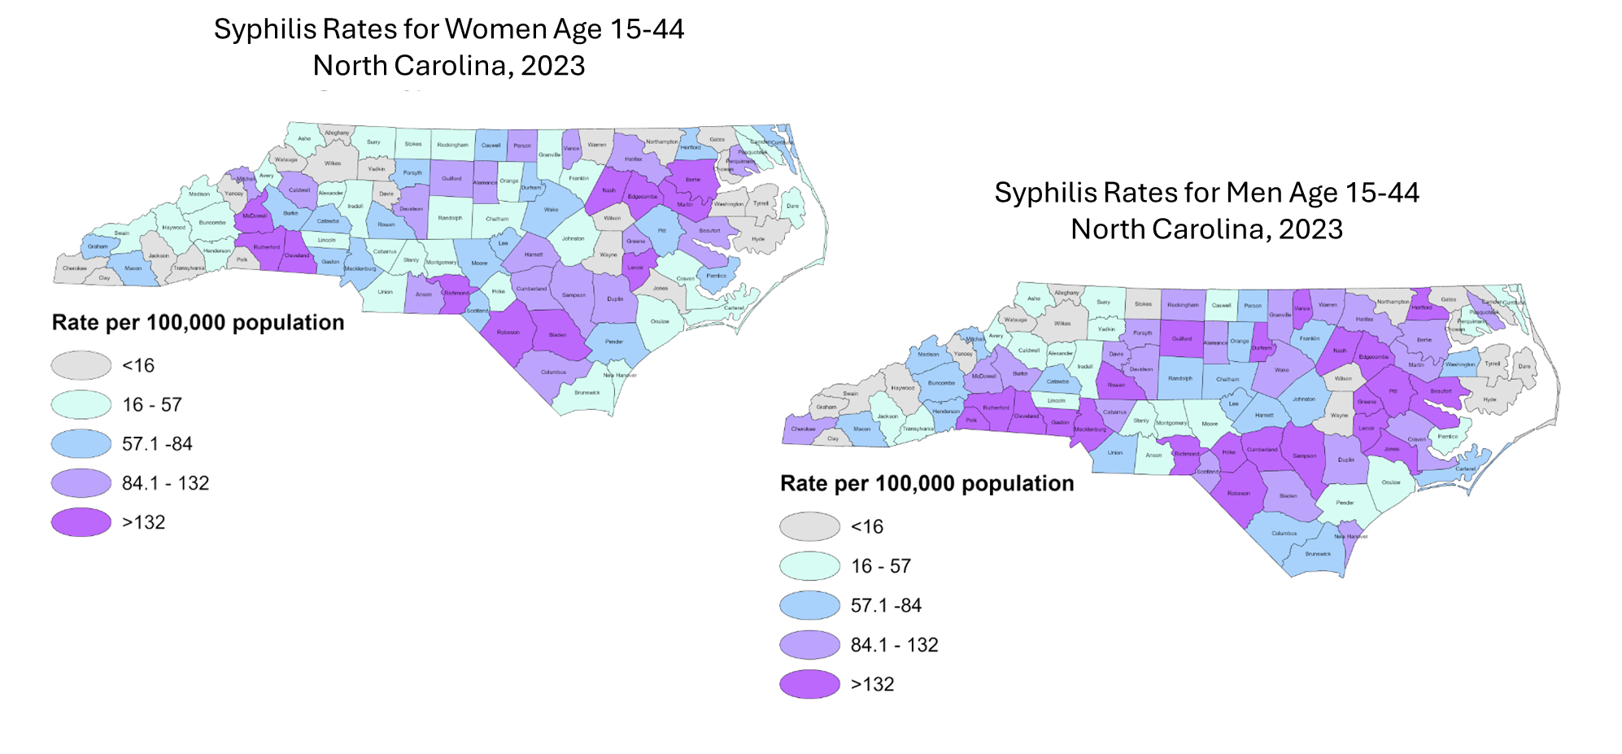
Syphilis in women concentrated in more rural areas

Slide 55
Syphilis is diagnosed by safety-net providers Most Common Provider Types Diagnosing Syphilis for Women, North Carolina, 2023
6/10 cs moms interviewed reported using Medicaid to pay healthcare costs during pregnancy/birth
Some feel that accessing care is difficult
"They probably won't help me because of the drugs"
Notes:
These are your key partners
Bicillin reimbursement rates from Medicaid have increased, so providers now don’t need to take a loss to carry bicillin.

Slide 56
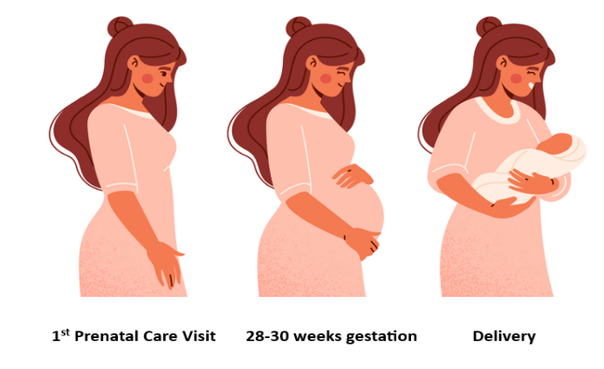
Congenital syphilis is preventable
By testing and treating, we prevented 71% of congenital syphilis cases in 2023
Data Source: North Carolina Electronic Disease Surveillance System (NC EDSS) (data as of June 2024).

Slide 57
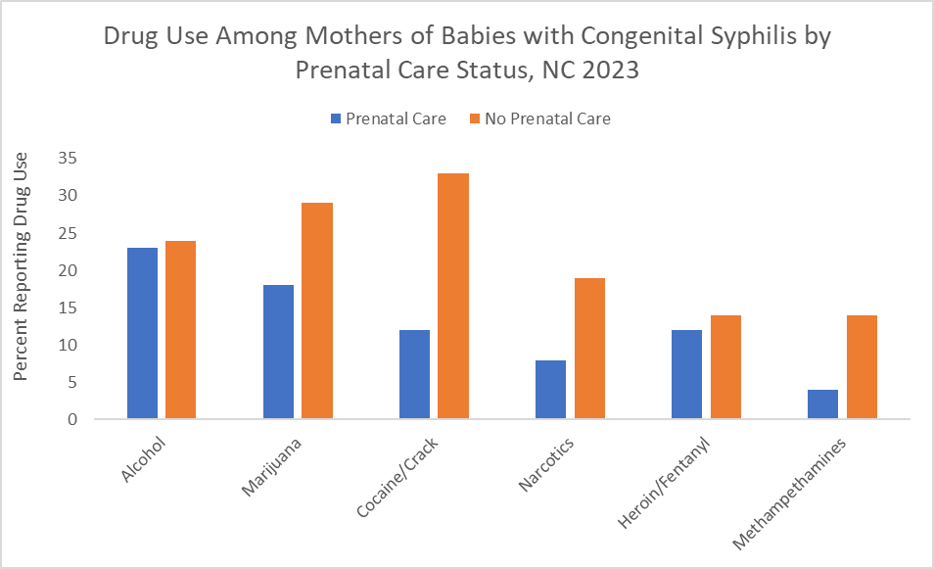
SSPs and people doing harm reduction are resources for pregnant people with syphilis
Data Source: North Carolina Electronic Disease Surveillance System (NC EDSS) (data as of September 2024).
*2024 data are still preliminary and subject to change
Notes:
This is the proportion of CS moms who reported illicit substance use (does not include ETOH or MJ) by prenatal care status; so 70% of women without PNC reported subst. Use compared to only 26% of women who accessed PNC and of those women that accessed PNC AND reported subst use, 60% started PNC in the 2nd or 3rd Trimester.

Slide 58
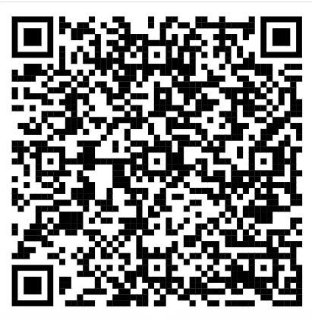
Conversations with people affected by congenital syphilis
Congenital syphilis mothers report not knowing about syphilis
What would be helpful?
"More pamphlets (handouts) and maybe signs or posters about syphilis in pregnancy"
"Providers need to have more sympathy and empathy also be more mindful on how to educate patients about syphilis”
"Women need more awareness and more information about the testing. Women need to know what syphilis is, and how it can affect your pregnancy and baby. Even if you think you are safe, you can have it."
… communication
…. also support for testing and care
Congenital syphilis
Information and resources
Notes:
"[Not having to wait] to get an appointment scheduled at the Health Department for prenatal care. I tried calling other OB doctors, but none would take my Medicaid."

Slide 59
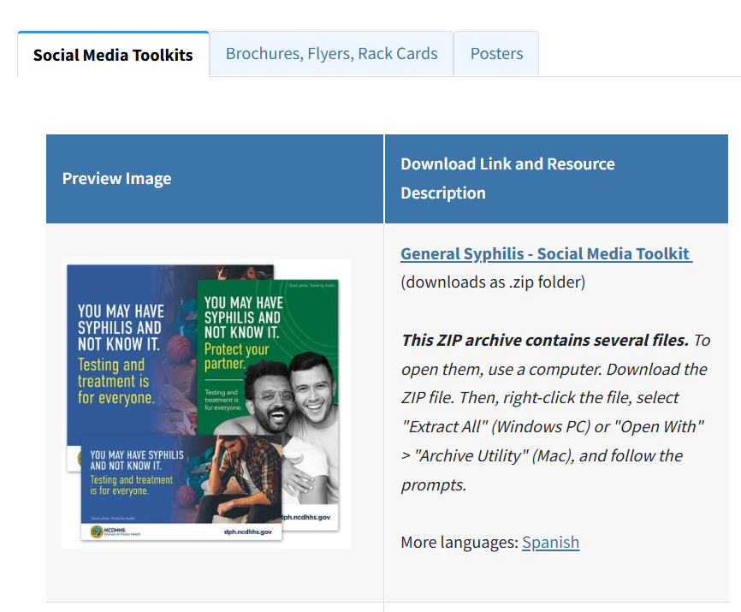
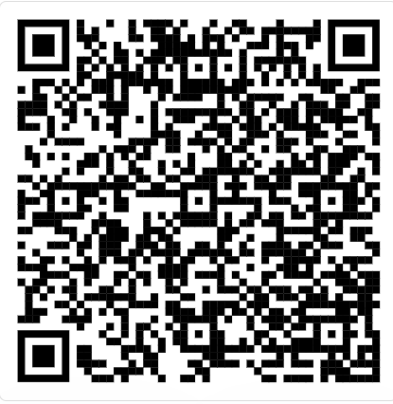
Congenital Syphilis Materials
Contact: erika.samoff@dhhs.nc.gov

Slide 60
NC Department of Health and Human Services HIV/STI/HCV Prevention Program Overview Focus on Syringe Service Programs

Slide 61
HIV/STI/HCV CTR Program Overview
North Carolina uses multiple methods for HIV, STI, and HCV testing/linkage to care in nontraditional settings
Programs offer access to prevention services to priority populations unable or uncomfortable with using traditional healthcare settings
Programs use a three-tiered approach:
Agencies funded for HIV/STI/HCV counseling, testing, and linkage to care
Agencies supported with free HIV, HCV, and syphilis rapid test kits
Free at home HIV testing program marketed through MSM chat sites
Notes:
- CTR in nontraditional sites and times, with populations most at risk to include PWID and SSPs
Programs
- ITTS, funding via contracts to LHDs and CB0s
- Free rapid test kits for data entry
- online marketed at home HIV tests

Slide 62
Integrated Targeted Testing Sites (ITTS) Project

Slide 63
Prevention Program Key Priority Groups
Men Who Have Sex With Men (MSM)
African American and Latino Men and Women
Minority Youth (ages 13-24 years)
Persons Who Inject Drugs (PWID)
Transgender Persons
Notes:
Anyone else at higher risk including commercial sex workers, incarcerated populations etc.
Our ITTS agencies test in 30 jails across NC
PWID and SSPs have always been a focus for our prevention program

Slide 64
ITTS Project Requirements
Reach
Attempt to reach key priority groups – Including the Latino Population
Test
Conduct Free HIV/STI/HCV Testing
Educate
Educate/Link High Risk HIV (-) clients to PrEP or other needed services
Link
Link HIV/STI/HCV (+) clients to
treatment and care
Integrate social media activities
Maintain
Maintain condom distribution sites/distribute condoms
Integrate

Slide 65
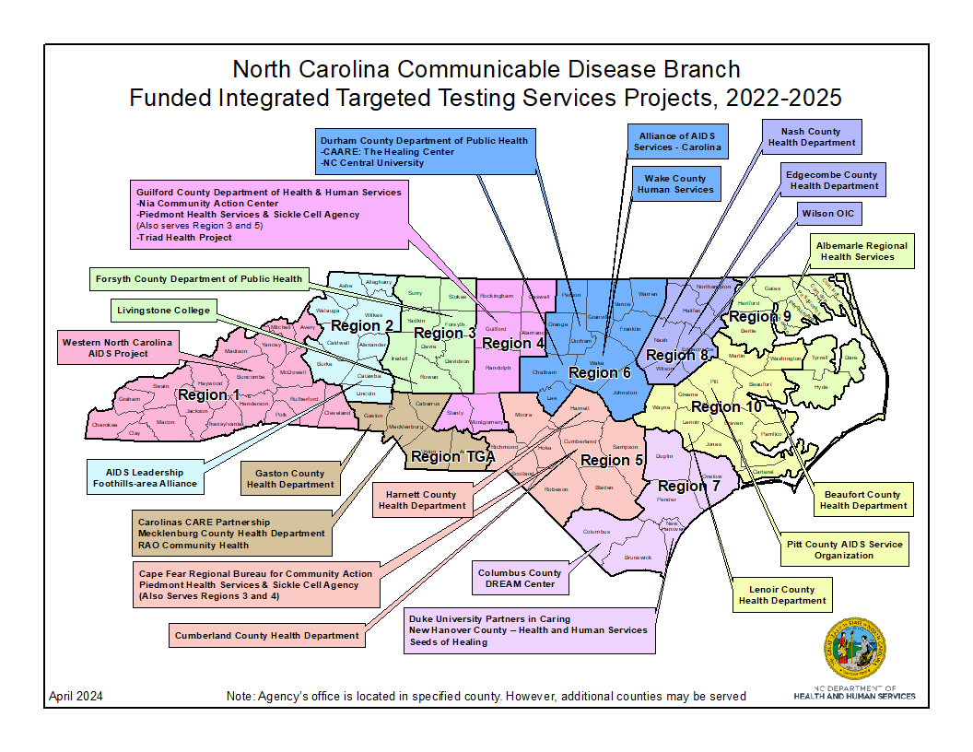
Notes:
30 CBOs and LHDs Geographically spread across NC
Contractually supported to do HIV/STI/HCV counseling, testing and linkage to care
These agencies as required to work with their Regional Networks to identify all SSPs in their service areas and ensure that testing is available. ITTS agencies are available to offer testing at SSPs.

Slide 66
Rapid Testing

Slide 67
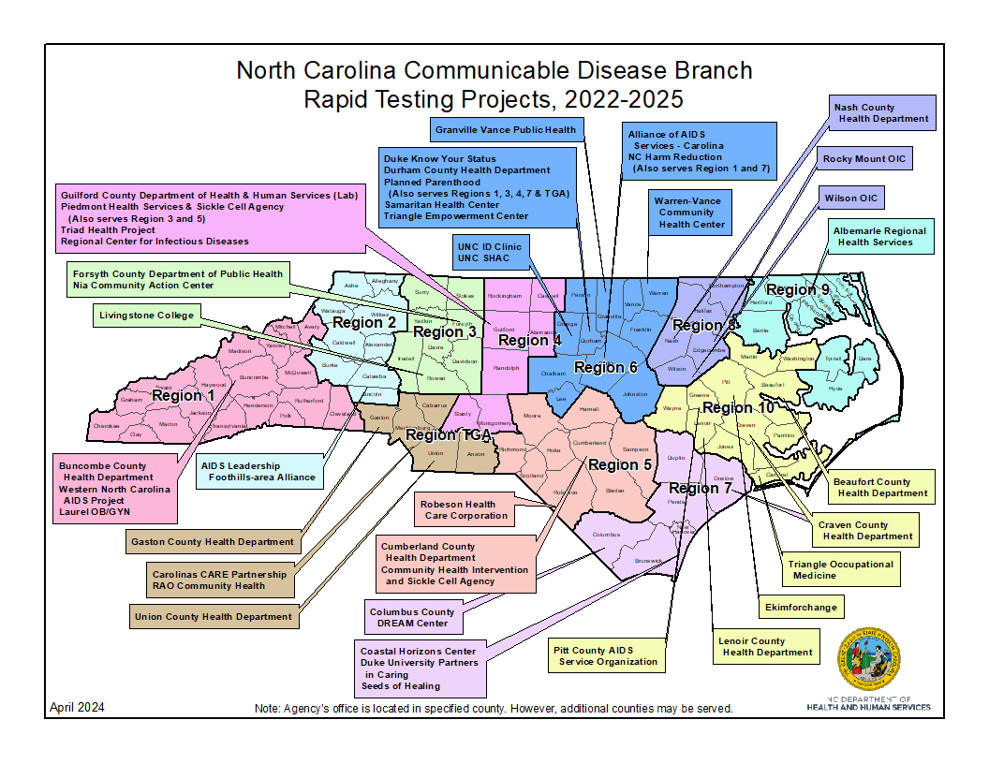
Notes:
NC supports approximately 46 agencies in this program
Provide free HIV/Syphilis and HCV test kits along with TA and capacity building for agencies to conduct their own testing of SSP clients. Data has to be submitted through EvalWeb.
Always trying to partner with SSPs to offer testing and linkage services to their clients
All ITTS and RT agencies provide education, risk reduction counseling, testing and linkage to HIV care, STI or HCV treatment, PrEP and MPX vaccine

Slide 68
TakeMeHome Testing Program

Slide 69
Background
Program in which free at home HIV testing is offered to people on MSM chat sites
Test kits are shipped to the persons home where they take an oral swab and conduct a rapid HIV test at their home
Information included on:
Safer sex information
How to get a confirmatory test
Where to get HIV care
Where to receive other Social services

Slide 70
HIV and Syphilis Testing among those with IDU History*
From 2023 to Projected 2024, there will be a 2% decrease in HIV testing and 7% decrease in syphilis testing
From 2022 to 2023 there was a 14% decrease in HIV testing and 19% decrease in syphilis testing
From 2022 to Projected 2024, there will be a 16% decrease in HIV testing and 25% decrease in syphilis testing
* IDU was defined as a person who answered “Yes” for “Injected Drugs or Substances Last 5 Years” in Evaluation Web.
Notes:
Trend of decreasing testing numbers in the last two years
Would like to increase these numbers and are willing to listen to suggestions on how to do this
Many of the participants in the upcoming panel discussion have experience with our Rapid Testing Program. We would love to get feedback on how to improve this program from you all if you have time in the discussion.

Slide 71
Notes:
- This is a flyer that we have developed to summarize our rapid testing program. Please use this yourself or disseminate to any agency who regularly serves those at higher risk for HIV or STI’s.

Slide 72
Resources
Rapid Testing Program: Rapid Testing Program Page
ITTS Program Manager: Marti.eisenberg@dhhs.nc.gov
Rapid Testing Program Manager: Carlotta.mcneill@dhhs.nc.gov
General Information: NC.Rapid.Testing@dhhs.nc.gov

Slide 73
PrEP 101
What is PrEP?
Pre-exposure prophylaxis (PrEP) is a medicine taken to prevent HIV infection. There are three choices of medications for PrEP: two pill options (Truvada, Descovy), and one long-acting injection (Apretude).
Who should use PrEP?
PrEP is for anyone who is at elevated risk of contracting HIV. If you are HIV-negative but have any of the following you should consider PrEP:
Multiple sex partners whose status is unknown
A partner who is living with HIV
Sex without condoms
Share needles or equipment to inject drugs

Slide 74
PrEP 101
How do I pay for PrEP?
PrEP is covered by most insurance companies. If you do not have health insurance, there are assistance programs that can help you pay for PrEP at little or not cost to you. You can access the Gilead PrEP assistance program here, or the ViiV PrEP assistance program here: https://apretude.com/access-and-support/
How can I start PrEP?
Talk with your doctor or healthcare provider to determine if PrEP is right for you. If you and your healthcare provider agree that PrEP might reduce your risk of getting HIV, they will test you for HIV and other STIs. Testing is the first step in accessing PrEP.

Slide 75
Additional Information and Resources
PrEP reduces the risk of HIV from sex by 99%
PrEP reduces the risk of HIV from injection drugs by 74%
PrEP Locator is an amazing resource where you can find a PrEP provider near you. Click here
On-Demand PrEP or “non-daily PrEP” is another effective protection. Learn more here.

Slide 76
Panel: Programs Across the State
Lauren Kestner, Queen City Harm Reduction (QCHR)
Michelle Mathis, Olive Branch Ministries (OBM)
Ainsley Bryce, Holler Harm Reduction
Charlton Roberson, North Carolina Harm Reduction Coalition (NCHRC)
Kristin Klinglesmith, Cabarrus Health Alliance

Slide 77
Wrap up and THANK YOU!
Sally Reeske, Division of Public Health
The meeting recording, agenda, and PowerPoint slides will be added to our NCDHHS Overdose/OPDAAC page within 7 days.
https://www.ncdhhs.gov/about/department-initiatives/overdose-epidemic/nc-opioid-and-prescription-drug-abuse-advisory-committee
Next OPDAAC Meetings:
March 18-20, 2025: NC Summit on Reducing Overdose at the Raleigh Convention Center
June 2025, date tbd

