Slide 1

New Fiscal Officer Overview
April 20, 2021

Slide 2
agenda
Purpose/Roles of DSS Fiscal Units
DSS Operations – General Overview
County Operations
Important Resources – where to find the information you’ll need!
DSS Fiscal Functions
Daysheets
Equipment Purchases
Contracts
Indirect Cost Reporting
Child Support Incentives
Receiving Reimbursement - 1571 Overview
1571 Reports Overview
Codes, Numbers & Letters – What do they mean?
Other Reimbursement
Monitoring & Audits
Monthly Timeline
Annual Timeline
Questions ?
Upcoming Virtual Trainings

Slide 3


PURPOSE/Roles of The DSS Fiscal Unit
Department of Social Services (DSS) fiscal units are responsible for implementation of fiscal regulations and policies, budget development, account oversight, and management of revenues and expenditures for the local county department of social services.
Training participants have varied roles. Each DSS fiscal office is structured differently but have many commonalities! You play a part in the link between:
County Department of Social Services
(or Consolidated Human Services Agency)
THE STATE
For Fiscal Management and Budget

Slide 4
DSS OPERATIONS – GENERAL OVERVIEW
The Department of Social Services is normally one of the larger departments in most counties. DSS has a department administrative or fiscal office that works with the County administrative offices.
Many local Departments of Social Service are a single department and include Child Support Services; however, there are eight counties in the State that operate a Stand-alone Child Support Office. For some counties, their Social Services and Health Departments are combined into one Consolidated Human Services Agency.
Each DSS develops a budget which is primarily funded with Federal, State, and County dollars.
With the variety of programs administered by DSS and the legislation that created those programs, there are over 50 different program budget lines in a typical DSS budget.

Slide 5
Some Federal and State funds appropriated for DSS operations are capped, others are open-ended and provide Federal or State participation as long as the county provides its matching funds.
The DSS budget is much different and more complex than budgets for most of the other county departments. Many find the DSS budget hard to understand.
County finance officers and local governing bodies may occasionally be confused by which programs are funded with what funding source.
That makes your role very important!
This training is intended to be a starting point to help you prepare for your role!
So, let’s get started…

Slide 6
County operations
Become familiar with who handles what functions at the County level…
Annual Budget
Budget Amendments
Authorizations for Payment
Purchase Orders
Contracts
End of Year Processes

Slide 7
Important Resources
– where to find the information you’ll need!
NC Department of Health and Human Services (NC DHHS) Websites
Funding Authorizations
Listserves
Fiscal Manual
Services Information System (SIS) Manual
NC-CoReLS
NCXCloud
Data Warehouse

Slide 8
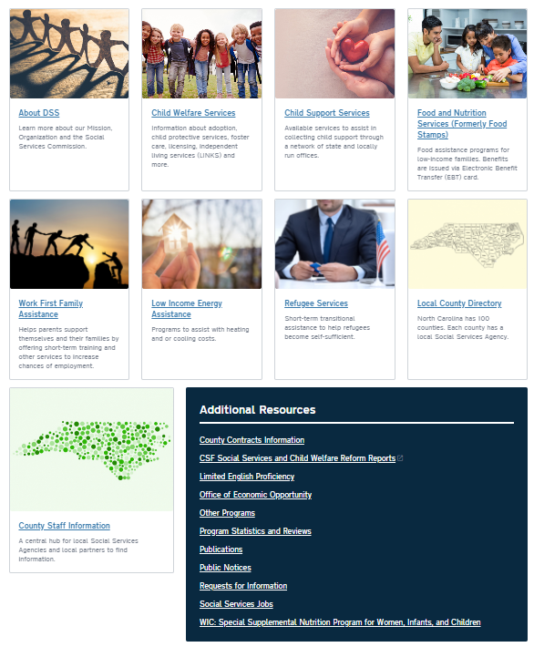
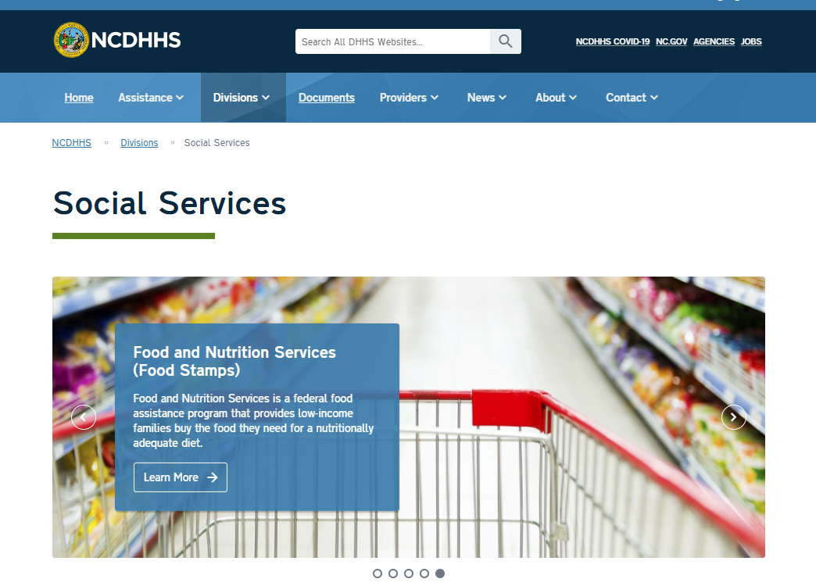
NCDHHS Home Page:
https://www.ncdhhs.gov/divisions/dss

Slide 9
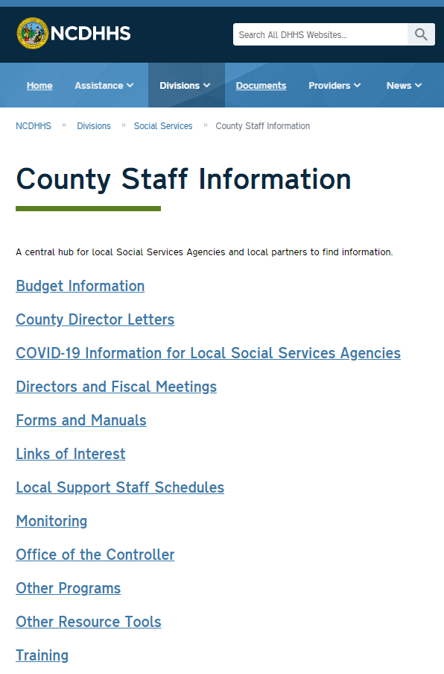


BOOKMARK
THIS PAGE !
https://www.ncdhhs.gov/divisions/social-services/county-staff-information
* This is the hub for many resources that you will need! *

Slide 10
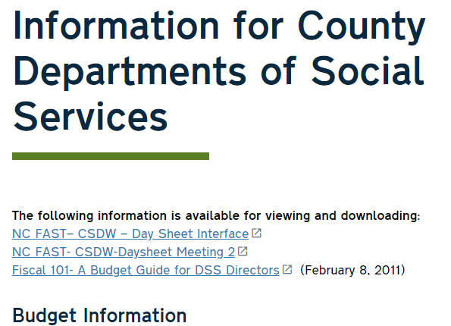
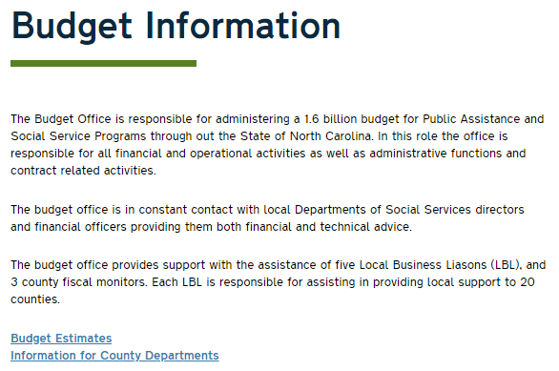
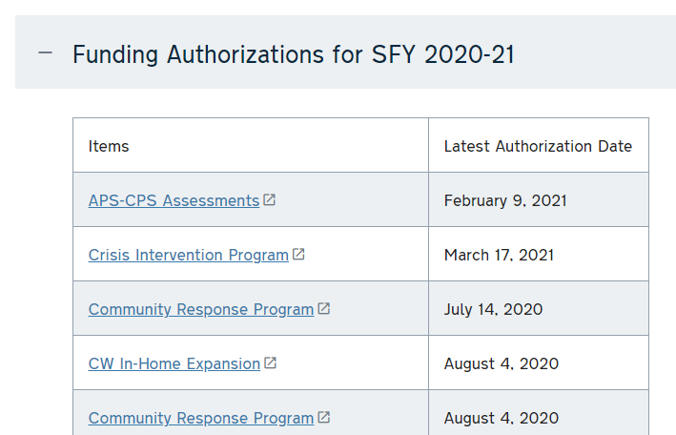
Funding Authorizations
https://www.ncdhhs.gov/divisions/social-services/county-staff-information/budget-information/information-county-departments
Scroll down page

Slide 11
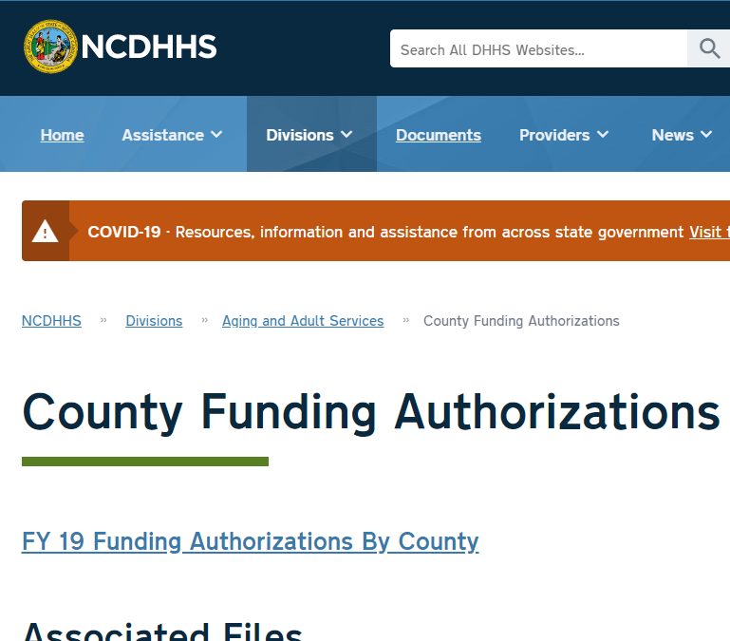
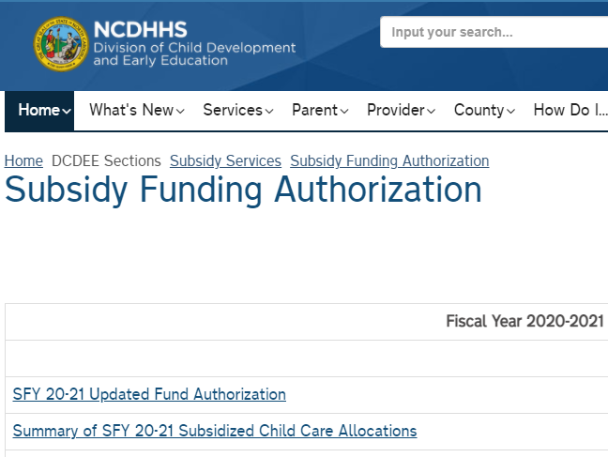
Other Funding Authorizations –
Adult Services DCDEE Subsidy/Child Care
https://www.ncdhhs.gov/divisions/aging-and-adult-services/county-funding-authorizations
https://ncchildcare.ncdhhs.gov/Home/DCDEE-Sections/Subsidy-Services/Subsidy-Funding-Authorization

Slide 12
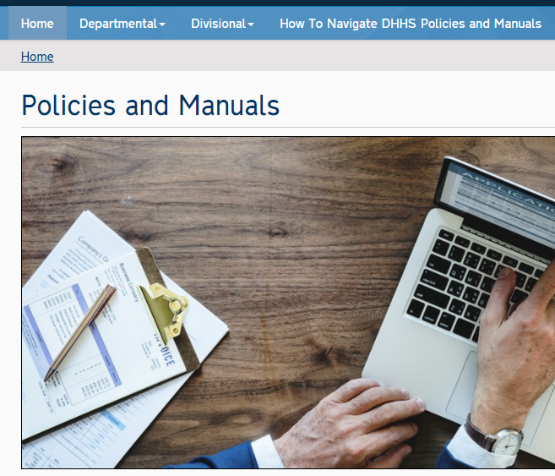

https://policies.ncdhhs.gov/
Fiscal Manual & SIS Manual are located here!

Slide 13


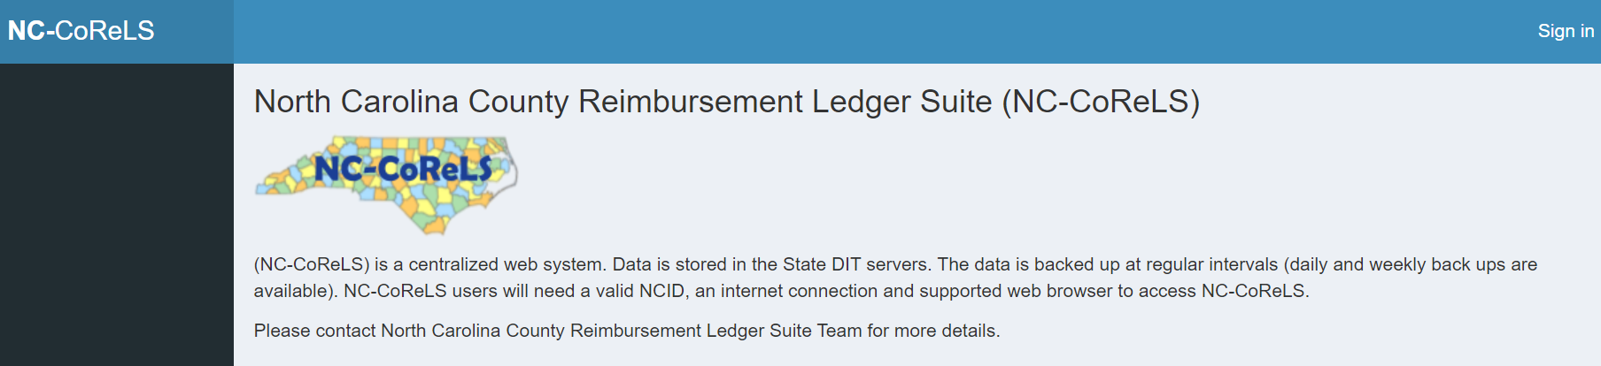
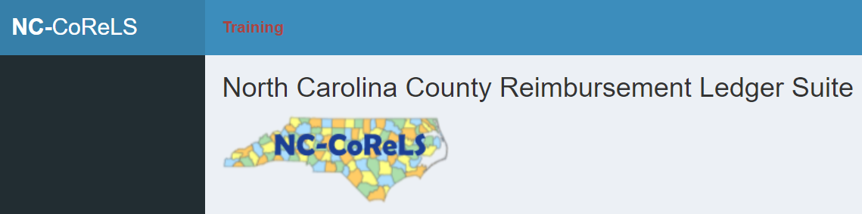
NC-CoReLS – website for entering 1571
Production Site: https://nccorels.dhhs.state.nc.us/#/
Training Site: https://nccorelstrain.dhhs.state.nc.us/#/
New user? Having CoReLS issues or questions?
Contact DHHS.CORELS.SUPPORT@dhhs.nc.gov

Slide 14
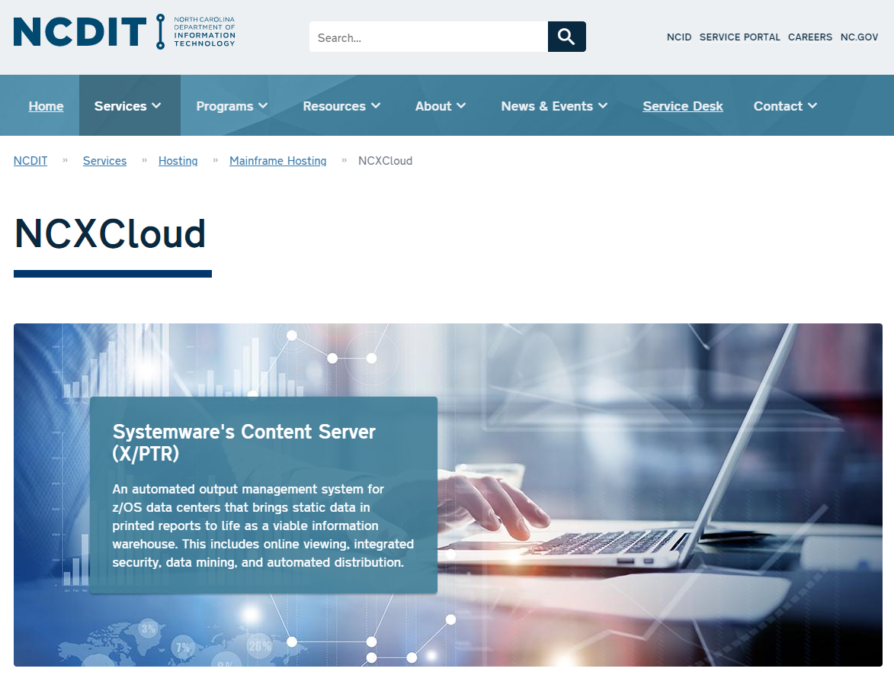
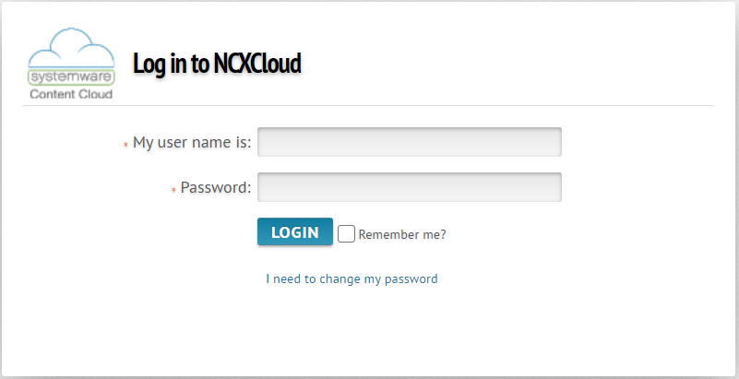
NCXCloud
Website for accessing monthly reports
Formerly referred to as XNET or XTND
Requires RACF & password
https://ncxcloud.nc.gov

Slide 15
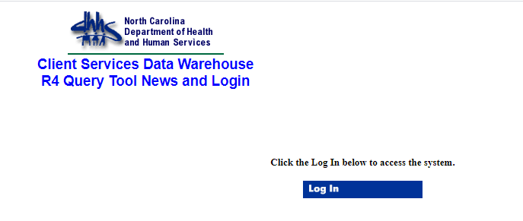
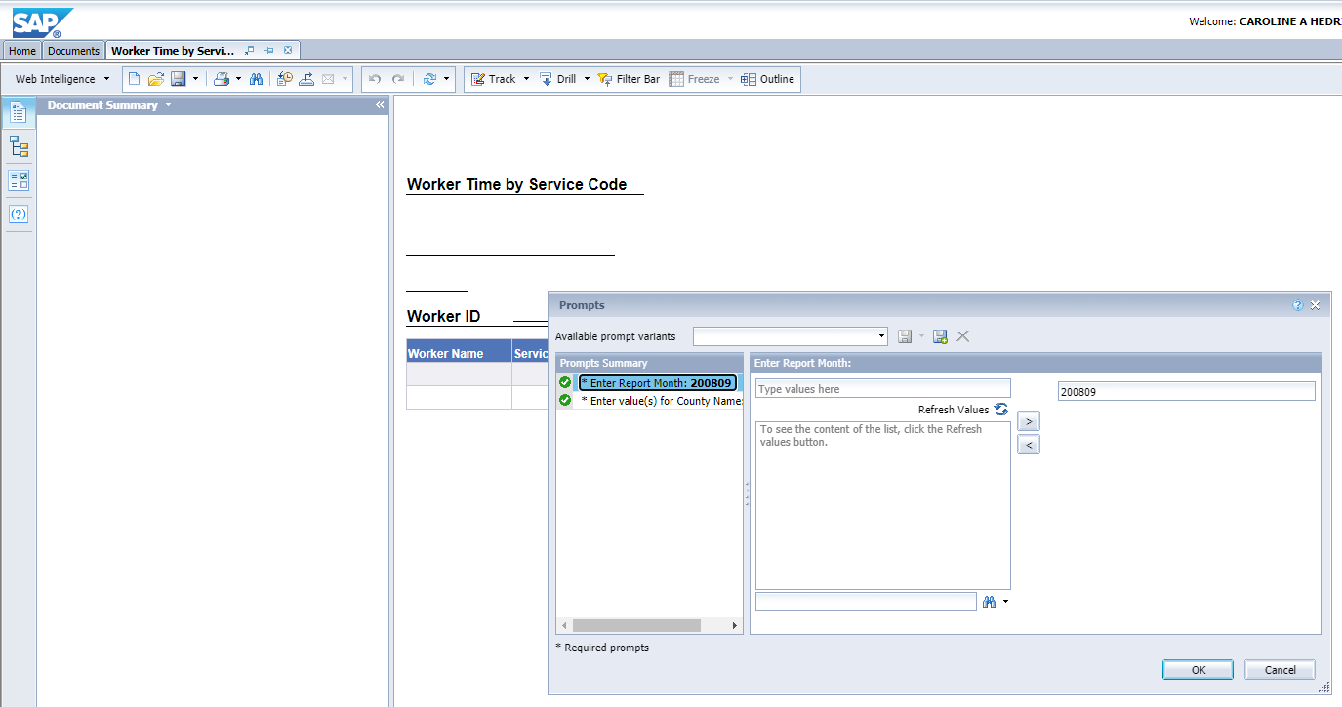
https://csdwportal.dhhs.state.nc.us/csdwlogin/

Slide 16
LISTSERVES
Listserve | Contact Email
NCACDSS Listserve | sransome@ncacdss.org
Medicaid Cost Calculation Notices | Dan.Parker@dhhs.nc.gov
Medicaid Transportation | Edward.Pettiford@dhhs.nc.gov
Medicaid Administrative Claiming (MAC) Notices | Charles.Williams@dhhs.nc.gov
Public State Mailing List (subscribe to lists): DSS Terminal Messages DSS.County.Directors DSS.County.Directors.Fiscal.Officers DSS.County.Fiscal.Contacts DSS.County.Security.Officers DHHS.EFT.Counties | https://lists.ncmail.net/mailman/listinfo
Adult Services | DAAS.AdultServices@dhhs.nc.gov
DCDEE | Jose.Merza@dhhs.nc.gov and cc: Nila.Acharya@dhhs.nc.gov

Slide 17
NOTICE OF CHANGE
Use this form to change information for County Director, fiscal officer or finance officer
Please provide the current name and/or email information for any of the following positions
in your county where a change has occurred.
 |  | County Name
 |  |  | NAME |  |  |  |  | EMAIL ADDRESS
NEW Director
Remove
NEW County Finance
Officer
Remove
NEW DSS Fiscal
Officer
Remove
Please send any changes to: DSS.Update@dhhs.nc.gov

Slide 18
Dss Fiscal functions
Budget (State budget is July 1 to June 30)
General Ledger
Accounts Payable/Receivable
Payroll Register
Daysheets
Equipment Purchases, Automated Data Plans (ADP), Direct Charge or Expense
Contracts
Indirect Cost Plans
Child Support Incentives
Receiving Reimbursement – 1571 and Other Reimbursement
All common fiscal functions in private sector and governmental finance

Slide 19
DAYSHEETS – ACCOUNTING FOR STAFF TIME
North Carolina elects to utilize 100% time reporting, via "daysheets", for distributing costs for personnel services for both the Division and the 100 local Departments of Social Services. These costs support a broad spectrum of programs funded through a wide range of Federal and non-Federal funding sources.
A worker’s time is reported on daysheets (DSS-4263) using a combination of Service Codes (SIS) and Program Codes and these codes help to determine reimbursement. Correct coding is important!
What is the purpose of a daysheet?
Computes percentages of time spent by staff in the delivery of direct service activities, which will provide the basis for county reimbursement
Provides documentation, along with the case record, to support reimbursement
Provides information to determine the cost of services provided
Enables more effective planning and budgeting
Provides a source of recipient counts for federal reporting and program management
Provides an audit trail for services

Slide 20
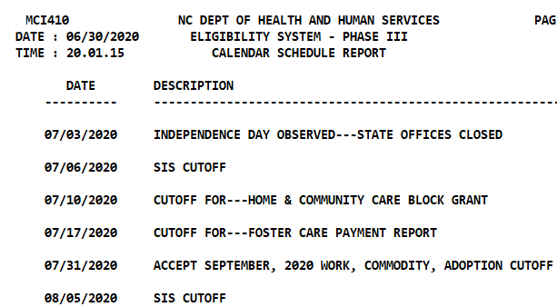
Who keeps a daysheet?
Staff with direct client contact who perform client-related service activities as defined it the SIS Manual.
Workers providing both direct Services and Income Maintenance functions.
Staff who are full-time Service Support or Other Administration and Child Support workers are not required to complete a daysheet; although a county can decide to require all staff to keep daysheets.
How frequently and where are daysheets documented?
Daily
Most counties use an electronic documentation system
Some use paper daysheets
When are they due (SIS Cutoff)?
Upload to the State on 5th day of the following month
or the nearest working day if the 5th day falls on a
weekend or holiday.
Two people should be trained with access to upload.
NCXCloud Name:
DHR/HRA DHRHR CALENDAR

Slide 21
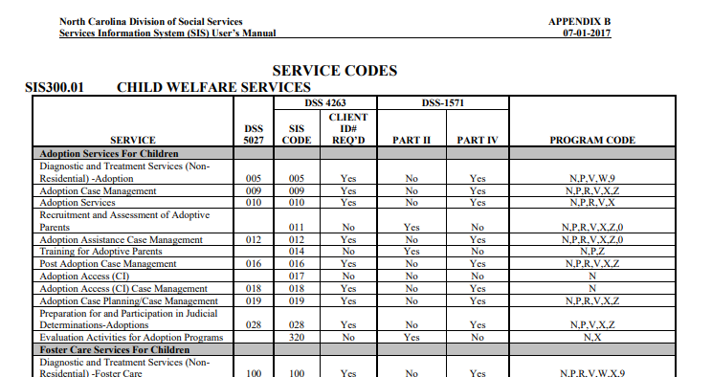
Resources:
SIS Manual
Daysheet Training Guide
ncswLearn.org

Slide 22
EQUIPMENT PURCHASES – AUTOMATION & ADP
What automation purchases need approval?
Terminals, personal computers, personal computer printers or workstations up to the level of one such device per worker.
System printers up to one per three workers or one per floor or one per site, whichever is greater.
Local area networks or minicomputers when necessary to maximize the benefit of such devices and other devices as required to connect to the state network.
Off-the-shelf software commercially available to the public for general business or personal use.
Where can I find more information about Automated Data Processing (ADP) Plans?
Fiscal Manual Sections II A, III B, VIII A

Slide 23
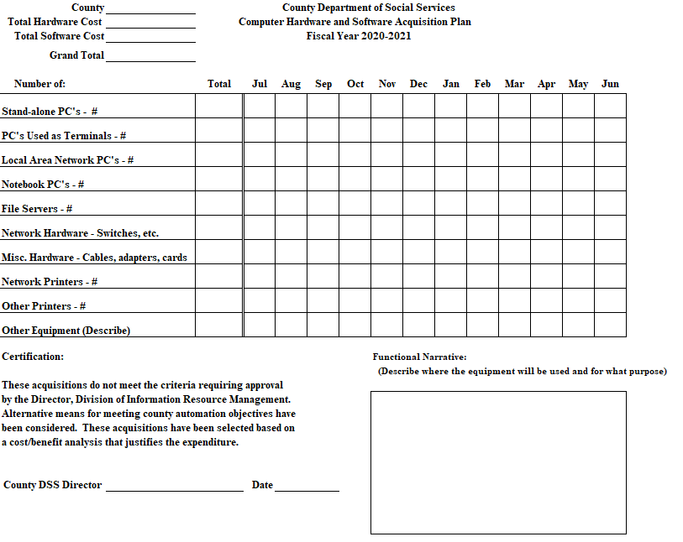
ADPs
When are they due?
Beginning of fiscal year, and
Prior to new automation purchases
Who signs?
DSS Director
Who is plan submitted to? ncdsscomputerplans@dhhs.nc.gov
What 1571 Part II Codes are used?
Code 380 Services
Code 381 Income Maintenance
Code 382 Child Support
Code 383 General Administrative

Slide 24
EQUIPMENT PURCHASES - OTHER
Direct Charging and Expensing of Equipment
Equipment (including hardware and software) with a unit cost of less than $5,000 may be expensed without the approval of the State (Note: ADP is required, but no additional approval needed to expense on 1571 if under $5,000).
Equipment (This includes hardware and software) with a unit cost of less than $5,000 may be direct charged to a particular funding source with the approval of the State.
Equipment (This includes hardware and software) that costs $5,000 or more must be depreciated. For non-ADP/ADP equipment (e.g. vehicles), the Department has authority for approval of direct charges and expenses. These requests should be submitted to the State, as outlined in Section III B of the Fiscal Manual. Also, capital leases of $5,000 or more need prior approval from the State. (See Fiscal Manual Section II A for definition of Capital Lease)
Vehicles costing up to $25,000 may be expensed. If over $25,000, vehicle must be depreciated. (See Fiscal Manual Section II A)

Slide 25
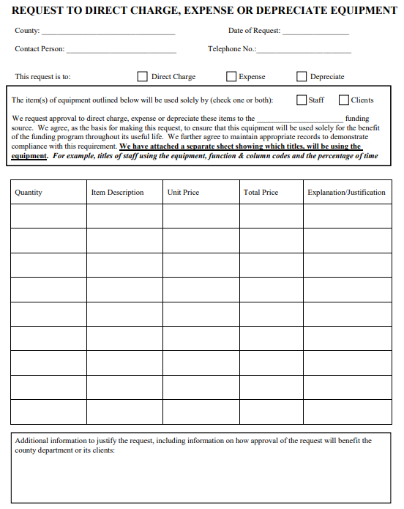
Request to Direct Charge, Expense, or Depreciate Equipment
When is form due?
Prior to purchase
What needs to be submitted?
Request Form
Letter on DSS letterhead signed by director
Who is request submitted to?
CNTY.ADMIN@dhhs.nc.gov

Slide 26
CONTRACTS
Counties, as subrecipients of the state, must develop monitoring and management procedures to ensure that funds are appropriately spent by any sub-awardee or contractor with whom they may contract to provide services.
Counties are required to follow Uniform Guidance unless State or local rules are more restrictive.
The county’s legal team should help to create and review contracts before entering into a contractual agreement.
Ensure expenses are paid according to contract terms.
Where can I find more information about contracts?
Contract templates are located on the Social Services website.
When should contracts be completed?
Annually or before procuring services/goods from a vendor.

Slide 27
INDIRECT COST REPORTING
County administration is required to prepare a county-wide central supporting services cost allocation plan (indirect cost plan). An indirect cost is one which cannot be so identified, but rather is incurred for the common benefit of the DSS as well as for other activities carried on by the county such as:
Other County Department Operations (Finance, Human Resources, Purchasing, IT, etc.)
Maintenance of County Buildings
Cost of space such as utilities, security, janitorial services, etc.
Courtroom and bailiffs
When are they due?
Indirect Cost Plans are due to the Controller’s Office no later than April 15th
Reference Fiscal Manual Section II E

Slide 28
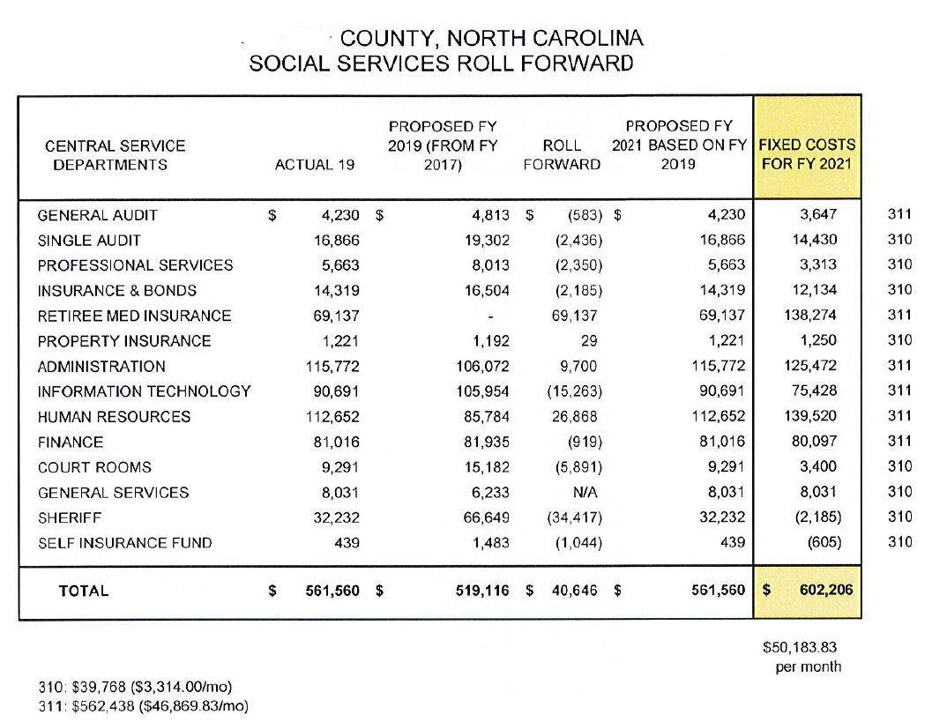
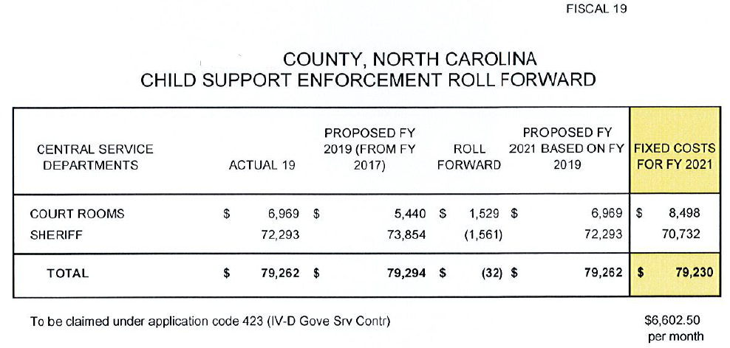
Example of Indirect Cost Plan Roll Forward Schedules
Amounts circled in red are claimed as costs on monthly 1571
New FY indirect costs are effective July 1

Slide 29
When are Indirect Cost Plans due?
As soon as county’s annual plan is completed (generally in the last months of the calendar year), but no later than April 15th following the state fiscal year in which reimbursement is being claimed.
What does DSS submit?
Letter certifying Indirect Cost Plan
Schedule A and Roll Forward Schedules for 310, 311, and 423 costs (please do not submit entire plan)
Who is request submitted to?
CNTY.ADMIN@dhhs.nc.gov AND
Mail to: County Administration Accounting Unit, Controller’s Office
2019 Mail Service Center
Raleigh, North Carolina 27699-2019

Slide 30
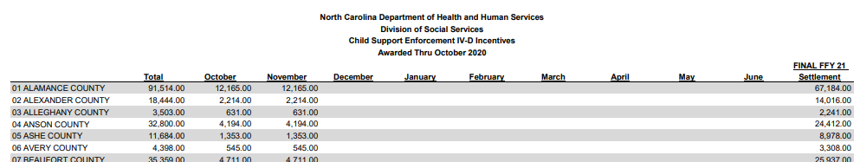
CHILD SUPPORT INCENTIVES
Counties receive Child Support Incentive dollars for meeting certain goals in Child Support. Funds are used to offset other child support expenditures. County Child Support submits an annual plan for reinvesting the incentive dollars.
Where can I find a report of incentive dollars awarded?
Budget Information web page CSE Incentive SFY 2020-21
How do I report incentive dollars on the 1571?
Incentive dollars are claimed as Part II code 123 and are non-reimbursable (dollars are deposited to county outside of 1571, but expenditures tracked on 1571).

Slide 31

RECEIVING REIMBURSEMENT – 1571 OVERVIEW
What is a 1571?
The 1571 is used to submit DSS expenditures to the State for reimbursement.
The 1571 has multiple parts:
  Part I Consolidates salary & benefits, daysheet SIS data, and effort data for your agency and has 3 different parts – Part A, Part B, and Part C.
  Part II Used to submit general administrative expenses from the general ledger, some fees, and indirect costs.
  Part IV Used to submit purchased services and some fees.
What resources are used to complete a 1571?
The Fiscal and SIS Manuals are the most important resources for developing the 1571.
These manuals help to determine allowable and unallowable costs as well as which codes to use when inputting information into NC-CoReLS.

Slide 32
RECEIVING REIMBURSEMENT – 1571 OVERVIEW
Who completes a 1571?
DSS fiscal staff
Two people should be trained with access to upload.
Cross training is critical!
How frequently is it completed and where?
1571 is completed monthly.
Information from daysheet SIS data, payroll register, and general ledger are keyed into NC-CoReLS 1571 system which is web-based.
When is the 1571 due?
Due by the 15th of each month (unless 15th falls on a weekend or State holiday, then due next business day).

Slide 33
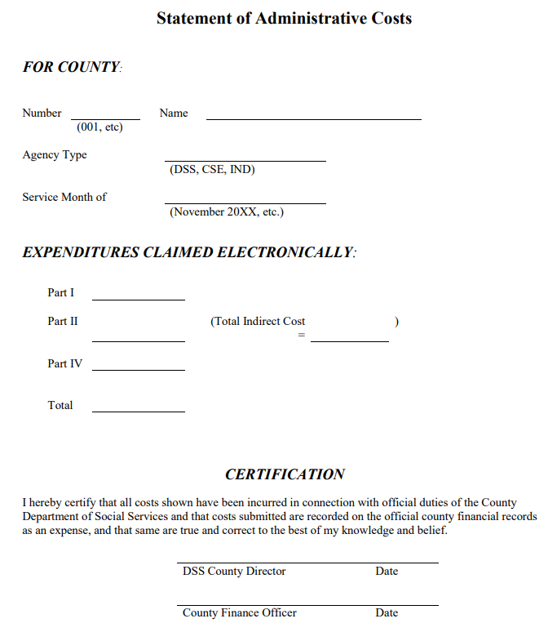
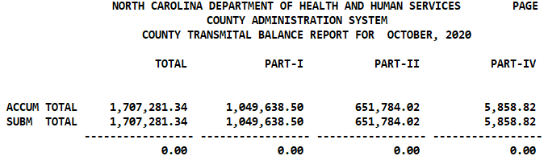
How is the 1571 submitted?
Information from NC-CoReLS (electronic submission), and
Statement of Administrative Costs (emailed form)
The two submissions must “balance”
Who is the Statement of Administrative Costs submitted to?
Controller’s Office - CNTY.ADMIN@dhhs.nc.gov
NCXCloud Name:
DHRWCA COUNTY TRANSMITAL BAL RPT

Slide 34
Questions
?

Slide 35

1571 REPORTS OVERVIEW
NCXCloud and XPTR have many reports available to counties. As a part of completing the 1571 counties should review:
Percentage of Time Report
After counties submit their 1571, the information is processed and then reimbursement reports are generated and made available to counties toward the end of the month.
XS325
XS335
XS337
WC373 Month & YTD
XS411
WC302
D E E P
DIVE
To come in a separate session…

Slide 36
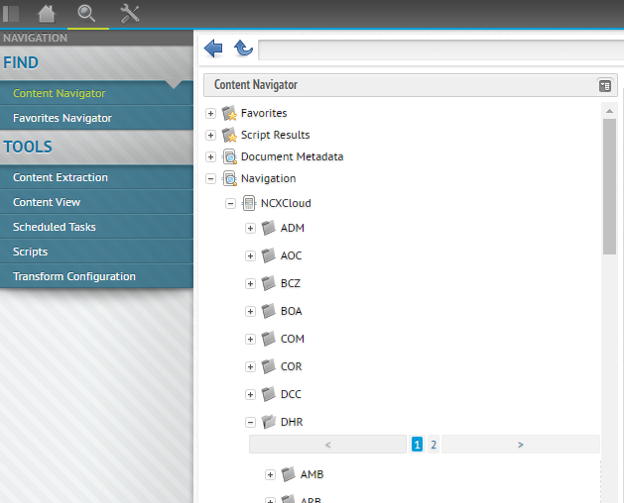
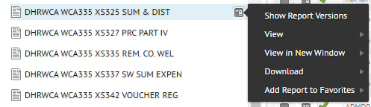
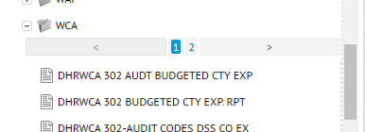
How to access reports - NCXCloud
https://ncxcloud.nc.gov
❶
❷
❸
To add a report to Favorites:
❹
❺

Slide 37
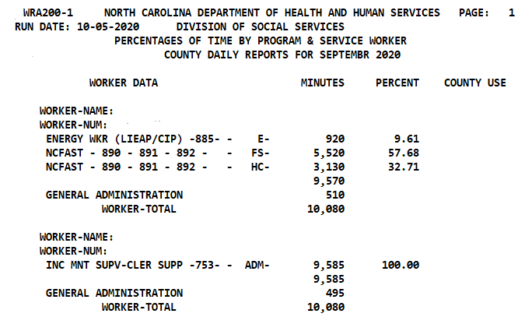
REPORTS OVERVIEW – WRA200 Percentage of Time
The Percentage of Time report shows a summary of minutes the worker coded on their daysheet and then converts it to a percentage.
NCXCloud Name:
DHR/SYA WR001F1 PERCENTAGE OF TIME
Month daysheets keyed
Report generated day after daysheet upload due date

Slide 38
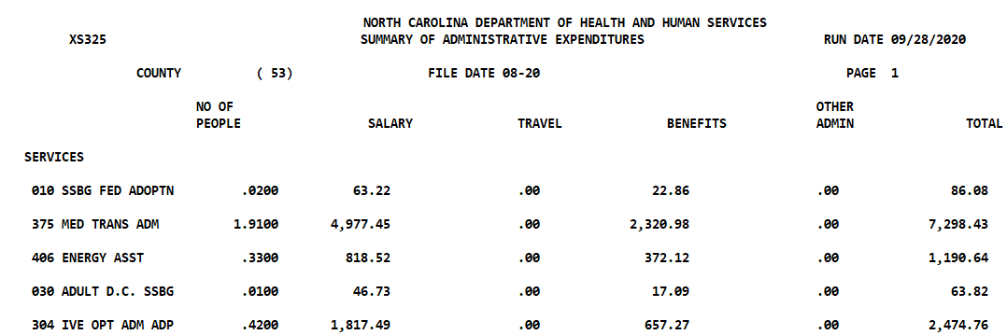
NCXCloud Name:
DHR/WCA/WCA335 XS325 SUM & DIST
REPORTS OVERVIEW – XS325
XS325 shows a county’s cost and how overhead is distributed based on FTE.
One report with 4 “passes”/subtitle sections.
PASS 1

Slide 39
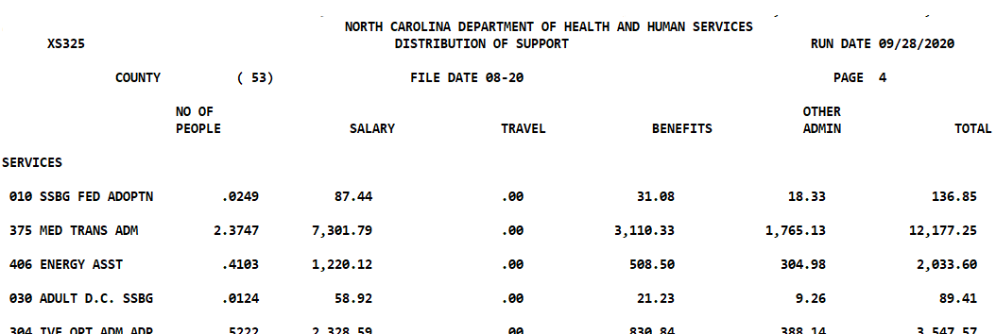
PASS 2

Slide 40
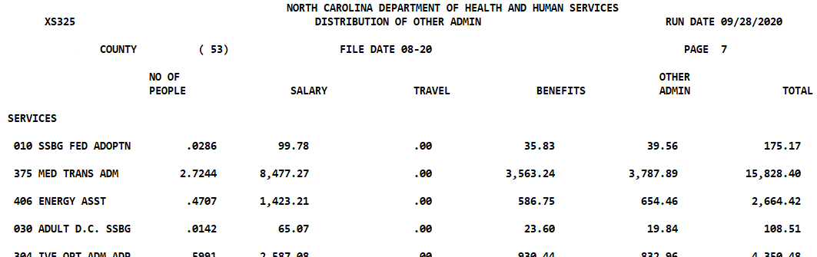
PASS 3

Slide 41
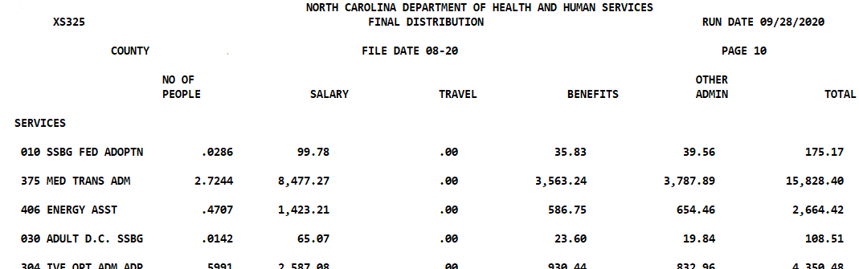
PASS 4

Slide 42
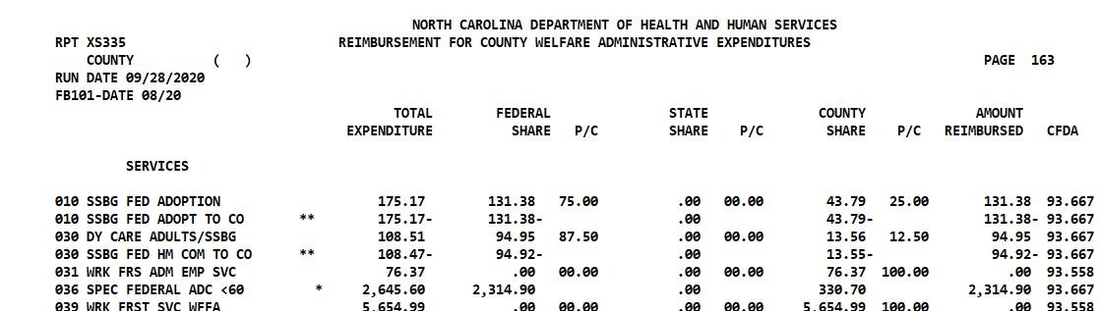
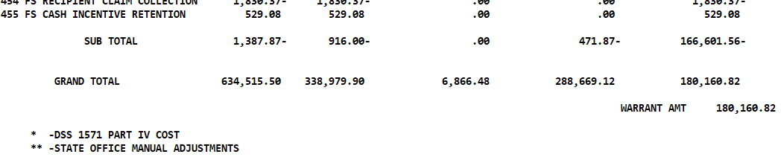
NCXCloud Name:
DHR/WCA/WCA335 XS335 REM.CO.WEL
REPORTS OVERVIEW – XS335
XS335 shows a county’s monthly 1571 reimbursement and manual adjustments.
Service Month Reimbursed
App Code
Amount Reimbursed
through EFT Notice

Slide 43
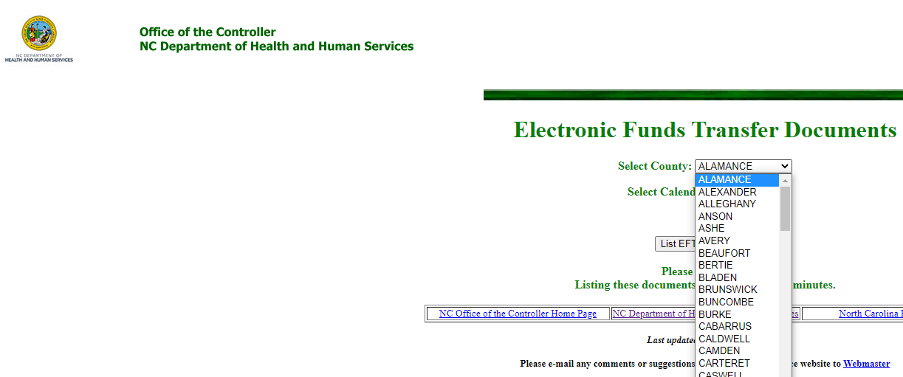
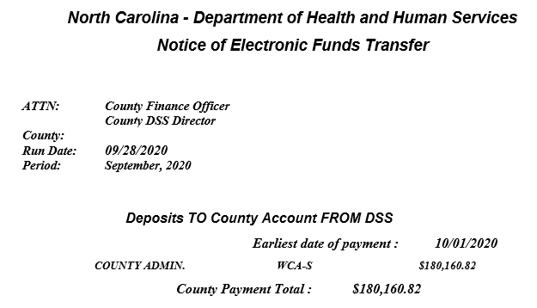

Office of the Controller EFT Documents
https://dhhs32d.dhhs.state.nc.us/dhhs/control/eftdocs/launch.htm

Slide 44
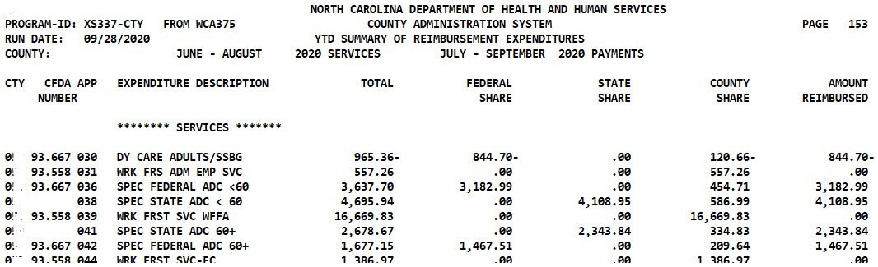
NCXCloud Name:
DHR/WCA/WCA375 XS337 CTY SUM REP
REPORTS OVERVIEW – XS337
XS337 shows a county’s cumulative, year to date reimbursement.
Service Months Reimbursed
Cumulative Payment Period

Slide 45
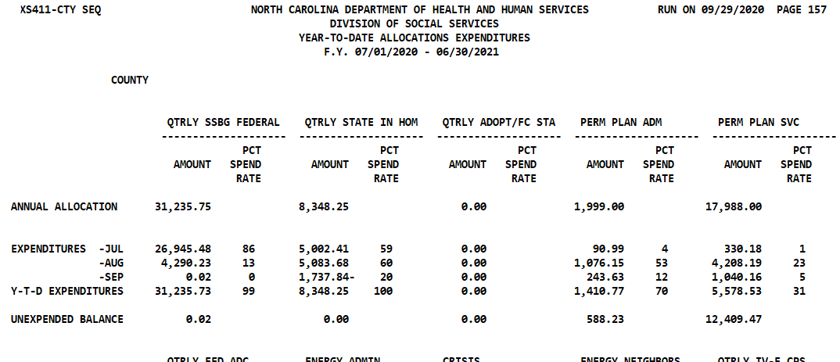
NCXCloud Name:
DHR/WCA/WCA410 XS411 CTY MTH ALL
REPORTS OVERVIEW – XS411
XS411 shows a county’s monthly spending per capped allocation.
Cumulative Payment Period
Allocation
Reimbursement Month
(Note: NC CoReLS displays service month)
X
B/C/I
P
P

Slide 46
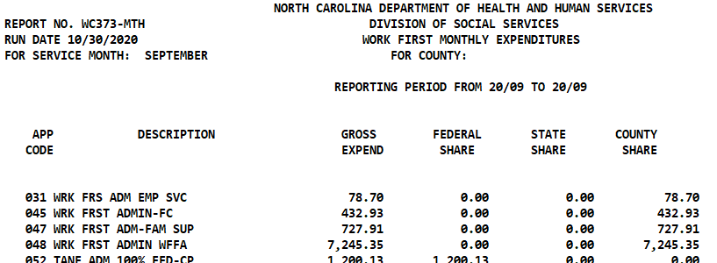
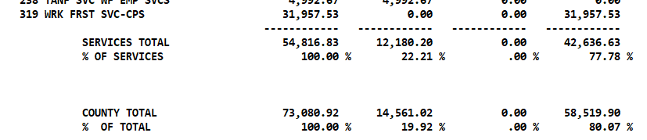
NCXCloud Name:
DHR/WCA/WCA410 WC373 MTH WF RPT
REPORTS OVERVIEW – WC373 MTH
WC373 shows a county’s monthly Work First Block Grant and Maintenance of Effort (MOE).
Month
Use this row – can also track on NC- CoReLS 411
Federal = Work First (R)
County = MOE (9)

Slide 47
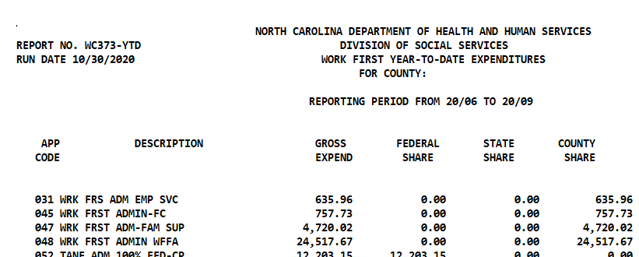
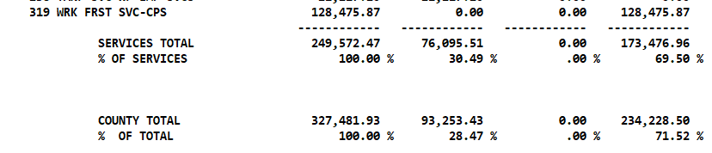
NCXCloud Name:
DHR/WCA/WCA410 WC373 YTD WF RPT
REPORTS OVERVIEW – WC373 YTD
WC373 shows a county’s year to date Work First Block Grant and MOE.
Period
Use this row – can also track YTD on NC- CoReLS 411
Federal = Work First (R)
County = MOE (9)

Slide 48
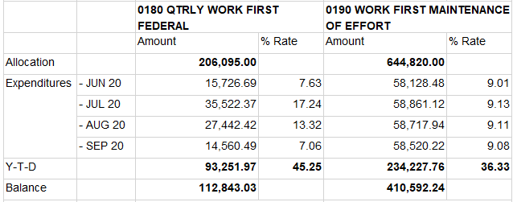
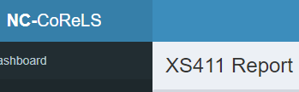
WC373 MTH
WC373 YTD
* Keep in mind there are rounding differences between the State and NC-CoReLS reports. Rely on the State WC373 numbers.

Slide 49
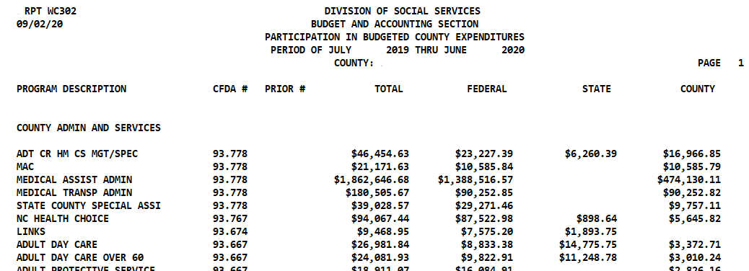
NCXCloud Name:
DHR/WCA 302 BUDGETED CTY EXP. RPT
REPORTS OVERVIEW – WC302
WC302 shows a county’s revenues from 1571 and additional sources.
Auditors will request report in order to select programs for audit and to reconcile to county ledger.
This report is for a full fiscal year

Slide 50
Questions
?

Slide 51

All Those Codes, Numbers & Letters…
What Do They Mean???
I have no idea what they’re talking about.
Nod and smile,
Nod and smile.

Slide 52

Program Codes – Assigns funding allocation
  Reference SIS Manual Appendix B
App Codes – Abbreviation for Application Code
  Code is used on XS325, 335, and 337 reports
  Note that Part II code and application code are not always the same
  Reference Fiscal Manual Section III B
SIS Codes – Abbreviation for Services Information System
  Code that workers use on daysheet
  Reference SIS Manual Appendix B
Client ID – SIS Number / 200# / CNDS
  11-digit identification number assigned to clients
  CNDS number used by NC Fast P4 counties (…and a P4 county is one that uses NC Fast for child welfare)
Keep in mind that some 3-digit app codes, SIS codes and Part II codes may be the same number but have different meanings! Pay attention to how the number is used…
For example:
211
SIS code 211 CPS Intake
App code 211 Adult Care Home Transition (396 SIS)
109
SIS code 109 FC Case Mgmt
App code 109 FC Case Worker Visit overspending code

Slide 53
Function/Column/Part – Codes apply to Part I of the 1571
  Function – Program function codes are used to classify the part that each worker plays in the determination of client eligibility or in the provision of social services to the client. Workers are classified with respect to their program assignment and contact with clients.
  Reference Fiscal Manual Section III A
  2 digit number ranging from 01-99
Services 01-59
Income Maintenance 60-74
Child Support Enforcement 79
Supervision and Support from 80-89
Administration 90-99
Parts of Part I:
A – Services Salaries
B – Income Maintenance, Administrative Support and Training Officer's Salaries
C – Child Support Salaries, IV-D

Slide 54
Fund No. – Fund Numbers pertain to Part II funds and are automatically assigned by NC-CoReLS
  1 = Reimbursable
  2 = Under 60 In-Home
  3 = Over 60 In-Home
  4 = Non-reimbursable
  5 = HCCBG
Fund ID Codes – Fund IDs pertain to Part IV funds
  Selected by 1571 preparer when keying Part IV expenses
Refer to table in Fiscal Manual Section III C
CFDA Number – Catalog of Federal Domestic Assistance
5 digit number (XX.XXX) assigned to federal grant awards
Auditors will refer to CFDA numbers

Slide 55
Other Reimbursement
Foster Care
Adoption Assistance & Vendor Payments
Adoption Promotion Fund
LINKS Special Funds
Medicaid Transportation
NC Tracks
NEMT DHB-2055
Child Care Subsidy
Home & Community Care Block Grant (HCCBG)

Slide 56
FOSTER CARE
Foster care board payments for children in DSS custody are paid directly to providers through the county, then the county is reimbursed.
Next largest line item on DSS budgets after salaries in most counties.
Expenditures submitted through the Child Placement and Payment System (CPPS) DSS-5094 for reimbursement.
When is the 5094 Deadline?
Monthly by the 19th
Reports that work together to show reimbursement:
PQA020 shows standard reimbursement for standard board rates.
PQA022 shows maximization reimbursement (amounts over standard rates).
Counties should have good reconciliation processes in place for what is being paid out compared to reimbursement.

Slide 57
ADOPTION ASSISTANCE
Adoption Assistance payments are made directly to adoptive families, then DSS is drafted for county share through an EFT.
Adoption Vendor payments are made for allowable costs of medical and non-medical services or treatment not covered by any medical insurance program on behalf of children who are eligible for adoption assistance under Title IV-B Part I and Title IV-E Adoption Assistance, with a maximum payment of $2,400 per year.
Counties make vendor payments on behalf of child to adoptive parents or providers and county is reimbursed by the state.
Expenditures submitted through the Child Placement and Payment System (CPPS) DSS-5095 for reimbursement.
When is the 5095 deadline?
Due monthly by the 19th
Reports that work together to show reimbursement:
  PQA 030 shows vendor payments per child.
  PQA 036 shows summary of vendor payment reimbursement.

Slide 58
ADOPTION PROMOTION FUND
Adoption Promotion Funds are non-recurring and provided to counties based on a Federal Baseline Methodology for adoptions completed.
The purpose of the fund is to enhance adoption programs and/or to expedite the adoptions of youth with special needs.
How is payment received?
County Child Welfare staff submit the DSS-5320 Adoption Promotion Program Fund/DSS Adoption Reporting workbook.
Counties must properly close out the child’s 5094 using the code for Adoption and open the 5095 for adoption assistance benefits.
Report to show reimbursement:
EFT Notice – usually once per year (and Child Welfare contact normally receives an email)
Program Contacts:
Shirley Williams Shirley.Williams@dhhs.nc.gov
Beth Riley Beth.Riley@dhhs.nc.gov

Slide 59
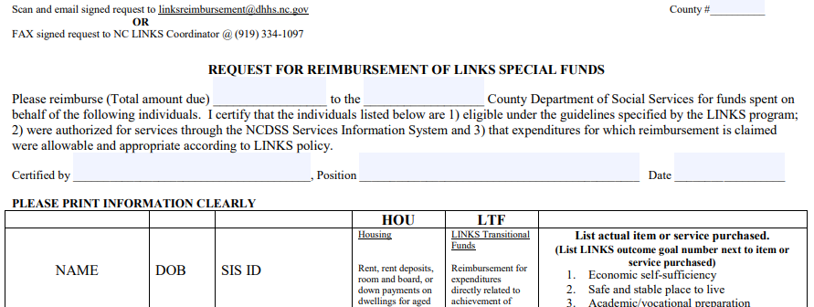
LINKS SPECIAL FUNDS
(not the same as LINKS on the 1571)
Purpose of fund is to help youth successfully transition to self-sufficiency by reducing barriers to achieving that goal. Housing and Transitional funds available.
Reimbursement for expenditures made on behalf of eligible foster teens and young adults up to age 21 who are or were in foster care as teens.
LINKS Special Funds are limited and are first come, first serve basis.
Expenditures submitted to State Links Coordinator Erin.Conner@dhhs.nc.gov.
When is request due?
Due monthly by the 15th
Report to show reimbursement:
EFT notice

Slide 60
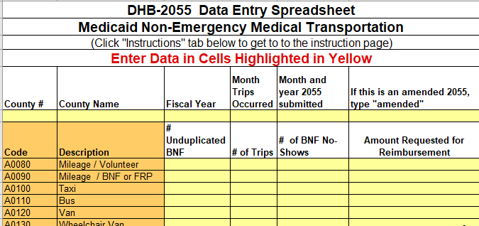
MEDICAID TRANSPORTATION
Non-Emergency Medicaid Transportation (NEMT) is part of DSS budget in many counties.
NEMT transportation services are billed through NC Tracks and provider is reimbursed directly. Services billed through NC Tracks are not included in the county budget.
NEMT transportation expenses such as mileage, lodging, etc. are paid to a client by the local agency, then reimbursed to the agency through DHB-2055 (formerly DMA-2055).
When is DHB-2055 due?
Due monthly by the 15th
Who is request submitted to?
Medicaid.financeAP@dhhs.nc.gov
Report to show reimbursement:
Email from Edward Pettiford or LBL

Slide 61
CHILD CARE SUBSIDY
Each county receives an allocation for Child Care Subsidy through the Division of Child Development and Early Education (DCDEE).
Payments to child care providers are paid directly to the provider through NC Fast.
Child Care and Smart Start administrative time is reimbursed through the 1571 with daysheet coding.
Funds for the Home & Community Care Block Grant (HCCBG) are from the Division of Aging and Community Care Block Grant Title III-C and B for Congregate Meals, Home Delivered Meals, and Transportation and Supportive services.
Grant funds are not always a part of the DSS budget, but other departments such as Senior Services. If part of DSS, staff time is coded to N.
HCCBG time is reimbursed through ARMS system.
Home & Community Care Block Grant

Slide 62
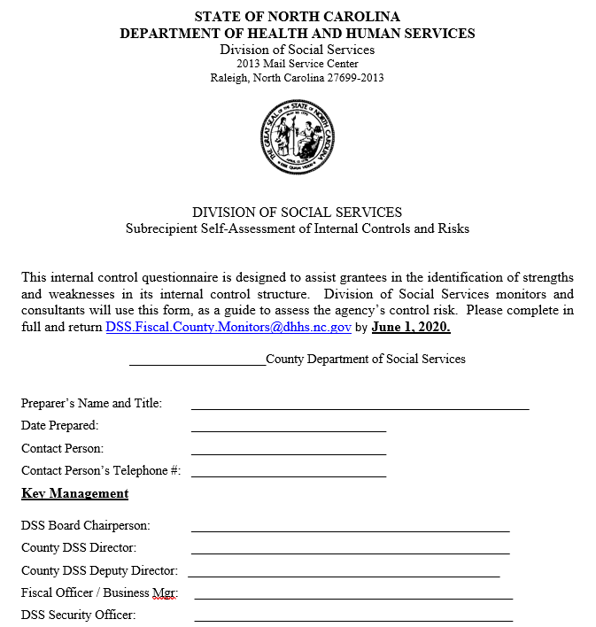
MONITORING & AUDITS
Fiscal Compliance Monitoring
  Self-Assessment Form completed each Spring by DSS (and Stand-alone Child Support Offices)
  Monitors review 1571 and processes
  Findings require 1571 adjustments or process changes
Single County Audit
Auditors review County finance records, 1571, and programs
Findings require change in internal controls, possible paybacks and Corrective Action Plan
Child Welfare Monitoring
Payment Adjustment Referral (PAR)
Medicaid Audit – 3 year cycle
Social Security Audit

Slide 63

MONTHLY
TIMELINE
5th
10th-15th
15th
16th
19th
Daysheet Upload (SIS Cutoff)
Prepare 1571
28th-31st
Review PQA 020 (second preliminary)
1571, DHB-2055, & Special Links Reimbursement Requests DUE
Review all PQA Reports
Review State 1571 Reports
Foster Care 5094 & Adoption Assistance Vendor Payment 5095 Deadline
Begin gathering 1571 documents and reconciling expenses
Key DSS-5094 for Foster Care Reimbursement (preliminary)/Review PQA 020
Submit Work First EA counts to LBL
* Note: some due dates change due to weekends and State closures – see DHRHR Calendar in NCXCloud
…and there are so many other county tasks!

Slide 64

Jul –
Sep
Oct – Dec
Jan –
Mar
Apr –
Jun
July 1st – New Fiscal Year begins
Single County Audits finalized for prior year
Budget preparation
April 15th – Indirect Cost Plans due to Controller’s Office
Funding authorizations start being issued
Self-Assessments due to State (will receive notice of due date)
302 reconciliation
May 31st – Expenses must be on general ledger for June 1571 Year-end
Submit year-end reclass letters to Controller’s Office
June – Submit ADPs for upcoming fiscal year
February 15th – Budget estimates to counties
Child Welfare Funding Surveys due
Ensure Energy expenditures balance in NC Fast, general ledger, & 411
Single County Audits begin
Combined Funding Authorizations released for Director signature
ANNUAL
TIMELINE
…this list is not all inclusive!

Slide 65
I have no idea what they’re talking about.
Nod and smile,
Nod and smile.

Slide 66
Questions
?

Slide 67
UPCOMING VIRTUAL TRAINING
1571 Admin Reports
NC-CoReLS 1571
…and more!
Virtual session recordings and materials are located on the Training webpage under the Local Business Liaison tab.

Slide 68

LoCal Business Liaison
& Fiscal monitor Team
Fiscal Monitors
Regina French
Regina.French@dhhs.nc.gov
Charles Robertson
Charles.Robertson@dhhs.nc.gov
Lead Fiscal Compliance Monitor/LBL
Margaret Faircloth Margaret.Faircloth@dhhs.nc.gov
Local Business Liaisons
Pamela Bell
Pamela.Bell@dhhs.nc.gov
Joyce Blackburn
Joyce.Blackburn@dhhs.nc.gov
Jennifer Gonzales Jennifer.Gonzales@dhhs.nc.gov
Pam Graham
Pamela.Graham@dhhs.nc.gov
Caroline Hedrick Caroline.Hedrick@dhhs.nc.gov

