Slide 1
NC Department of Health and Human Services
NC Opioid and Prescription Drug Abuse Advisory Committee (OPDAAC)
March 22, 2024

Slide 2
Welcome to OPDAAC!
Kimberly McDonald, Division of Public Health

Slide 3
Housekeeping
Poll Categories
Behavioral Health
Treatment and Recovery
Public Health
Academia
Harm Reduction
State Corrections Administration/Management
State Prisons Corrections Officers/Staff
State Community Corrections Officers/Staff
Juvenile Justice
County/Local Detention Centers
Municipality Police or Sheriffs
Re-entry Programs
EMS or Fire
Others

Slide 4
Housekeeping, Cont.
Take breaks as needed
For questions during the meeting:
  Virtual attendees: Please put your questions in the Q&A box, which will be monitored for the duration of the meeting. Note: you need to send to all panelists and attendees to ensure your question is addressed in a timely manner.
  In-person attendees: Fill out an index card given at registration with your questions and put in box at the back table.
  All attendees: If you would like to ask a question to a specific presenter, please be sure to include their name in your question (either in the Q&A box or on an index card).

Slide 5
Opening Remarks
Ziev Dalsheim-Kahane, Office of The Governor

Slide 6
Justice Involvement and its Risk Factors for Overdose Death
Evan Ashkin

Slide 7

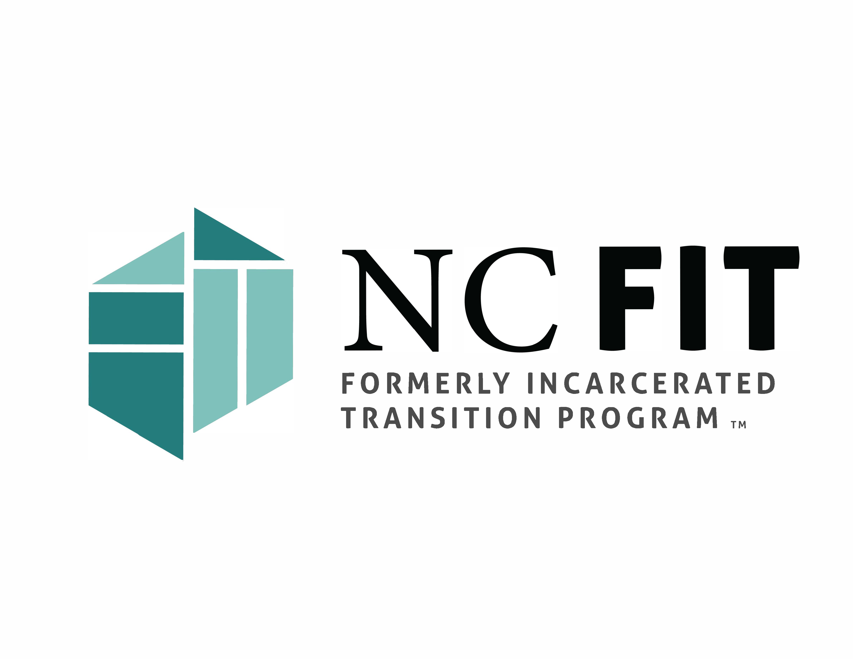
Justice Involvement and Risk Factors for Overdose Death
Evan Ashkin MD
Director NC FIT Program
Director NC Technical Assistance Center
Professor Family Medicine UNC Chapel Hill
I have no disclosures
Slide Acknowledgements:
Some slides within this slide deck are used with permission from MAHEC, including slides titled as follows: “Treatment of Opioid Use Disorder in Adults,” “Opioid Use Disorder Treatment and Rates of Adherence,” “Why MOUD?,” “Economic Impact of SUDs,” “MOUD is Effective in Correctional Settings,” “MAT Pilot for Non-Pregnant Adults & FIT Recovery: Eligible Reentry Counties.”

Slide 8
Drug Overdose
#1 Cause of Death in the US for people under 50 years old.
Vast Majority of overdose deaths are from Opioids
Heroin, Fentanyl…..

Slide 9
North Carolina Prison System
First 2 weeks post-release
Death from Overdose
50x higher
than general population
1. Opioid Overdose Deaths Among Formerly Incarcerated Persons and the General Population: North Carolina, 2000‒2018 AJPH 2022

Slide 10
North Carolina Prison System
“From 2017 to 2018, the OOD rates in the North Carolina general population decreased by 10.1% but increased by 32% among FIPs”
1. Opioid Overdose Deaths Among Formerly Incarcerated Persons and the General Population: North Carolina, 2000‒2018 AJPH 2022

Slide 11
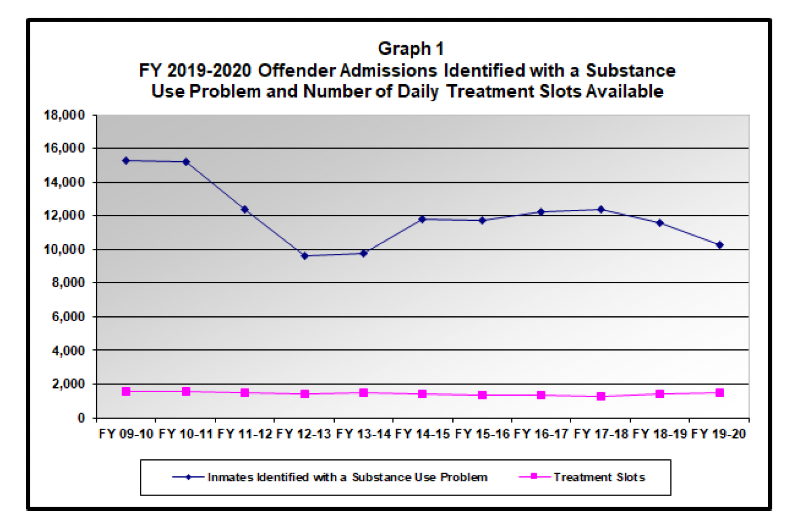
NC DAC: 74% screen + SUD

Slide 12
Treatment of Opioid Use Disorder in Adults
Detox and abstinence
Methadone
Buprenorphine
Naltrexone injection
3. SAMHSA, 2022.
4. MAHEC, 2024.
Notes:
Citation:
SAMHSA. Medication-Assisted Treatment (MAT). SAMHSA. Published July 25, 2022. Accessed October 13, 2022. https://www.samhsa.gov/medication-assisted-treatment

Slide 13
Opioid Use Disorder Treatment & Rates of Adherence
4. MAHEC, 2024.
5. Weiss R, Rao V 2017
6. Mintzer Il, Eisenberg M, Terra M, et al. 2007
7. Potter J, Marino E, Hillhouse M, et al. 2013
8. Strain E, Stitzer M, Liebson I 1993
9. Lee J, Nunes E, Novo P, et al. 2018
10. Tuten M, DeFulio A, Jones H, et al. 2012
Notes:
Speaker Notes:
We have 4 options for OUD (see above)
Detox is most popular but least effective
Naltrexone study results are variable (35% may be optimistic)
Citations:
Weiss RD, Rao V. The Prescription Opioid Addiction Treatment Study: What have we learned. Drug Alcohol Depend. 2017;173 Suppl 1:S48-S54. doi:10.1016/j.drugalcdep.2016.12.001
Mintzer IL, Eisenberg M, Terra M, MacVane C, Himmelstein DU, Woolhandler S. Treating opioid addiction with buprenorphine-naloxone in community-based primary care settings. Ann Fam Med. 2007;5(2):146-50.
Potter, J. S., Marino, E. N., Hillhouse, M. P., Nielsen, S., Wiest, K., Canamar, C. P., … Ling, W. (2013). Buprenorphine/naloxone and methadone maintenance treatment outcomes for opioid analgesic, heroin, and combined users: findings from starting treatment with agonist replacement therapies (START). Journal of Studies on Alcohol and Drugs, 74(4), 605–13. Retrieved from http://www.ncbi.nlm.nih.gov/pubmed/23739025
Strain EC, Stitzer ML, Liebson IA, Bigelow GE. Dose-response effects of methadone in the treatment of opioid dependence. Ann Intern Med. 1993;119(1):23-27.
Lee JD, Nunes EV, Novo P, et al. Comparative effectiveness of extended-release naltrexone versus buprenorphine-naloxone for opioid relapse prevention (X:BOT): a multicentre, open-label, randomized controlled trial. Lancet. 2018;391(10118):309-318. doi:10.1016/S0140-6736(17)32812-X
Tuten M, DeFulio A, Jones HE, Stitzer M. Abstinence-contingent recovery housing and reinforcement-based treatment following opioid detoxification. Addiction. 2012;107(5):973-982. doi:10.1111/j.1360-0443.2011.03750.x

Slide 14
Why MOUD?
The use of the opioid agonists methadone and buprenorphine reduces:¹
Buprenorphine and Methadone: 73% decrease in overdose mortality!³
What about Long-Acting Naltrexone (Vivitrol)?
Overdose
Illicit drug use
Transmission of infectious diseases
11. NIDA 2018
12. Fairley et al. 2021
13. Bahji, Cheng, Gray, et al. 2019
4. MAHEC, 2024.
Notes:
Doesn’t account for work, kids not in DSS care, etc.
National Institute on Drug Abuse. Effective Treatments for Opioid Addiction. National Institutes on Drug Abuse; 2016. Accessed July 10, 2018. https://nida.nih.gov/publications/effective-treatments-opioid-addiction
Fairley M, Humphreys K, Joyce VR, et al. Cost-effectiveness of Treatments for Opioid Use Disorder. JAMA Psychiatry. 2021;78(7):767. doi:10.1001/jamapsychiatry.2021.0247
Bahji A, Cheng B, Gray S, Stuart H. Reduction in mortality risk with opioid agonist therapy: a systematic review and meta-analysis. Acta Psychiatr Scand. 2019;140(4):313-339. doi:10.1111/acps.13088
*for 2: could also cite “1.
ACLU Massachusetts. Addressing opioid addiction: treatment, not jail. ACLU Massachusetts. Published November 12, 2015. Accessed October 11, 2022. https://www.aclum.org/en/addressing-opioid-addiction-treatment-not-jail
OR

Slide 15
What about Naltrexone/Vivitrol?
Heavily marketed to Sheriff’s associations, correctional organizations, law enforcement, drug courts, elected officials¹
Company has pushed for decreased access to buprenorphine/methadone
Unlike methadone/buprenorphine, naltrexone does NOT induce opioid tolerance, thus has increased risk of overdose with return to use
Out of pocket cost: ~$1000/month, compared to ~$70/month for buprenorphine
MULTIPLE studies show NO IMPROVEMENT in overdose risk with naltrexone compared to placebo, and WORSE overdose risk compared to buprenorphine/methadone²³
14. NPR 2017
15. Wakeman 2020
16. Morgan 2019
Notes:
https://www.npr.org/sections/health-shots/2017/06/12/523774660/a-drugmaker-tries-to-cash-in-on-the-opioid-epidemic-one-state-law-at-a-time
Wakeman SE, Larochelle MR, Ameli O, et al. Comparative Effectiveness of Different Treatment Pathways for Opioid Use Disorder. JAMA Netw Open. 2020;3(2):e1920622. doi:10.1001/jamanetworkopen.2019.20622
Morgan JR, Schackman BR, Weinstein ZM, Walley AY, Linas BP. Overdose following initiation of naltrexone and buprenorphine medication treatment for opioid use disorder in a United States commercially insured cohort. Drug Alcohol Depend. 2019;200:34-39. doi:10.1016/j.drugalcdep.2019.02.031

Slide 16

Abstinence: Higher OD Deaths than No Treatment
17 Heimer 2024 Connecticut
Notes:
Heimer R, Black AC, Lin H, et al. Receipt of opioid use disorder treatments prior to fatal overdoses and comparison to no treatment in Connecticut, 2016-17. Drug Alcohol Depend. 2024;254:111040. doi:10.1016/j.drugalcdep.2023.111040

Slide 17
Economic Impact of SUDs
Treatment is less expensive than alternatives
  Approximate average cost for 1 full year:
Including criminal justice costs, MOUD treatment saved $25,000 to $105,000 in lifetime costs per person ²
Buprenorphine treatment
Methadone treatment
Naltrexone treatment
Incarceration
$6,000
per patient¹
$6,500
per patient¹
$14,000
per patient¹
$36,000
per person²
18. ASAM 2015
12. Fairley et al. 2021
19. SAMHSA 2019.
20. MAHEC 2023.
Notes:
State report on Horizons residential program - costs saved on homeless services, foster care, etc.
Other costs:
Overall cost to immediate community:
Substance use treatment
Criminal justice costs
Loss of productivity
Premature death
Reduced productive working hours
Incarceration
Children born with Neonatal Abstinence Syndrome (NAS)
Disproportionately affects low-income communities
Lowest social capital (employment, education, transportation, etc.) 🡪 highest rate of prescription opioid use
Vearrier, 2019; Florence et al., 2016; Liu et al., 2019; Dasgupta et al., 2018
Citations:
ASAM. Access to Medications Talking Points. https://www.asam.org/docs/default-source/advocacy/mat-talking-points-final.pdf?sfvrsn=0. Accessed July 10, 2018.
Fairley M, Humphreys K, Joyce VR, et al. Cost-effectiveness of Treatments for Opioid Use Disorder. JAMA Psychiatry. 2021;78(7):767. doi:10.1001/jamapsychiatry.2021.0247
Huang L (SAMHSA/OPPI). Medication-Assisted Treatment (MAT) in the Criminal Justice System: Brief Guidance to the States. SAMHSA.:8.

Slide 18
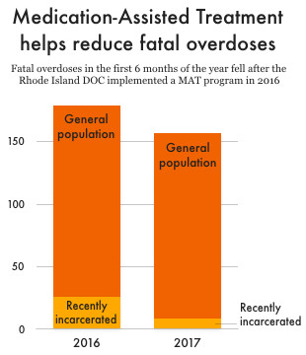
MOUD is Effective in Correctional Settings
After expanding MOUD statewide, the Rhode Island Department of Corrections saw a 61% reduction in post-correctional overdose death rates in the first year.¹
A study of >12,000 people in England found that a prison-based MOUD program was linked with a 75% reduction in all-cause mortality and an 85% reduction in overdose deaths in the first month after release.²
Another study showed that access to MOUD during the first four weeks in prison, was associated with a 94% reduction in risk of death, primarily associated with a reduction of suicide deaths among incarcerated people.³
21. Green, Clarke, Brinkley-Rubinstein 2018
22. Marsden, Stillwell, Jones, Eastwood, Farrell 2017
23. Larney, Gisev, Farrell, Dobbins, Burns, Gibson, Kimber, Degenhardt 2018
20. MAHEC 2023.
Notes:
Green TC, Clarke J, Brinkley-Rubinstein L, et al. Post incarceration Fatal Overdoses After Implementing Medications for Addiction Treatment in a Statewide Correctional System. JAMA Psychiatry. 2018;75(4):405-407. doi:10.1001/jamapsychiatry.2017.4614
Marsden, J., Stillwell, G., Jones, H., Cooper, A., Eastwood, B., Farrell, M.,. . . Hickman, M. (2017). Does exposure to opioid substitution treatment in prison reduce the risk of death after release? A national prospective observational study in England. Addiction, 112, 1408-1418.
Larney, S., Gisev, N., Farrell, M., Dobbins, T., Burns, L., Gibson, A., Kimber, J., & Degenhardt, L. (2018). Opioid substitution therapy as a strategy to reduce deaths in prison: retrospective cohort study. BMJ Open, 4, e004666.

Slide 19
What the Literature Shows about MOUD in Jails/Prisons
Follow up from RIDOC Prison MOUD Program:
1,600 people enrolled
12 Overdose Deaths <1%
1 OD Death in 1st 2 weeks post-release
12 months post-release: 86% engaged in MOUD
The Lancet Regional
Health - Americas
2023;18: 100419
24. Martin et al. 2023
Notes:
Cates L, Brown AR. Medications for opioid use disorder during incarceration and post-release outcomes. Health Justice. 2023;11(1):4. Published 2023 Feb 4. doi:10.1186/s40352-023-00209-w
Chatterjee A, Weitz M, Savinkina A, et al. Estimated Costs and Outcomes Associated With Use and Nonuse of Medications for Opioid Use Disorder During Incarceration and at Release in Massachusetts. JAMA Netw Open. 2023;6(4):e237036. doi:10.1001/jamanetworkopen.2023.7036

Slide 20
What the Literature Shows about MOUD in Jails/Prisons
Increases post release treatment rates
Decrease post release overdose rates, substance use
Lowers criminal activity, rearrests, probation violations, suicide in jail, behavior issues in jail
Improves family relationships, employment
Cost effective!
^{25. Cates 2023}
^{26. Chatterjee 2023}
Notes:
Cates L, Brown AR. Medications for opioid use disorder during incarceration and post-release outcomes. Health Justice. 2023;11(1):4. Published 2023 Feb 4. doi:10.1186/s40352-023-00209-w
Chatterjee A, Weitz M, Savinkina A, et al. Estimated Costs and Outcomes Associated With Use and Nonuse of Medications for Opioid Use Disorder During Incarceration and at Release in Massachusetts. JAMA Netw Open. 2023;6(4):e237036. doi:10.1001/jamanetworkopen.2023.7036

Slide 21
MAT in Prison Pilot (MIPP)
Partnership DAC-MAHEC-NC FIT
Planning starts 4/2021
Pilot Sites: NC Correctional Institute for Women (NCCIW)
Orange Correctional
MAHEC:
    Screen for participants
    Initial telehealth evaluation
    Enroll in MIPP
    Initiate MOUD with oral Suboxone Sublocade injection prior to release

Slide 22
MAT in Prison Pilot (MIPP)
Partnership DAC-MAHEC-NC FIT
MOUD Initiations begin:
NCCIW: 7/2022
Orange 10/2022
NC FIT: FIT Recovery links people to community provider
combination of FQHCs and OTPs
FIT Recovery Network now covers >50 Counties
    Pays for visits and meds for 1st 6 mos. post-release

Slide 23
27. MAHEC 2024.

Slide 24
MAT in Prison Pilot (MIPP)
Outcomes
Since Inception:
  696 people referred
    377 ineligible
    272 interviewed
    187 enrolled

Slide 25
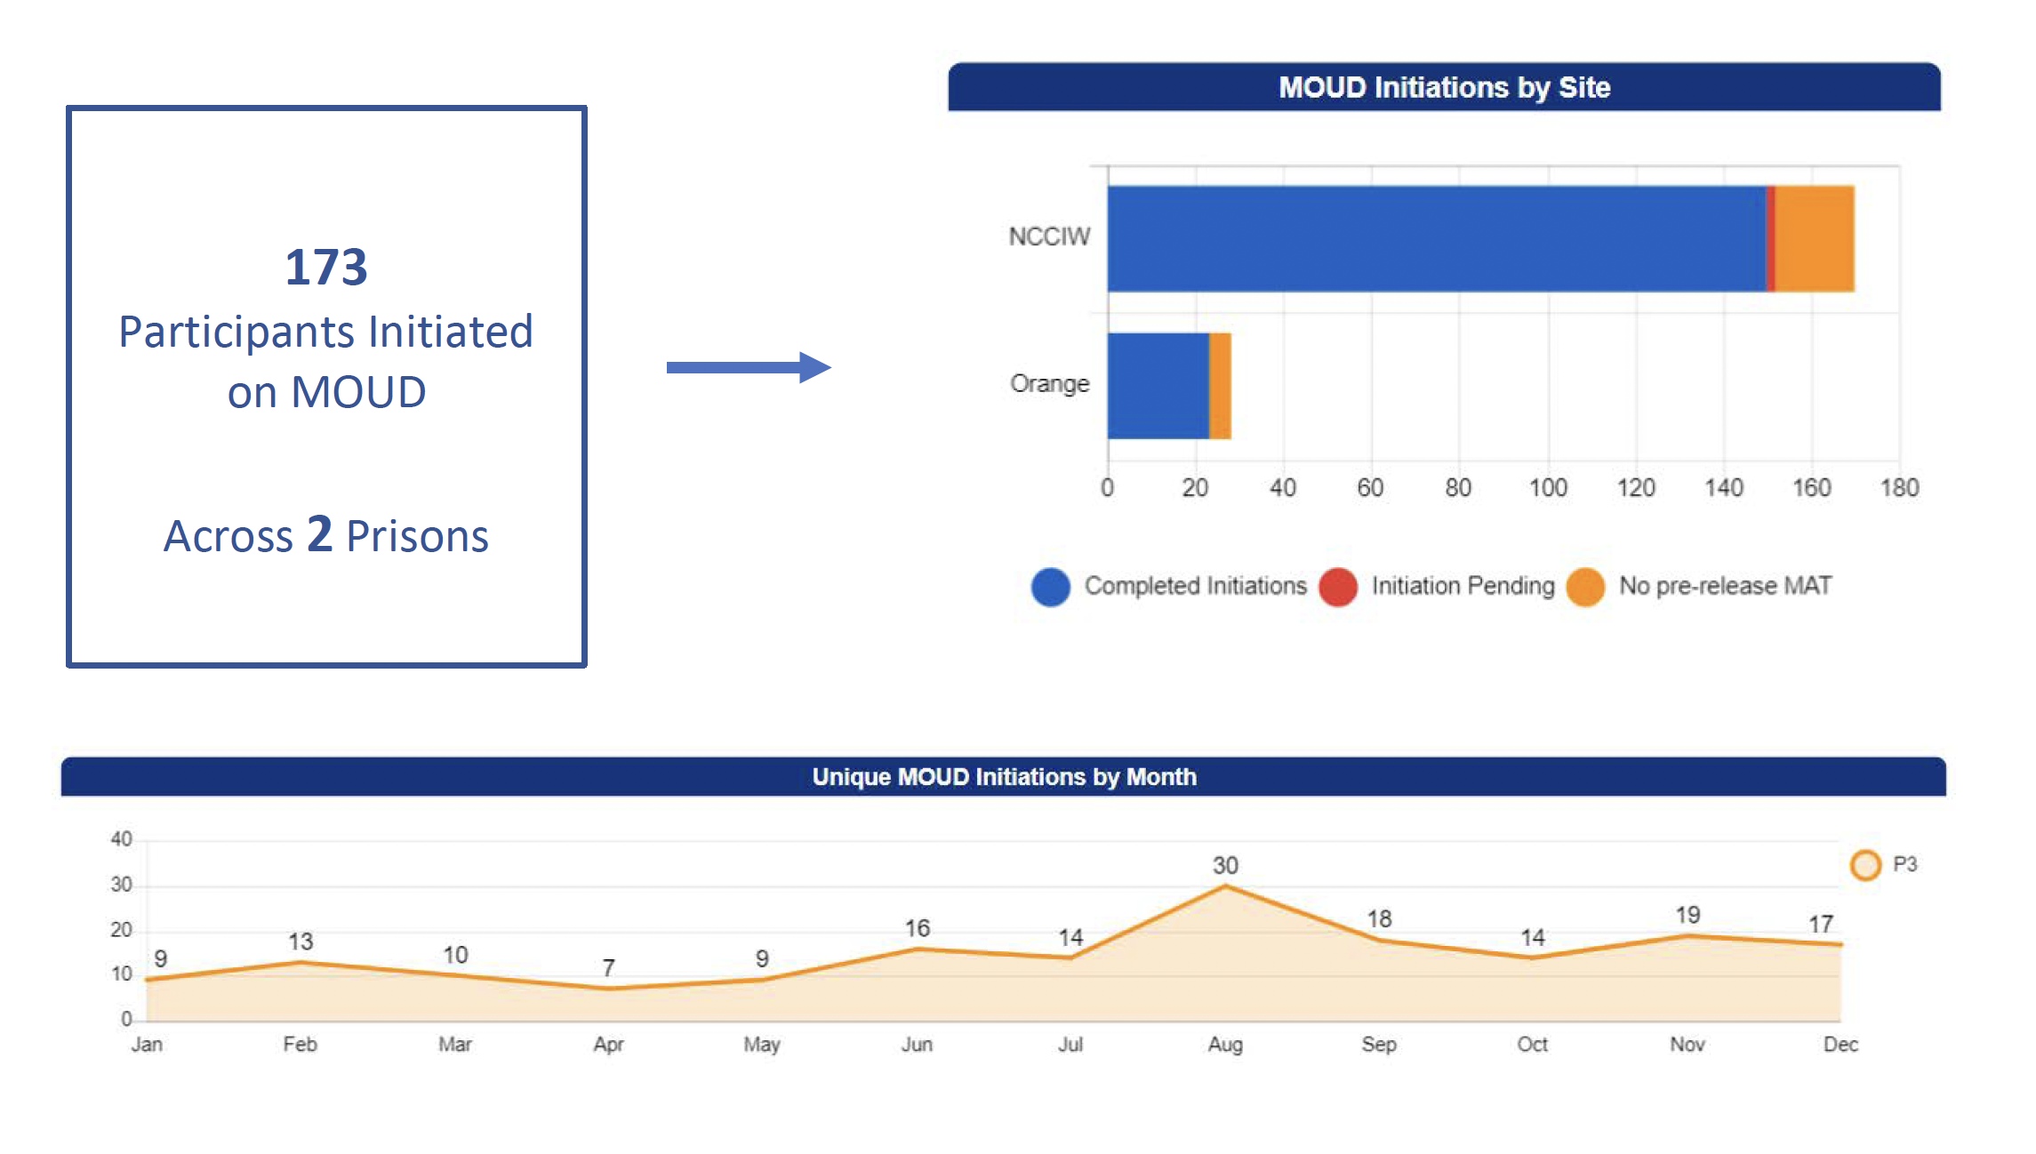
MAT in Prison Pilot (MIPP)

Slide 26
MAT in Prison Pilot (MIPP)
Outcomes
188 people released
    116 released to FIT Eligible County
    80 FIT intakes completed post-release – 70%
83% attended First clinic appt to continue MOUD

Slide 27
References
Ranapurwala SI, Figgatt MC, Remch M, et al. Opioid Overdose Deaths Among Formerly Incarcerated Persons and the General Population: North Carolina, 2000‒2018. Am J Public Health. 2022;112(2):300-303. doi:10.2105/AJPH.2021.3066
FY 2019-2020 Offender Admissions Identified with a Substance Use Problem and Number of Daily Treatment Slots Available. NC Department of Adult Corrections.
SAMHSA. Medication-Assisted Treatment (MAT). SAMHSA. Published July 25, 2022. Accessed October 13, 2022. https://www.samhsa.gov/medication-assisted-treatment
UNC Health Sciences at MAHEC. Medication for Opioid Use Disorder (MOUD 101). 2024. Asheville, NC’
Weiss RD, Rao V. The Prescription Opioid Addiction Treatment Study: What have we learned. Drug Alcohol Depend. 2017;173 Suppl 1:S48-S54. doi:10.1016/j.drugalcdep.2016.12.001
Mintzer IL, Eisenberg M, Terra M, MacVane C, Himmelstein DU, Woolhandler S. Treating opioid addiction with buprenorphine-naloxone in community-based primary care settings. Ann Fam Med. 2007;5(2):146-50.
Potter, J. S., Marino, E. N., Hillhouse, M. P., Nielsen, S., Wiest, K., Canamar, C. P., … Ling, W. (2013). Buprenorphine/naloxone and methadone maintenance treatment outcomes for opioid analgesic, heroin, and combined users: findings from starting treatment with agonist replacement therapies (START). Journal of Studies on Alcohol and Drugs, 74(4), 605–13. Retrieved from http://www.ncbi.nlm.nih.gov/pubmed/23739025
Strain EC, Stitzer ML, Liebson IA, Bigelow GE. Dose-response effects of methadone in the treatment of opioid dependence. Ann Intern Med. 1993;119(1):23-27.
Lee JD, Nunes EV, Novo P, et al. Comparative effectiveness of extended-release naltrexone versus buprenorphine-naloxone for opioid relapse prevention (X:BOT): a multicentre, open-label, randomized controlled trial. Lancet. 2018;391(10118):309-318. doi:10.1016/S0140-6736(17)32812-X
Tuten M, DeFulio A, Jones HE, Stitzer M. Abstinence-contingent recovery housing and reinforcement-based treatment following opioid detoxification. Addiction. 2012;107(5):973-982. doi:10.1111/j.1360-0443.2011.03750.x
National Institute on Drug Abuse. Effective Treatments for Opioid Addiction. National Institutes on Drug Abuse; 2016. Accessed July 10, 2018. https://nida.nih.gov/publications/effective-treatments-opioid-addiction
Fairley M, Humphreys K, Joyce VR, et al. Cost-effectiveness of Treatments for Opioid Use Disorder. JAMA Psychiatry. 2021;78(7):767. doi:10.1001/jamapsychiatry.2021.0247
Bahji A, Cheng B, Gray S, Stuart H. Reduction in mortality risk with opioid agonist therapy: a systematic review and meta-analysis. Acta Psychiatr Scand. 2019;140(4):313-339. doi:10.1111/acps.13088

Slide 28
References
Harper, J. (2017) ‘A Drugmaker Tries To Cash In On The Opioid Epidemic, One State Law At A Time’, National Public Radio. Available at: https://www.npr.org/sections/health-shots/2017/06/12/523774660/a-drugmaker-tries-to-cash-in-on-the-opioid-epidemic-one-state-law-at-a-time (Accessed: 2024).
Wakeman SE, Larochelle MR, Ameli O, et al. Comparative Effectiveness of Different Treatment Pathways for Opioid Use Disorder. JAMA Netw Open. 2020;3(2):e1920622. doi:10.1001/jamanetworkopen.2019.20622
Morgan JR, Schackman BR, Weinstein ZM, Walley AY, Linas BP. Overdose following initiation of naltrexone and buprenorphine medication treatment for opioid use disorder in a United States commercially insured cohort. Drug Alcohol Depend. 2019;200:34-39. doi:10.1016/j.drugalcdep.2019.02.031
Heimer R, Black AC, Lin H, et al. Receipt of opioid use disorder treatments prior to fatal overdoses and comparison to no treatment in Connecticut, 2016-17. Drug Alcohol Depend. 2024;254:111040. doi:10.1016/j.drugalcdep.2023.111040
ASAM. Access to Medications Talking Points. https://www.asam.org/docs/default-source/advocacy/mat-talking-points-final.pdf?sfvrsn=0. Accessed July 10, 2018.
Huang L (SAMHSA/OPPI). Medication-Assisted Treatment (MAT) in the Criminal Justice System: Brief Guidance to the States. SAMHSA.:8. March 2019.
UNC Health Sciences at MAHEC. Opioid Use Disorder and the Criminal Justice System. 2023. Asheville, NC.
Green TC, Clarke J, Brinkley-Rubinstein L, et al. Post incarceration Fatal Overdoses After Implementing Medications for Addiction Treatment in a Statewide Correctional System. JAMA Psychiatry. 2018;75(4):405-407. doi:10.1001/jamapsychiatry.2017.4614
Marsden, J., Stillwell, G., Jones, H., Cooper, A., Eastwood, B., Farrell, M.,. . . Hickman, M. (2017). Does exposure to opioid substitution treatment in prison reduce the risk of death after release? A national prospective observational study in England. Addiction, 112, 1408-1418.
Larney, S., Gisev, N., Farrell, M., Dobbins, T., Burns, L., Gibson, A., Kimber, J., & Degenhardt, L. (2018). Opioid substitution therapy as a strategy to reduce deaths in prison: retrospective cohort study. BMJ Open, 4, e004666.
Martin, et al. Post-incarceration outcomes of a comprehensive statewide correctional MOUD program: a retrospective cohort study. The Lancet Regional Health - Americas 2023;18: 100419 Published Online 23 December 2022 https://doi.org/10. 1016/j.lana.2022. 100419
Cates L, Brown AR. Medications for opioid use disorder during incarceration and post-release outcomes. Health Justice. 2023;11(1):4. Published 2023 Feb 4. doi:10.1186/s40352-023-00209-w
Chatterjee A, Weitz M, Savinkina A, et al. Estimated Costs and Outcomes Associated With Use and Nonuse of Medications for Opioid Use Disorder During Incarceration and at Release in Massachusetts. JAMA Netw Open. 2023;6(4):e237036. doi:10.1001/jamanetworkopen.2023.7036
Christensen, S. MAT Pilot for Non-Pregnant Adults & FIT Recovery: Eligible Reentry Counties. MAHEC, 2024. Asheville, NC.

Slide 29
The Role of Adult Corrections for Reentry
Maggie Brewer
George Pettigrew
Gary Junker

Slide 30
Opioid Prescription Drug Abuse Advisory Committee
March 22, 2024
Maggie Brewer, Chief Deputy Secretary
George Pettigrew, Deputy Secretary, Rehabilitation and Reentry
Gary Junker, Deputy Secretary Comprehensive Health Services

Slide 31
The Division of Health Services envisions correctional facilities as public health stations that significantly impact the health status of the larger community. The Division is committed to providing care that will positively impact the public health sector; improve the health status of justice involved persons; engage in sound healthcare practices that meet or exceed community standards; and in support of the mission and goals of the North Carolina Department of Adult Correction.

Slide 32
Chief Medical Officer: Maintains responsibility for the quality of medical care provided to justice involved persons.
Chief Nursing Officer: Nursing Services function as an integral part of multidisciplinary teams and participate in the planning, implementation and monitoring of safe, evidenced-based health care.
Chief Dental Officer: Responsible to develop, implement and monitor dental care in accordance with North Carolina State Board of Dental Examiners and applicable statutes, rules and regulations.
Director of Behavioral Health: Oversight for services for individuals identified with a serious mental illness and those with less severe mental health needs related to emotional, cognitive and behavioral deficits. In addition, substance use treatment is provided within behavioral health services as a holistic approach to healthcare.
Chief of Psychiatry: Maintains responsibility for the quality of psychiatric services provided to offenders and specifically management of psychiatric medications.
Director of Clinical Support Services: Provides oversight for Risk Management/Quality Assurance, Telehealth, Healthcare Records, and Clinical Informatics.
Business Officer: Provides support for contracts, business administration, and Human Resources.
The Director of Pharmacy Services: Is responsible for all pharmaceutical services provided by the Central Pharmacy, a centralized outpatient pharmacy and on-site pharmacies.

Slide 33
Behavioral Health Statistics
% of Prison Population on MH Caseload
Notes:
MH Caseload 2023 was 7,498
MH Caseload 2022 was 7,067
MH Caseload 2021 was 6,748
MH Caseload 2020 was 6,307
19% increase from 2020-2023 (from 6,307 to 7,498)

Slide 34
Average Intake MH Referral Rate
MHSI Screenings/MHSI Generated Referrals

Slide 35
ACDP Screening
Substance Abuse Subtle Screening Inventory (SASSI)
  1: No treatment indicated
  Males 10%
  Females 8%
  2: Intervention
  Males 14%
  Females 9%
  3: Intermediate treatment (90 days)
  Males 42%
  Females 22%
  4: Intermediate to long term (90-180)
  Males 23%
  Females 35%
  5: Long term treatment (120-365)
  Males 10%
  Females 26%

Slide 36
Alcoholism and Chemical Dependency Programs (ACDP) and Services
All ACDP Treatment Programs and Services are customized to address any Substance Use Disorder specific to the participant, to include Opioid Use Disorder.
ACDP In-Prison Treatment Programs currently encompass 19 programs spread across 17 prison facilities.
Residential programs for individuals on parole or probation are located at:
  DART Center – 270 capacity residential male treatment facility
  Black Mountain – 64 capacity residential female treatment facility
  Narcan provided at program completion

Slide 37
About Opioid Use Disorder (OUD)
What is OUD?
OUD is a specific kind of substance use disorder, individuals with OUD have a pattern of opioid use that leads to significant issues, such as health problems and difficulty meeting major responsibilities at home, work, or school. OUD can involve the use of illegal opioids (for example, heroin) or prescription opioids (for example, oxycodone).
Is OUD a disability?
For many people, OUD is a disability under the ADA’s definition because it is a drug addiction that substantially limits a major life activity. For example, OUD can affect a person’s:
  Ability to take care of themselves
  Thinking
  Learning
  Concentrating
  Communication
  Working

Slide 38
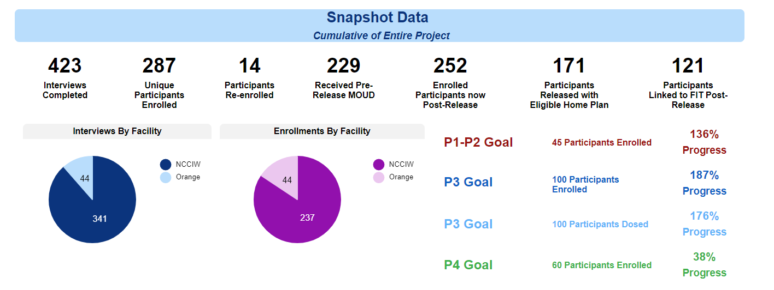
MOUD Pilot Program p

Slide 39
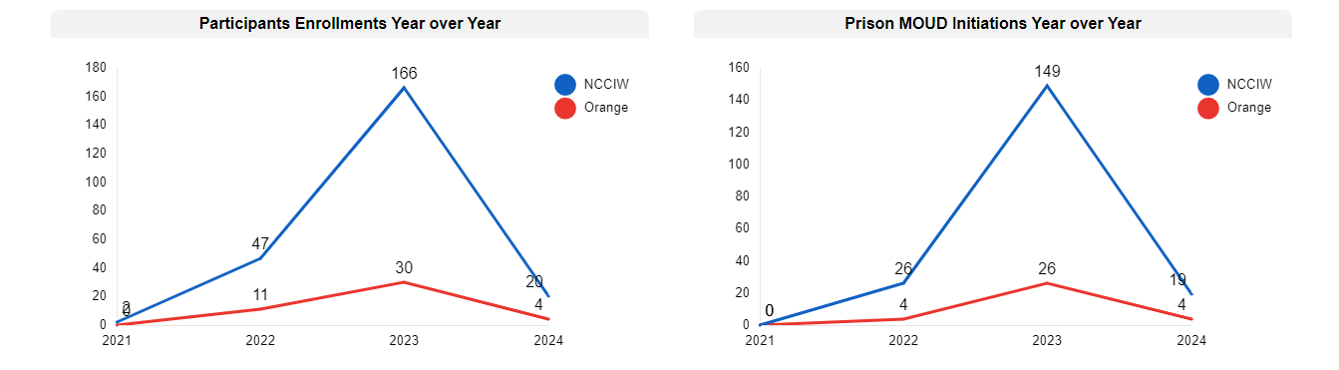
DAC/MAHEC/UNCFIT Pilot

Slide 40
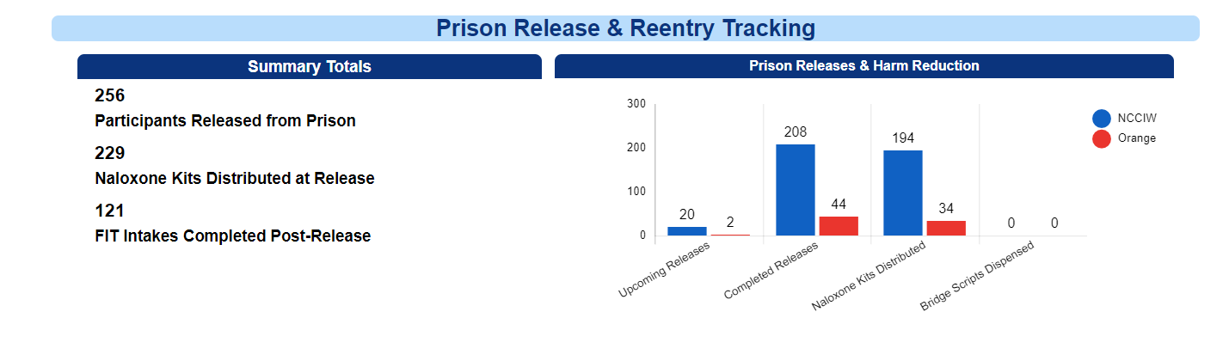

Slide 41
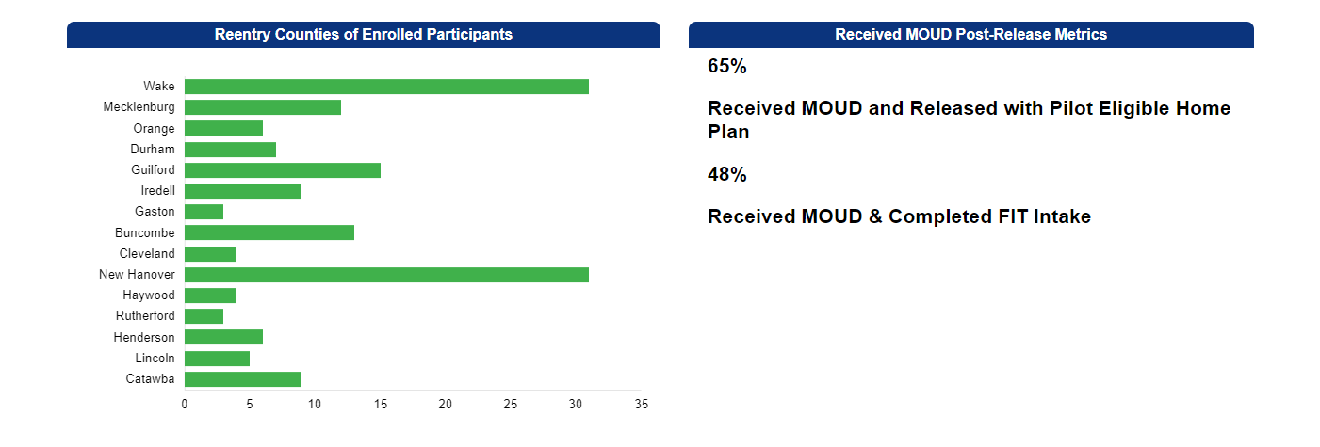
MOUD Release by County

Slide 42
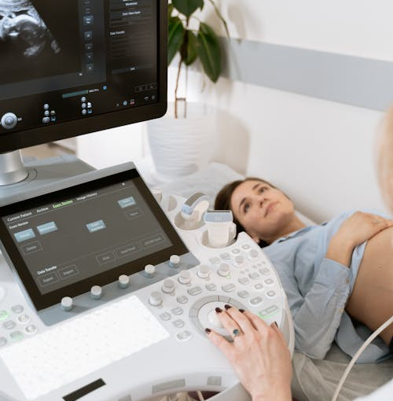
Medicated Assisted Treatment for Incarcerated Pregnant Females
The High-Risk Obstetrics team at NCCIW provides MAT services for incarcerated females who are pregnant and have a diagnosis of Opioid Dependence.
The team includes OB/GYN providers, nurses, behavioral health clinicians, and social workers
Partnership with UNC Horizons to provide in-reach services
  Substance use counseling
  Housing supports
  Aftercare planning
  Care coordination

Slide 43
NCDAC MOUD Organizational Structure
Expert Advisory Committee (EAC):
Comprised of DAC medical leaders, clinicians and external experts
Coordinate with local, state and federal agencies (DEA, SAMHSA, NCDHHS, SOTA, NC-FIT and others) to develop policy, protocols and implementation procedures
Regionalized program mirroring institutional organizational structure:
  MOUD Program Director Chief, Psychiatry
  MOUD Medical Director Chief Medical Officer
  MOUD Clinical Director Addiction-trained physician
  Regional MOUD providers (one for each of the four prison regions)

Slide 44
Sustain: Maternity MOUD Program
Expand existing pilot programs: Assume responsibility from MAHEC team with end of contract June 30, 2024)
Pre-release naloxone
Provision of naloxone to all releasing offenders at all facilities (regardless of substance use history or not)
Reentry MOUD Program
Screening and identification of at-risk offenders and initiation of MOUD treatment prior to release with community coordination for continuity of care
Establish new programs: Sustained MOUD treatment for offenders arriving to prison on active MOUD treatment with sentences (<91 days).
Confinement in Response to Violation (CRV) facilities and residential Alcohol and Chemical Dependency Program (ACDP) facilities.
MOUD Program Expansion (Initial Phases)

Slide 45
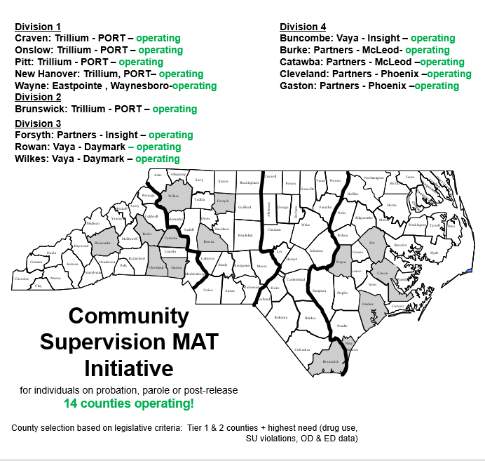

Slide 46
Community Supervision MAT Active and Pending 2023 & 2024

Slide 47
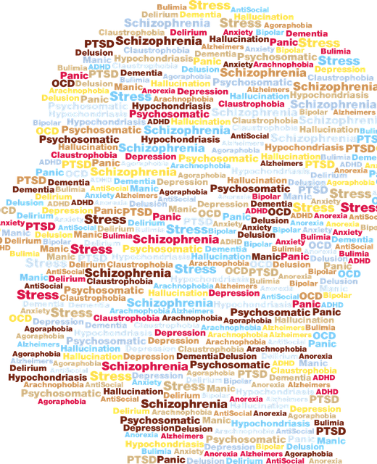
Severe Mental Illness Initiative
DAC collaborates with the four LME/MCO’s (Local Management Entity/Managed Care Organization) to provide care coordination and enhanced supports for individuals releasing from prison.
Individuals in this program have been diagnosed with a Severe Mental Illness (SMI) and have committed a serious violent crime and/or a sex offense.
Each of the LME/MCO’s have dedicated staff who provide in-reach services when the individuals are within 90 days of their release date.
Enhanced services include:
Coordination of behavioral and physical health services in the community
Housing support
Other social determinants of health needs

Slide 48
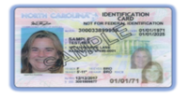
State IDs for Incarcerated People before Release
DAC is partnering with the Division of Motor Vehicles to provide State IDs to incarcerated individuals 90 days prior to release.
Since August 1, 2023
  Of those eligible, 73% of offenders being released have accepted the issuance of a State ID.
Notes:
Secretary comments: We have collaborated with DMV to provide State IDS to incarcerated individuals 90 days prior to their release. Every week, DAC staff run a batch to determine the men and women that qualify for a State ID. Staff review the ability to obtain a state id with qualified individuals and are careful to ensure that the issuance of a state ID upon release does not invalidate a potential active driver’s license. If the individual wants to receive a state ID, their information is sent to the DMV 90 days before their release. DMV reviews the information to ensure the offender is still qualified for an ID and if they do, a state ID is issued. Rehabilitation and reentry staff pick up the IDs and mail them out to facilities on a weekly basis.

Slide 49

Improved Access to Healthcare
Effective December 1, 2023
Medicaid eligible if:
  Age 19-64
  US Citizen
  Household income of $20,100 or less
Up to 92% of incarcerated individuals will be eligible upon release in 2024.
Notes:
Secretary comments: An initial data report run by DAC identifies 4,800 offenders ages 19-64 with PRDs of December 1, 2023, through June 30, 2023. DAC leadership and field staff have been hard at work to identify and assist all offenders that are eligible for Medicaid expansion.
Effective December 1st, 2,105 incarcerated people gained coverage based on their prior enrollment in the Family Planning Medicaid Program. These individuals are not eligible for release in the next six months but will be covered by Medicaid upon release

Slide 50
Improved Access to Healthcare
DAC Actions Taken:
  Placed Medicaid enrollment flyer in all Institutions, release packets, and on tablets.
  Social Workers, Case Managers and Contract employees completing paper applications, mailing to DSS for Medicaid on offenders being released within 90 days.
  Provided educational material to LRCs and Recidivism Reduction Service Vendors.
  Collaborating with DHHS to create an automated process that identifies eligible offenders, notifies DAC when the offender is approved, and prefills Medicaid applications with data from OPUS.
  Named a Medicaid Expansion Coordinator for the Department and have increased social work positions within the Division of Rehabilitation and Reentry.
  Community Supervision is providing information to all supervised individuals and partnering with DSS offices to enroll supervised people.
  Hired Retired Correctional Staff to hold meetings with incarcerated individuals and assist in completing and submitting Medicaid applications.
Notes:
DAC leadership and field staff have been hard at work to identify and assist all incarcerated people that are eligible for Medicaid expansion as well as to educate our staff.
A memo was sent to facility program staff that requested their assistance in enrolling offenders 90 days prior to their release. Case managers facilitate paper applications being filled out by the men and women in our custody and mail completed applications to the local DSS office. Social workers are facilitating applications for men and women with intellectual and developmental disabilities and complex medical cases.
DAC is collaborating with DHHS to create an automated process that identifies eligible offenders, notifies DAC when the offender is approved, and prefills Medicaid applications with data from OPUS.
Effective December 1st, 2,105 incarcerated individuals gained coverage based on their prior enrollment in the Family Planning Medicaid Program.

Slide 51

Local Reentry Councils
A local reentry council (LRC) is an organized network of individuals and agencies that provide programs and services to support justice-involved citizens living in local communities.
Typical services include assistance with housing, employment, transportation, substance use disorder, and other basic needs.
The State of North Carolina has 17 LRCs that serve 19 counties.
An additional 30 counties have emerging Local Reentry Councils.
Within existing state funding, we anticipate funding up to 6 of these emerging Local Reentry Councils.
Notes:
Secretary Comments: A local reentry council (LRC) is an organized network of individuals and agencies that provide programs and services to support justice-involved citizens living in local communities. The LRC mission is to reduce recidivism and victimization, enhance public safety, create a network of individuals and organizations assisting justice-involved individuals, maximize the use of existing resources and services, and develop innovative responses to address gaps in resources and services. North Carolina has 17 local reentry councils that serve justice-involved individuals in 19 counties. Typical services include assistance with housing, employment, transportation, substance abuse, obtaining personal documentation, and other basic needs. DAC is reviewing internal funding to fund 3 emerging LRCs. DAC is also partnering with the Department of Commerce’s Workforce Solutions Division to transfer available funding to support 3 emerging LRCs that are closely aligned with local workforce solutions offices.

Slide 52
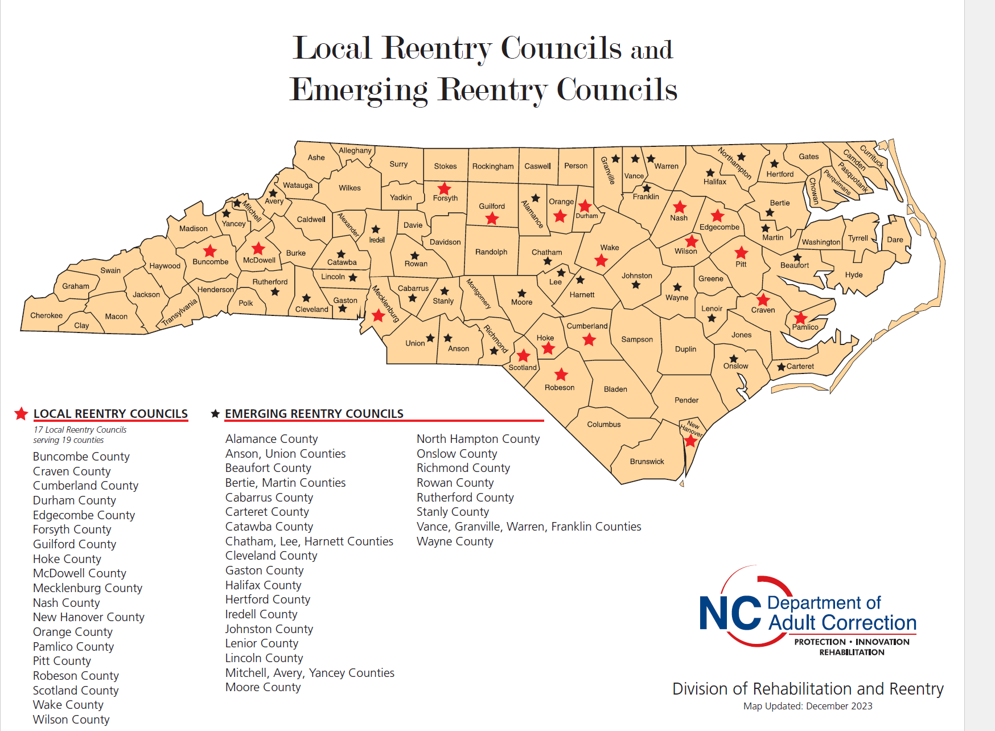



Local Reentry Councils
Notes:
Secretary Comments: Here is a map of the current LRCs in North Carolina as well as emerging LRCs.

Slide 53
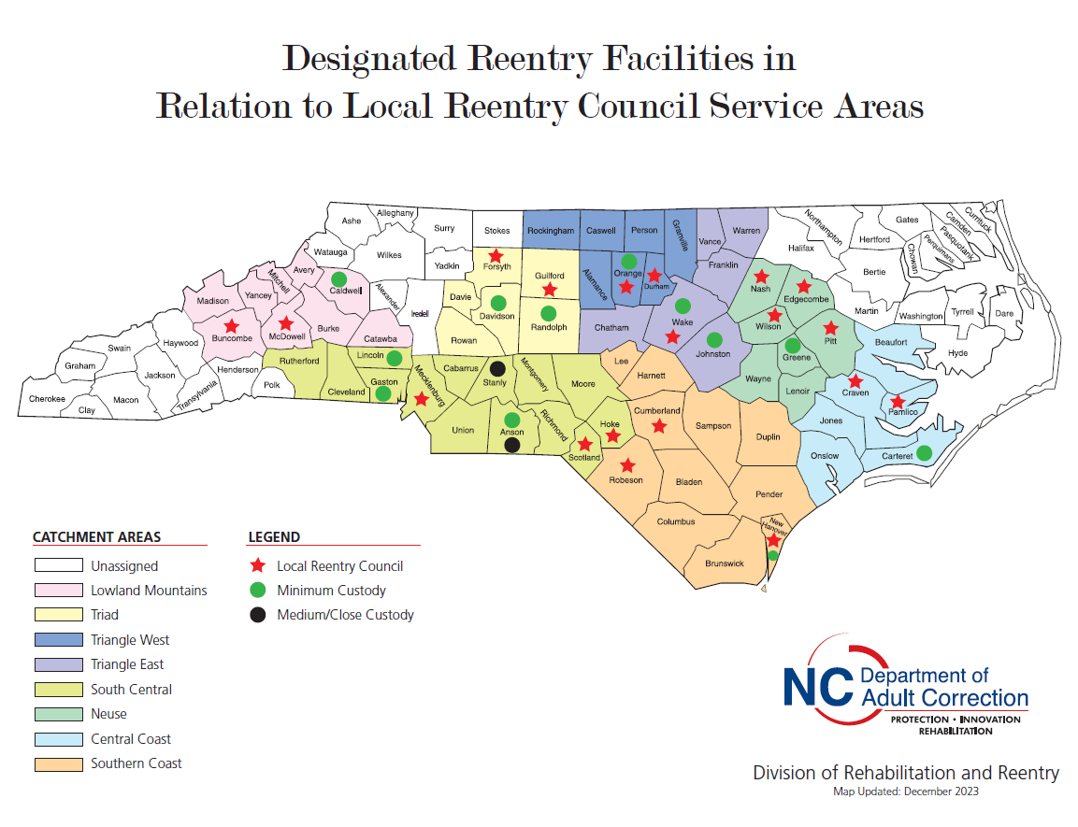
Notes:
Catchment area, Still on boarding Randolph, NEW exceptions will be NCCIW and Greene, still prioritized for those counties but can still have other areas involved.

Slide 54

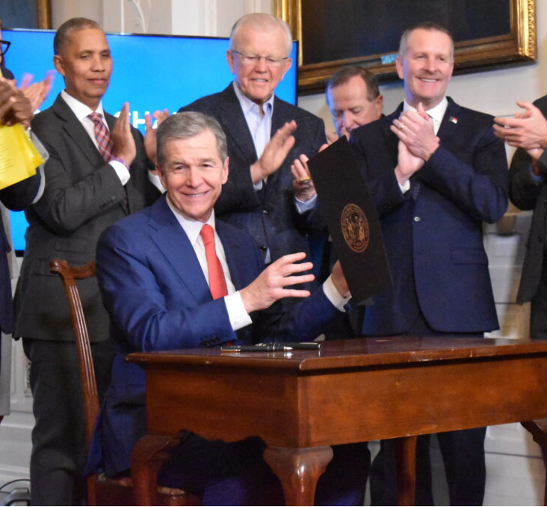
Executive Order 303, titled Establishing a Unified Approach to Improving Education, Rehabilitation, and Reentry Services for Incarcerated and Formerly Incarcerated people in North Carolina was signed by Governor Cooper on January 29, 2024.
The order directs a whole-of-government effort to achieve these goals:
Improve economic mobility of formerly incarcerated people by increasing the number of local reentry councils and providing access to educational, technical training, apprenticeship, work-based learning and employment opportunities pre-and post-release.
Improve mental and physical health by expanding access to behavioral health and substance use disorder services pre-and post-release and ensuring that all eligible incarcerated people obtain Medicaid upon release.
Expand housing opportunities for formerly incarcerated people.
Remove barriers to successful community reintegration, especially for those returning to historically underserved communities.

Slide 55
Questions???
Thank you

Slide 56
Panel: Supportive Services
David Crispell
Brian Scott
Kenneth Robinson
Marcus Reddrick
Kerry Shipman

Slide 57
Wrap up and THANK YOU!
Sally Reeske, Division of Public Health
The meeting recording, agenda and PowerPoint slides will be added to our NC DHHS Overdose/OPDAAC page within 7 days
  https://www.ncdhhs.gov/about/department-initiatives/overdose-epidemic/nc-opioid-and-prescription-drug-abuse-advisory-committee
  Next OPDAAC Meetings:
    June 28, 2024

