Slide 1
Office of Rural Health
NC Department of Health and Human Services
State Designated Rural Health Centers Support - Request for Application Information Session
March 1, 2022
11:30 a.m. – 12:30 p.m.
Notes:
SLIDE PRESENTER- BETH

Slide 2
Welcome
Please keep your lines muted when not speaking
Submit questions in the chat box or use the raise hand feature during designated Q&A section
Use the call-in feature if you have audio difficulties
Presentation session will be recorded
Notes:
SLIDE PRESENTER- BETH

Slide 3
About the Office of Rural Health (ORH)
First state office (1973) in the nation created to focus on the needs of rural and underserved communities​
ORH Mission Statement: The North Carolina Office of Rural Health (ORH) supports equitable access to health in rural and underserved communities.​
To achieve its mission, ORH works collaboratively to provide:​
Funding​
Training​
Technical assistance​
For high quality, innovative, accessible, cost-effective services that support the maintenance and growth of the State’s safety net and rural communities.​
​
State Fiscal Year 2021 Office Facts:​
Administered over 250 contracts ​
Expended $27.5 million from state, federal, and philanthropic sources (not including Community Health Worker contracts)​
Partnered with Division of Public Health to administer $14.9M in contracts to support Community Health Workers​
Returned over 84% of its budget directly to NC communities​
Provided 4,168 technical assistance activities to outside Organizations/Stakeholders. These include 700 Communications disseminated to SafetyNet (Facebook, Constant Contact) and regional conferences.​
While we do not provide direct care, our programs support numerous health care safety net organizations throughout North Carolina.​
Notes:
SLIDE PRESENTER- Allison

Slide 4
Rural Health Centers Program
NC General Assembly
Office of Rural Health
State Designated Rural Health Centers
Primary, Behavioral and Preventative Care
Purpose
The purpose of the state designation is to support health care access in primary care sites that do not fit the CMS RHC or FQHC designation to provide services to low income, uninsured and underserved rural populations.
Notes:
SLIDE PRESENTER – ALLISON

Slide 5
State Designated Rural Health Center (SDRHCs)
ORH definition:
SDRHC is a health care safety net organization that is a 501(c)3 non-profit, community-owned organization with an active board that has as its primary mission to provide primary health care services to those residing in its community.
SDRHCs must be located within communities that are both rural and underserved and must currently be delivering primary health care services in its proposed service area.
Notes:
SLIDE PRESENTER - DOROTHEA
What is a State-Designated Rural Health Center ?
State designation is to support health care access in primary care sites that do not fit the CMS_RHC or FQHC designation. Recognizing the need for access to healthcare as the demographics of NC, as well as access points, change (due to FQHC growth and multi-site practice locations) is necessary in supporting the growth of new access points for health care in rural NC.
NC ORH assists underserved communities and populations with developing innovative strategies for improving access, quality, and cost-effectiveness of health care. Distribution of primary care providers in North Carolina has historically been skewed toward cities and larger towns. Rural residents, who often face transportation issues, find accessing primary care services difficult. Through the establishment of State Designated Rural Health Centers (SDRHC), NC ORH partners with local communities to provide funding to improve ability to serve underserved populations who would otherwise be unable to access needed primary care services due to geographic, economic, or other barriers. Thus, State Designated Rural Health Centers have become an integral part of the health care safety net for North Carolina’s rural and underserved residents.
The purpose of the state designation is to support health care access in primary care sites that do not fit the CMS_RHC or FQHC designation. Recognizing the need for access to healthcare as the demographics of NC, as well as access points, change (due to FQHC growth and multi-site practice locations) is necessary for incubating and supporting the growth of new access points for health care in rural NC.
ORH defines an SDRHC as a health care safety net organization that is a 501(c)3 non-profit, community-owned organization with an active board that has as its primary mission to provide primary health care services to those residing in its community. SDRHCs must be located within communities that are both rural and underserved and must currently be delivering primary health care services or can serve patients within six months in its proposed service area.
The State Designated Rural Health Center Guide is available as a resource for more detailed information about the Office of Rural Health’s work to increase access to quality care in rural and underserved communities. The Guide outlines the process for receiving State Designation as Rural Health Center and the activities the funds support. <Link to guide>

Slide 6
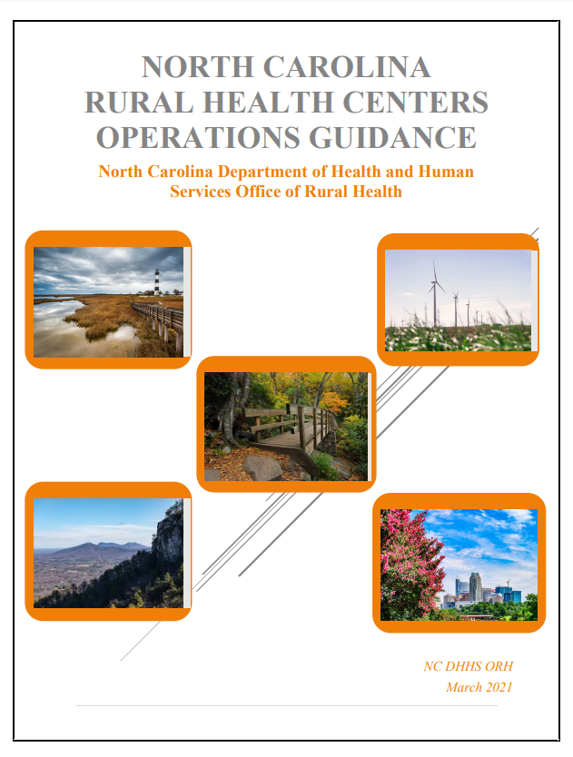
Eligibility
The purpose of the SDRHC program is to increase access to primary care for rural uninsured and underinsured residents. To determine eligibility to become an SDRHC, the applicant organization must first assess if the proposed location can meet important criteria.
The following factors are considered:
Rural determination
Health Professional Shortage Area determination
Availability of primary care services in neighboring communities
County Distress Ranking – Tier 1 or 2
501c3 Organization
Notes:
SLIDE PRESENTER - DOROTHEA
New applicants seeking to become a SDRHC. We require all applicants to review the guidance manual.

Slide 7
Types of Applicants
Continuing Rural Health Centers
New Rural Health Centers
A current State Designated Rural Health Center (SDRHC) that has received funds from the NC ORH and seeks to continue serving its current service area and target population.
An organization that is not currently funded through the NC ORH State Designated Rural Health Center grant and seeks to serve an underserved area and uninsured target population with one or more permanent service delivery site(s).
Notes:
Kim

Slide 8
Types of Funding
Medical Access Plan (MAP)
Funds available for primary health care coverage
Visits are reimbursable at a rate of $100 per encounter based on medically necessary face-to-face encounters
Behavioral Health (BH)
Funds available for behavioral and mental health counseling services
Visits are reimbursable at a rate of $75 per encounter based on face-to-face behavioral health provider encounters
Operating/Infrastructure Funds
Funds available to support access to primary care in the service area.
On-site x-rays
In-house labs
Surgical procedures
Services provided by practice providers
Prophylaxis
Telemedicine visits
Eligible providers:
LCSWs
Advanced Practice RNs
Psychologists
Psychiatrists
Create systems and processes that promote sustainability of the organization
Supplement the primary care services provided through MAP and/or BH
Support innovative strategies
Notes:
Kim
A. Advanced Medical Home- National Committee for Quality Assurance (NCQA) Patient Centered Medical Home (PCMH).
An outside subject matter expert to assist with PCMH/AMH recognition or
Costs associated with educating site personnel with becoming a PCMH Certified Content Expert and/or Advanced Medical Home.
B. Supports the creation and implementation of sustainable technological infrastructure that enhances access to health care and improves quality.
Technological infrastructure (hardware, software, telehealth applications etc.)
Administrative and clinical innovations that sustain primary medical care delivery models through the adoption of Electronic Health Records (EHR) technology and using the North Carolina HealthConnex.
Methods for expanding the ability to collect, exchange, store, and disseminate health information. Example: Patient Portal
C. Supports rural health center’s activities that increase and/or improve efficiencies, effectiveness, transformation, sustainability, quality, or access to care.
Provides rural health centers with funding to hire or retain professional services including but not limited: legal aid, actuarial services, and other professional services deemed prudent and necessary for business operations. Grantees must use the practice assessment/workplans completed to inform request for funds in this category.
D. Funding to support Innovative Strategies including but not limited to:
Healthy Opportunities Screening
Telehealth (including Telepsychiatry), Community Paramedicine, Integrated Care, etc.
Opioid Disorder Treatment
Incorporating Community Health Workers into the care setting
Innovative collaboration with Community-Based Organizations to support Healthy Opportunities
Staffing and contract services
The use of NC HealthConnex

Slide 9
Applicant Requirements
Applicant awardees will be awarded for 1-year period and must participate in a site visit or desk review within 1 to 3 months of the awarded start date.
All Applicants are required to sign an attestation statement.
Applicants are required to provide the following supporting documentation:
Three (3) letters of support from community partners or stakeholders (encouraged to link to one or more proposed activities)
Submit Copy of Bylaws or documentation of 501c3 status
Submit a weblink to the most recent county or regional community health needs assessment (CHNA)
Provide Organizational Chart and description of Quality Improvement Team
Completed Project Narrative
Complete Budget Template and Narrative
Acknowledge and sign the attestation agreement.
Notes:
Kim
Requirement listings for applicants. All supporting documentations are required to be attached.

Slide 10
Applicant Requirements cont'd
All Applicants are required to sign an Attestation Statement
What is the purpose of an Attestation Statement?
The Attestation Statement provides transparency of expectations for both the State Designated Rural Health Center and for the Office of Rural Health.
What is covered in the Attestation Statement?
Program Expectations – Scope of Work
Specific Expectations to the MAP & BH Programs
Meeting Requirements
Documentation & Reporting Requirements
Complete annual practice assessment, action plan and identify mutually agreed upon activities for execution with the NC AHEC Practice Support Coach.
Attestation Statement Link
Notes:
Dorothea
Requirement listings for applicants. All supporting documentations are required to be attached.

Slide 11
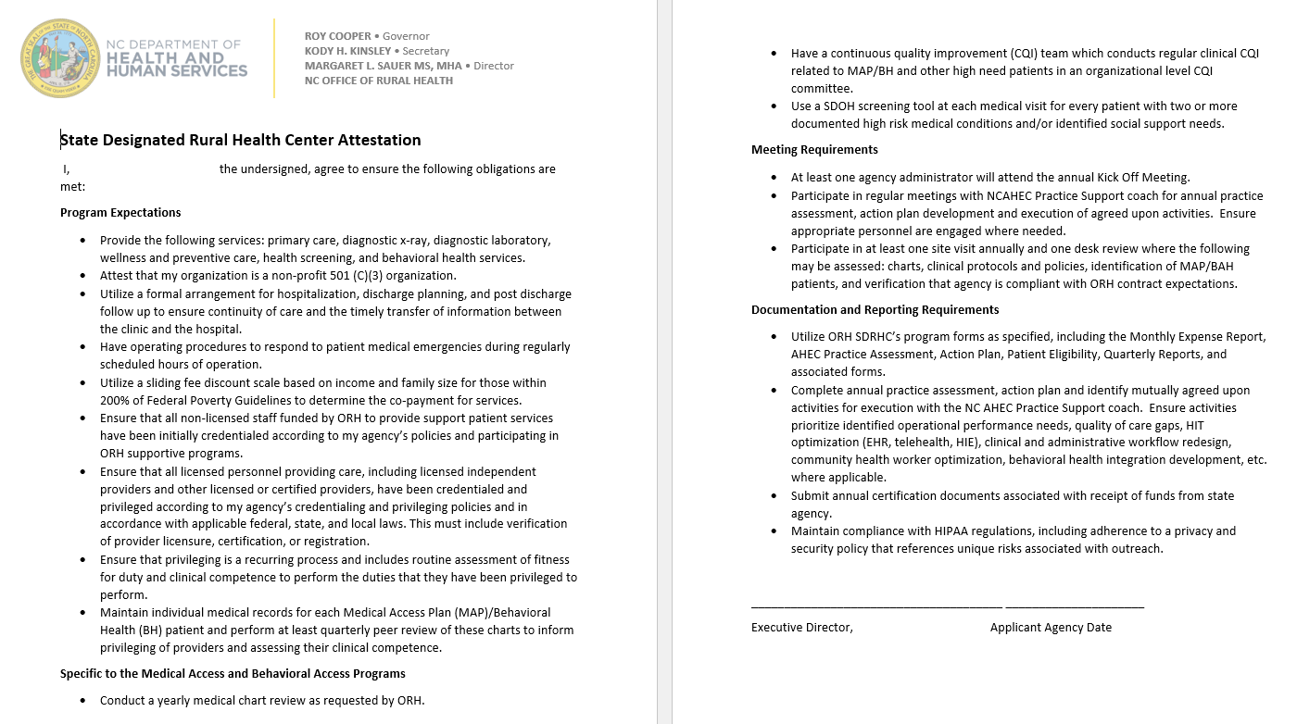
Applicant Requirements cont'd
Notes:
Dorothea
Requirement listings for applicants. If funded, the agency is responsible for and ensuring compliance of program expectations.
As a recipient of Medicaid and Medicare funding, provider offices must abide by certain criteria, some of which are also expected of SDRHC grantees. As a program within the Office of Rural Health, grantees must also abide by associated state requirements and expectations including connection to NC HealthConnex. All applicants must abide by the Grant Assurances included with the funding application.

Slide 12
Applicant Requirements cont'd.
Your application must document an understanding of the need for primary health care services in the service area and propose a comprehensive plan that demonstrates alignment to the NC ORH mission and vision.
The plan within the application must ensure the availability and accessibility of primary health care services to all individuals in the service area and target population with collaborative and coordinated delivery systems for the provision of health care to the underserved.
Provide baseline and target metrics for clinical performance measures.
Applicants are required to attach an attestation sheet along with their application indicating that their site is currently offering primary care services, has an established board of directors, is actively using an identified EHR system, and follows the State of North Carolina requirements.
Notes:
Kim
Requirements: As a condition of receiving state funds.

Slide 13
One grant application per organization will be reviewed. Under session law, grantees must provide direct primary and preventive care and serve as a medical home.
Application Deadline
March 21, 2022
Anticipated Notice of Awards
April 15, 2022
Maximum Award
Dependent on availability of funds and number of applications
Instructions and Budget Template
Request Unique Application Link
Contract Period
July 1, 2022 -
June 30, 2023
Application Link
Instructions & Required Documents
Primary care is defined as that care provided by physicians specifically trained for and skilled in comprehensive first contact and continuing care for persons with any undiagnosed sign, symptom, or health concern. There are providers of health care other than physicians who render some primary care services. Such providers may include nurse practitioners, physician assistants and some other health care providers. Medical home is a team-based health care delivery model led by a health care provider to provide comprehensive and continuous medical care to patients with a goal to obtain maximal health outcomes. *American Association of Family Practice: http:www.aafp.org.
Notes:
Kim

Slide 14
Two-Step Application Process
Request Unique Application Link
Submit your organization name and contact information
Application Deadline
Submit application electronically using the link unique to your email address and organization by close of business March 21, 2022
https://ncruralhealth.az1.qualtrics.com/jfe/form/SV_9oFvgxFYmSRdI7s
Notes:
Kim

Slide 15
Scoring Criteria
Grant awards will be based on the below criteria. Failure to fully complete all sections will impact the funding amount, up to disqualification. Applications will be reviewed and scored according to all the criteria regardless of the funding categories requested.
Overview of the Organization | 5 Points
Community Need | 20 Points
Improved Access to Care | 20 Points
Community Collaboration (e.g., health departments, departments of social services, housing authority, etc.) | 15 Points
Performance Measures | 15 Points
Sustainability Model | 10 Points
Budget | 15 Points
Total Points Awarded | 100 Points
Notes:
SLIDE PRESENTER - DOROTHEA
Overview of the organization: Includes location and where the grant will be utilized; organization history, and description of your organization’s primary care services or experience in primary care; patient insurance status in your organization.
Community need: provide a description of the proposed service area, reference your county/regional community health needs assessment
Improved access to care: how will your organization educate the target population; will provide or support the continuity of care with community partners; if applicable telehealth/telemedicine plans or current services in use.
Community collaboration:
Workplan
Performance
Sustainability Model
Budget

Slide 16
Overview of Organization 5 Points Tell us about your organization!
Include the following:
Location and where the grant will be utilized
Organization history and mission
Description of your organization’s primary care services or experience in primary care including hours of operation
Unique services provided
Data collection of social risk factors or SDOH
On the excel attachment, include the following:
Patient insurance status
Patients by race and ethnicity
Notes:
Dorothea

Slide 17
Community Need 20 points Why are grants funds needed?
Provide a description of the proposed service area, including the following:
Population demographics
Other safety net services in the area
Challenges
Poverty levels
Percent uninsured
Reference your county/region community health needs assessment to provide information in this section.
Will this grant align with the CHNA? Provide citations/reference sources for all community demographics and health-status data.
Provide a description of how the services will be communicated in the community and to stakeholders.
Notes:
Dorothea

Slide 18
Improved Access to Care 20 Points Will your organization make a difference in the community?
Describe how your organization is positioned to effectively use the requested funds to increase access to care for underserved residents
Indicate MAP and BH funding request
Describe plan to reach 100% expenditure of requested funds
How will your organization educate the target population?
Describe your approach to building racial equity and inclusion
Describe how you use or plan to use telehealth to reduce barriers to care
Notes:
Dorothea

Slide 19
Community Collaboration 15 Points Is your organization partnering with others in the community?
Describe how your organization has built partnerships or anticipates collaborative partnerships with community organizations that serve under- and uninsured individuals.
Include traditional and non-traditional examples
Include partnerships directly related to your funding requests
Provide at least 3 examples
Describe how your organization will provide/support continuity of care with community providers.
List agencies who refer to you
List agencies to whom you refer when unable to provide services ​
Notes:
Dorothea

Slide 20
Performance Measures 15 Points Medical Access Plan Targets and Performance Measure Narrative
Describe how many MAP patients and total patients your organization seek to serve.
Use the county or regional community health needs assessment data for the uninsured/underinsured population identified for your area.
Applicants should include how you plan to collect quarterly survey data and make improvements over time.
Notes:
David
Performance Measures Narrative: Describe how and what your organization will identify as appropriate benchmarks or use for tracking your workplan goals and reporting data on examples such as practices’ clinical processes, outcomes, patient satisfaction, cost saving, and quality improvement. Examples: Healthy North Carolina 2030; U.S Department of Health and Human Services Healthy People 2030 ​
Quarterly reporting on clinical performance measures are completed. It would be helpful to include in your workplan how you plan to move the needle on one or more of the clinical measures. Remember your AHEC and ORH partners are here to assist you.

Slide 21
Performance Measures Cont'd Our performance measures are based off the measures in the Uniform Data System, a standardized reporting system that federally qualified health centers use to submit data. - BMI - High Blood Pressure - Diabetes – HbA1c - Tobacco Use “If I don't have faith that the data obtained is meaningful and accurate, it doesn’t make me want to put time into it.” – Clinic Manager
Notes:
David

Slide 22
Performance Measures Cont'd For each measure, you will need to include the following information: Data Source: where will you obtain the information you report for your performance measures? Collection Process and Calculation: what method will you use to collect the information? Data Limitations: what may prevent you from obtaining data for your performance measures?
Notes:
David

Slide 23
Measure Description | Hemoglobin A1c Poor Control Percentage of patients 18-75 years of age with diabetes who had hemoglobin HbA1c > 9.0% during the reporting period
Guidance | Note that this is a “negative” measure. For this measure, the lower the number of adult diabetics with poorly controlled diabetes, the better the performance on the measure. Also note that unlike the Hypertension measure, this measure calls for reporting on patients with diabetes regardless of when they were first diagnosed. Only include patients with an active diagnosis of Type 1 or Type 2 diabetes Include patients in the numerator whose most recent HbA1c level is greater than 9 percent, the most recent HbA1c result is missing, or when no HbA1c tests were performed or documented during the reporting period. This measure is calculated using the numerator and denominator defined below. This service cannot be conducted via telehealth.
Notes:
David

Slide 24
Measure Description | Controlling High Blood Pressure Percentage of patients 18-85 years old who had a diagnosis of hypertension (HTN) overlapping the reporting period and whose most recent Blood Pressure (BP) was adequately controlled (less than 140/90 mm Hg) during the reporting period.
Guidance | Note that this is a “positive” measure. For this measure, the higher the number of patients with controlled hypertension the better the performance on the measure. Adequate control is defined as systolic Blood Pressure lower than 140 mm Hg AND diastolic blood pressure lower than 90 mm Hg. Include patients who have an active diagnosis of hypertension even if their medical visits during the year were unrelated to the diagnosis. Include blood pressure readings taken at any visit type at the health center as long as the result is from the most recent visit. Only blood pressure readings performed by a clinician in the provider office are acceptable for numerator compliance with this measure. Blood pressure readings from the patient's home (including readings directly from monitoring devices) are not acceptable. Patients self-reporting their blood pressure is not acceptable. The provider must be able to visually see the results on the patient's device or the Provider must use a remote monitoring device. If no blood pressure is recorded during the reporting period, the patient's blood pressure is assumed "not controlled” and isn’t counted in the numerator If there are multiple blood pressure readings on the same day, use the lowest systolic and the lowest diastolic reading as the most recent blood pressure reading.
Notes:
David

Slide 25
Measure Description | Body Mass Index (BMI) Screening and Follow-Up Plan Percentage of patients aged 18 years and older with a visit during the reporting period with a BMI documented during the most recent visit or within the previous 12 months to that visit AND, when the BMI is outside normal parameters, a follow-up plan is documented during the visit or during the previous 12 months of that visit.
Guidance | This performance measure, as a whole, cannot be completed in a telehealth visit. The only aspect that is allowable as a telehealth visit is the documented follow-up plan with the patient. Patient's self-reporting their height and weight is not acceptable. Report this measure for all patients seen during the reporting period. An eligible professional or their staff is required to measure both height and weight. Both height and weight must be measured within 12 months of the current encounter and may be obtained from separate visits. Do not use self-reported values. BMI may be documented in the medical record at the health center or in outside medical records obtained by the health center. If more than one BMI is reported during the measurement period, use the most recent BMI to determine if the performance has been met. Document the follow-up plan based on the most recent documented BMI outside of normal parameters. Documentation in the medical record must show the actual BMI or the template normally viewed by a clinician must display BMI. Do not count as meeting the measurement standard charts or templates that display only height and weight. The fact that a HIT/EHR can calculate BMI does not replace the presence of the BMI itself.
Notes:
David

Slide 26
Measure Description | Tobacco Screening and Cessation Intervention Percentage of patients aged 18 years and older who were screened for tobacco use one or more times within 24 months and received tobacco cessation intervention if identified as a tobacco user This measure is calculated using the numerator and denominator defined below.
Guidance | Include in the numerator patients with a negative screening and those with a positive screening who had cessation intervention if a tobacco user. If patients use any type of tobacco (i.e., smokes or uses smokeless tobacco), the expectation is that they should receive tobacco cessation intervention (counseling and/or pharmacotherapy). If a patient has multiple tobacco use screenings during the 24-month period, use the most recent screening which has a documented status of tobacco user or non-user. If tobacco use status of a patient is unknown, the patient does not meet the screening component required to be counted in the numerator and has not met the measurement standard. "Unknown" includes patients who were not screened or patients with indefinite answers. The medical reason exception applies to the screening data element of the measure or to any of the tobacco cessation intervention data elements. If a patient has a diagnosis of limited life expectancy, that patient has a valid denominator exception for not being screened for tobacco use or for not receiving tobacco use cessation intervention (counseling and/or pharmacotherapy) if identified as a tobacco user. Electronic nicotine delivery systems (ENDS), including electronic cigarettes for tobacco cessation, are not currently classified as tobacco. They are not to be evaluated for this measure. Include in the numerator records that demonstrate that the patient had been asked about their use of all forms of tobacco within 24 months before the end of the measurement period. Include patients who receive tobacco cessation intervention, including: Received tobacco use cessation counseling services, or Received an order for (a prescription or a recommendation to purchase an over-the-counter [OTC] product) a tobacco use cessation medication or Are on (using) a tobacco use cessation agent.
Notes:
David

Slide 27
Sustainability Model 10 Points What is your organization's long-term plan?
Describe how your organization is planning for sustainability should funds not be available? Please include financial, programmatic, and leadership aspects that provide a specific blueprint for raising the money to continue operating your programs, serving your patients and community beyond the current funding.
Describe the ways your organization plans to use these funds to expand capacity with an accountable care organization or a clinically integrated network (CIN), or any other integrated care models/solutions.
Provide operating budget
Include percentage of SDRHC funds that comprise your overall operating budget
New applicants may provide this based on the proposed funding request
Notes:
Caroline

Slide 28
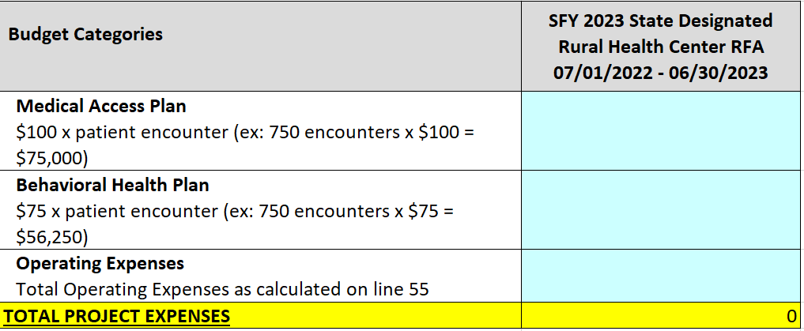
Budget & Budget Narrative 15 Points
Separate Excel attachment
Three tabs to complete:
SDRHC Budget
Budget Narrative
Personnel (only required for applicants requesting funds to cover salaries)
Note: Do not add line items to the budget spreadsheet. All budget expenses must fit into one of the existing line items.
Notes:
Caroline
Section 1
Section 2
Section 3
Section 4

Slide 29
Budget & Budget Narrative cont.
Budget narrative must show the calculations for all budget line items and must clearly justify/explain the need for these items. Please ensure all line items from the budget tab are included in the budget narrative. Calculations should be easy to follow/recreate, and justifications should be specific. Each budgeted line item should explain:
What is it?
How many?
How much?
For what purpose?
REMINDER - Per the Free Clinics Federal Tort Claims Act (FTCA) Program Policy Guide, grant funding that applies to reimbursement, payment, or compensation for the delivery of health services to patients falls within the statutory prohibition, while grant funding that is not intended for or applied to this purpose does not. Free clinics who are FTCA recipients that choose a “per encounter’ reimbursement methodology may void their FTCA liability protection.
Notes:
Caroline
Section 1
Section 2
Section 3
Section 4

Slide 30
Questions?
This Photo by Unknown Author is licensed under CC BY-SA
Notes:
SLIDE PRESENTER - BETH

Slide 31
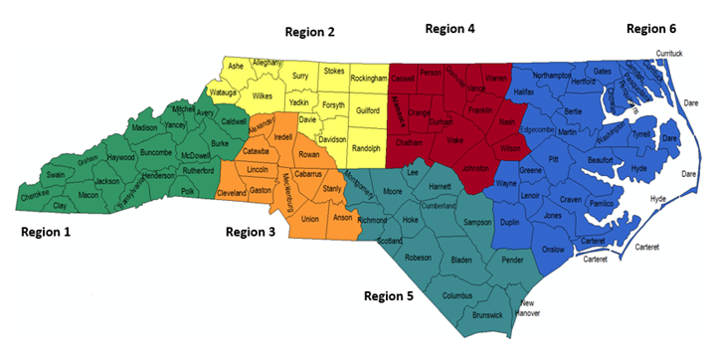
Operations Team Information
Dorothea Brock, MPH
Program Manager
dorothea.brock@dhhs.nc.gov
Kimberly McNeil, MIS
Rural Health Operations Specialist - Regions 4 & 6
kimberly.r.mcneil@dhhs.nc.gov
Beth Blaise, MPA
Rural Health Operations Specialist - Regions 3 & 5
beth.blaise@dhhs.nc.gov
Caroline Collier, MPH
Rural Health Operations Specialist - Regions 1 & 2
caroline.collier@dhhs.nc.gov
https://www.ncdhhs.gov/divisions/orh
Notes:
SLIDE PRESENTER - BETH

