Slide 1
NC Department of Health and Human Services
Refugee Information System Provider Entry Training
Kimberly Saunders
Refugee Program Consultant
Fall, 2021

Slide 2
RIS Provider Training
This Training will explore how to:
Create New Provider Entries
Enter Assistance Services
RCA, RMA, MG, etc.
Enter Employment Services
Enter Support Services (for all funding sources)

Slide 3
Locate Refugee Information Screen
Main Menu
File
Reports
Utilities
Admin
Help

Slide 4
File Drop Down Menu
Refugee Information
Provider List
Exit System

Slide 5
RIS: Refugee Information
Refugee Search Screen

Slide 6
RIS: Client Search Results
Important Buttons on Refugee Search Screen
Edit: To add yourself as a provider
Add New Refugee Button

Slide 7
Refugee Detail Screen: Providers
Providers:
List of all agencies serving the client
“New Provider” button allows agencies to enter themselves as a new provider
“Edit” button modifies information within the provider
“View” button shows all providers and services received
“Delete” button removes an agency from list

Slide 8
Provider Reference Detail Screen

Slide 9
Provider Reference Detail Screen
Client Information
Provider
Initial Services
Initial Employment Services
RCA/RMA Case Numbers
DSS 5022 Information
Case Manager Contacts

Slide 10
Provider Reference: Client Information
Client Information
Case ID (to enter), Alien #, Client Name
Provider
Name, Contract Code (to enter), County (to enter)

Slide 11
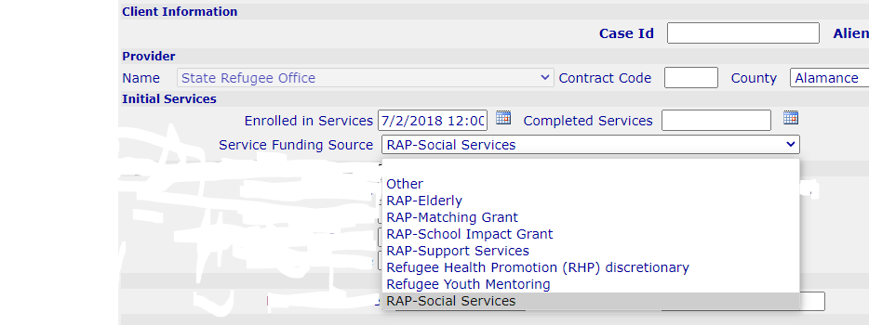
Provider Reference: Initial Employment

Slide 12
Provider Reference: Initial Services
Enrolled in Service: Date Enrolled in NC RAP Services
Completed Service: Date Completed NC RAP Services
Reasons for completion could be:
One year of inactivity
Five years from the arrival date
Client moved out of state
Service Funding Source
Funding source supporting the client
*If a client moves out of state & returns within 5 yrs. the completed services date must be removed. If it is not done, the client will not appear in provider reports.

Slide 13
Provider Reference: Initial Employment

Slide 14
Provider Reference: Initial Employment
Enrolled in Service: Date Enrolled in Employment Services
Completed Service: Date Completed Employment Services
Services Completed: Reason service ended
Service Funding Source
Funding source supporting the client
Type of Assistance
Which cash benefit the client receives
RCA/RMA Case Numbers

Slide 15
Initial Employment/Initial Services
Scenario 1:
A Youth Mentoring (YM) client under 18 is enrolled. This enrollment date would go under initial services and funding source would be YM.
At 18 years of age, they want employment help and to enroll in RSS. Initial Employment Services would then have that enrollment date entered, along with RSS funding source. So, the client would show two different dates and funding sources on this page, one for initial services and one for employment services.

Slide 16
Initial Employment/Initial Services
Scenario 2:
A mom upon arrival enrolls just in RSS services (does not/cannot work).
Later, her youngest child starts school, and mom wants to work.
The Initial Service date would be first enrollment under RSS, and then later you would add Employment Service Enrollment date using RSS Funding source.

Slide 17
Provider Reference: DSS Information
DSS 5022 Part B
Certification Completed (Y/N)
If yes, Enter the Signed Date
To: County Name
Upload DSS 5022 Part B-Certification
Case Manager
Name of agency employee working on the case
Agency
Contact Information for Specific County Workers

Slide 18
RIS: Uploading 5022 Forms
How to Upload:
1. Click Choose File to select document to upload
2. Click Upload Icon
3. Once uploaded a pop-up box will appear
4. Then you will see the document icon under this section

Slide 19
RIS: Uploading 5022 Forms
Uploading Tips
If the wrong document is uploaded, you can upload another document to replace (override) it
If you have a newer version of a document, you can override what is currently there with the new version.

Slide 20
Provider Reference: Assistance
Assistance Button
Assistance List
Click “Assistance” to view/add assistance
In Assistance List you can view current/prior assistance as well as add “New” assistance
*See RIS manual for more detailed instructions on this process.

Slide 21
Provider Reference: Assistance

Slide 22
Provider Reference Detail: Employment
Employment Button
Employment List
Click “Employment” to view/add employment information
In Employment List you can view current/prior employment as well as add “New” employment information

Slide 23
Provider Reference Detail: Employment

Slide 24
Employment Detail Screen
Complete ALL fields on Employment Screen.
2. End Date should only be entered if a job has been terminated
3. Never delete a Job Placement unless wrong information has been entered
4. Employment information is CRITICAL to calculate Retention Rate employed 90 days later

Slide 25
Employment Detail Screen
Federal Assistance Type is Required
Status of Cash Benefits is Affected by Employment
If a client receiving RCA, works part-time, enter an RCA reduction
If a client gets a FT job, enter RCA termination
If an initial job is PT and a second job is FT, choose RCA reduction for the initial job and RCA termination for the second job

Slide 26
Employment Detail: 5022 Form
DSS 5022 Part C Upload
Employment/Refusal Note Completed? Y/N
If yes, Upload the 5022 Document
Select the Signed Date
Select the appropriate County
Uploading this form is required if;
It is a client's initial job
Employment (even subsequent positions) occurs within the first 8 months of arrival

Slide 27
Provider Reference Detail: Services

Slide 28
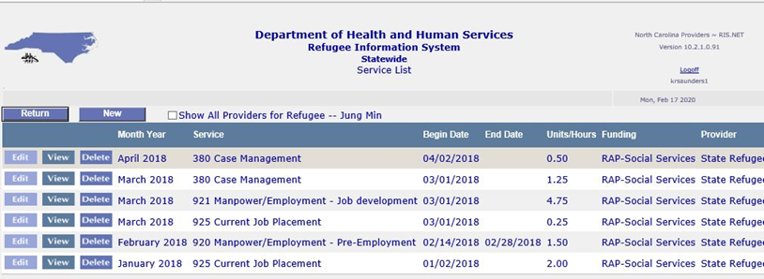
Service List Screen
In the Service List Screen, you can:
Edit, View or Delete Current Service Records
Add New Service Record

Slide 29
Service Detail: New Service
Select Service being provided
Select Funding Source
Add Comments
Service Begin & End Dates

Slide 30
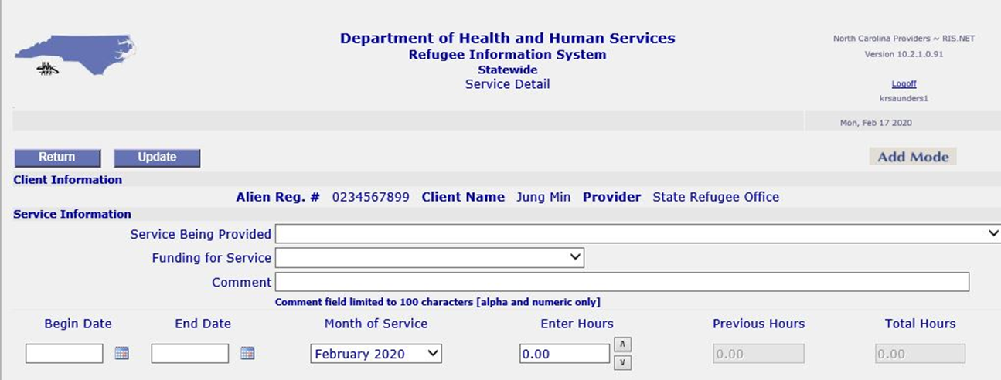
Service Detail: New Service
Month of Service: Month & Year Service was completed
This month should be the same as month in the Begin and End date
Enter Hours: Number of hours/units of service provided
Update

Slide 31
RIS Next Steps
Additional Trainings are Available
RIS Overview Training
RIS New Client Entry Training
RIS Provider Entry Training
RIS Reports Training

