Slide 1
NC Department of Health and Human Services
RIS Reports Training
Kimberly Saunders
Refugee Program Consultant
Fall, 2021
Notes:
Hello and welcome to the North Carolina Department of Health and Human Services Refugee Information System Reports Training. My name is Kimberly Saunders, and I am a Refugee Program Consultant with the North Carolina State Refugee Office and I will be conducting this training today.

Slide 2
RIS Reports Training
Refugee State-Of-Origin Report
Monthly Service Delivery Reports
Performance Report
Annual Service Plan
Refugee List
DOA Tracking
Missing Health Screening
Employment Report
New Arrivals Reports
Name & Addresses by County/City
Annual Performance Goals and Actuals
Bullet 3
SOURCE:
Notes:
In this RIS Reports training we will review all of the reports listed on this slide.

Slide 3
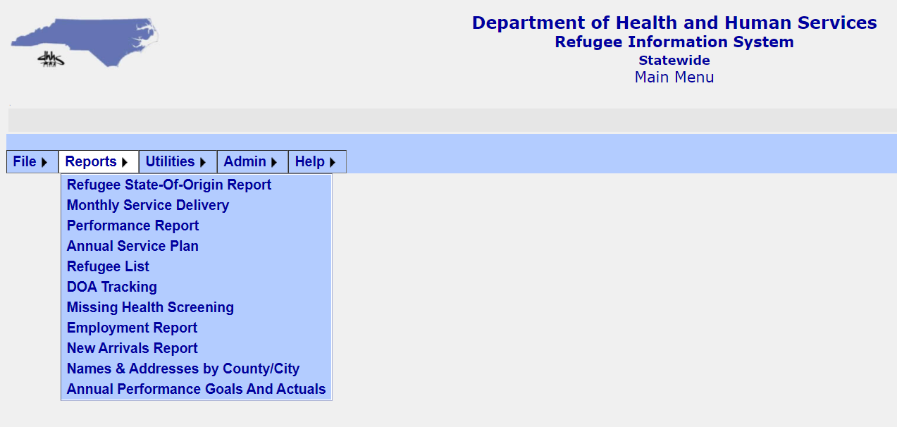
RIS Reports
Where to find Reports in RIS:
Notes:
Let’s begin with where to find reports in RIS. Once you log-in, you will go to the Main Menu and hover over the Reports button to see the complete list of reports. If you hover over a report name, further report dropdowns will appear. You will see more details on this in slides going forward.

Slide 4
RIS Report: Refugee State of Origin
View Detail Report
New arrivals by date & sorted by State of Origin
View Detail Report (No State)
New arrivals with No State-of-Origin & No Local Affiliate
View Summary Report
New Arrivals count per State-of-Origin
Notes:
The first report we will look at is the Refugee State of Origin Report. Within this report there are three options; Detail Report: Lists new arrivals by date and is sorted by State of Origin. Detail Report (No State); New Arrivals with No state-of-origin and no local affiliate and finally; a Summary Report. This provides a New Arrivals count per state-of-origin.

Slide 5
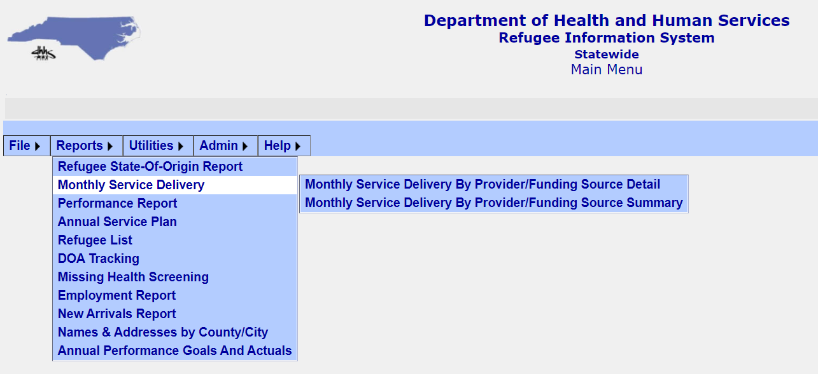
RIS Report: Monthly Service Delivery
This report contains two options
Detail
Summary
Notes:
The next report is the Monthly Service Delivery Report. This report contains two options when you hover over it. The two options are the Detail Report and the Summary Report.

Slide 6
RIS Report: Monthly Service Delivery
Detail Report
Search Services by date, provider and funding source
Notes:
The detail report requires providers to search by service dates, provider, and funding sources. Once criteria is entered, click View Report.

Slide 7
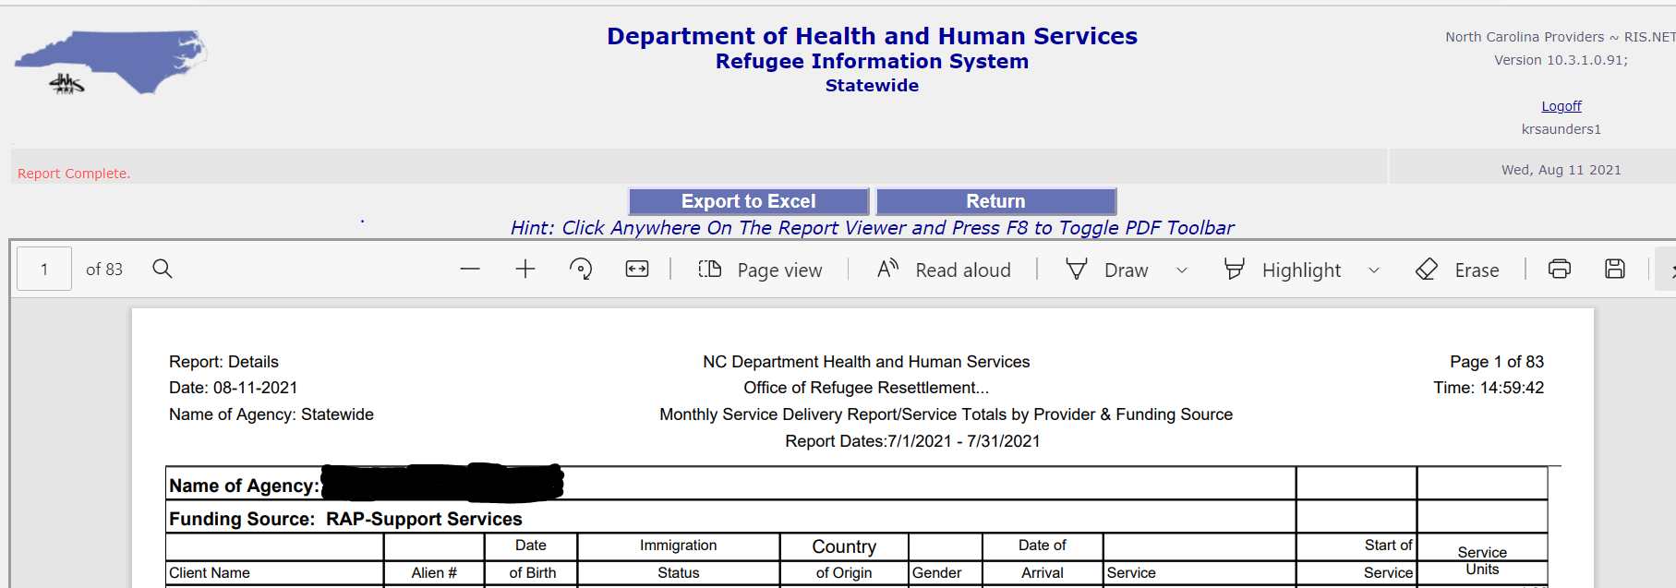
RIS Report: Monthly Service Delivery Detail
Can be exported to Microsoft Excel or saved as PDF
Displays client information and the service provided
Notes:
The report can be exported to Excel or pdf. The report will display client information and the services provided during the time period selected.

Slide 8
RIS Report: Monthly Service Delivery
Summary Report
Search Services by date, provider and funding source
Notes:
The summary report requires providers to search by service dates, provider, and funding sources. Once criteria is entered, click View Report.

Slide 9
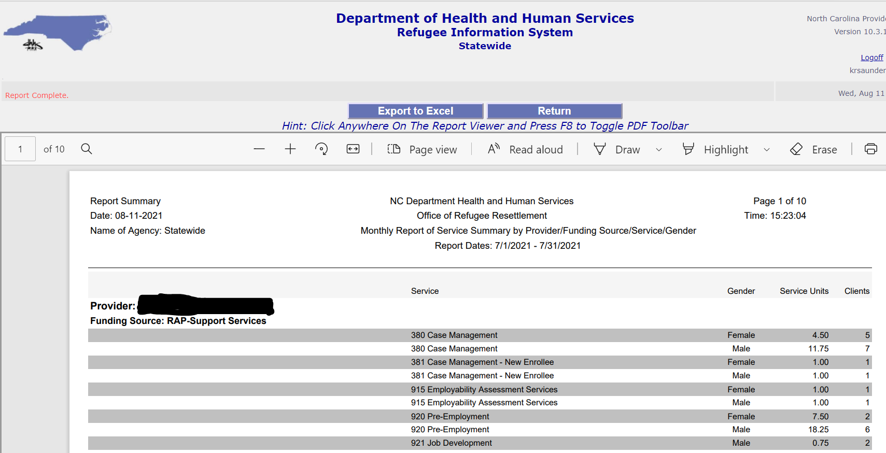
RIS Report: Monthly Service Delivery Summary
Can be exported to Microsoft Excel or saved as PDF
Displays service units per service code by gender
Notes:
The monthly service delivery summary report can also be exported to excel and pdf. This report will be a summary of service units provided per service code. As you can see it is broken down by gender.

Slide 10
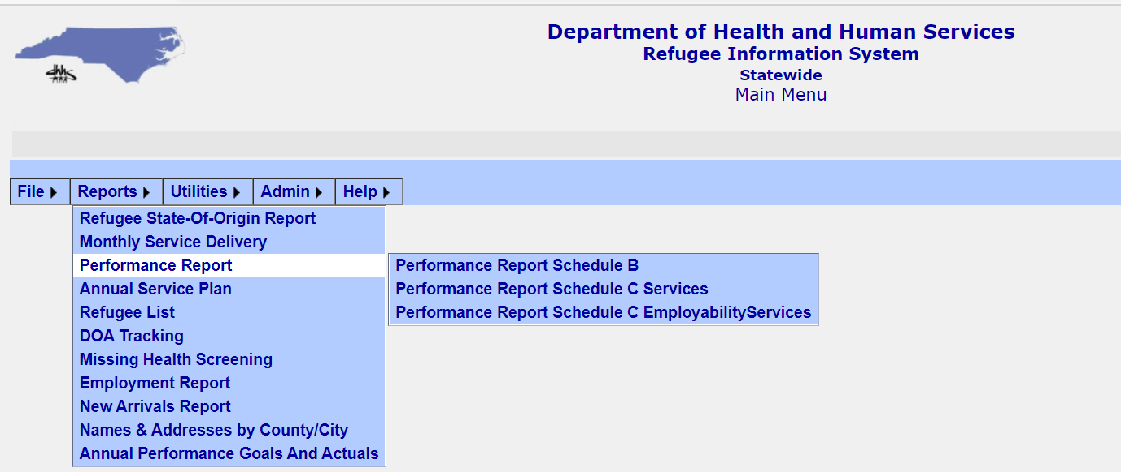
RIS Report: Performance Report
Schedule B
Schedule C Services
Schedule C Employability Services
Notes:
When hovering over Performance Report you will see a list of three reports. Performance Report Schedule B, Performance Report Schedule C Services, Performance Report Schedule C Employability Services.

Slide 11
RIS Report: Performance Schedule B
Schedule B
Search by date and provider name
Notes:
This report requires you to search by date range and provider name.

Slide 12
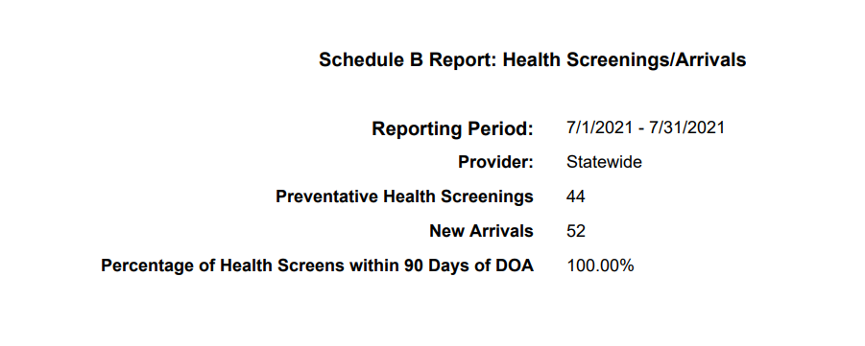
RIS Report: Performance Schedule B
Health Screenings/Arrivals
The number of preventative health screenings done and new arrivals by provider
Notes:
The Performance Report Schedule B displays the number of health screenings done and the percentage that were done within 90 days of DOA. It also displays the number of new arrivals. It only exports to pdf.

Slide 13
RIS Report: Schedule C Services
Schedule C Services Report
Search by date range, provider, and funding source
Notes:
This report allows you to search within a date range by provider and funding source. It will show you completed services for the time frame you choose.

Slide 14
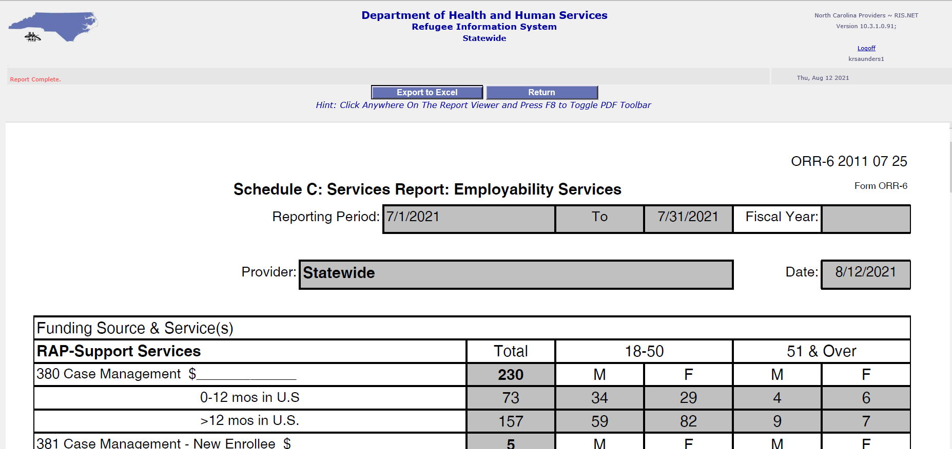
RIS Report: Schedule C Services
Displays services by provider & funding source for any date range
Breaks down service codes by age and gender
Notes:
Report can be exported to Microsoft Excel or saved as a pdf. This report is required to accompany some reporting you will submit to the State Refugee Office. It is a great tool to keep up with how many clients you have served thus far in the contract year.

Slide 15
RIS Report: Schedule C Employability
Schedule C Employability Report
Search by date range, provider, and funding source
Notes:
This report allows you to search within a date range by provider and funding source. It will show you completed Employability related services for the time frame you choose.

Slide 16
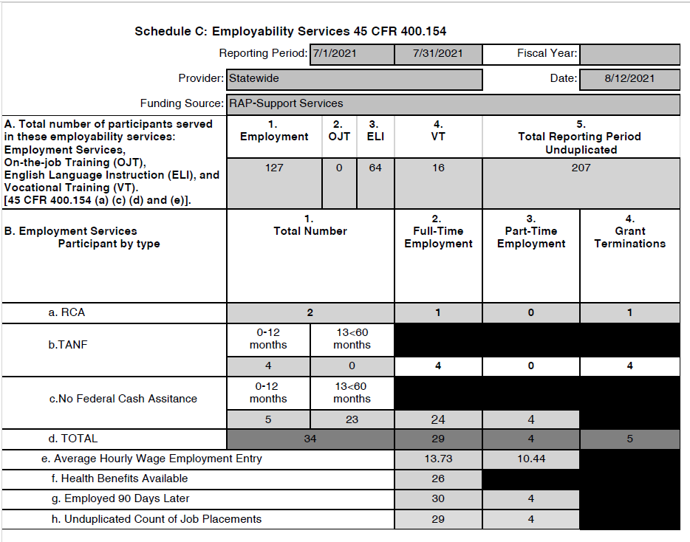
RIS Report: Schedule C Employability
Notes:
This Report will show those clients who are receiving employability services that have been entered into Client Services portion of RIS for the time period selected. These services include Employment, On the Job Training, English Language Services, and Vocational Training Services.
Any actual Employment Information entered in RIS like health benefits information, wages and full time and part time employments placed during the selected time period along with any cash assistance information entered in RIS.

Slide 17
RIS Report: Annual Service Plan
Annual Service Plan Report
Search by date range, and provider
Notes:
This report does not export to Microsoft Excel only to PDF

Slide 18
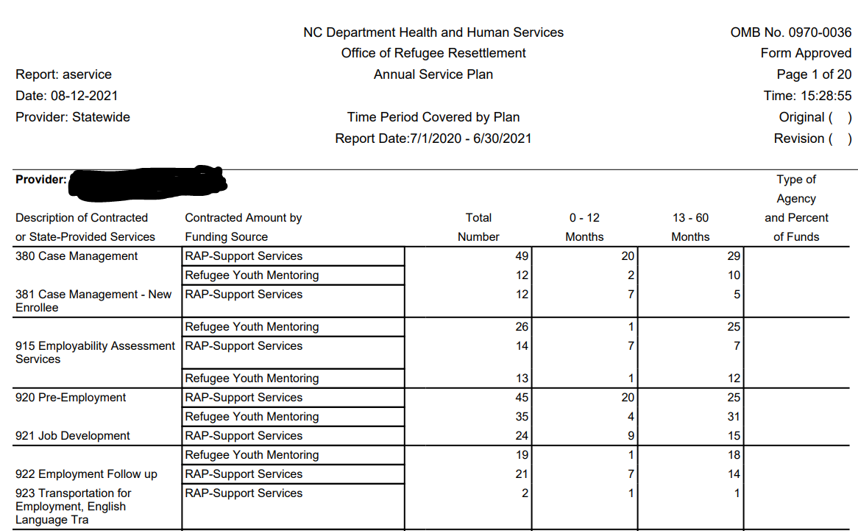
RIS Report: Annual Service Plan
Notes:
This report will show what services your agency has provided year to date. They are broken down by Service type, funding source and when the service was provided within the scope of five years.

Slide 19
RIS Report: Refugee List
Refugee List Report
Search by one or more of the fields below
Notes:
Remember, as when searching for a refugee, the more criteria you enter, the smaller your results pool will be. This report can be exported to Excel.

Slide 20
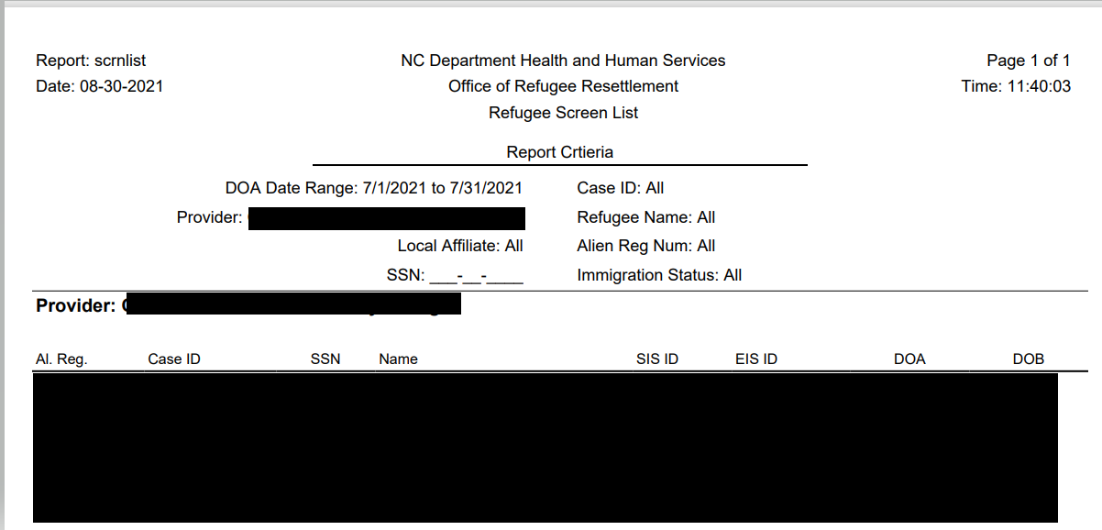
RIS Report: Refugee List
Notes:
This report shows new arrivals your agency has entered for a specific time period.
You will see results displayed for the time period you selected and details such as A#, Case ID, SSN, Name, SIS ID, EIS ID, DOA and DOB.

Slide 21
RIS Report: DOA Tracking
DOA Tracking Report
Search by date range, and provider
Notes:
This report provides data on those entering Employment and those with Health Screening Data entered in RIS. Currently the buttons Export Entering Employment data to excel and Export health screening data to excel are not working. You can only view this report in a pdf form.

Slide 22
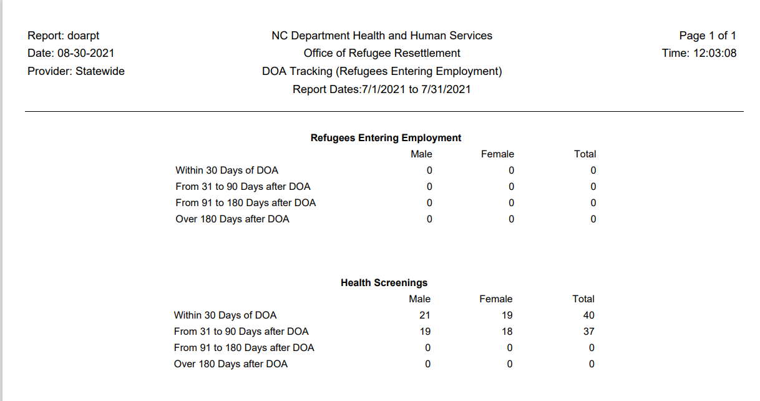
RIS Report: DOA Tracking
Notes:
As you can see this report breaks down the information in several ways. Remember that this report and all reports discussed in this powerpoint can really help your agency collect and track data in many ways. They should be referenced and used as needed to keep track of and improve your client services.

Slide 23
RIS Report: Missing Health Screening
Missing Health Screening Report
Search by minimum number of days and provider
Notes:
This report shows those missing health screenings for 60 days or greater and less than 90 days.

Slide 24
RIS Report: Missing Health Screening
Notes:
As you can see this report displays client name, country of origin, alien number, gender, and DOA for those with missing health screenings during the time period selected.

Slide 25
RIS Report: Employment Report
Employment Report
Displays employment data entered in the Employment tab
Three reports can be run from this screen
Employment 1
Employment 2
Job Placement Summary
Notes:
These reports for the most part provide information on actual employment. They do not display Employment service data. The Schedule C Services Report will show employment service data. If your agency provides employment services but not actual job placement you may not see any data in these reports. In the next few slides I will review what each of the three reports look like.

Slide 26
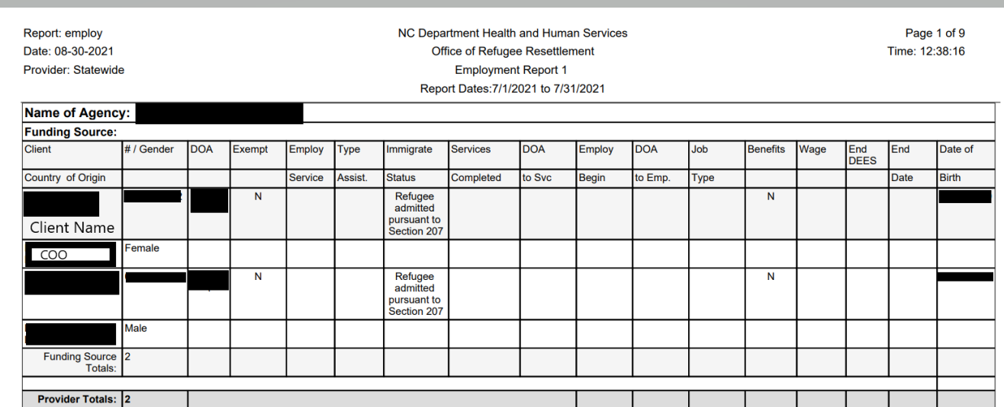
RIS Report: Employment Report
Employment 1 Report
Notes:
This report allows users to search for employable clients. The search is based around a Date of Arrival, Provider, and Funding Source. Information in this report is grouped by Funding Source and includes: Name, Country of Origin, Alien Number, Gender, Date of Arrival (DOA), Employment Services Date, Employment Assistance Type, Immigration Status, Services Completed, DOA to services received, Employment Begin Date, DOA to Employment, Job Type, Benefits Offered, Wage, End Date and Date of Birth. Of note: Employable clients are defined as clients who are between 18 and 65 upon arrival in the U.S., and who do not possess an Employment Exempt reason listed in the “Refugee Detail” Screen.

Slide 27
RIS Report: Employment Report
Employment Report 2
Notes:
This report shows a combination of employment services provided as well as job placement by a specific time period. The user may view all job placements made during the specified time period (including multiple job placements for the same individual). Employment data is grouped by Funding Source.
I will review what each heading means next.
Demographic Information (Client Name, Alien Number, Country of Origin, Sex/Gender, Date of Arrival)
Next is Exempt: Are they exempt from employment?
Employment Service Enrollment Information:
Emp SRV: Date employment Service started
To SVC: Days from DOA to Employment Services start date.
Job Placement Information:
Start Date: Job start date
To Strt: Total days From DOA to Job start date
Job Type
Benefits available
Wage
End Date of Employment if it exists
Federal Assistance Type being received at time of Job Placement

Slide 28
RIS Report: Employment Report
Job Placement Summary Report
Notes:
This is an employment summary report by Provider within the report’s specified time range. It contains a chart that lists the number of individuals that a Provider has placed in jobs, according to Funding Source. It also displays the number of actual jobs found by the Provider within the same time period, according to a specific Funding Source

Slide 29
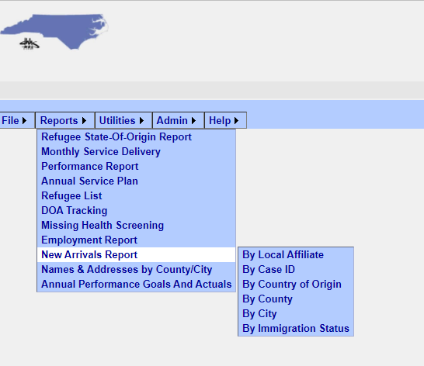
RIS Report: New Arrivals Report
New Arrivals Report
A list of clients who arrive in the US within a specified time period, by provider. This data can be sorted in six ways and therefore, has six sub-reports.
Notes:
This report is a listing of clients who arrive in the US within a specified time period, by provider. This data can be sorted in six ways and therefore, has six sub-reports.

Slide 30
RIS Report: New Arrivals-Local Affiliate
New Arrivals Local Affiliate Report
Search by Date of Arrival, Local Affiliate and/or Provider Name
Notes:
This report allows you to search by Local Affiliate and Provider Name.

Slide 31
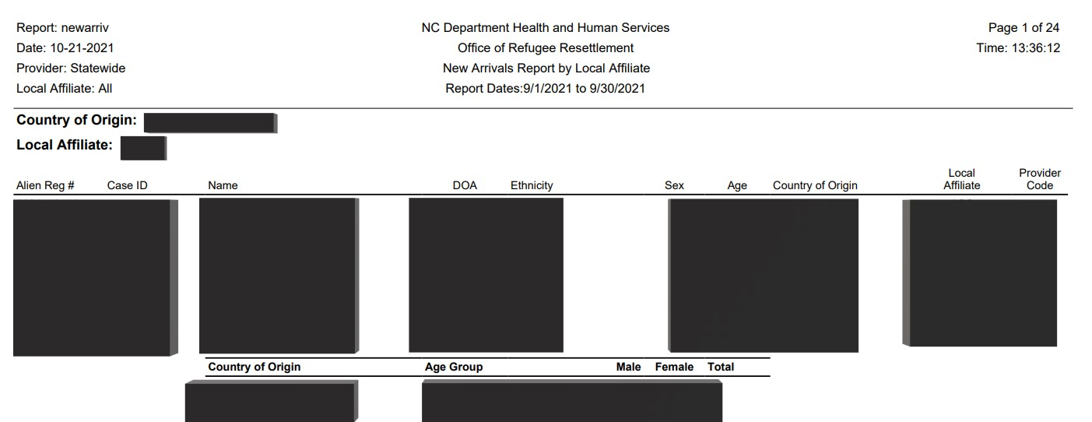
RIS Report: New Arrivals-Local Affiliate
Notes:
The reports contain: Alien Registration Number, Case ID, Name, Date of Arrival, Ethnicity, Sex, Age, Country of Origin, Local Affiliate (i.e. Agency providing R&P services to the client), and the Provider Code.
It also displays Country of origin by age group and separates it by gender and gives a total.

Slide 32
RIS Report: New Arrivals-Case ID
New Arrivals by Case ID Report
Search by Date of Arrival, Local Affiliate and/or Provider Name
Notes:
This report allows you to search by Local Affiliate and Provider Name. It allows you to View Report, which I will show in the next screen. You may click export self-sufficiency Data to Excel. This will produce an excel file with service dates, volag agencies, case id, dos id, a # Name, gender, doa, dob, immigration status, employment exemption reason, if one exists, types of assistance they are/were on.

Slide 33
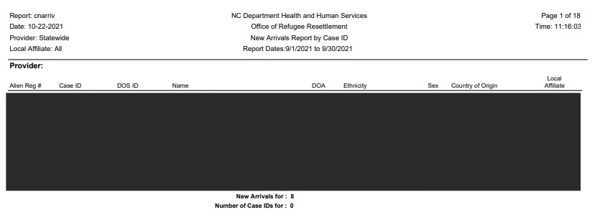
RIS Report: New Arrivals-Case ID
Notes:
This report if exported into PDF looks like this report. It will display A #, Case ID, DOS ID, Name, DOA, Ethnicity, Sex, Country of Origin, Local Affiliate and gives a total of new arrivals and total number of Case Ids.

Slide 34
RIS Report: New Arrivals-Country of Origin
New Arrivals by Country of Origin Report
Search by Date of Arrival, Local Affiliate and/or Provider Name
Notes:
The New Arrivals Country of Origin Report can be run by using date of arrival local affiliate and or provider name. You can run a Detail Report from this screen or a Summary Report.

Slide 35
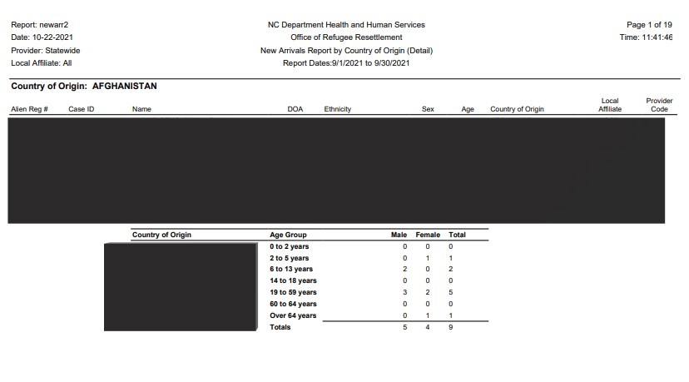
RIS Report: New Arrivals-Country of Origin
Detail Report
Notes:
The detail report will display A#, Case ID number, name, doa, ethnicity, sex, age, country of origin, local affiliate, and display the provider code. It will then break down by country of origin, age group and sex.

Slide 36
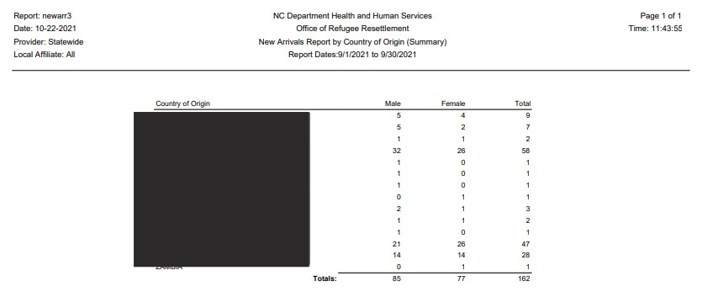
RIS Report: New Arrivals-Country of Origin
Summary Report
Notes:
The summary report will only break down by country of origin, and sex.

Slide 37
RIS Report: New Arrivals- By County
New Arrivals by County Report
Search by Date of Arrival, Local Affiliate and/or Provider Name
Notes:
This report can be run by using date of arrival, local affiliate, and or provider name. You can run a Detail Report from this screen or a Summary Report. The export FEDNACO.XLS button does not work.

Slide 38
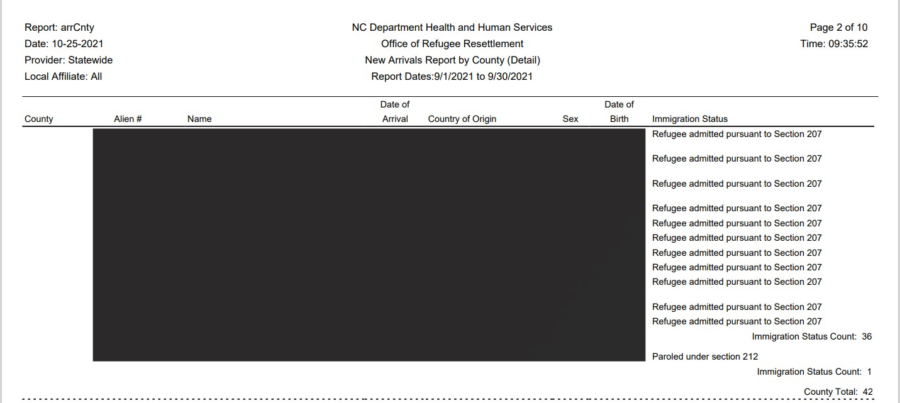
RIS Report: New Arrivals by County
Detail Report
Notes:
This report shows New Arrivals by county and gives demographic information including County as it is entered in RIS.

Slide 39
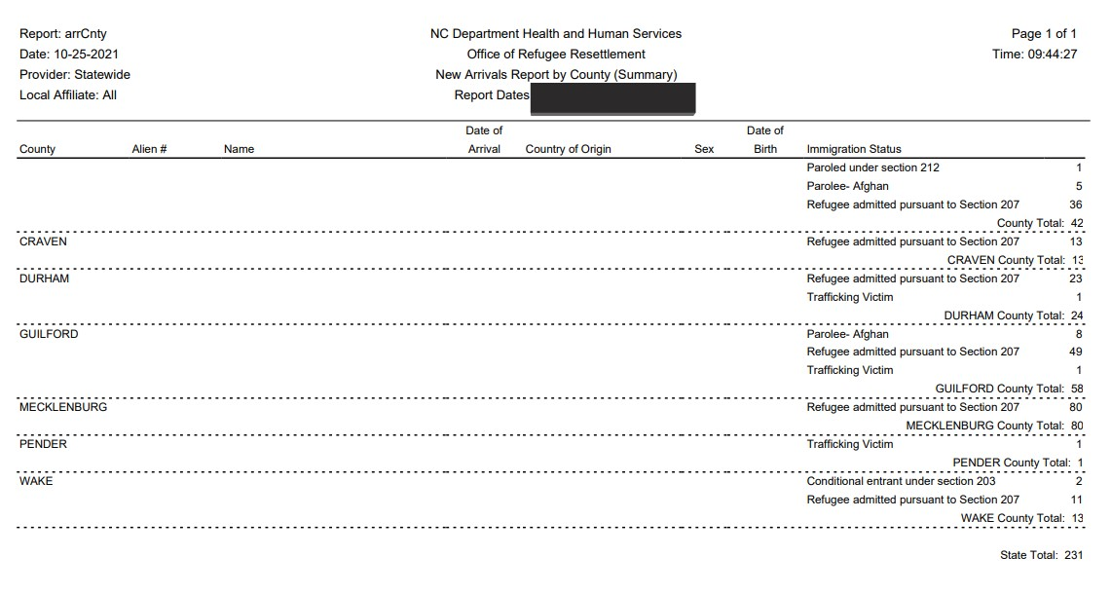
RIS Report: New Arrivals by County
Summary Report
Notes:
The summary by county shows refugee totals by immigration status and county for a specified period of time.

Slide 40
RIS Report: New Arrivals by City
New Arrivals by City Report
Search by Date of Arrival, Local Affiliate and/or Provider Name
Notes:
The new arrivals by city report is similar to the County report, only it shows New Arrival Information by City. It also has a detail and summary report option.

Slide 41
RIS Report: New Arrivals by City
Detail Report
Notes:
This detail report will show you new arrivals broken down by date of arrival and cities. It will also give you a total number per city.

Slide 42
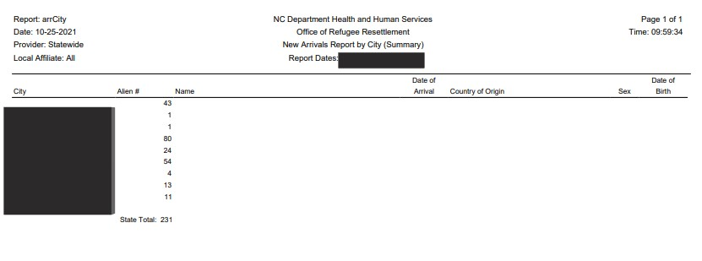
RIS Report: New Arrivals by City
Summary Report
Notes:
This report will give you a breakdown of how many new arrivals during a specific time frame arrived by city name.

Slide 43
RIS Report: New Arrivals by Immigration Status
New Arrivals by Immigration Status Report
Search by Date of Arrival, Immigration Status, Local Affiliate and/or Provider Name
Notes:
New Arrivals Report by Immigration Status will show us reports broken down by date of arrival and immigration status through a summary and a detail report. You can choose a specific immigration status or leave it blank and the report will show all immigration status’ of the new arrivals during the time frame selected. Of note: the export function does not work on this screen.

Slide 44
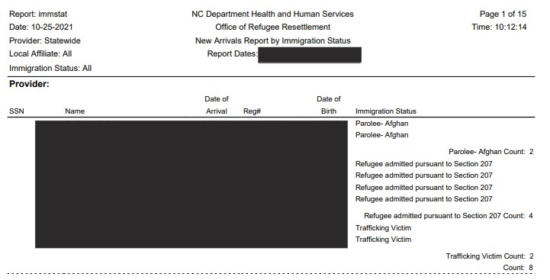
RIS Report: New Arrivals by Immigration Status
Detail Report
Notes:
This detail report will show you the names and immigration statuses of clients based on the date of arrival you chose. It will also give you a count of each status.

Slide 45
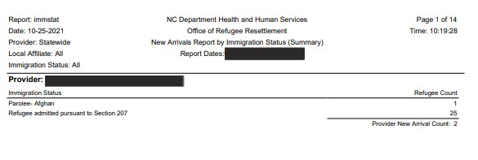
RIS Report: New Arrivals by Immigration Status
Summary Report
Notes:
This report will give you a count of new arrivals by immigration status. This is the final New Arrivals report.

Slide 46
RIS Report: Name & Address by County/City
Name & Address by County/City
Search by Date of Arrival, and Provider Name
Notes:
This detailed report which will show the Name and addresses entered into RIS by County/City.

Slide 47
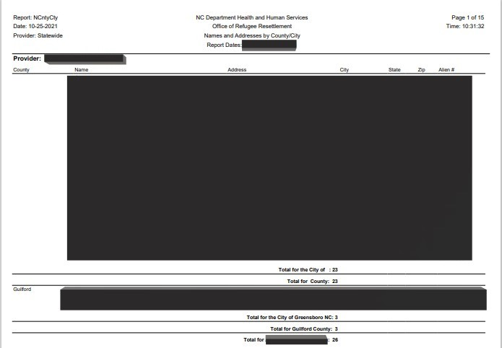
RIS Report: Name & Address by County/City
Detail Report
Notes:
This report will display all names and addresses of clients during a certain time period by provider as they were entered into RIS.

Slide 48
RIS Report: Annual Performance Goal/Actual
Annual Performance Goal/Actual Report
Search by Date Range, Provider Name, and funding source
Notes:
Funding Source is not necessary to enter on this report. You will, however, need to enter Provider Name.

Slide 49
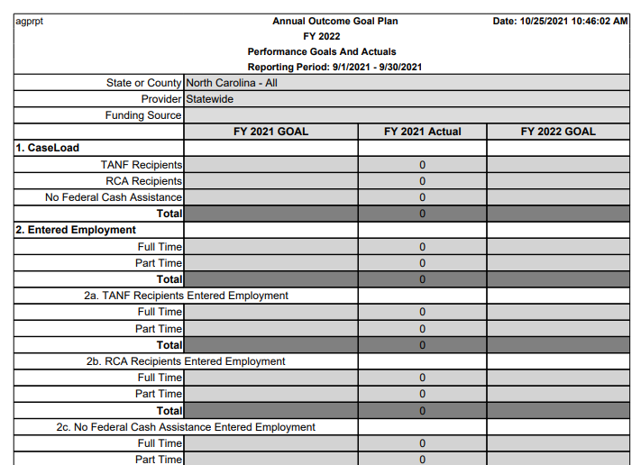
RIS Report: Annual Performance Goal/Actual
Annual Outcome Goal Plan
Notes:
This report is meant to show you where you are in meeting your Annual Outcome Goal Plan. This report will be updated in the near future to reflect changes in the reporting content. Also, remember that this report is based on what your agency has entered into RIS. If the data is not in RIS the reports will not be accurate.

Slide 50
RIS Reports Summary
RIS reports are only as good as the data entered by providers.
Some reports are required to be run either monthly or semi-annually, due to state reporting requirements.
RIS reports can give you a snapshot of services provided, new arrivals, as well as employment.
Notes:
A few things to keep in mind as we wrap up this training on RIS Reports.
The reports are only as good as the data that gets entered by providers.
Some RIS reports are required to be run either monthly or semi-annually, due to the state reporting requirements.
RIS Reports can give you a good snapshot of services provided, new arrivals, as well as employment data. I hope you will take advantage of having the capability to run these reports as they can give you a good picture of the clients you are serving.

Slide 51
RIS Next Steps
Additional Trainings Available
RIS Overview Training
RIS New Client Entry Training
RIS Provider Entry Training
RIS Reports Training

