Slide 1
Welcome to NC CACFP Monthly Institution Call
All information presented on this call is true and accurate as of the date of the call (September 3, 2021).
Notes:
First Friday of every month @ 1:00 pm
Questions should be submitted through chat function
State agency encourages topic suggestions

Slide 2
Emergency Cost Information Update
Policy Memos
Application Update
Upcoming State Agency Trainings
Messenger and NC Crunch
Q&A

Slide 3
Emergency Cost Reimbursement
Child and Adult Care Food Program

Slide 4
Emergency Operational Costs Reimbursement Grant
EOC funds are additional funding for institutions whose revenues declined or were temporarily interrupted during the early months of the pandemic due to COVID-19 related restrictions and closures

Slide 5
Emergency Operating Cost Grant
As of September 2, 2021, the State agency had disbursed about 99% of the funds to eligible institutions.
If you have not received EOC funds and believe you are entitled to emergency cost payments, please contact FinancialManagementTeam@dhhs.nc.gov immediately.
Institutions may decline all or part of a payment. If you are unable to use the funds, email FinancialManagementTeam@dhhs.nc.gov by 9/30.

Slide 6
Allowable Use of Funds
All funds received must be used on allowable CACFP expenses that were part of the approved budget.
Note: you cannot use the EOC funds to reimburse yourself for expenses that have already been paid with another source of Federal funding.
Any remaining funds must be deposited in the Nonprofit Food Service account and used in accordance with normal program requirements, including providing a spending plan to the State agency or included in FY 2022 Budget as Other Income.

Slide 7
Applying EOC Funds To Past and Future Expenses
If your Institution already reported CACFP expenses in NC CARES and the expenses were more than the program reimbursement you received from the CACFP, your EOC funds can be applied against those expenses. You should have documentation on file for such expenses.
Examples:
If your CACFP reimbursement for FY 2020 was $10,000 and you had $15,000 in reported CACFP expenses, then you could apply up to $5,000 of EOC funds towards FY 2020 expenses. In this case, you have already reported enough expenses to offset your EOC funds.
If your CACFP reimbursement for FY 2020 was $10,000 and your reported CACFP expenses were $10,000 or less, you would need to apply your EOC funds to FY 2022. In this case, the EOC funds would need to be recorded as Other Income in the FY 2022 Budget.

Slide 8
Emergency Cost Reimbursement Benefits Timeline
The State agency will begin disbursing funds to institutions
Funds obligation deadline
The State agency must submit a summary of the use of funds to FNS
May 30, 2021
June 30, 2021
Aug. 1, 2021
Sept 30, 2021
Jan 31, 2022
March 31, 2022
Institutions will receive an official notice from the State agency
Anticipated reimbursement amount
Acceptable use of funds
Any institution not eligible will have to provide assurance by June 15, 2021
Requirement to report use of funds
The State agency is still waiting for funds from USDA.
Once received they will be properly allocated.
Institutions are not required to apply for funds.
Funds liquidation deadline
Recovery process begins
Institutions must report to the State agency of the use of funds
All institutions receiving Emergency Cost Reimbursement must report back to the State agency how the funds were used.

Slide 9
Questions
For questions that cannot be answered during the Institution call, email FinancialManagementTeam@dhhs.nc.gov

Slide 10
What questions do you have?

Slide 11
Policy Memo
Child and Adult Care Food Program

Slide 12
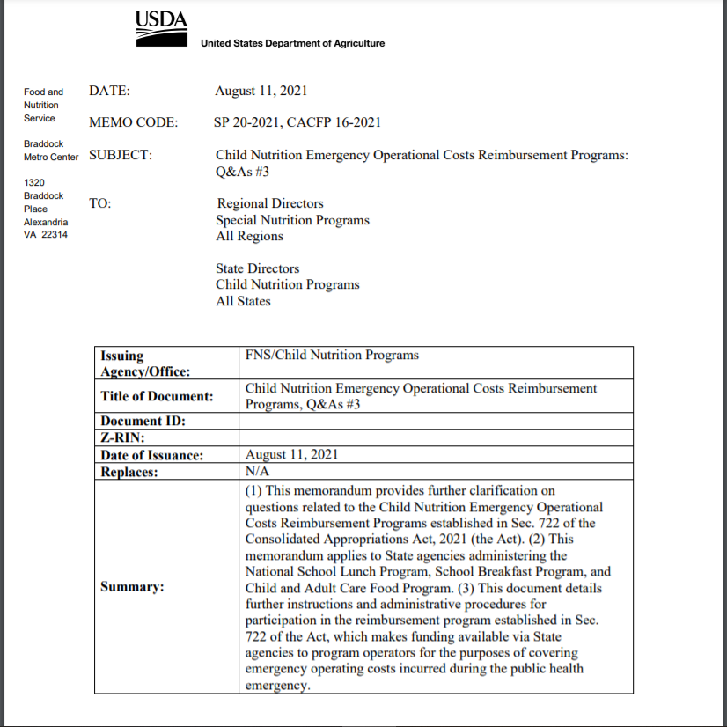
CACFP 16-2021
New Policy Memo

Slide 13
What questions do you have?

Slide 14
Application Update 2022
Child and Adult Care Food Program

Slide 15
Notes:
So far this season, there are only 4% of all the NC CACFP institutions with approved application updates.
Please not the deadline is in 3 weeks – all institutions should be working on making updates now. The deadline is September 30th.

Slide 16
Annual Application Update 2022
If you missed one of the 11 State agency trainings or would like refresher we have a recorded courses (IC and SO) on our website.
Annual Application Update is due on or before September 30, 2021.
01
02

Slide 17
Application Update 2022
Sponsoring Organizations of Unaffiliated Centers will be required to submit a sponsored center budget for all their sponsored facilities.
State Forms added to application update 2022
IRS Tax Exemption Verification (Non-Profits Only)
Conflict of Interest Acknowledgement and Policy-all institutions
SAM Registration (Required for ALL Institutions)
For information regarding SAM Registration go to:
https://www.sam.gov/SAM/

Slide 18
What questions do you have?

Slide 19
Upcoming State Agency Trainings
Child and Adult Care Food Program

Slide 20
Upcoming NC CACFP Live Training Webinars
September and October 2021
Tuesday, September 14th | 9:00-12:00pm | Duties and Documents for ICs
Thursday, September 16th | 9:00-12:00pm | Duties and Documents for SOs
Tuesday, October 12th | 1:00-4:00pm | Duties and Documents for ICs
Wednesday, October 13th | 1:00-4:00pm | Duties and Documents for SOs
Tuesday, October 19th | 1:00-3:00pm | Compliance Review – Are You Ready?
Thursday, October 21st | 10:00-11:00pm | Menu Planning for Older Adults
Notes:
The second upcoming training is Application Update for 2022. It is almost that time of year again. This coming year’s Application Update does have some changes that institutions need to know so it is important to attend this virtual training.

Slide 21
What questions do you have?

Slide 22
Messenger and NC Crunch
Child and Adult Care Food Program

Slide 23
NC CACFP Messenger September/October
Will be emailed to Institutions September 3, 2021.
Application Update reminders
Ounce Equivalents resources
September: National Fruit and Vegetable Month
October: National Farm to School Month

Slide 24
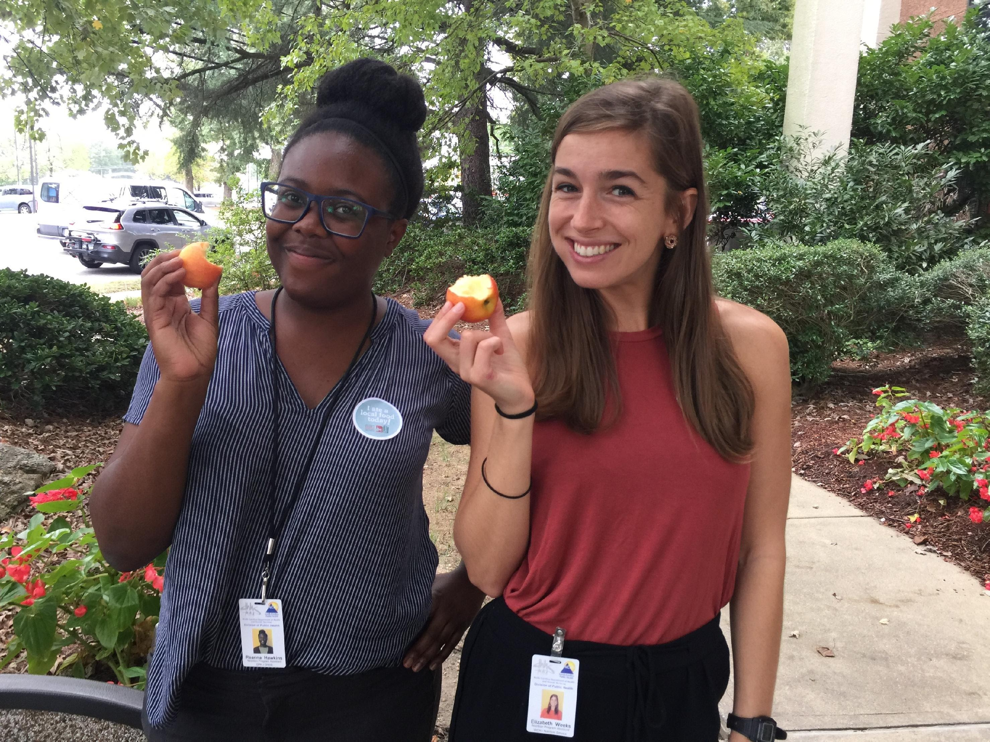
The NC Crunch is Coming Soon!
Celebrate National Farm to School Month by crunching into a locally grown apple
October 20, 2021, at noon
Register today to receive a Crunch Guide with tips on buying local apples, curriculum connections, and more
https://growing-minds.org/north-carolina-crunch/

Slide 25
In Closing
Child and Adult Care Food Program

Slide 26
Monthly Institution Calls
The PowerPoints for the institution calls can now be found on our website www.nutritionnc.com
Click on Child and Adult Care Food Program
Click on Program Resources
Click on Monthly Institution Calls

Slide 27
Q&A Session
1) Please use the chat function
to submit your questions.
2) We will review what we have
time for that pertains to the good
of the group.
3) Questions that apply to one
specific institution will be handled
offline.

Slide 28
Just Want to Say…….

