Slide 1
BRAIN HEALTH, DEMENTIA & AGING AMONG RURAL POPULATIONS
North Carolina Building Our Largest Dementia (NC BOLD) Infrastructure Project

Slide 2
BRAIN HEALTH, DEMENTIA AND AGING AMONG RURAL POPULATIONS
North Carolina Building Our Largest Dementia (NC BOLD) Infrastructure Project

Slide 3
INTRODUCTION
Overview of dementia as a public health concern
Dementia Prevalence in Rural America
Importance of understanding risk factors in rural areas
North Carolina Building Our Largest Dementia (NC BOLD) Infrastructure Project
Notes:
While dementia is a pressing public health concern that affects individuals worldwide. Here we will focus on understanding the specific risk factors for dementia in rural areas. It is essential to explore these factors to develop targeted interventions and support for rural communities.

Slide 4
IMPACT OF AGE AS A RISK FACTOR
Impact of aging on dementia risk
Higher proportion of older adults in rural areas
North Carolina Building Our Largest Dementia (NC BOLD) Infrastructure Project
Notes:
One of the primary risk factors for dementia is age. As individuals grow older, the risk of developing dementia increases. Rural areas often have a higher proportion of older adults, which contributes to the elevated risk of dementia within these communities.

Slide 5
SOCIOECONOMIC FACTORS
Link between lower socioeconomic status and dementia risk
Rural poverty rates and limited access to education and economic opportunities
North Carolina Building Our Largest Dementia (NC BOLD) Infrastructure Project
Notes:
Lower socioeconomic status is associated with an increased risk of dementia. In rural areas, the prevalence of poverty is higher, and access to education and economic opportunities may be limited. These socioeconomic factors contribute to the higher risk of dementia among rural residents.

Slide 6
LIMITED ACCESS TO HEALTHCARE
Challenges faced by rural communities in accessing healthcare services
Shortage of healthcare providers and facilities in rural areas
North Carolina Building Our Largest Dementia (NC BOLD) Infrastructure Project
Notes:
Rural communities face unique challenges in accessing healthcare services. Limited availability of healthcare providers and facilities poses barriers to timely and comprehensive dementia care. The shortage of healthcare resources in rural areas further increases the risk of dementia among rural Americans.

Slide 7
HEALTH DISPARITIES
Higher rates of chronic health conditions in rural areas
Impact of conditions such as cardiovascular disease, obesity, and diabetes on dementia risk
North Carolina Building Our Largest Dementia (NC BOLD) Infrastructure Project
Notes:
Health disparities, including higher rates of chronic conditions, are prevalent in rural areas. Conditions such as cardiovascular disease, obesity, and diabetes significantly contribute to the risk of developing dementia. Addressing these health disparities is crucial in reducing dementia risk among rural populations.

Slide 8
LIFESTYLE FACTORS
Influence of lifestyle factors on dementia risk
smoking
physical inactivity
diet
North Carolina Building Our Largest Dementia (NC BOLD) Infrastructure Project
Notes:
Unhealthy lifestyles can elevate the risk of dementia. In rural areas, lifestyle factors such as smoking, physical inactivity, and poor diet patterns may be more prevalent. These have a direct impact on dementia risk, this highlights the importance of promoting healthy behaviors in rural communities.

Slide 9
ENVIRONMENTAL EXPOSURES
Unique environmental exposures in rural areas (e.g., pesticides, air pollution)
Potential implications for cognitive health and dementia risk
North Carolina Building Our Largest Dementia (NC BOLD) Infrastructure Project
Notes:
Unique environmental exposures in rural areas, such as pesticides and air pollution, may have implications for cognitive health and dementia risk. These exposures require further investigation to understand their specific effects and develop appropriate preventive measures.

Slide 10
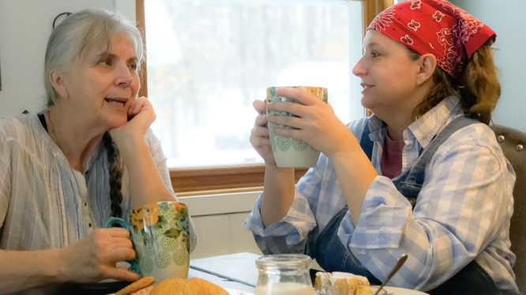
SOCIAL ISOLATION
Lower population densities and limited social networks in rural areas
Association between social isolation and increased dementia risk
North Carolina Building Our Largest Dementia (NC BOLD) Infrastructure Project
Notes:
Rural areas often have lower population densities and limited social networks, leading to increased social isolation. Social isolation is associated with a higher risk of cognitive decline and dementia. Addressing social isolation and promoting social connections are essential strategies in reducing dementia risk among rural Americans.

Slide 11
STRATEGIES FOR RISK REDUCTION
Improve
Improve access to healthcare services in rural areas
Enhance
Enhance health literacy and awareness about dementia risk factors
Promote
Promote healthy lifestyle choices
North Carolina Building Our Largest Dementia (NC BOLD) Infrastructure Project
Notes:
To mitigate the risk of dementia in rural America, several strategies can and should be implemented. These include improving access to healthcare services, promoting healthy lifestyle choices (we will talk about these on the next slide), and enhancing health literacy about dementia risk factors. A comprehensive approach is necessary to ensure optimal brain health in rural communities. (presenter should stop at each of these and ask the audience ways they can see this work in their community, what could be done, the answers will vary depending on who this is being presented to, save promote health lifestyle discussion until the next slide).

Slide 12
PROMOTING HEALTHY LIFESTYLE CHOICES
physical activity
healthy
diet
hearing services
North Carolina Building Our Largest Dementia (NC BOLD) Infrastructure Project
Notes:
Go over each of these and ask: “What are some ways you can see this being implemented in your community?”
One important thing to note is that hearing loss has been identified as a potentially modifiable risk factor for dementia. Recent research suggests that addressing and treating hearing loss may help reduce the risk or delay the onset of dementia. How could your community increase the access to hearing services for people?
Engaging community organizations and support networks is vital in addressing dementia risk factors. Building social connections, reducing social isolation, and fostering a sense of belonging can significantly contribute to dementia prevention efforts in rural areas.
Emphasize the need for collaborative efforts to address risk factors and promote brain health.

Slide 13
ACTION STEPS
What is one action step you as an individual or community will take to reduce dementia risk in your community?
North Carolina Building Our Largest Dementia (NC BOLD) Infrastructure Project

