Slide 1
NC Department of Health and Human Services
Refugee Information System Client Information Training
Kimberly Saunders
Refugee Program Consultant
Fall 2021

Slide 2
RIS Client Information Topics
Locate the Refugee Information Screen
Search within the Refugee Information Screen
How to Add a New Client
Refugee List Screen
Refugee Detail Screen
Uploading

Slide 3
Locate Refugee Information Screen
Main Menu
File
Reports
Utilities
Admin
Help

Slide 4
File Drop Down Menu
Refugee Information
Provider List
Exit System

Slide 5
RIS: Refugee Information
Refugee Search Screen

Slide 6
RIS: Client Search Criteria
DOS ID: Department of State (DOS) ID Number
EIS ID: Employee Information System ID Number
Alien Registration Number: Alien Number
Refugee Name: Last, First
(For best results enter only one name or last name, first letter of first name)
Date of Arrival (Thru): Can enter in both fields or just first one
Date of Birth (Thru): Can enter in both fields or just first one
* If you are having difficulty finding a client in RIS, expand your search by adding a % sign to either the beginning or the end of the number or name you are entering.

Slide 7
RIS: Client Search Results
Important Buttons on Refugee Search Screen
Edit: Add services, or change client information
View: View client information only
Delete: Delete Client
Add New Refugee Button
Notes:
Once you enter a refugee into the search screen you will see a list of possible clients like the list above. On this screen you will notice the Add Refugee Button.

Slide 8
RIS: Adding New Clients
When you click “Add Refugee” in the Search screen
A warning box will appear asking for a SS#
Add SS# if one has been assigned

Slide 9
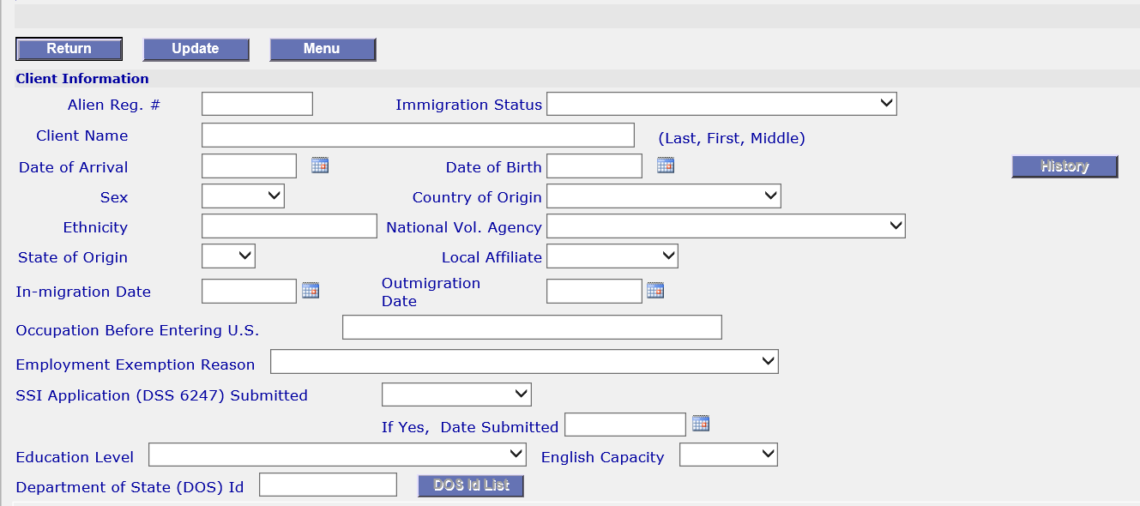
RIS: Adding New Clients
Client Information Section

Slide 10
RIS: Adding New Clients
Enter ALL Client Information in Your Possession
It is extremely important for reporting & funding
New client information should be entered within two weeks of arrival or ASAP

Slide 11
RIS: Adding New Clients
Alien Reg #: Number should be 8-9 digits
Immigration Status: Status on paperwork
Client Name: Client Surname (last name), followed by “,” then First Name & Middle Name
Date of Arrival: Date client arrived in the U.S., not date the client arrived in the provider’s area
Sex: “Male” or “Female”
Country of Origin: Native country (country from where client fled persecution).
Childs’ Country of Origin should be same as parents even if they were born outside the parents’ native country.

Slide 12
RIS: Adding New Clients
Ethnicity: Clients ethnic group
National Vol Agency: The National Voluntary Agency that sponsored initial resettlement in the U.S.
History (Button): Displays history of changes/additions made to client information.
State of Origin: 1st state the client entered upon resettlement in the U.S. If this is a secondary migration you must add the state the client initially resettled in
Notes:
Continue adding all relevant information to client demographics. The History button is for informational purposes only. It will tell people who created the client file and who edited it.

Slide 13
RIS: Adding New Clients
Local Affiliate: The local resettlement agency that provided Reception & Placement Services
In-migration Date: Date the client came into the state (must be entered for secondary migrants)
Outmigration Date: Date the client left the state (if known)
Occupation Before Entering US: Job the client had before entering the United States

Slide 14
RIS: Adding New Clients
Employment Exemption Reason: To be used if client is exempt from employment
SSI Application Submitted: Yes or No.
If Yes, include date in the next box.
Education Level: Choose from dropdown
English Capacity: Choose from dropdown
Department of State (DOS) Id: Overseas Case Number assigned by the U.S. DOS
DOS Id List (Button): Lists everyone in case

Slide 15
RIS: Adding New Clients-Uploading
Upload ANY of the following documents available
Immigration Documents
SSI Documents
DSS 6247
DSS 8108
DSS 8110

Slide 16
RIS: Adding New Clients-Uploading
How to Upload:
1. Click Browse and select document to upload
2. Click Upload Document Icon
Square with circle at bottom right
Notes:
Upload: Directly under the Client Information section you will see a space to upload documents. Use the instructions in this detailed slide to upload any information in your possession on the client.

Slide 17
RIS: Adding New Clients-Uploading
Uploading Tips
If the wrong document is uploaded, you can upload another document to replace (override) it
If you have a newer version of a document, you can override what is currently there with the new version.

Slide 18
RIS: Adding New Clients-Language
Language
Language 1: Preferred language
Language 2: Second most fluently spoken language with the most interpreters available
Language 3: To be used if a third language is spoken by the client with which you will be providing services

Slide 19
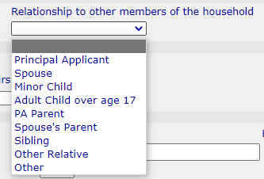
RIS: Adding New Clients-Household
Case Size: Number of Adults & Children
Relationships: Parent, child, spouse

Slide 20
RIS: Adding New Clients-Sponsor
Sponsor: Entity that sponsored/co-sponsored the client's initial resettlement in the U.S.

Slide 21
RIS: Adding New Clients-Demographics
Enter ALL Available Information
County, City, State, and Zip Code must be entered
Update if a client moves
Enter Landlord information if applicable

Slide 22
RIS: Adding New Clients-Health Screening
Health Screenings Should Always Be Entered
Date: Scheduled (or rescheduled) Date of First Visit with Health Department
Agency: Agency Conducting Screening
Health Department
Managed Care Provider
Other
Private Practice Physician

Slide 23
RIS: Administrator Changes
The following can only be changed by a Statewide Administrator of RIS
Alien Registration #
Client Name
Date of Arrival
Date of Birth

Slide 24
RIS: Next Steps
Additional Trainings are Available
RIS Overview Training
RIS New Client Entry Training
RIS Provider Entry Training
RIS Reports Training

