Slide 1
NC Department of Health and Human Services
Refugee Information System RIS Overview Training
Kimberly Saunders
Refugee Program Consultant
UPDATED August 2023
Fall 2021

Slide 2
RIS Overview
What Data Does it Capture
Why is it Important to Refugees & Service Providers
Gaining Access to RIS
NCID (North Carolina Identity Management System)
Levels of Access
RIS Website
Potential Log-in Issues
Lost/Resetting Password
Other Log-in Issues
RIS Main Menu Options
Notes:
NCID is an acronym that stands for North Carolina Identity Management System. It is the standard identity management service that allows users to achieve an elevated degree of security and real-time access control to the state's customer-based applications.

Slide 3
What is RIS?
RIS: Refugee Information System
Tracks services provided to eligible refugees
Produces reports displaying these services
Provides Refugee Service Providers with a valuable look at the services they are delivering.
Notes:
RIS is a system that collects data in order to keep track of services provided to refugees. It then produces reports reflecting this data and provides us with a snapshot into the amazing services refugee service providers are delivering throughout the state.

Slide 4
RIS Data Collection System
Data Elements Include:
Who is the client? (client demographics)
What services were provided to the client?
(service type)
When was the service provided to the client?
(date/month of service)
How many units of service were provided?
Notes:
RIS System Data Elements. Let’s talk briefly about what data RIS collects – (read slide)
WHO is the client?
WHAT services were provided to the client?
WHEN was the service provided to the client?
HOW many units of service were provided? (How ever it is deemed appropriate to be counted in the Service Codes and descriptions document.)

Slide 5
RIS Data Collection
Why is RIS Data Important to NC Refugees and Service Providers?
(Y)OUR FUNDING greatly depends on the timeliness and accuracy of reported data
Notes:
Read Slide.
Let’s not lose out on funding because of data entry errors!

Slide 6
How to Gain Access to RIS
There are two steps to gaining access to RIS
Obtaining an NCID
RIS Website/Account Creation
Email NC SRO to create RIS account
or
A RIS user within your agency with Administrator access can create your RIS account.
3.
Notes:
Next, we will discuss gaining access to RIS. There are essentially two steps we need to follow in order to do this.
The first step is to register with the state of NC for an NCID.
* A side note about an NCID… An NCID lets the general public access state resources and services online. Because this is a statewide ID and not just specific to RIS if you have a problem with your NCID the NC SRO is not able to help you, you must contact NCID. All this information will be supplied in subsequent slides.
The second step is to create an account in RIS using your NCID. You may either email the SRO to create a RIS account for you using your newly created NCID, or you may ask a RIS user at your agency who has Administrator access to create a RIS account for you.

Slide 7
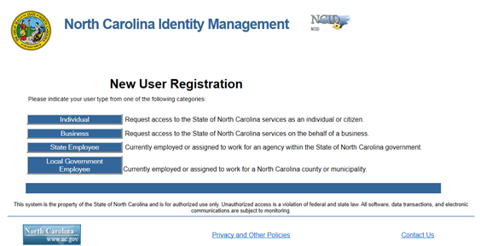
Step 1: Obtaining an NCID
To register go to: New User NCID Registration Individual
Watch how-to video: Register for An NCID Account – YouTube
From “New User Registration” Screen, select “Individual” to begin the process
*See RIS Guide for more on this process
Notes:
Users must first obtain an NCID to create a RIS account. To register for an NCID go to the website on this slide. You can also find this website in the RIS Guide. I will show you later in the presentation where to find the RIS Guide. Fill out all information requested once in the website and follow the instructions carefully.

Slide 8
RIS Website
To log-in to RIS go to:
https://ris.ncdhhs.gov/
Notes:
This is the RIS website. To visit the site and log in either click the link or copy and paste into your browser.

Slide 9
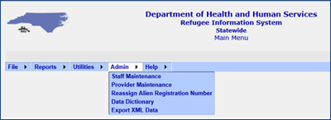
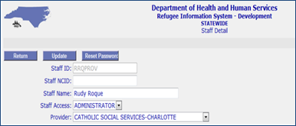
RIS Access
How to add new users if you have Administrator Access:
Admin>Staff Maintenance Staff Maintenance Screen
Staff Maintenance
1. Type in name and search for user
2. If entry does not already exist enter the RIS user
Notes:
These screenshots show how easy it can be to add RIS access to new employees. Please see the RIS guide for complete instructions. As always, I am happy to assist in this process.

Slide 10
Four Access Levels
View Only: Allows data to be viewed only
Data Entry: Allows access to edit & add new records
Administrator: Allows data entry access & ability to add new users to your agency
None: If an employee leaves change their access to None instead of deleting them
*You only have access to your agency’s data regardless of access level.
Notes:
There are four access levels in RIS. The first is View only. This is as it implies only allows for viewing of data and reports.
The second is Data Entry which allows for viewing and creating new clients and adding services.
Administrators are allowed to do everything previously stated as well as add new users and change access levels of users.
We will take a look at how to set up new RIS users in the following slide.
As always, please feel free to reach out to the RIS Program consultant should questions arise.

Slide 11
RIS Log-In Issues
QUESTION: I was able to log-in to RIS yesterday, but I cannot log-in today. What should I do?
ANSWER: Go to the NCID website (https://ncid.nc.gov/). You may need to reset your password.
QUESTION: I am locked out of RIS due to too many log-in attempts with incorrect password. What should I do?
ANSWER: Contact NCID help desk and have your password reset or unlocked (http://it.nc.gov/service-desk).
*Unfortunately, I am unable to assist with log-in issues as it would be a security issue, but I am happy to assist you by directing you to the websites above.
Notes:
These are the two most frequent issues with RIS log-ins.

Slide 12
Log-In Issues Training Videos
Unlock Account – YouTube
Forgot Username – YouTube
Forgot Password – YouTube
Changing your Password - YouTube
Notes:
Please see the following Youtube Videos put together to assist you with NCID issues.

Slide 13
RIS Main Menu Options
Main Menu Drop Down Options
File
Reports
Utilities
Admin
Help
Notes:
After you log-in to RIS you will see these five dropdown options. File, Reports, Utilities, Admin, and Help. In the next slide we will discuss the options available when you hover over the File drop down.

Slide 14
File Drop Down Menu
Refugee Information
Provider List
Exit System
Notes:
The File dropdown will display the following:
Refugee Information
Client demographics can be entered & viewed here
Provider List
List of providers who delivered a service to the client
Exit System
Click to exit the RIS System
You may also click log-off at the top right of the screen or by closing the browser

Slide 15
Reports Drop Down
List of all reports available to run
Notes:
The reports dropdown will show all the reports available to run. I will go into further detail on each report in the PowerPoint RIS Training Reports

Slide 16
Utilities Drop Down
This dropdown contains a link to change your password
Manage Legal Documents is only accessible by the State Refugee Office
Notes:
The Utilities dropdown contains a link to change your password. Manage Legal Documents is not currently a working dropdown

Slide 17
Admin Drop Down
Staff Maintenance: Admins can add new users here
Data Dictionary: For State Refugee Office
Export XML Data: For State Refugee Office
Notes:
Under the Admin Drop Down the first thing that appears is Staff Maintenance. This is where Admins can add new users. Data Dictionary and Export XML Data are both for the State Refugee Office.

Slide 18
Help Drop Down
RIS Web User Manual: RIS Guide
Service Codes Descriptions and Units: Listing of all Service Codes and Descriptions
Notes:
Under the Help dropdown you will find the RIS Guide aka RIS Web User Manual and a pdf of the most recent Service Codes and Descriptions.

Slide 19
RIS Overview Training Conclusion
Much of what has been outlined in this PowerPoint will be expanded upon in other Training PowerPoints (4 in total)
RIS Overview Training
RIS New Client Entry Training
RIS Provider Entry Training
RIS Reports Training
Notes:
We have come to the end of our RIS Overview Training. Much of what was briefly reviewed in this initial training will be expanded upon three additional training powerpoints. New Client Entry, Provider Entry Training, and Reports Training. The State Refugee Office will make you aware as they become available. Thank you for spending time learning about the RIS Data System.

